Slide 1

Restaurant Website System
RIZVANA K A
(MES24MCA-2045)
Department of Computer Applications
MES College of Engineering, Kuttippuram
20-08-2025

Slide 2
PRODUCT OWNER NOWSHAD C V (ASSISTANT PROFESSOR) DEPARTMENT OF COMPUTER APPLICATIONS MES COLLEGE OF ENGINEERING, KUTTIPPURAM

Slide 3
TABLE OF CONTENTS
Introduction
Objective
Existing System
Proposed System
Motivation
Functionalities
Module Description
Developing Environment
Sprint Backlog
Product Backlog
User Story
Project Plans
Data Flow Diagrams
ER Diagram

Slide 4
RESTAURANT WEBSITE SYSTEM
RESTAURANT WEBSITE SYSTEM
A web-based platform designed to modernize restaurant services.
Provides features like online food ordering, table reservations, and menu browsing.
Includes customer login, feedback system, and daily specials display.
Helps restaurants showcase dishes, ambiance, and services to attract customers.
Enhances customer convenience and reduces errors in booking and ordering.

Slide 5
OBJECTIVES
To enhance customer convenience by reducing reliance on manual methods like phone calls and walk-ins.
To provide a centralized digital platform that allows customers to browse menus, order food online, and book tables easily.
To improve operational efficiency for restaurants by digitalizing bookings, orders, and customer feedback.
To showcase the restaurant’s offerings (food, ambiance, specials) through an attractive and structured online interface.
To build trust and engagement by offering transparency, real-time updates, and a feedback mechanism.

Slide 6
EXISTING SYSTEM
Customers rely on manual/phone bookings for tables
Walk-in orders and menu browsing only at the restaurant
No proper system for today’s specials or signature dishes
High chance of errors in taking orders/reservations
Time-consuming process for both staff and customers
No digital feedback/review system from customers
Records maintained manually, making tracking difficult
Limited customer engagement and low efficiency

Slide 7
PROPOSED SYSTEM
Online platform for menu browsing, orders, and reservations
Customer login/registration via email or phone
Interactive menu with images, specials, and signature dishes
Table reservation system with date & time slots
Customer reviews & ratings to improve services
Admin dashboard for menu, orders, reservations, and reviews
Centralized database for accurate, fast, and error-free service
Enhances customer experience and reduces manual effort

Slide 8
MOTIVATIONS
Traditional restaurant operations are manual and time-consuming
Customers face delays in ordering and table booking through phone/walk-ins
Lack of transparency in specials, pricing, and availability
Errors in manual order/reservation handling reduce customer satisfaction
No proper system for customer feedback and reviews
Need for a centralized, digital platform to improve efficiency
Enhances customer convenience and boosts restaurant’s service quality

Slide 9
FUNCTIONALITIES
User Registration & Login (via email/phone)
Menu Browsing with categories, images, specials, and signature dishes
Online Ordering with cart, checkout, and order tracking
Table Reservation with date & time selection
Customer Feedback & Reviews submission
Admin Dashboard for menu, orders, reservations, and reviews
Reports & Analytics for better decision-making
Centralized Database for secure and reliable operations

Slide 10
MODULE DESCRIPTION
User Module
User Registration/Login: Allows customers to securely create accounts and access the system.
Profile Management: Users can update personal details and preferences.
Menu Browsing: Customers can view menu items, categories, prices, and specials.
Order & Reservation Access: Users can place orders, book tables, and check their status.
Notification System: Customers receive alerts for order confirmations, reservation updates, or cancellations.
Transaction History: Users can view past orders, reservations, and payment details.

Slide 11
MODULE DESCRIPTION
2. Menu Module
Menu Display: Shows food categories, items, prices, and images.
Special Dishes: Highlights today’s specials and signature dishes.
Search & Filter: Allows customers to search by dish type, price, or category.
Admin Control: Admin can add, edit, or delete menu items.

Slide 12
MODULE DESCRIPTION
3. Order Module
Cart & Checkout: Customers can add items to the cart and place orders.
Order Processing: Tracks order from placement to confirmation and completion.
Payment Handling: Supports cash-on-delivery or integration with payment gateways.
Order History: Customers can view past and ongoing orders.
Admin Oversight: Admin can update order status (Pending, Preparing, Delivered).

Slide 13
MODULE DESCRIPTION
4. Reservation Module
Table Booking: Customers can book tables with date, time, and party size.
Reservation Management: Users can cancel or reschedule bookings.
Confirmation System: Provides instant booking confirmations.
Admin Oversight: Admin can approve, reject, or manage table availability.

Slide 14
MODULE DESCRIPTION
5. Admin Module
User & Menu Management: Admin can add, edit, or block users and update menu items.
Order & Reservation Oversight: Admin monitors orders and reservations for smooth flow.
Report Generation: Creates reports on sales, reservations, and customer feedback.
Communication Management: Sends announcements, offers, and updates to customers.
System Monitoring: Ensures system security, performance, and smooth operation.

Slide 15
DEVELOPING ENVIRONMENT
Operating System: Windows / Linux
Front-End: HTML, CSS, JavaScript
Back-End: PHP (Laravel) / Python (Django)
Database: MySQL / Firebase
Framework: Bootstrap / Laravel / Django
IDE / Code Editor: Visual Studio Code, Sublime Text
Web Server: XAMPP / Apache / Firebase Hosting
Version Control: Git / GitHub for collaboration

Slide 16
SPRINT BACKLOG
Backlog tem | Status And Completion Date | Original Estimation in Hours | Day 1 hrs | Day 2 hrs | Day 3 hrs | Day 4 hrs | Day 5 hrs | Day 6 hrs | Day 7 hrs | Day 8 hrs | Day 9 hrs | Day 10 hrs
SPRINT 1
Project initialization | 16/08/2025 | 2 | 1 | 1 | 0 | 0 | 0 | 0 | 0 | 0 | 0 | 0
User registration/ Login | 18/08/2025 | 3 | 1 | 1 | 1 | 0 | 0 | 0 | 0 | 0 | 0 | 0
Database Schema Design | 20/8/2025 | 3 | 1 | 1 | 1 | 0 | 0 | 0 | 0 | 0 | 0 | 0
SPRINT 2
Menu module | 27/08/2025 | 7 | 1 | 1 | 1 | 1 | 1 | 1 | 1 | 0 | 0 | 0
Order placement | 31/08/2025 | 7 | 1 | 1 | 1 | 1 | 1 | 1 | 1 | 0 | 0 | 0

Slide 17
SPRINT BACKLOG
Backlog tem | Status And Completion Date | Original Estimation in Hours | Day 1 hrs | Day 2 hrs | Day 3 hrs | Day 4 hrs | Day 5 hrs | Day 6 hrs | Day 7 hrs | Day 8 hrs | Day 9 hrs | Day 10 hrs
SPRINT 3
Reservation System | 25/09/2025 | 7 | 1 | 1 | 1 | 1 | 1 | 1 | 1 | 0 | 0 | 0
Review & feedback | 30/09/2025 | 7 | 1 | 1 | 1 | 1 | 1 | 1 | 1 | 0 | 0 | 0
SPRINT 4
Admin Dashboard | 06/10/2025 | 7 | 1 | 1 | 1 | 1 | 1 | 1 | 1 | 0 | 0 | 0
Reports & Analytics | 12/10/2025 | 7 | 1 | 1 | 1 | 1 | 1 | 1 | 1 | 0 | 0 | 0
TOTAL |  | 50 | 9 | 9 | 8 | 6 | 6 | 6 | 6

Slide 18
PRODUCT BACKLOG
ID | Name | Priority | Estimate (Hours) | Status
1 | User Registration & Login | High | 6 | In Progress
2 | Profile Management | High | 5 | In Progress
3 | Menu Browsing & Display | High | 8 | In Progress
4 | Specials & Signature Dishes | High | 5 | In progress
5 | Search & Filter Menu Items | High | 6 | In progress

Slide 19
PRODUCT BACKLOG
ID | NAME | PRIORITY <high/medium/low> | ESTIMATE (Hours) | STATUS <Planned/In progress/Completed>
6 | Order Placement Module | High | 10 | In progress
7 | Table Reservation Module | High | 8 | In progress
8 | Notification System | Medium | 7 | In progress
9 | Transaction History | Medium | 6 | In progress
10 | Customer Review & Feedback | Medium | 6 | In progress

Slide 20
PRODUCT BACKLOG
ID | NAME | PRIORITY <high/medium/low> | ESTIMATE (Hours) | STATUS <Planned/In progress/Completed>
11 | Admin Dashboard | Medium | 5 | In progress
12 | Menu Management | Medium | 7 | In progress
13 | Reservation Oversight | Medium | 7 | In progress
14 | Report Generation | Medium | 7 | In progress
15 | System Monitoring & Security | Low | 7 | In progress

Slide 21
USER STORY
User Story ID | As a type of User | I want to | So that I can
1 | ADMIN | Login | Access the system securely with correct username and password
2 | ADMIN | Manage Menu | Add, edit, or delete food items, categories, and prices
3 | ADMIN | Manage Reservations | Approve, reject, or update table bookings
4 | ADMIN | Generate Reports | View sales, reservations, and customer feedback for decision making

Slide 22
USER STORY
User Story ID | As a type of User | I want to | So that I can
5 | CUSTOMER | Register & Login | Create an account and access personalized services
6 | CUSTOMER | Update Profile | Maintain personal details and preferences
7 | CUSTOMER | Browse Menu | View menu categories, prices, images, and specials
8 | CUSTOMER | Search & Filter Menu | Quickly find dishes by type, price, or category

Slide 23
USER STORY
User Story ID | As a type of User | I want to | So that I can
9 | CUSTOMER | Place Orders | Order food online for delivery or dine-in
10 | CUSTOMER | Book a Table | Reserve seats for a specific date and time
11 | CUSTOMER | Receive Notifications | Get alerts for order confirmations, reservations, or cancellations
12 | CUSTOMER | View Transaction History | Track past orders, reservations, and payment details
13 | CUSTOMER | Submit Feedback | Share dining experience and rate food/service quality

Slide 24
PROJECT PLAN
User Story ID | Task Name | Start Date | End Date | Days | status
1 | Sprint 1 | 1/09/25 | 14/09/25 | 14 | In progress
2 | Sprint 1 | 1/09/25 | 14/09/25 | 14 | In progress
3 | Sprint 1 | 1/09/25 | 14/09/25 | 14 | In progress
4 | Sprint 2 | 15/09/25 | 28/09/25 | 14 | In progress

Slide 25
PROJECT PLAN
User Story ID | Task Name | Start Date | End Date | Days | status
5 | Sprint 2 | 15/09/25 | 28/09/25 | 14 | In progress
6 | Sprint 2 | 15/09/25 | 28/09/25 | 14 | In progress
7 | Sprint 3 | 29/09/25 | 12/10/25 | 14 | In progress
8 | Sprint 3 | 29/09/25 | 12/10/25 | 14 | In progress

Slide 26
PROJECT PLAN
User Story ID | Task Name | Start Date | End Date | Days | status
9 | Sprint 3 | 29/09/25 | 12/10/25 | 14 | In progress
10 | Sprint 4 | 13/10/25 | 26/10/25 | 14 | In progress
11 | Sprint 4 | 13/10/25 | 26/10/25 | 14 | In progress
12 | Sprint 4 | 13/10/25 | 26/10/25 | 14 | In progress
13 | Sprint 4 | 13/10/25 | 26/10/25 | 14 | In progress

Slide 27
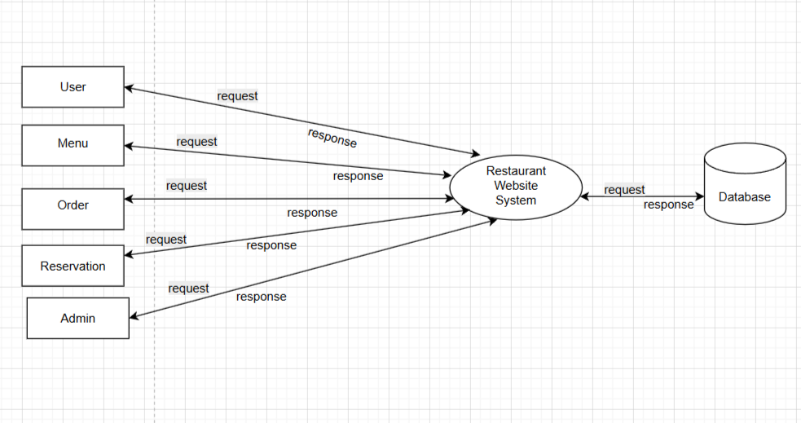
DATA FLOW DIAGRAM
LEVEL 0

Slide 28
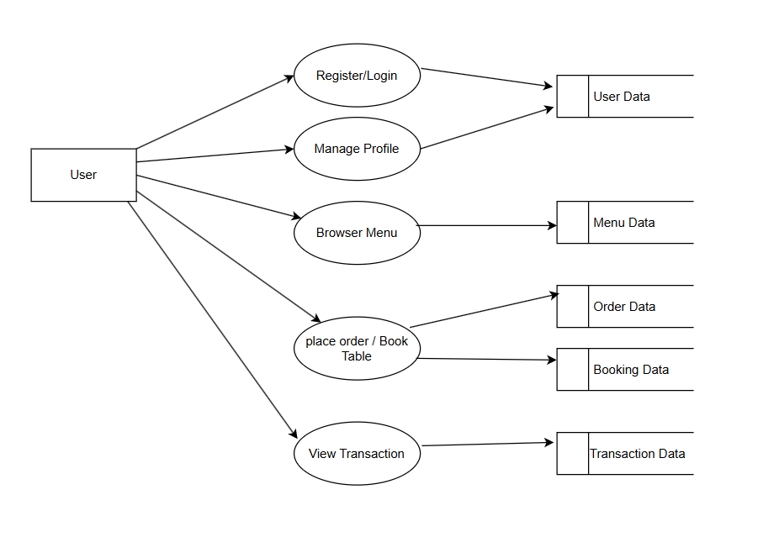
DATA FLOW DIAGRAM
Level 1

Slide 29
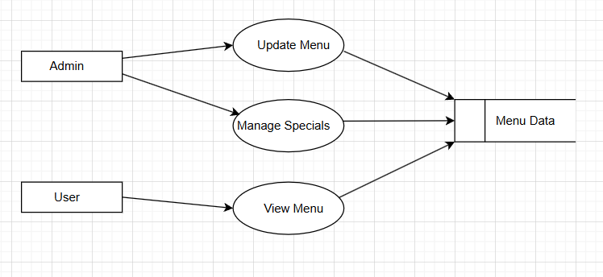
DATA FLOW DIAGRAM
Level 2

Slide 30
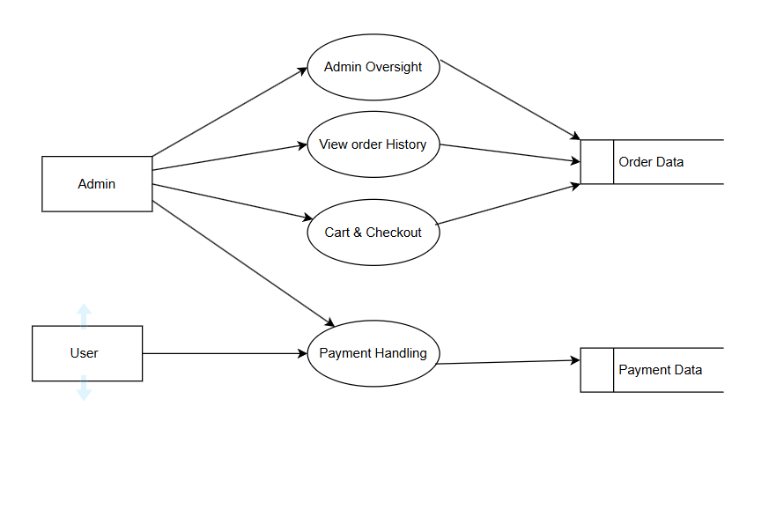
DATA FLOW DIAGRAM
Level 3

Slide 31
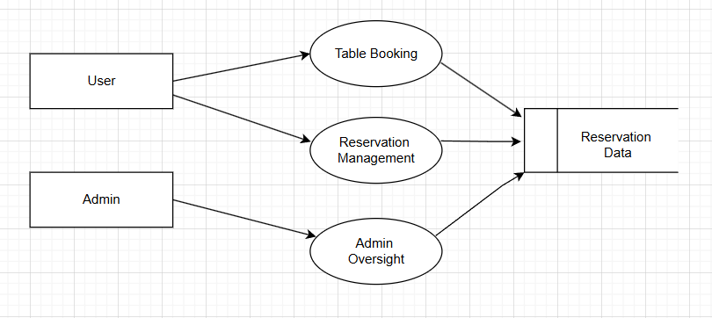
DATA FLOW DIAGRAM
Level 4

Slide 32
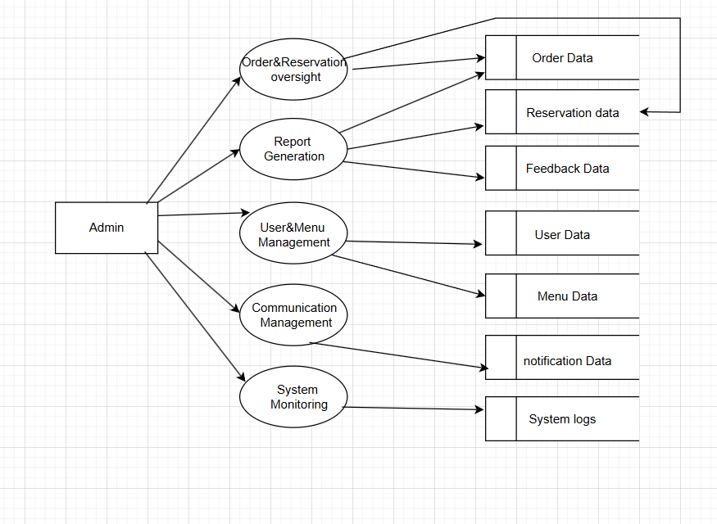
DATA FLOW DIAGRAM
Level 5

Slide 33
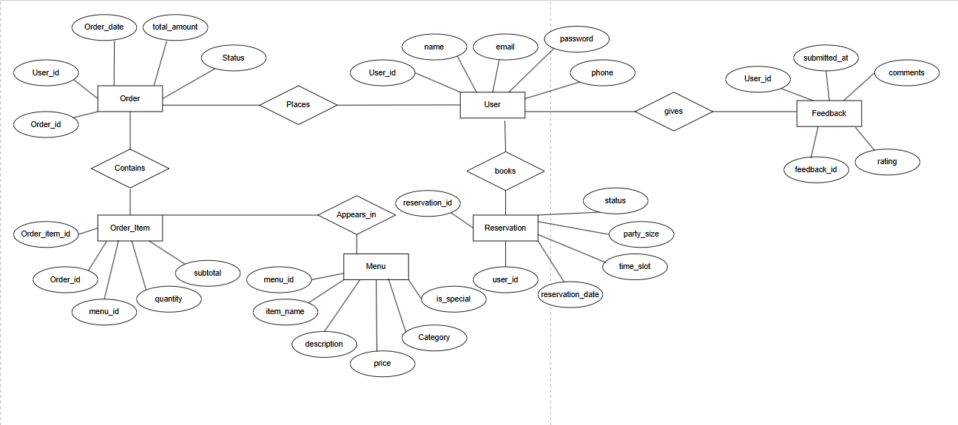
ER DIAGRAM

Slide 34
THANK YOU

