Slide 1
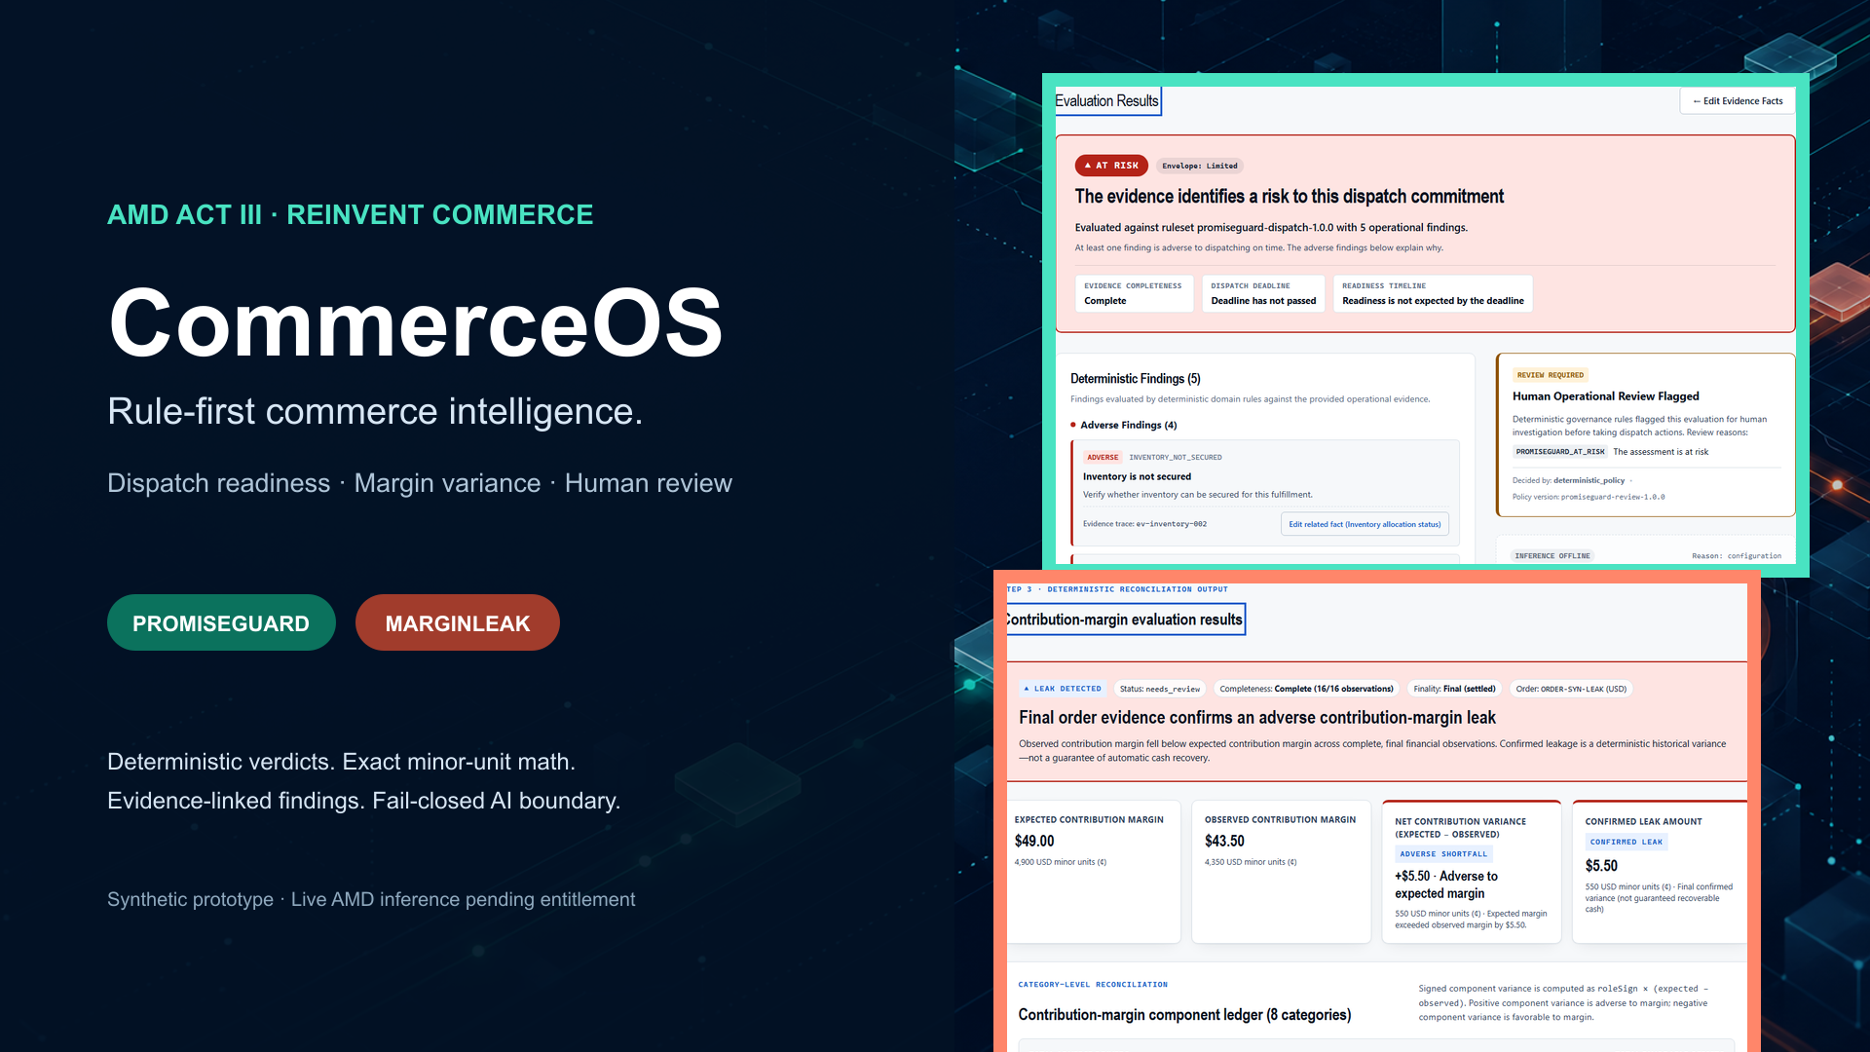
Notes:
CommerceOS is a rule-first commerce control room. Deterministic rules own verdicts, money, and review gates. Live AMD inference is pending event entitlement and is not claimed in this deck.

Slide 2
Commerce failures are discovered too late
Dashboards report outcomes; generic assistants can explain without owning evidence quality or arithmetic.
Silent promise risk
Hidden margin variance
Opaque automation
Inventory, blockers, and readiness estimates drift apart until a dispatch cutoff is missed.
Revenue and cost movements offset each other, while provisional or missing facts create false confidence.
An AI answer cannot be the source of truth for a customer promise, a financial number, or a review decision.
CommerceOS turns evidence into a deterministic decision first—then permits only bounded, optional advisory AI.
Notes:
Frame the problem around operational trust. CommerceOS is not another chat interface; it is a deterministic evidence and governance layer.

Slide 3
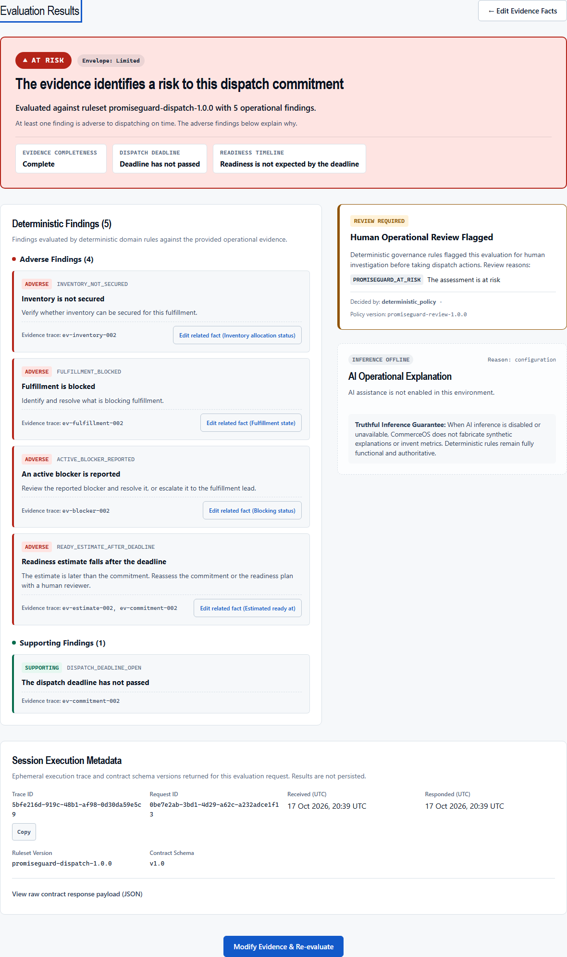
PromiseGuard: dispatch readiness with evidence
Functional synthetic preview · capability registry remains stub
3 truthful outcomes
Supported · At risk · Indeterminate
Traceable findings
Every rule points to the evidence that triggered it.
Human review
Risk or insufficient evidence produces explicit review reasons.
AI is offline in this proof. The deterministic result remains complete.
Notes:
Show the at-risk result. Point out inventory, blocker, deadline, and readiness findings; then show the human-review flag and inference-offline truthfulness.

Slide 4
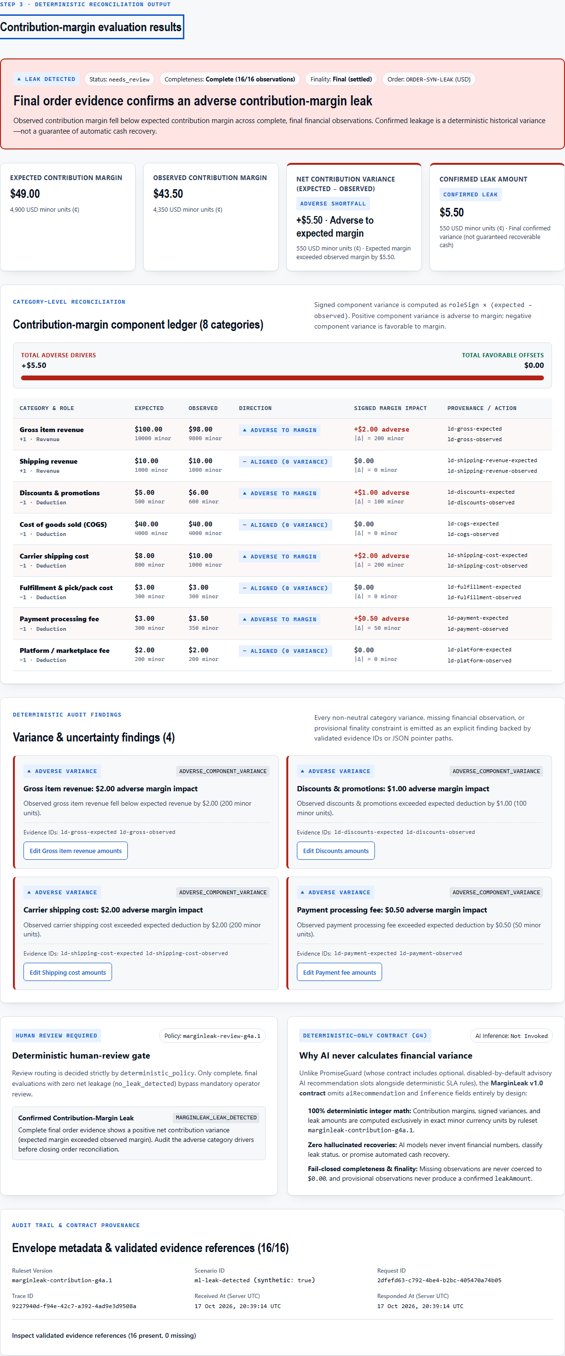
MarginLeak: exact variance without invented money
Development-only synthetic preview · capability registry remains planned
$49.00
expected contribution margin
$43.50
observed contribution margin
+$5.50 adverse
confirmed variance · human review required
Integer minor-unit arithmetic · 8-category ledger · missing totals withheld
Notes:
Walk through expected versus observed contribution margin and the category ledger. Emphasize that provisional and incomplete evidence never produces a confirmed leak amount.

Slide 5
One contract-first decision path
The model boundary is downstream of deterministic truth—not in charge of it.
Synthetic / merchant evidence
Zod + API contracts
Deterministic evaluator
Review policy + provenance
Optional advisory AI
Verdicts stay deterministic
Money stays deterministic
Failure stays visible
AI cannot mark a risky order supported.
AI cannot calculate or invent leak amounts.
No silent live-to-mock fallback.
Notes:
Explain the order of operations. Evidence is validated, rules evaluate, review policy routes, provenance is attached, and only then can an optional model produce bounded advisory text.

Slide 6
Fail closed by design
Prototype honesty is a product feature.
Incomplete evidence
Provisional observations
Provider unavailable
PromiseGuard returns indeterminate; MarginLeak withholds totals.
Adverse variance is visible, but confirmed leakage remains unavailable.
Deterministic analysis completes; AI state reports unavailable.
Production MarginLeak
Secrets
Capability truth
Page returns 404 and analysis API returns 403.
Server-only variables, repository scanner, no credentials in assets.
PromiseGuard stub · MarginLeak planned · RescueCart disabled.
No live AMD inference is claimed without an authenticated request and generated response.
Notes:
Use this slide to answer trust and safety questions. Every uncertain state is explicit and production restrictions stay intact.

Slide 7
Verified on the release baseline
Private source f13f7de · public release 3075513 · automated checks from Mission 017
205
18
8
173
unit tests passed
production E2E passed
MarginLeak viewport widths
public files scanned
Build
Security
Browser gates
Next.js production build passed.
No recognized secrets; no known high vulnerabilities.
Production 404/403 restrictions verified.
MIT-licensed public release and production deployment verified on October 18, 2026.
Notes:
Summarize the release evidence. Public CI passed quality and browser-smoke on commit 3075513. The deployed application preserves production MarginLeak restrictions.

Slide 8
Ready to submit truthfully
The public release is live. AMD entitlement and the operator's final Submit action remain unresolved.
Published
Operator action
External dependency
MIT source · public repository · Vercel deployment · cover · slides/PDF · authentic video
Review the completed event form and perform the reserved final Submit action.
Organizer must map the approved account to Token Factory API-key distribution.
CommerceOS
Deterministic first. Advisory AI only when proven.
Notes:
Close with the exact remaining asks: organizer entitlement for AMD and the operator's reserved final submission confirmation.

