Slide 1

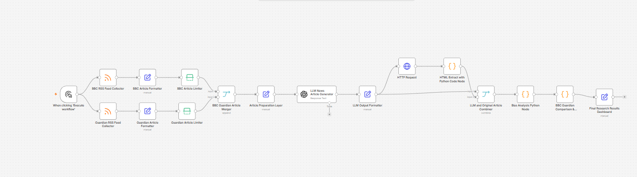
AI System for News Bias and Misinformation Analysis
with Responsible AI Considerations
Automated agentic AI workflow BBC + Guardian → GPT → Python analysis → Dashboard
Muhammad Rizwan Riaz
MSc Artificial Intelligence
Supervisor: Dr Aboozar Taherkhani
Viva Presentation
Notes:
Introduce the project title, your name, degree and supervisor. Explain that the work develops an automated agentic AI workflow for analysing bias and misinformation risks in AI-generated journalism.

Slide 2
Background and Motivation
AI and Large Language Models are increasingly used in journalism and digital media.
Generated articles can look coherent, professional and realistic.
Key risks include misinformation, hallucinated details and linguistic bias.
The project focuses on evaluating generated news content rather than simply producing it.
Main motivation
Can an automated workflow compare original journalism with AI-generated news?
Can it produce explainable bias and risk indicators?
Research focus
Bias
Misinformation risk
Semantic overlap
Responsible AI
MSc AI Dissertation Viva • Muhammad Rizwan Riaz • Slide 2
Notes:
Explain the growth of AI-generated journalism and why generated content must be evaluated. Emphasise risks around bias, hallucination, and misinformation.

Slide 3
Research Problem, Aim and Objectives
Research problem
Project aim
AI-generated news may appear factual even when unsupported.
Bias and framing can be difficult to detect manually.
A transparent automated workflow is needed for comparative analysis.
Develop an automated agentic AI workflow.
Analyse bias and misinformation risk in AI-generated journalism.
Use Responsible AI principles to guide system design.
Objectives
Collect BBC and Guardian RSS articles
Generate GPT-based news articles
Apply Python bias and risk analysis
Compare original vs generated content
Present findings using dashboard outputs
MSc AI Dissertation Viva • Muhammad Rizwan Riaz • Slide 3
Notes:
State the research problem clearly. Explain that the objective was not just generation but evaluation and comparison of generated content against original journalism.

Slide 4
Literature Review and Research Gap
Study | Contribution to this project
Bender et al. (2021) | LLM limitations and unreliable outputs
Weidinger et al. (2021) | Ethical and social risks of language models
Fang et al. (2024) | Multi-level bias analysis inspiration
Stahl (2021) | Responsible AI: transparency and accountability
Research gap addressed
Live RSS collection
GPT article generation
Bias and sentiment analysis
Misinformation risk estimation
Responsible AI discussion in one automated workflow
Gap: limited practical workflows combine live journalism, AI generation, comparative analysis and Responsible AI evaluation.
MSc AI Dissertation Viva • Muhammad Rizwan Riaz • Slide 4
Notes:
Explain how the literature shaped your project. Fang et al. inspired the multi-level bias analysis, while Responsible AI literature guided transparency and explainability.

Slide 5
Overall n8n Workflow Architecture
BBC and Guardian RSS feeds collect live article metadata.
GPT generates a headline-based news article.
HTTP request and Python extraction clean the original article text.
Python analysis calculates bias, sentiment, similarity and misinformation risk.
Final dashboard presents comparative results.
MSc AI Dissertation Viva • Muhammad Rizwan Riaz • Slide 5
Notes:
Walk through the workflow from left to right. Use simple language: collection, preparation, generation, extraction, analysis and dashboard.

Slide 6
Architecture: Node-by-Node Explanation
Trigger: starts the workflow execution
BBC RSS Feed Collector: collects BBC titles and links
Guardian RSS Feed Collector: collects Guardian titles and links
Article Formatter: standardises title, source and URL fields
Article Limiter: controls sample size for each source
BBC/Guardian Merger: combines both news streams
Article Preparation Layer: prepares prompt input and metadata
LLM News Generator: creates headline-based AI article
LLM Output Formatter: structures generated article output
HTTP Request: retrieves original article webpage
HTML Extract Python Node: removes tags and extracts clean text
Combiner: pairs original and generated articles
Bias Analysis Python Node: calculates metrics
Comparison + Dashboard: produces final research results
Purpose: each node performs one clear step, making the workflow easier to trace and explain.
MSc AI Dissertation Viva • Muhammad Rizwan Riaz • Slide 6
Notes:
Explain each node briefly. Do not over-explain. Highlight that this visual design supports transparency because the workflow stages are observable.

Slide 7
Methodology: Comparative Experimental Approach
1
Data collection
2
AI generation
BBC and Guardian RSS feeds
GPT article from headline only
3
Preprocessing
4
Bias analysis
HTML cleaning and text extraction
Word, sentence and document levels
5
Risk estimation
6
Comparison
Similarity and misinformation risk
BBC vs Guardian dashboard results
The methodology compares professionally written journalism with AI-generated news-style articles under controlled analytical conditions.
MSc AI Dissertation Viva • Muhammad Rizwan Riaz • Slide 7
Notes:
Explain that the study used a comparative approach. Each original article was compared with a generated article, then scores were computed and compared.

Slide 8
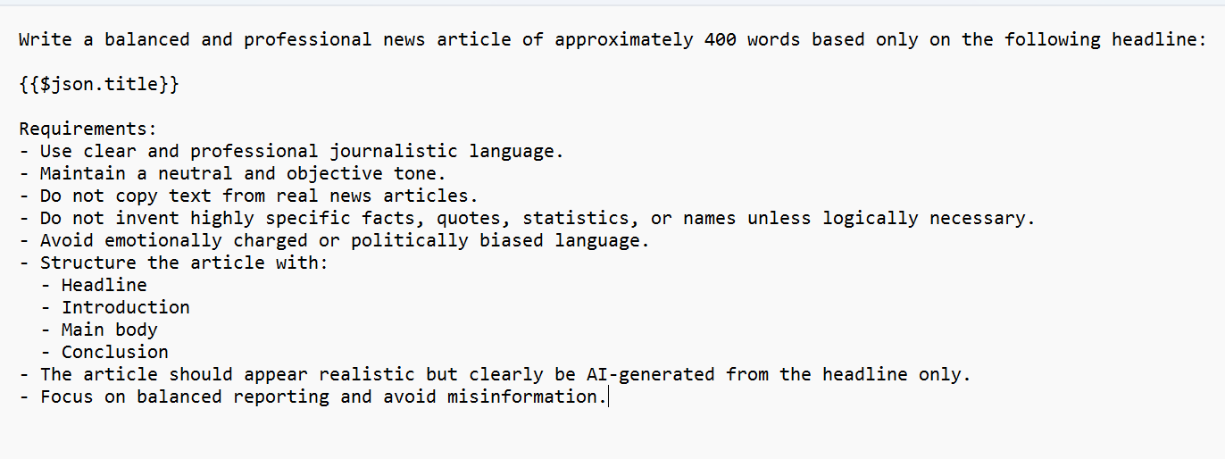
GPT Generation and Text Preprocessing
GPT article generation
Headline-only input from RSS feed
Approximately 400-word generated article
Neutral and professional journalistic tone
Prompt asks model to avoid unsupported claims
HTML extraction
Why preprocessing matters
HTTP Request retrieves original article webpage
Python script removes tags, scripts and formatting noise
Clean article text is passed to analysis nodes
Reduces irrelevant webpage noise
Improves consistency of bias and similarity analysis
Keeps analysis focused on journalistic text
MSc AI Dissertation Viva • Muhammad Rizwan Riaz • Slide 8
Notes:
Explain that GPT generated articles using only the headline. Then explain that original article text needed cleaning because webpages include scripts, menus and formatting noise.

Slide 9
Bias Analysis Metrics
Word-level bias
Bias_word = N_biased_terms / N_total_words
Sentence / sentiment tone
Sentiment = (N_positive − N_negative) / N_total_words
Counts predefined emotionally weighted terms
Normalised by article length
Higher value = stronger emotional wording
Compares positive and negative vocabulary
Values near zero indicate neutral tone
Used as a simplified sentiment indicator
Document-level bias
Bias_document = (Bias_word + Bias_sentence) / 2
Combines word-level and sentence-level measurements
Produces one overall comparative bias indicator
Used to compare original and generated articles
MSc AI Dissertation Viva • Muhammad Rizwan Riaz • Slide 9
Notes:
Explain the three bias measures. Make clear that these are computational indicators and not definitive political bias detection.

Slide 10
Similarity and Misinformation Risk
Semantic overlap measurement
Similarity = (2 × N_overlap) / (N_unique_original + N_unique_generated)
Compares shared unique vocabulary between original and AI-generated articles.
Higher similarity = stronger alignment with the source article.
Implemented as semantic overlap rather than true vector-based cosine similarity.
Misinformation risk estimation
Risk_misinfo = 1 − Similarity
Lower overlap increases risk score
Indicates potential unsupported interpretation or narrative variation
Not a replacement for professional fact-checking
MSc AI Dissertation Viva • Muhammad Rizwan Riaz • Slide 10
Notes:
Be careful here. Explain that the code used semantic overlap, not sklearn cosine similarity. Misinformation risk is an indicator, not proof.

Slide 11
Responsible AI Principles Implemented
Transparency
Explainability
Original and AI-generated articles kept separate
Bias, sentiment, similarity and risk scores displayed
Accountability
Source traceability
Limitations and uncertainty clearly acknowledged
RSS source name, title and link retained
MSc AI Dissertation Viva • Muhammad Rizwan Riaz • Slide 11
Notes:
Explain the Responsible AI principles you actually implemented. Do not claim human oversight as implemented. Say it is future work.

Slide 12
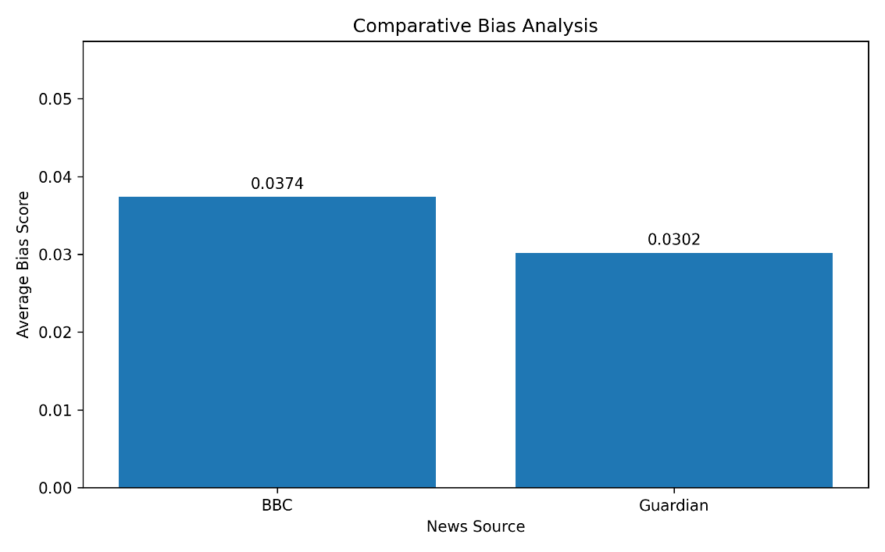
Results: Comparative Bias Analysis
Source | Bias Score
BBC | 0.0374
Guardian | 0.0302
BBC articles produced a slightly higher average bias score.
Both scores remain low in absolute terms.
Interpretation: minor measurable differences in linguistic framing.
Bias score is an indicator of emotionally weighted wording, not definitive political bias.
MSc AI Dissertation Viva • Muhammad Rizwan Riaz • Slide 12
Notes:
Explain the BBC and Guardian bias scores. Highlight that BBC is slightly higher, but both are low and should be interpreted cautiously.

Slide 13
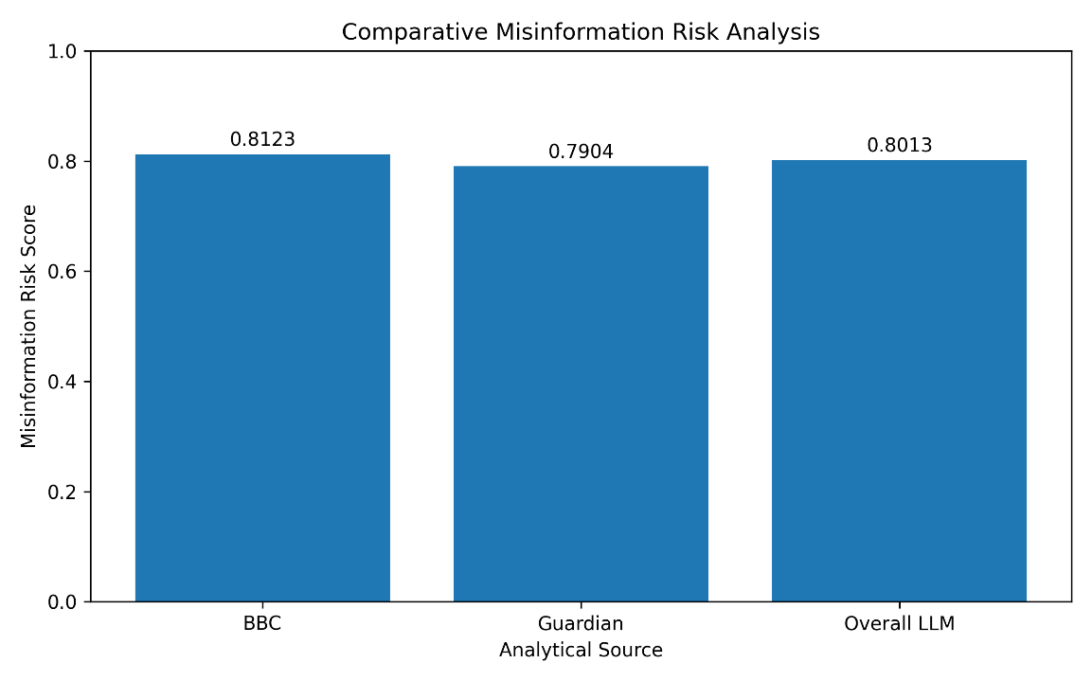
Results: Misinformation Risk Evaluation
Source | Risk Score | Level
BBC | 0.8123 | High
Guardian | 0.7904 | High
Overall LLM | 0.8013 | High
All generated outputs were classified as high risk using the selected threshold.
BBC-generated articles showed slightly higher risk than Guardian-generated articles.
Risk reflects reduced overlap and possible narrative variation, not confirmed misinformation.
A high score means the generated article differed substantially from the original source text.
MSc AI Dissertation Viva • Muhammad Rizwan Riaz • Slide 13
Notes:
Explain that misinformation risk is based on overlap with the source article. Emphasise that it does not prove misinformation; it flags possible divergence.

Slide 14
Key Findings, Limitations and Future Work
Key findings
Limitations
AI-generated articles remained coherent and readable.
Measurable differences appeared in wording and sentiment intensity.
Semantic overlap varied between original and generated articles.
The workflow produced explainable comparative indicators.
No external fact-checking database was used.
Lexicon-based bias analysis is simplified.
Context, political nuance and intention are difficult to automate.
Only BBC and Guardian sources were evaluated.
Future improvements
Fact-checking APIs
Transformer-based semantic models
Additional news sources
Human review stage
Multilingual analysis
MSc AI Dissertation Viva • Muhammad Rizwan Riaz • Slide 14
Notes:
Summarise what the workflow achieved and be honest about limitations. Mention that future work could add human review and external fact-checking.

Slide 15
Conclusion and Questions
Conclusion
An automated agentic AI workflow was developed in n8n.
BBC and Guardian news articles were collected and compared with GPT-generated outputs.
Python scripts calculated bias, sentiment, similarity and misinformation risk indicators.
Responsible AI was addressed through transparency, explainability, accountability and source traceability.
Thank you
Questions?
MSc AI Dissertation Viva • Muhammad Rizwan Riaz • Slide 15
Notes:
Conclude confidently. Repeat the main contribution: an automated workflow for comparing original and AI-generated journalism with explainable bias and risk indicators.

