Slide 1
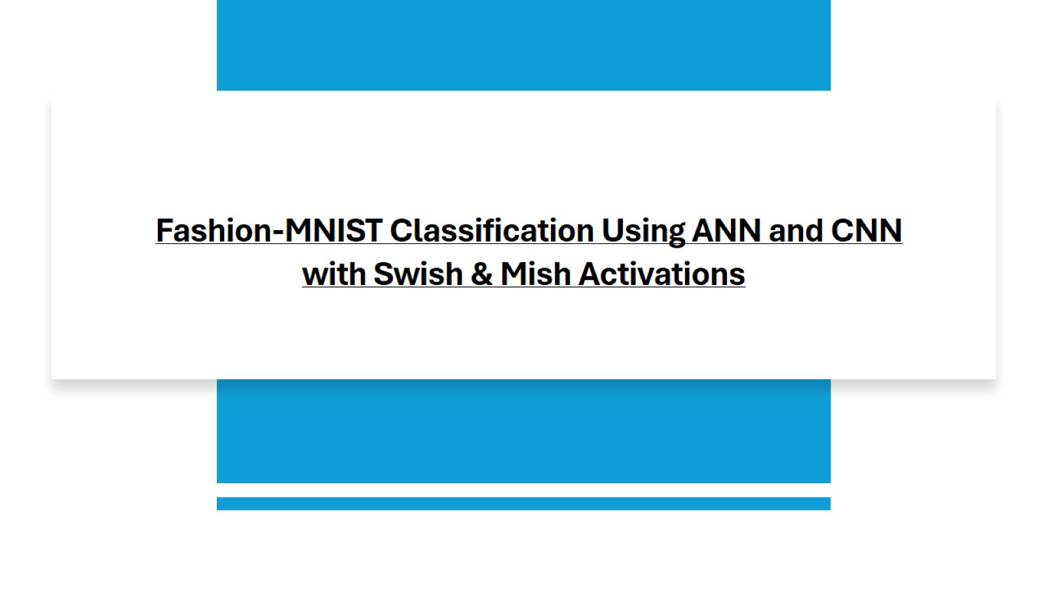
Fashion-MNIST Classification Using ANN and CNN with Swish & Mish Activations

Slide 2
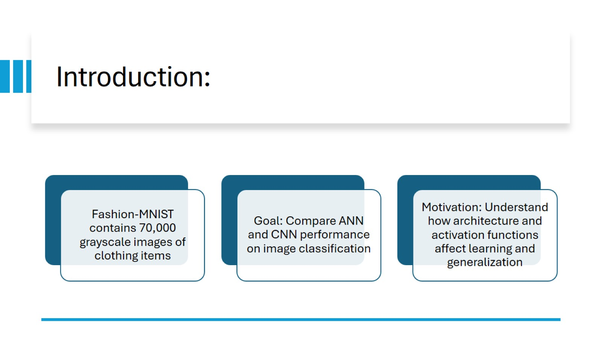
Introduction:

Slide 3
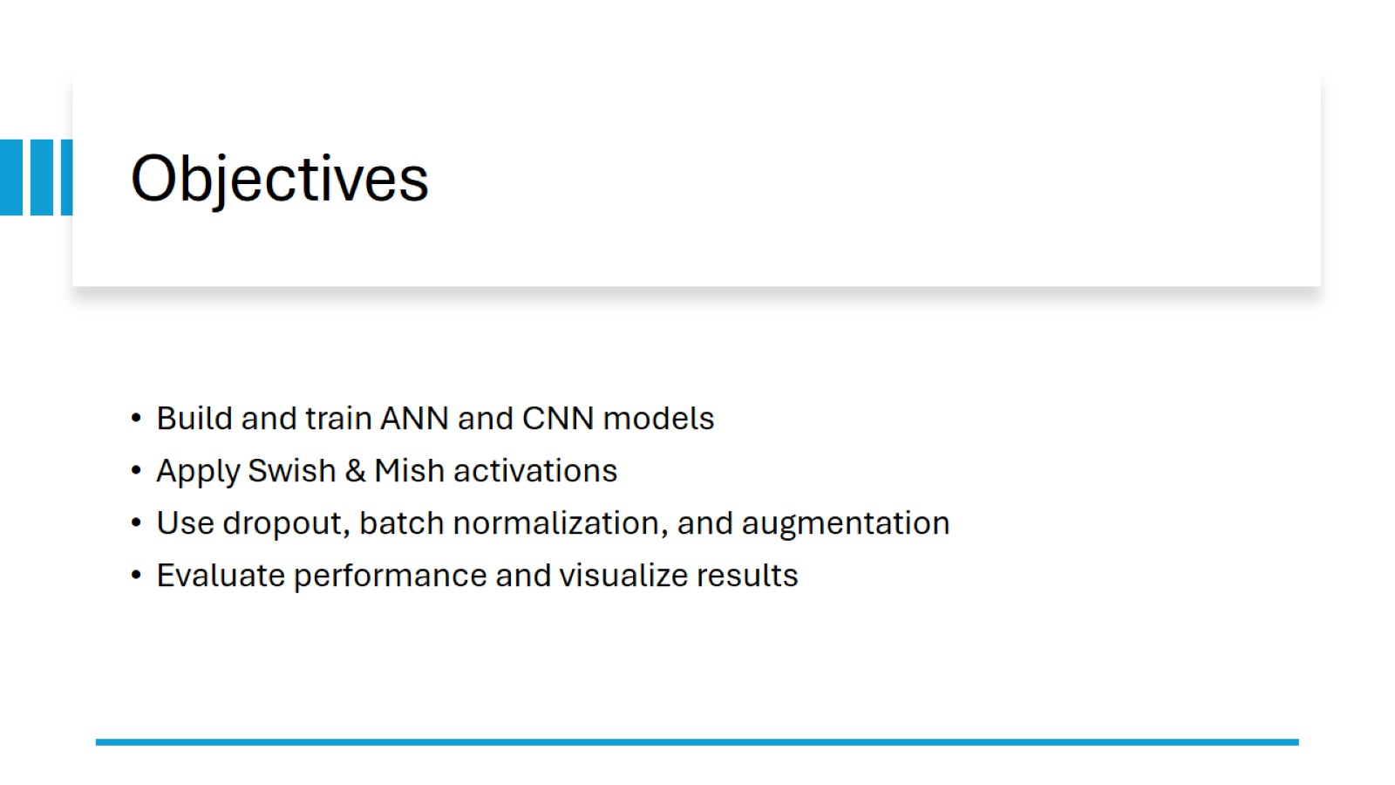
Objectives

Slide 4
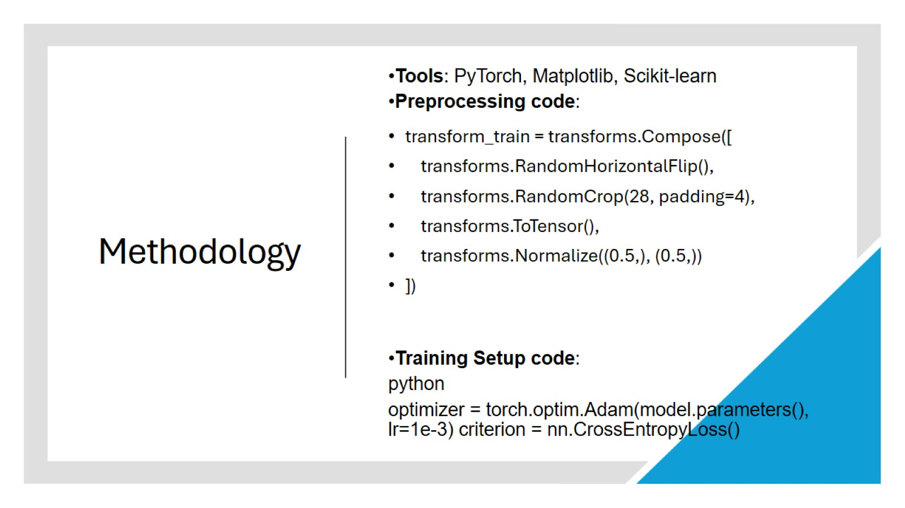
Methodology

Slide 5
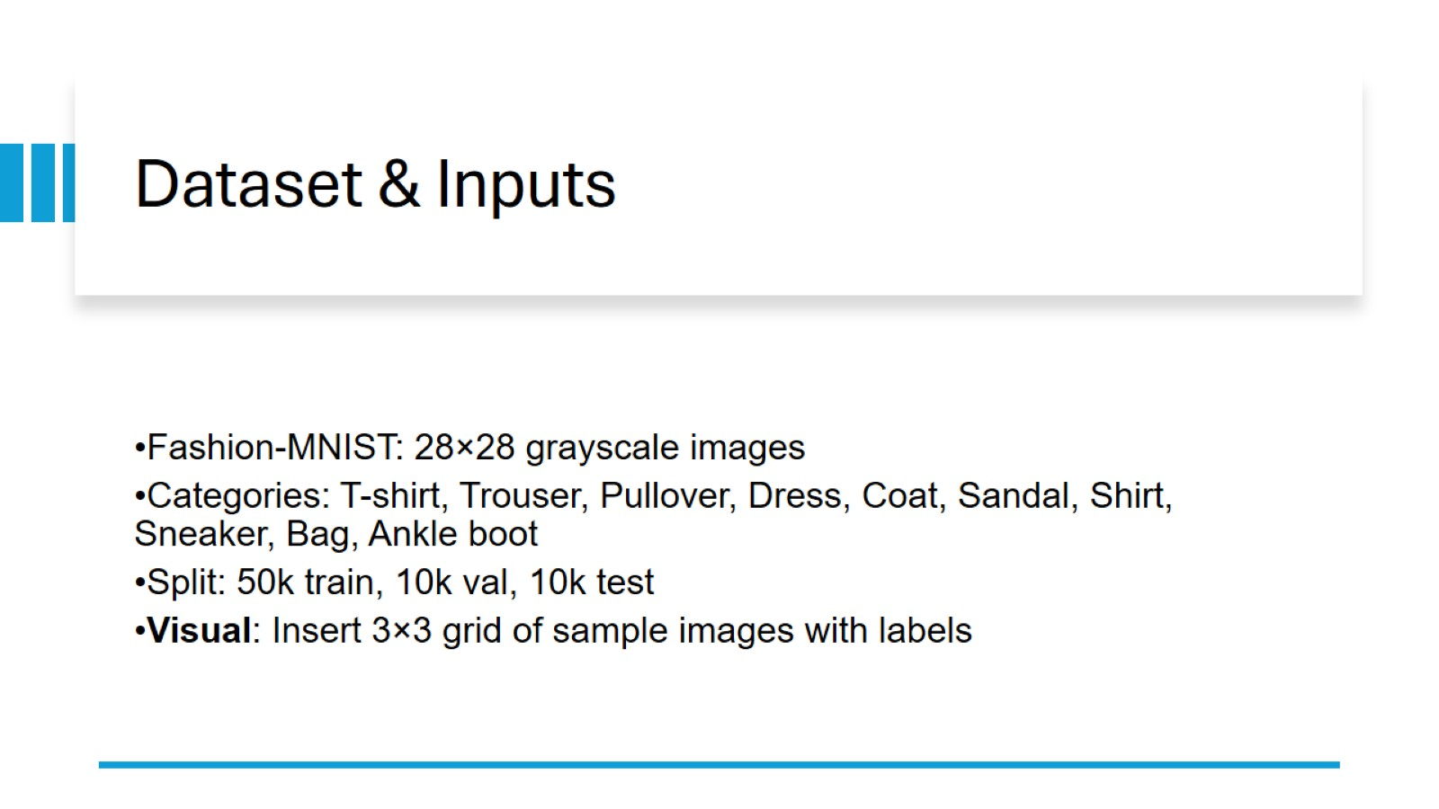
Dataset & Inputs

Slide 6
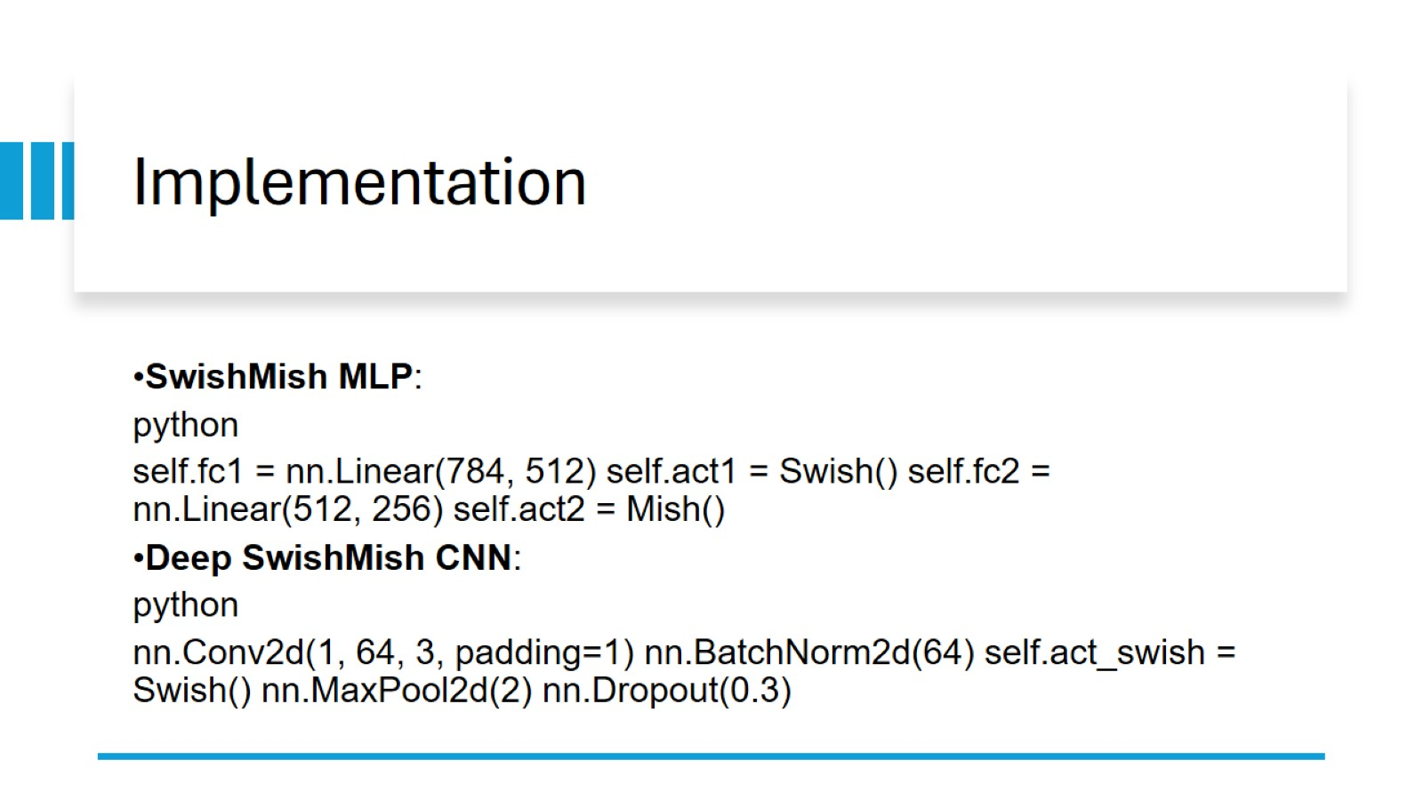

Implementation

Slide 7
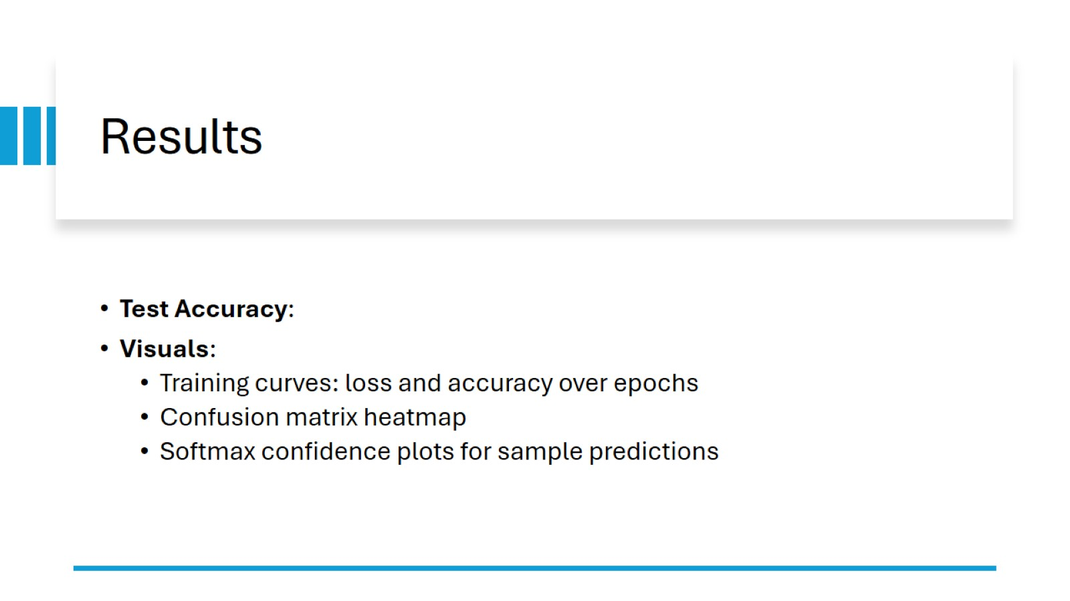

Results

Slide 8
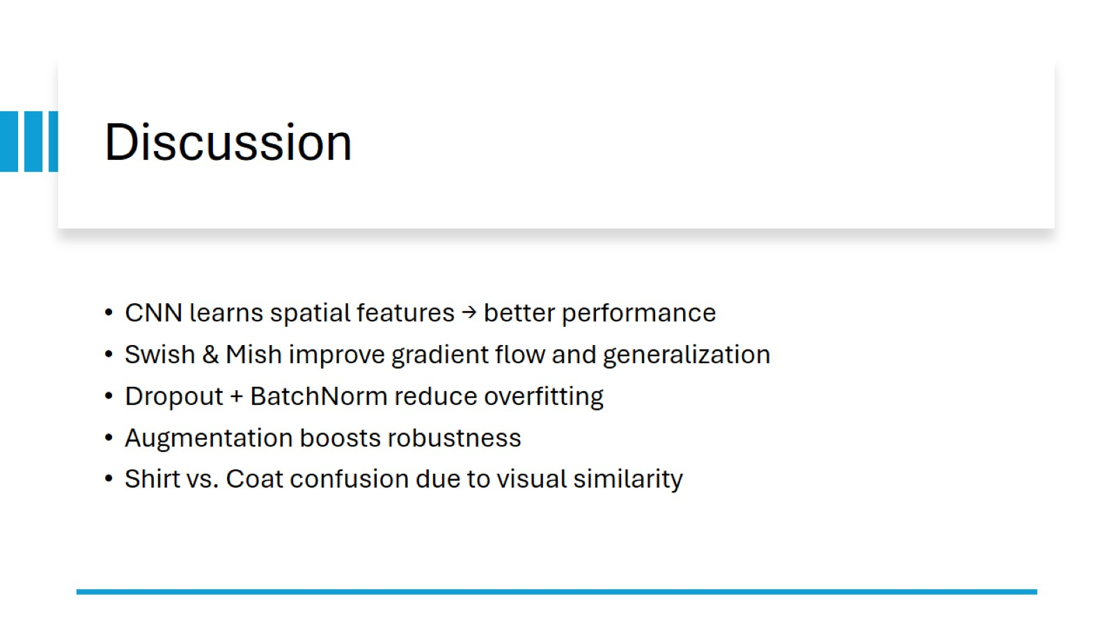

Discussion

Slide 9
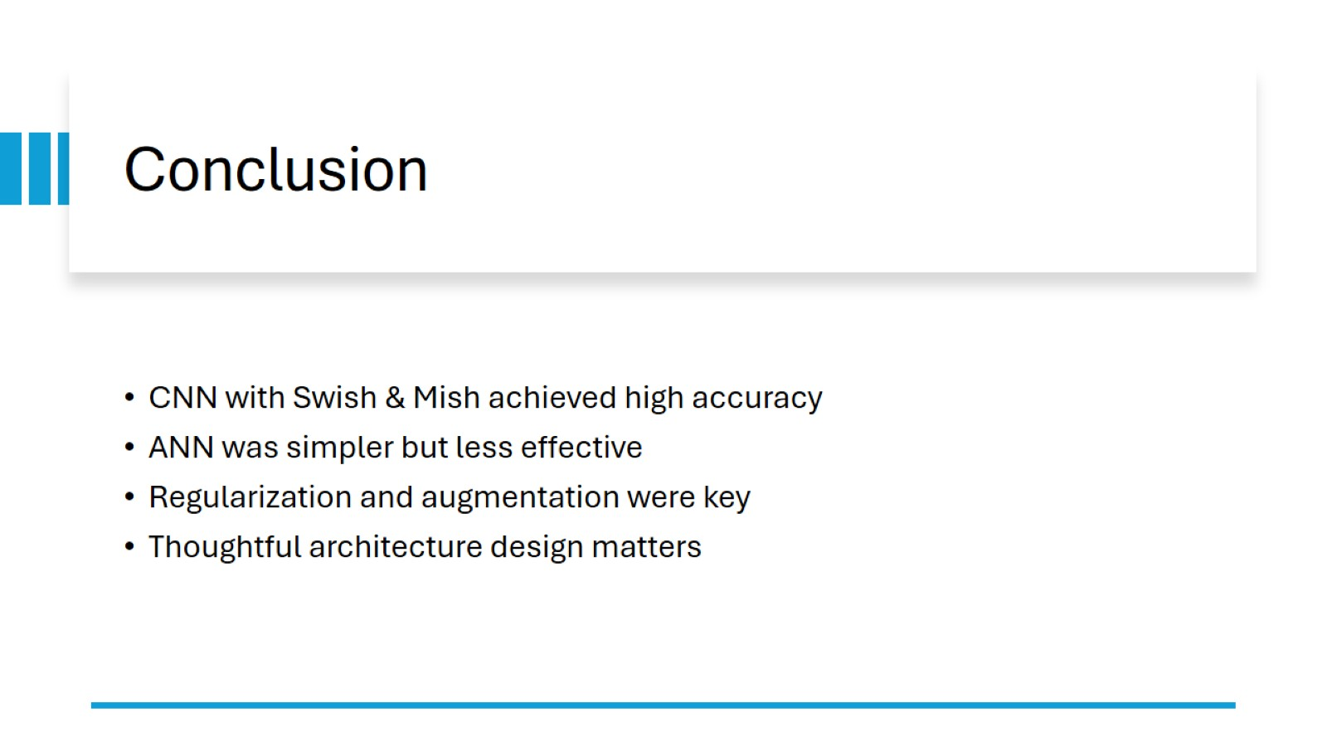
Conclusion

Slide 10
Future Work & Acknowledgments Try learning rate scheduling, cutout, or ensemble models Explore attention mechanisms or focal loss Acknowledge: PyTorch, torchvision, course instructors References: Swish/Mish papers, dataset source

