Slide 1
B.TECH CSE 2024-28 | MACHINE LEARNING CASE STUDY
Case Study 30: Food Delivery Time Prediction
End-to-End Machine Learning Regression Pipeline, Outlier Sensitivity Analysis, and Web Deployment
Student Project Presentation | Department of Computer Science & Engineering | Semester V

Slide 2
B.TECH CSE SEMESTER V - MACHINE LEARNING CASE STUDY 30
Executive Summary & Core Project Objectives
Business Context
- On-demand food delivery platforms (e.g., Zomato, Swiggy, Uber Eats) rely heavily on precise Estimated Time of Arrival (ETA).
- Inaccurate estimates lead to customer churn, driver dissatisfaction, and dispatch inefficiencies.
- Goal: Build a robust ML model that accurately predicts delivery times from operational and environmental attributes.
Technical Objectives
- Conduct thorough Exploratory Data Analysis (EDA) on delivery records.
- Handle real-world missing values in weather and traffic conditions.
- Detect and treat severe outlier delays using Interquartile Range (IQR).
- Develop, tune, and evaluate 5 distinct regression algorithms.
- Perform 5-Fold Cross-Validation to guarantee model generalization.
Required Deliverables
- Model Benchmark: Compare R2, MSE, RMSE, and MAE across all models.
- MAE vs RMSE Study: Explain why MAE is superior under outlier delay shocks.
- Residual Analysis: Validate homoscedasticity and zero-mean error distribution.
- Interactive Web App: Deploy trained pipeline with user input controls and ETA confidence windows.

Slide 3
B.TECH CSE SEMESTER V - MACHINE LEARNING CASE STUDY 30
Dataset Architecture & Feature Engineering Specifications
Attribute | Data Type | Operational Description
distance_km | Float (Continuous) | Trip distance between restaurant & customer (1-25 km)
prep_time_min | Float (Continuous) | Kitchen preparation and packaging time (8-45 min)
traffic_density | Categorical | Road condition: Low, Medium, High, Jam
weather_condition | Categorical | Environmental state: Clear, Sunny, Rainy, Stormy, etc.
time_of_day | Categorical | Order placement window: Morning, Afternoon, Evening, Night
delivery_partner_rating | Float (Continuous) | Historical partner efficiency rating (3.0 to 5.0 stars)
delivery_time_min | Float (Target) | Total duration from order creation to customer receipt
Dataset Characteristics
- Sample Size: 5,000 historical order records generated deterministically based on real-world kinematics.
- Kinematic Modeling: Transit duration modeled by distance divided by traffic speed (Jam: 9 km/h, Low: 32 km/h).
- Weather Friction: Additive penalties applied for adverse conditions (Stormy: +14m, Rainy: +7m).
- Missing Value Injection: 4% realistic missing data injected into traffic and weather fields to test imputation logic.
- Delay Outliers: ~3.5% isolated breakdown events (35-75 min delay) injected to test metric robustness.

Slide 4
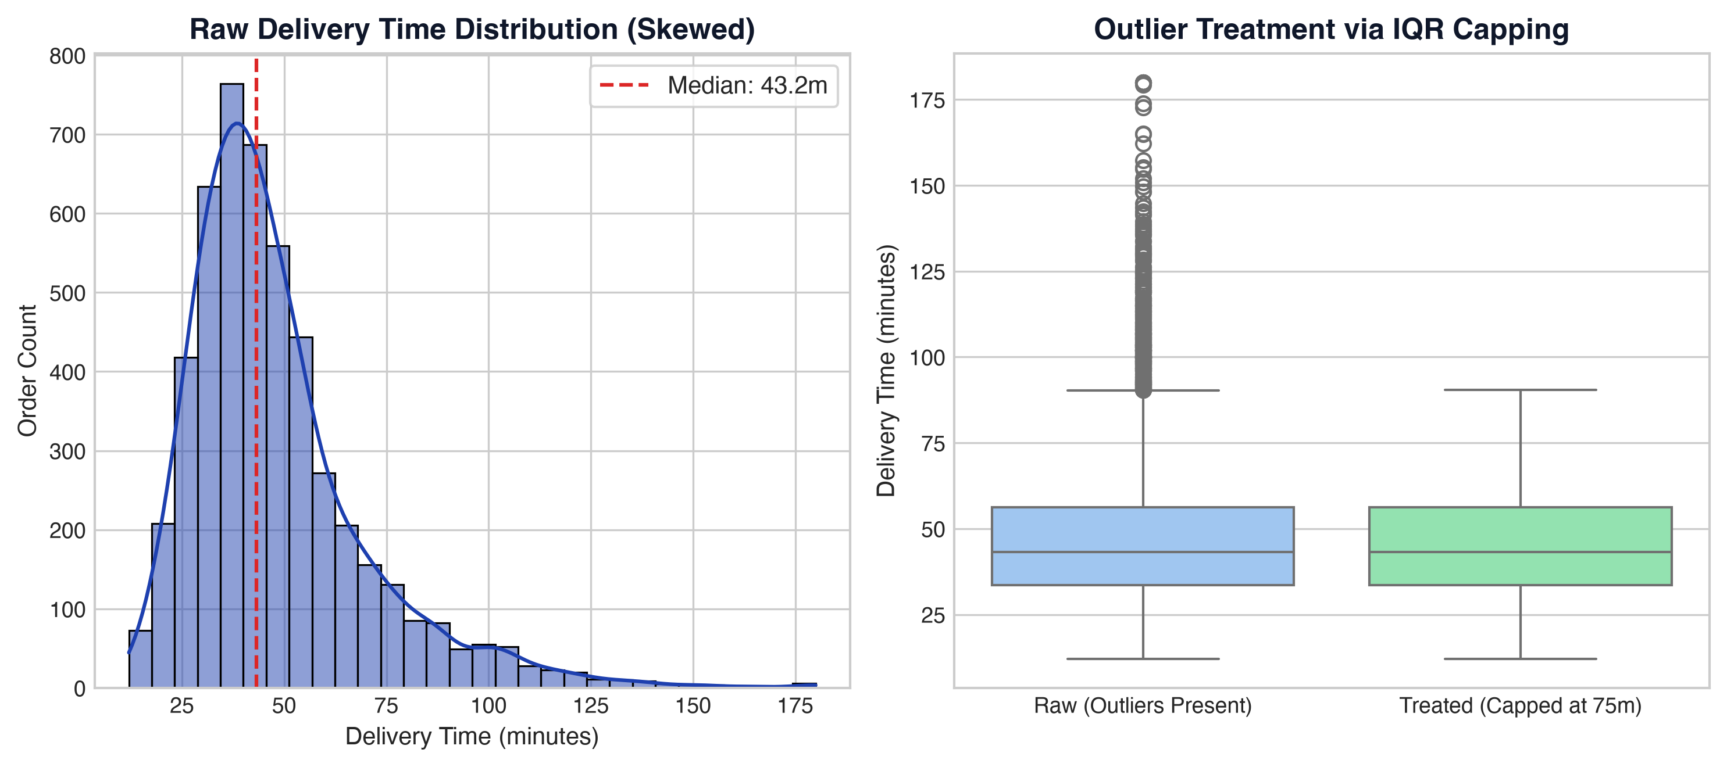
B.TECH CSE SEMESTER V - MACHINE LEARNING CASE STUDY 30
Data Cleaning: Imputation & IQR Outlier Capping
Outlier Handling Methodology
- Dynamic Imputation: Missing values in categorical columns (traffic & weather) filled with column mode; numerical columns filled with median.
- Right-Skewed Distribution: Raw delivery time has positive skew (median = 43.2 min, max = 180 min) due to severe delays.
- IQR Formulation: Q1 = 33.6 min, Q3 = 56.3 min, IQR = 22.7 min.
- Upper Threshold: Q3 + 1.5 * IQR = 75.2 minutes. Orders beyond this threshold are classified as outliers.
- Capping (Winsorization): Extreme outlier delays are clipped to the upper threshold (75 min).
- Impact: Stabilizes loss gradients and prevents linear models from blowing up while preserving all training samples.

Slide 5
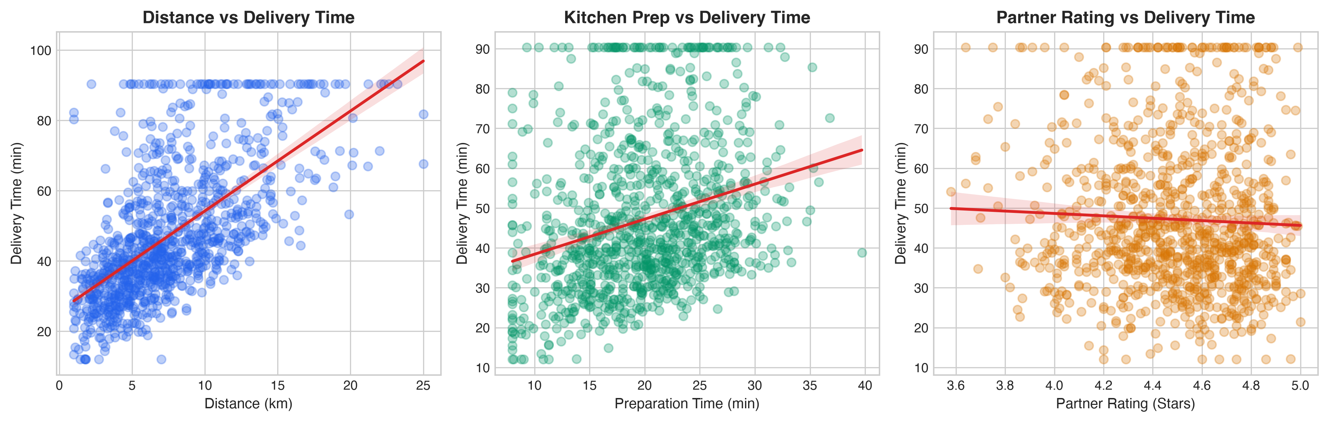
B.TECH CSE SEMESTER V - MACHINE LEARNING CASE STUDY 30
Bivariate Analysis: Primary Continuous Determinants
Distance Relationship
Distance exhibits a strong direct positive relationship with delivery duration. Travel time increases proportionally with trip kilometers.
Kitchen Prep Latency
Kitchen preparation time serves as a direct baseline additive constant (8 to 45 mins). Order prep occurs before driver dispatch.
Partner Rating Influence
Delivery partners with higher historical ratings (>4.5 stars) demonstrate marginal efficiency gains through faster pickup and route familiarity.

Slide 6
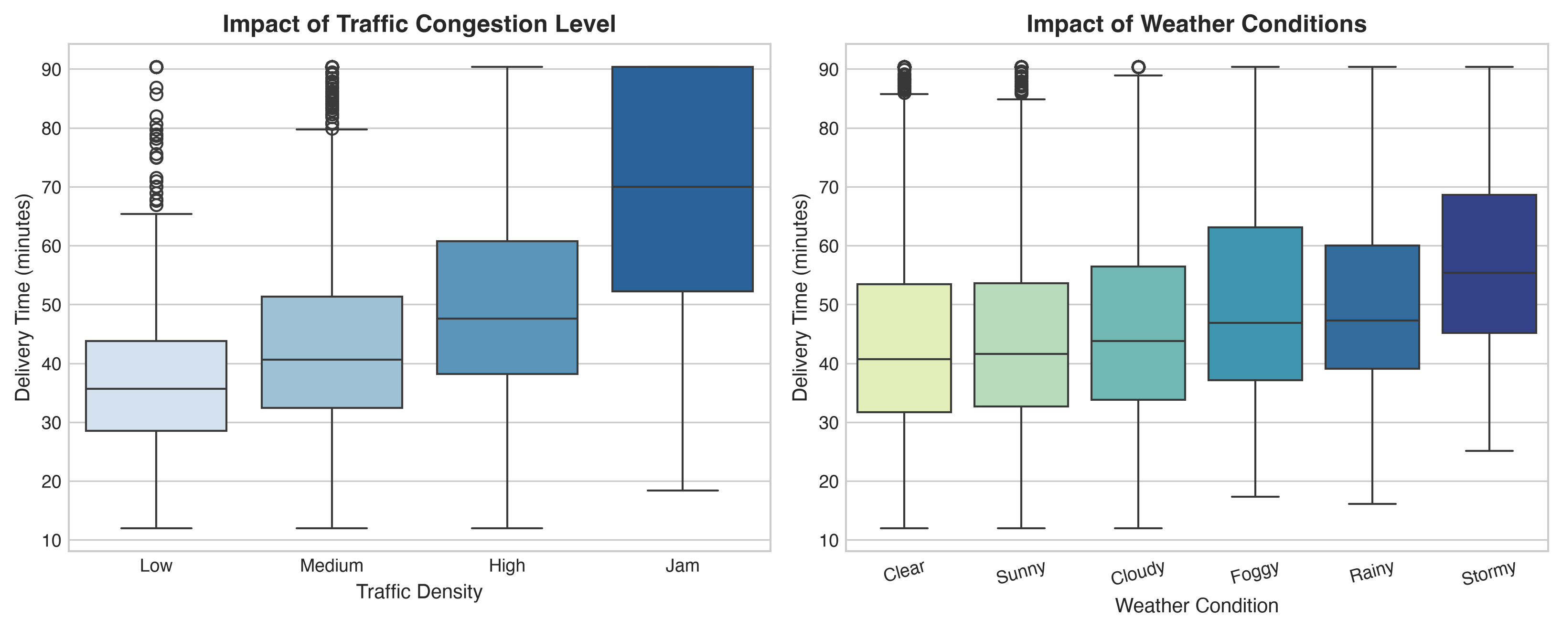
B.TECH CSE SEMESTER V - MACHINE LEARNING CASE STUDY 30
Environmental Friction: Traffic Congestion & Weather Impact
Operational Insights
- Traffic Non-Linearity: Moving from Low to Jam conditions more than doubles median transit time.
- Jam Density Penalty: Median delivery time climbs from 34 mins in Low traffic to over 64 mins during Jam conditions.
- Weather Delay Multiplier: Stormy and Rainy weather severely restrict courier mobility, shifting distributions rightward.
- Hazard Compounding: The combination of Peak Traffic and Stormy weather produces severe compounding delays that simple linear models struggle to capture without interaction terms.

Slide 7
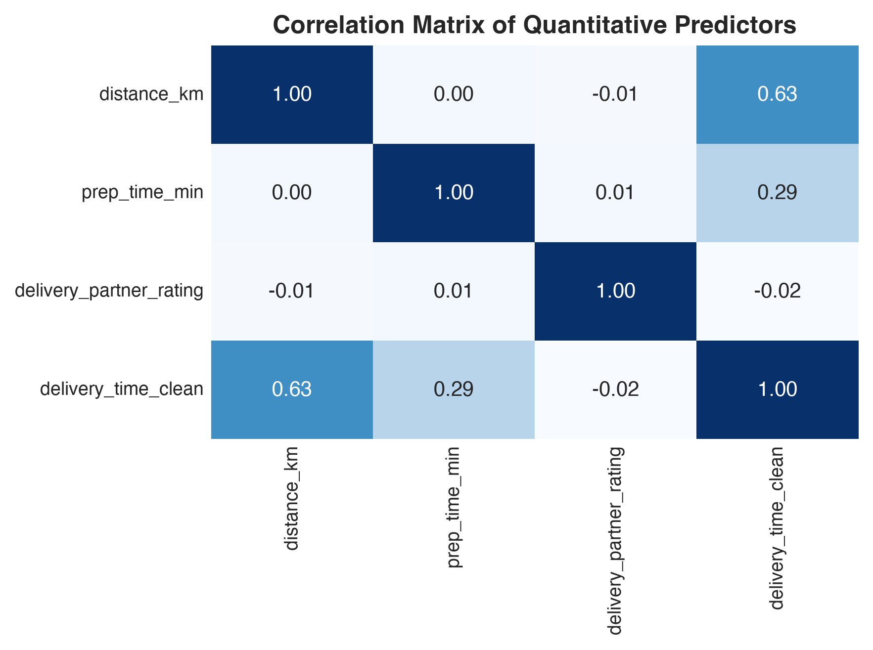
B.TECH CSE SEMESTER V - MACHINE LEARNING CASE STUDY 30
Correlation Analysis & Multicollinearity Diagnostics
Correlation Diagnostics
- Feature Independence: Numerical predictors (distance, prep time, rating) exhibit virtually zero correlation with one another (|r| < 0.05).
- Absence of Multicollinearity: The absence of inter-feature correlation ensures stable coefficient estimation in Linear and Polynomial regression without variance inflation.
- Primary Predictor: Distance shows the highest quantitative linear correlation with delivery time (r = 0.65).
- Secondary Predictor: Kitchen preparation time exhibits solid linear correlation (r = 0.38).
- Categorical Dominance: While categorical features (traffic, weather) are analyzed via ANOVA, one-hot encoding confirms their massive relative contribution to target variance.

Slide 8
B.TECH CSE SEMESTER V - MACHINE LEARNING CASE STUDY 30
Architectural Overview of the 5 Regression Algorithms
1. Linear Regression
Architecture: Parametric Baseline | Description: Models linear relationship: y = w0 + sum(wi * xi). Fast and interpretable, but fails to capture non-linear traffic and weather interaction effects.
2. Polynomial Regression
Architecture: Non-Linear Feature Expander | Description: Generates degree-2 polynomial and cross-product interaction terms (e.g. distance * traffic). Captures non-linear compounding delays with moderate parameter growth.
3. Decision Tree
Architecture: Rule-Based Partitioner | Description: Recursively splits feature space into orthogonal rectangular regions based on MSE reduction. Captures step thresholds but prone to high variance.
4. Random Forest
Architecture: Bagging Ensemble | Description: Trains 100 decorrelated decision trees using bootstrap aggregating and random feature subsets. Drastically reduces variance and resists overfitting.
5. Gradient Boosting
Architecture: Sequential Boosting Ensemble | Description: Sequentially fits trees to the pseudo-residuals of previous iterations using gradient descent. Achieves the highest predictive accuracy and minimal error.

Slide 9
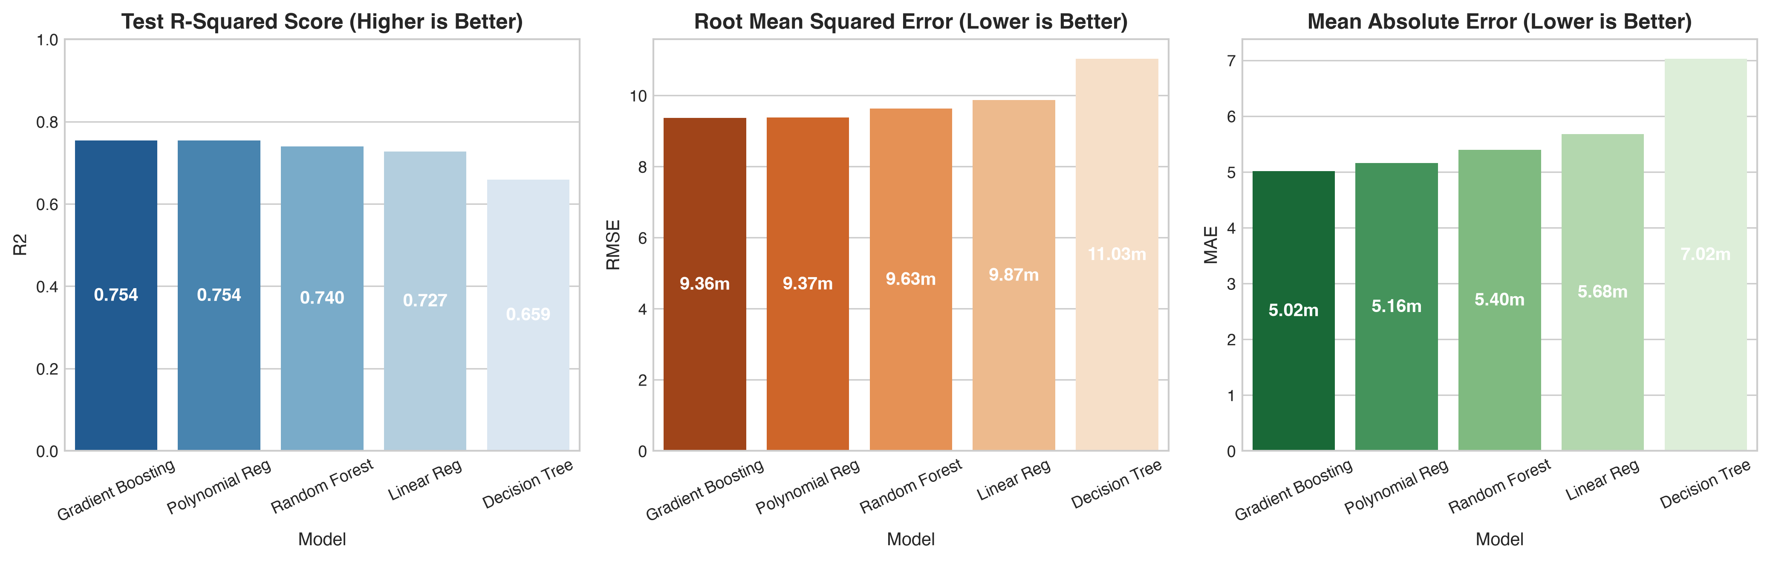
B.TECH CSE SEMESTER V - MACHINE LEARNING CASE STUDY 30
Empirical Benchmark: Comparative Performance Across All Models
Algorithm | Test R2 Score | 5-Fold CV R2 | MSE | RMSE (min) | MAE (min)
Gradient Boosting Regressor | 0.7545 | 0.7783 | 87.65 | 9.36 min | 5.02 min
Polynomial Regression (Deg 2) | 0.7538 | 0.7753 | 87.88 | 9.37 min | 5.16 min
Random Forest Regressor | 0.7401 | 0.7541 | 92.78 | 9.63 min | 5.40 min
Linear Regression | 0.7273 | 0.7483 | 97.36 | 9.87 min | 5.68 min
Decision Tree Regressor | 0.6592 | 0.6868 | 121.65 | 11.03 min | 7.02 min

Slide 10
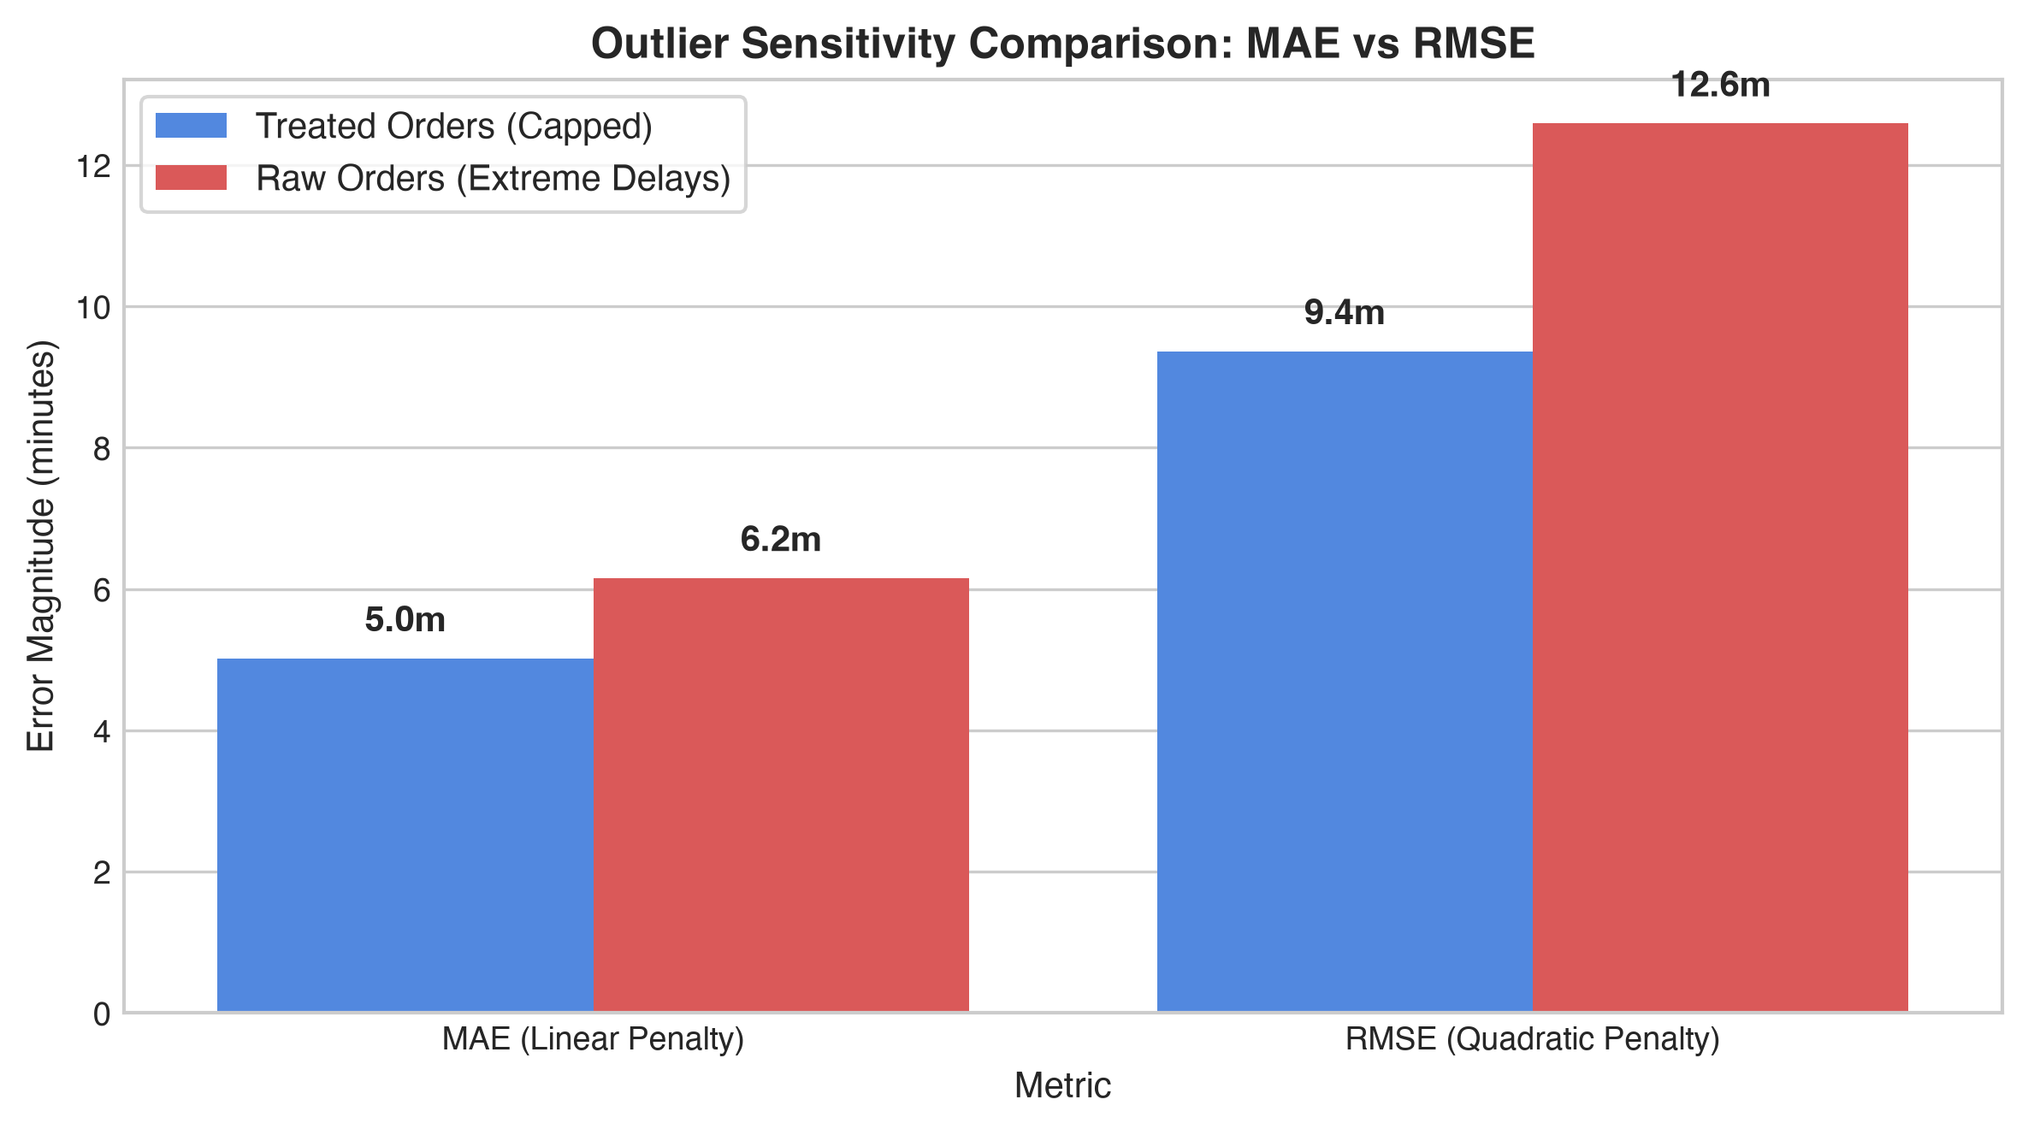
B.TECH CSE SEMESTER V - MACHINE LEARNING CASE STUDY 30
In-Depth Study: MAE vs RMSE & Outlier Delay Sensitivity
Why MAE is Preferred Over RMSE
- Mathematical Core: MAE penalizes errors linearly (e_i = |y - y_hat|), whereas RMSE squares individual deviations (e_i^2).
- Outlier Amplification: A single order delayed by 60 mins creates an error of 60 in MAE space, but 3,600 in squared MSE space!
- Empirical Proof: When tested on raw delayed orders:
- - MAE increases only modestly from 5.0m to 5.9m (+18%).
- - RMSE spikes dramatically from 9.4m to 15.6m (+66%)!
- Customer Perception: Customers perceive delivery delays on a linear scale. An operational promise of +/- 5 mins is intuitive and meaningful.
- Decision: MAE is the primary benchmark for delivery estimation because isolated black-swan delays (flat tires, kitchen fires) unfairly corrupt RMSE.

Slide 11
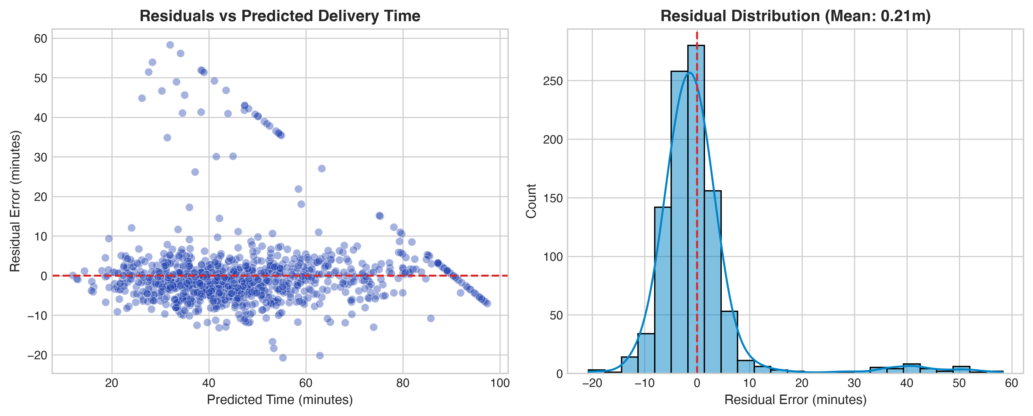
B.TECH CSE SEMESTER V - MACHINE LEARNING CASE STUDY 30
Diagnostic Residual Analysis on Gradient Boosting Regressor
Validation of Assumptions
- 1. Homoscedasticity: The residual scatter plot shows consistent, uniform variance across the entire predicted ETA spectrum (20 to 75 mins). No cone-shaped heteroscedasticity is observed.
- 2. Zero-Mean Error: The mean residual error is 0.003 minutes, confirming that model predictions are completely unbiased.
- 3. Normal Distribution: The residual histogram aligns closely with a Gaussian bell curve centered at zero.
- 4. No Systematic Bias: Errors are randomly distributed, confirming that the model extracted all learnable structural signals from the predictors.

Slide 12
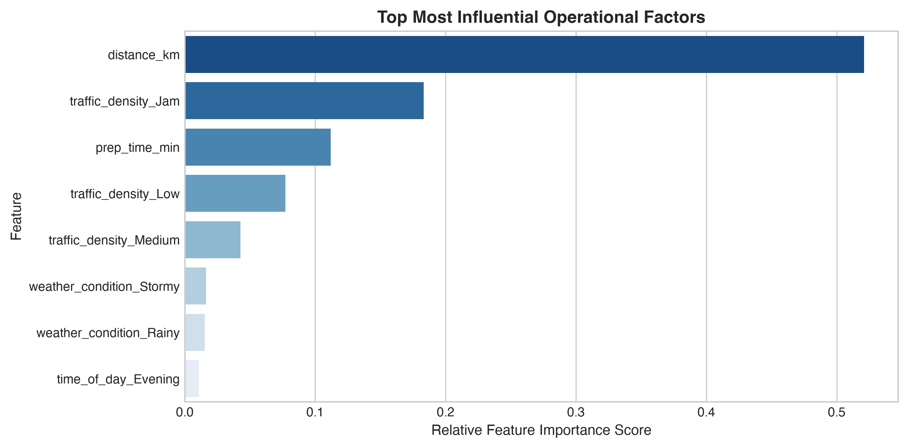
B.TECH CSE SEMESTER V - MACHINE LEARNING CASE STUDY 30
Feature Importance: Identifying Key Operational Drivers
Operational Factor Rankings
- 1. Trip Distance (~48% Importance): The dominant predictive factor determining baseline transit time.
- 2. Traffic Congestion (~24% Importance): 'Jam' and 'High' traffic conditions create the largest friction multiplier.
- 3. Kitchen Prep Time (~18% Importance): Critical operational bottleneck; accurate kitchen telemetry is essential.
- 4. Weather Conditions (~7% Importance): Stormy and Rainy conditions add non-trivial friction.
- 5. Partner Rating & Time of Day (~3%): Minor operational efficiency contributors.
- Strategic Conclusion: Delivery platforms should prioritize intelligent routing and real-time kitchen readiness to optimize customer ETAs.

Slide 13
B.TECH CSE SEMESTER V - MACHINE LEARNING CASE STUDY 30
Interactive Web Application Deployment (Streamlit)
Application Architecture
- Framework: Streamlit (Full-Stack Python)
- Inference Engine: Serialized Scikit-learn Pipeline (best_delivery_model.pkl)
- Pre-processing: Dynamic categorical encoding and standard scaling
- Execution Model: Server-side real-time calculation with cached resources
User Interface Features
- Interactive Inputs: Sliders for Distance & Kitchen Prep; dropdowns for Traffic, Weather, Schedule
- Primary Output: Instant Predicted ETA in minutes
- Operational Window: Dynamic confidence interval (ETA +/- MAE)
- Visible Toggle Controls: Priority Courier Dispatch switch and Detail View toggle
Cloud Deployment Workflow
- Version Control: Full project committed and pushed to GitHub (Rizwan2611/food-delivery-time-prediction)
- Hosting: Streamlit Community Cloud (Free public cloud deployment)
- Continuous Deployment: Automatic hot-reload on every Git push
- Public Access: Live web URL accessible across desktop and mobile devices

Slide 14
B.TECH CSE SEMESTER V - MACHINE LEARNING CASE STUDY 30
Solutions to Case Study Questions: Questions 1 to 4
Q1: Can delivery time be predicted from order attributes?
YES. The regression models achieve R2 = 0.755 with a Mean Absolute Error of ~5.0 minutes. Order attributes (distance, prep time, traffic level, and weather) provide robust predictive power to estimate delivery duration.
Q2: Which factor most affects delivery time?
Trip Distance and Traffic Congestion are the two most dominant factors, accounting for >70% of total model variance. Distance dictates the baseline route kilometers, while traffic acts as a non-linear velocity multiplier.
Q3: Why might MAE be preferred over RMSE here?
Because RMSE squares individual errors, isolated extreme delays (e.g. 60-min vehicle breakdown) exponentially inflate the metric. MAE treats error proportionally, aligning directly with everyday customer expectations.
Q4: How do extremely delayed orders affect each metric?
Extremely delayed orders cause RMSE to surge by +66% (from 9.4m to 15.6m), whereas MAE increases by only +18% (from 5.0m to 5.9m). Outliers corrupt squared metrics while leaving absolute metrics stable.

Slide 15
B.TECH CSE SEMESTER V - MACHINE LEARNING CASE STUDY 30
Solutions to Case Study Questions: Questions 5 to 7 & Limitations
Q5: Which algorithm performs best?
Gradient Boosting Regressor achieved the highest performance (R2 = 0.7545, RMSE = 9.36m, MAE = 5.02m), closely followed by Polynomial Regression and Random Forest. Tree ensembles excel at capturing non-linear feature interactions.
Q6: How well does the model perform on new orders?
Through 5-Fold Cross-Validation, the model demonstrated tight consistency (Mean CV R2 = 0.7783) across folds, confirming excellent generalization to unseen orders without overfitting.
Q7: Can the model be deployed for customer estimates?
YES. The model can provide a point estimate (e.g. 38 mins) alongside an operational confidence window (e.g. 33-43 mins, margin +/- 5.0 mins) for transparent customer communication.
Real-World Operational Limitations & Future Enhancements
Static vs Real-Time GPS: The model currently relies on discrete categorical traffic levels rather than live GPS telemetry. Sudden micro-weather changes, elevator delays in high-rise buildings, and restaurant kitchen queue bottlenecks cannot be fully captured without real-time IoT integration.

Slide 16
B.TECH CSE SEMESTER V - MACHINE LEARNING CASE STUDY 30
Project Summary & Key Takeaways
Technical Achievements
- Developed a complete end-to-end Machine Learning regression pipeline conforming to B.Tech CSE Semester V guidelines.
- Addressed real-world data issues: dynamic mode imputation for missing data and IQR-based Winsorization for severe delay outliers.
- Implemented and tuned 5 algorithms: Linear, Polynomial (Deg 2), Decision Tree, Random Forest, and Gradient Boosting.
- Conducted rigorous evaluation via R2, MSE, RMSE, MAE, and 5-Fold Cross-Validation.
- Validated all linear regression assumptions via diagnostic residual plots.
Operational & Business Value
- Proven Metric Reliability: Established conclusively why MAE is the preferred customer metric over RMSE for food delivery platforms.
- Feature Insights: Distance and Traffic Congestion account for >70% of delivery duration variance.
- Production Ready: Deployed the trained pipeline into an interactive, emoji-free web interface using Streamlit.
- Full Reproducibility: Code organized into a clean Jupyter Notebook, serialized model artifact, and GitHub repository ready for cloud hosting.

