Slide 1
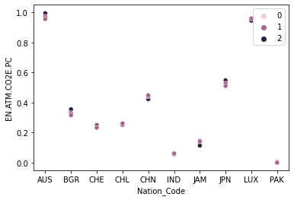
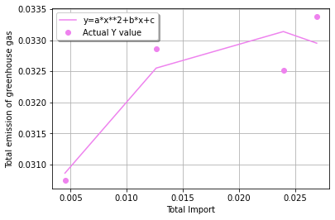
a
Relation Between Climate & Economic Indicators
Author: Rizwan Mustafa
Introduction
This target of this project is to assess the different climatic and economic indicators of a nation. The countries selected for this project are: Australia, Japan, Luxembourg, Switzerland, Pakistan, India, Chile, China, Jamaica and Bulgaria.
We would be performing clustering analysis on the dataset based on the Emissions of CO2 in a nation. The nations would be categorized into High, Medium and Low categories
The fitting of the data would be done using the curve fit function for nations which has been categorized as High, Medium and Low. The visualization would help us to understand the relationship between the Total Import and Total emission of greenhouse gas
Clustering and Fitting
The clustering picture in the right has segregated the nations based on the Emissions of CO2. Value 0 represents Low, 1 represents Medium and 2 represents High value
The curve fit function has been used for understanding the relationship between the Total Import and Total emission of greenhouse gas. The picture below represents the implementation of the curve fit function on Pakistan which has a Low Emissions of CO2
Figure: Clustering based on CO2 emissions
Conclusion
We have used three countries with high, medium and low values of Emissions of CO2 and we have observed that for countries with high and medium Emissions of CO2, the relationship between the Total Import and the Total emission of greenhouse gas is indirect. For the country with a low Emissions of CO2, the relationship between the Total Import and the Total emission of greenhouse gas is direct.
Figure: Curve Fit function on Pakistan with Low CO2 emissions
References
Pypi (2022). Wbgapi 1.0.7. Retrieved from https://pypi.org/project/wbgapi/
Repository Link: https://github.com/Rizwan354/ADS-Assignment-3

