Slide 1
Announcements
Lab 1 is due today, September 20
Homework 3 due Tuesday, September 25
Current Event Volunteer?
CS 484 – Artificial Intelligence

Slide 2
Game Playing
Lecture 7

Slide 3
Kinds of Games
Deterministic
Turn-taking
2-player
Zero-sum
Perfect information
CS 484 – Artificial Intelligence
Notes:
a move always has the same result
zero-sum – one player wins and the other must loose (or tie)
perfect information – all information available to players (unlike cards)
games are interesting because they are too hard to solve
chess: branching factor 35 and there will be about 50 moves (need to make some decisions)
inefficiency is plenalized

Slide 4
Game as Search Problem
Initial State: board position and player to move
Successor Function: returns a list of legal (move, state) pairs
Terminal Test: determines when the game is over
Utility function: Gives a numeric value for the terminal state
CS 484 – Artificial Intelligence
Notes:
chess utility = +1, 0, -1
backgammon utility = -192 to +192

Slide 5
Game Trees
Game trees are used to represent two-player games.
Alternate moves in the game are represented by alternate levels in the tree (plies).
Nodes in the tree represent positions.
Edges between nodes represent moves.
Leaf nodes represent won, lost or drawn positions.
CS 484 – Artificial Intelligence

Slide 6
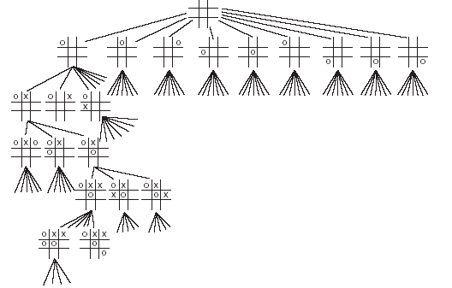
Game Trees
This is an example of a partial game tree for the game tic-tac-toe.
Even for this simple game, the game tree is very large.
CS 484 – Artificial Intelligence

Slide 7
Assumptions
In talking about game playing systems, we make a number of assumptions:
  The opponent is rational – will play to win.
  The game is zero-sum – if one player wins, the other loses.
  Usually, the two players have complete knowledge of the game. For games such as poker, this is clearly not true.
CS 484 – Artificial Intelligence
Notes:
deterministic, turn-taking, two-player, zero-sum games or perfect information

Slide 8
Minimax
Minimax is a method used to evaluate game trees.
A static evaluator is applied to leaf nodes, and values are passed back up the tree to determine the best score the computer can obtain against a rational opponent.
CS 484 – Artificial Intelligence

Slide 9
Minimax – Animated Example
Max
3
6
The computer can obtain 6 by choosing the right hand edge from the first node.
6
Min
5
3
Max
1
3
6
0
7
5
5
2
1
3
6
2
0
7
CS 484 – Artificial Intelligence

Slide 10
Minimax Function
MINIMAX-VALUE(n) =
  UTILITY(n) if n is a terminal state
  max_{s} _{∈ Successors(n)} MINIMAX-VALUE(s) if n is a MAX node
  min_{s} _{∈ Successors(n)} MINIMAX-VALUE(s) if n is a MIN node
CS 484 – Artificial Intelligence
Notes:
minimax performs complete depth-first search of tree O(b^m) where max depth of tree = m and b legal moves at each point
for real games this time cost is totally impractical

Slide 11
Searching Game Trees
Exhaustively searching a game tree is not usually a good idea.
Even for a game as simple as tic-tac-toe there are over 350,000 nodes in the complete game tree.
An additional problem is that the computer only gets to choose every other path through the tree – the opponent chooses the others.
CS 484 – Artificial Intelligence

Slide 12
Alpha-beta Pruning
A method that can often cut off a half the game tree.
Based on the idea that if a move is clearly bad, there is no need to follow the consequences of it.
alpha – highest value we have found so far
beta – lowest value we have found so far
CS 484 – Artificial Intelligence

Slide 13
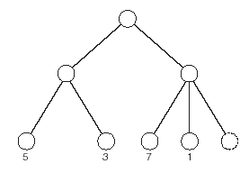
Alpha-beta Pruning – Example.
max
3
In this tree, having examined the nodes with values 7 and 1 there is no need to examine the final node.
min
CS 484 – Artificial Intelligence
Notes:
optimal time – O(b^(m/2)) instead of O(b^m)
branching factor goes from b to sqrt(b)
order of nodes matters
random order: O(b^(3m/4))
chess: order (capture first, then threats, then forward moves, then backward moves) gets within factor of 2 of best case
adding dynamic ordering – try moves that were best last time brings close to theoretical limit

Slide 14
Bounded Lookahead
For trees with high depth or very high branching factor, minimax cannot be applied to the entire tree.
In such cases, bounded lookahead is applied:
  search is cut off at specified depth
  static evaluator applied.
Horizon effect
CS 484 – Artificial Intelligence
Notes:
Must be applied carefully: In some positions a static evaluator will not take into account significant changes that are about to happen.

Slide 15
Static Evaluation Functions
A static evaluator assigns a score to a position:
  High positive = computer is winning
  Zero = even game
  High negative = opponent is winning
It is most important that a static evaluator will give a better score to a better position – the actual values are not so important.
CS 484 – Artificial Intelligence
Notes:
Since game trees are too large to be fully searched, it is important to have a function to statically evaluate a given position in the game.

Slide 16
Creating Evaluation Function
How likely are you to win from a given position?
Usually weighted linear functions
  Different scores are given to different position and added together in a weighted fashion
Possible chess function
  score = 9q + 5r + 3b + 3n + p
    q = # of queens, r = # of rooks, b = # of bishops, n = # of knights, and p = # of pawns
CS 484 – Artificial Intelligence

Slide 17
Checkers
In 1959, Arthur Samuel creates a computer program that could play checkers to a high level using minimax and alpha-beta pruning.
Chinook, developed in Canada defeated the world champion:
  Uses alpha-beta pruning.
  Has a database of millions of end games.
  Also has a database of openings.
  Uses heuristics and knowledge about the game.
CS 484 – Artificial Intelligence

Slide 18
Chess
In 1997, Deep Blue defeated world champion, Garry Kasparov.
This has not yet been repeated.
Current systems use parallel search, alpha-beta pruning, databases of openings and heuristics.
The deeper in a search tree the computer can search, the better it plays.
CS 484 – Artificial Intelligence

Slide 19
Go
Go is a complex game played on a 19x19 board.
Average branching factor in search tree around 360 (compared to 38 for chess).
The best computer programs cannot compete yet with the best human players.
Methods use pattern matching or selective search to explore the most appropriate parts of the search tree.
CS 484 – Artificial Intelligence

Slide 20
Games of Chance
The methods described so far do not work well with games of chance such as poker or backgammon.
Expectiminimax is a variant of minimax designed to deal with chance.
Nodes have expected values based on probabilities.
CS 484 – Artificial Intelligence

