Slide 1
Game Playing
Perfect decisions
Heuristically based decisions
Pruning search trees
Games involving chance

Slide 2
Differences from problem solving
Opponent makes own choices!
  Each choice that game playing agent makes depends on what response opponent makes
Playing quickly may be important – need a good way of approximating solutions and improving search

Slide 3
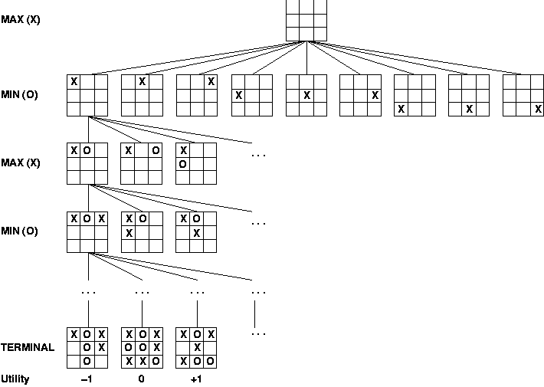
Starting point:
Look at entire tree

Slide 4
Minimax Decision
Assign a utility value to each possible ending
Assures best possible ending, assuming opponent also plays perfectly
  opponent tries to give you worst possible ending
Depth-first search tree traversal that updates utility values as it recurses back up the tree

Slide 5
Simple game for example:
Minimax decision
MAX (player)
MIN
(opponent)
3
12
8
2
4
6
14
5
2

Slide 6
Simple game for example:
Minimax decision
3
MAX (player)
MIN
(opponent)
3
2
2
3
12
8
2
4
6
14
5
2

Slide 7
Properties of Minimax
Time complexity
  O(b^{m})
Space complexity
  O(bm)
Same complexity as depth-first search
For chess, b ~ 35, m ~ 100 for a “reasonable” game
  completely intractable!

Slide 8
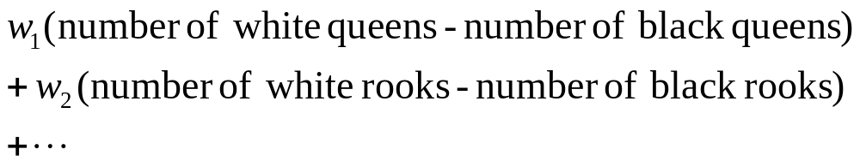
So what can you do?
Cutoff search early and apply a heuristic evaluation function
  Evaluation function can represent point values to pieces, board position, and/or other characteristics
  Evaluation function represents in some sense “probability” of winning
  In practice, evaluation function is often a weighted sum

Slide 9
How do you cutoff search?
Most straightforward: depth limit
  ... or even iterative deepening
Bad in some cases
  What if just beyond depth limit, catastrophic move happens?
  One fix: only apply evaluation function to quiescent moves, i.e. unlikely to have wild swings in evaluation function
    Example: no pieces about to be captured
Horizon problem
  One piece running away from another, but must ultimately be lost
  No generally good solution currently

Slide 10
How much lookahead for chess?
Ply = half-move
Human novice: 4 ply
Typical PC, human master: 8 ply
Deep Blue, Kasparov: 12 ply
But if b=35, m = 12:
Time ~ O(b^{m}) = 35¹² ~ 3.4 x 10¹²
Need to cut this down

Slide 11
Alpha-Beta Pruning: Example
MAX (player)
MIN
(opponent)
3
12
8
2

Slide 12
Alpha-Beta Pruning: Example
3
MAX (player)
Stop right here when
evaluating this node:
opponent takes
minimum of these nodes,
player will take maximum
of nodes above
MIN
(opponent)
3
3
12
8
2

Slide 13
Alpha-Beta Pruning: Concept
If m > n, Player would
choose the m-node to
get a guaranteed utility
of at least m
n-node would never be
reached, stop evaluation
m
n

Slide 14
Alpha-Beta Pruning: Concept
If m < n, Opponent would
choose the m-node to
get a guaranteed utility
of at m
n-node would never be
reached, stop evaluation
m
n

Slide 15
The Alpha and the Beta
For a leaf, α = β = utility
At a max node:
  α = largest child utility found so far
  β = β of parent
At a min node:
  α = α of parent
  β = smallest child utility found so far
For any node:
  α <= utility <= β
  “If I had to decide now, it would be...”

Slide 16
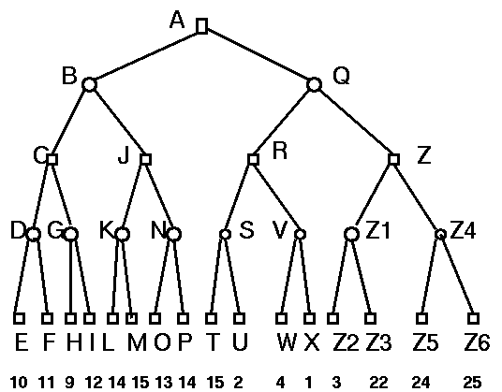
A: α = -inf, β = inf
B: α = -inf, β = inf
C: α = -inf,
β = inf
D: α = -inf,
β = inf
E: α = 10,
β = 10
utility = 10
Originally from http://yoda.cis.temple.edu:8080/UGAIWWW/lectures95/search/alpha-beta.html

Slide 17
A: α = -inf, β = inf
B: α = -inf, β = inf
C: α = -inf,
β = inf
D: α = -inf,
β = 10
E: α = 10,
β = 10
Originally from http://yoda.cis.temple.edu:8080/UGAIWWW/lectures95/search/alpha-beta.html

Slide 18
A: α = -inf, β = inf
B: α = -inf, β = inf
C: α = -inf,
β = inf
D: α = -inf,
β = 10
F: α = 11,
β = 11
Originally from http://yoda.cis.temple.edu:8080/UGAIWWW/lectures95/search/alpha-beta.html

Slide 19
A: α = -inf, β = inf
B: α = -inf, β = inf
C: α = -inf,
β = inf
D: α = -inf,
β = 10
utility = 10
F: α = 11,
β = 11
utility = 11
Originally from http://yoda.cis.temple.edu:8080/UGAIWWW/lectures95/search/alpha-beta.html

Slide 20
A: α = -inf, β = inf
B: α = -inf, β = inf
C: α = 10,
β = inf
D: α = -inf,
β = 10
utility = 10
Originally from http://yoda.cis.temple.edu:8080/UGAIWWW/lectures95/search/alpha-beta.html

Slide 21
A: α = -inf, β = inf
B: α = -inf, β = inf
C: α = 10,
β = inf
G: α = 10,
β = inf
Originally from http://yoda.cis.temple.edu:8080/UGAIWWW/lectures95/search/alpha-beta.html

Slide 22
A: α = -inf, β = inf
B: α = -inf, β = inf
C: α = 10,
β = inf
G: α = 10,
β = inf
H: α = 9,
β = 9
utility = 9
Originally from http://yoda.cis.temple.edu:8080/UGAIWWW/lectures95/search/alpha-beta.html

Slide 23
A: α = -inf, β = inf
B: α = -inf, β = inf
C: α = 10,
β = inf
G: α = 10,
β = 9
utility = ?
H: α = 9,
β = 9
At an opponent node, with α > β : Stop here and backtrack (never visit I)
Originally from http://yoda.cis.temple.edu:8080/UGAIWWW/lectures95/search/alpha-beta.html

Slide 24
A: α = -inf, β = inf
B: α = -inf, β = inf
C: α = 10,
β = inf
utility = 10
G: α = 10,
β = 9
utility = ?
Originally from http://yoda.cis.temple.edu:8080/UGAIWWW/lectures95/search/alpha-beta.html

Slide 25
A: α = -inf, β = inf
B: α = -inf, β = 10
C: α = 10,
β = inf
utility = 10
Originally from http://yoda.cis.temple.edu:8080/UGAIWWW/lectures95/search/alpha-beta.html

Slide 26
A: α = -inf, β = inf
B: α = -inf, β = 10
J: α = -inf,
β = 10
... and so on!
Originally from http://yoda.cis.temple.edu:8080/UGAIWWW/lectures95/search/alpha-beta.html

Slide 27
How effective is alpha-beta in practice?
Pruning does not affect final result
With some extra heuristics (good move ordering):
  Branching factor becomes b^{1/2}
  35 → 6
  Can look ahead twice as far for same cost
  Can easily reach depth 8 and play good chess

Slide 28
Determinstic games today
Checkers: Chinook ended 40­year­reign of human world champion Marion Tinsley in 1994. Used an endgame database defining perfect play for all positions involving 8 or fewer pieces on the board, a total of 443,748,401,247 positions.
Othello: human champions refuse to compete against computers, who are too good.
Go: human champions refuse to compete against computers, who are too bad. In go, b > 300, so most programs use pattern knowledge bases to suggest plausible moves.

Slide 29
Deterministic games today
Chess: Deep Blue defeated human world champion Gary Kasparov in a six­game match in 1997. Deep Blue searches 200 million positions per second, uses very sophisticated evaluation, and undisclosed methods for extending some lines of search up to 40 ply.

Slide 30
More on Deep Blue
Garry Kasparov, world champ, beat IBM’s Deep Blue in 1996
In 1997, played a rematch
  Game 1: Kasparov won
  Game 2: Kasparov resigned when he could have had a draw
  Game 3: Draw
  Game 4: Draw
  Game 5: Draw
  Game 6: Kasparov makes some bad mistakes, resigns
Info from http://www.mark-weeks.com/chess/97dk$$.htm

Slide 31
Kasparov said...
“Unfortunately, I based my preparation for this match ... on the conventional wisdom of what would constitute good anti-computer strategy.
Conventional wisdom is -- or was until the end of this match -- to avoid early confrontations, play a slow game, try to out-maneuver the machine, force positional mistakes, and then, when the climax comes, not lose your concentration and not make any tactical mistakes.
It was my bad luck that this strategy worked perfectly in Game 1 -- but never again for the rest of the match. By the middle of the match, I found myself unprepared for what turned out to be a totally new kind of intellectual challenge.
http://www.cs.vu.nl/~aske/db.html

Slide 32
Some technical details on Deep Blue
32-node IBM RS/6000 supercomputer
Each node has a Power Two Super Chip (P2SC) Processor and 8 specialized chess processors
  Total of 256 chess processors working in parallel
  Could calculate 60 billion moves in 3 minutes
Evaluation function (tuned via neural networks) considers
  material: how much pieces are worth
  position: how many safe squares can pieces attack
  king safety: some measure of king safety
  tempo: have you accomplished little while opponent has gotten better position?
Written in C under AIX Operating System
  Uses MPI to pass messages between nodes
http://www.research.ibm.com/deepblue/meet/html/d.3.3a.html

Slide 33
Alpha-Beta Pruning:
Coding It
(defun max-value (state, alpha, beta)
(let ((node-value 0))
(if (cutoff-test state) (evaluate state)
(dolist (new-state (neighbors state) nil)
(setf node-value
(min-value new-state alpha beta))
(setf alpha (max alpha node-value))
(if (>= alpha beta) (return beta)))
alpha)))

Slide 34
Alpha-Beta Pruning:
Coding It
(defun min-value (state, alpha, beta)
(let ((node-value 0))
(if (cutoff-test state) (evaluate state)
(dolist (new-state (neighbors state) nil)
(setf node-value
(max-value new-state alpha beta))
(setf beta (min beta node-value))
(if (<= beta alpha) (return alpha)))
beta)))

Slide 35
Nondeterminstic Games
Games with an element of chance (e.g., dice, drawing cards) like backgammon, Risk, RoboRally, Magic, etc.
Add chance nodes to tree

Slide 36
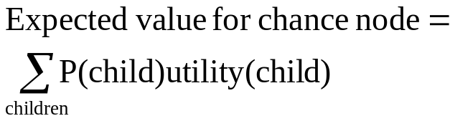
Example with coin flip instead of dice (simple)
0.5
0.5
0.5
0.5
2
4
7
4
6
0
5
-2

Slide 37
Example with coin flip instead of dice (simple)
3
3
-1
0.5
0.5
0.5
0.5
2
4
0
-2
2
4
7
4
6
0
5
-2

Slide 38
Expectimax Methodology
For each chance node, determine expected value
Evaluation function should be linear with value, otherwise expected value calculations are wrong
  Evaluation should be linearly proportional to expected payoff
Complexity: O(b^{m}n^{m}), where n=number of random states (distinct dice rolls)
Alpha-beta pruning can be done
  Requires a bounded evaluation function
  Need to calculate upper / lower bounds on utilities
  Less effective

Slide 39
Real World
Most gaming systems start with these concepts, then apply various hacks and tricks to get around computability problems
Databases of stored game configurations
Learning (coming up next): Chapter 18

