Slide 1

FUZZY SYSTEMS
Fuzzy Inference: Fuzzy Associative Matrix

Slide 2
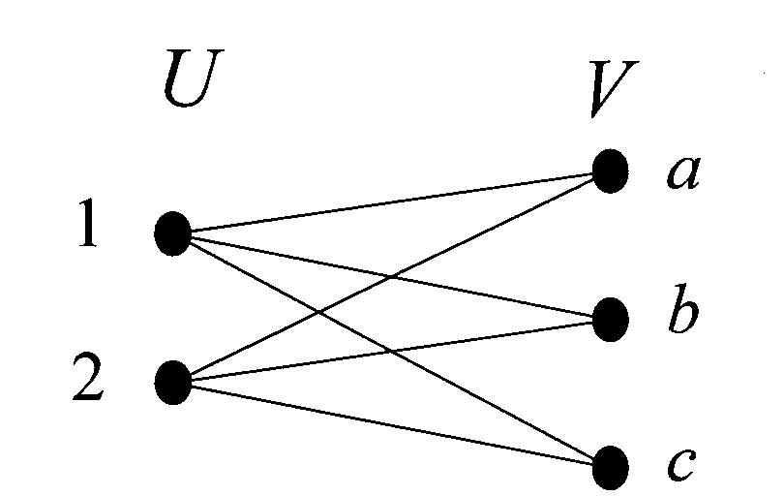
FUZZY SYSTEMS
Fuzzy Relations
Classical relation between two universes
U = {1, 2} and V = {a, b, c} is defined as:
a b c
R = U x V = 1 1 1 1
2 1 1 1

Slide 3
FUZZY SYSTEMS
Fuzzy Relations
Fuzzy relation between two universes U and V is defined as:
µ_{R} (u, v) = µ_{AxB} (u, v) = min [µ_{A} (u), µ_{B} (v)]
i.e. we take the minimum of the memberships of the two elements which are to be related

Slide 4
FUZZY SYSTEMS
Fuzzy Relations
Example:
Determine fuzzy relation between A₁ and A₂
A₁ = 0.2/x₁ + 0.9/x₂
A₂ = 0.3/y₁ + 0.5/y₂ + 1/y₃

Slide 5
FUZZY SYSTEMS
Fuzzy Relations
R = μ_{R}(A₁, A₂)
= 0.2 0.2 0.2
0.3 0.5 0.9
A₂
a₂₃
_{(1.0)}
0.2
a₂₂
_{(0.5)}
0.9
0.2
0.5
a₂₁
_{(0.3)}
0.2
0.3
a₁₁
_{(0.2)}
a₁₂
_{(0.9)}
A₁

Slide 6
FUZZY SYSTEMS
Fuzzy Relations
Example: The fuzzy relation R is
R = A₁ x A₂ = 0.2 x 0.3 0.5 1
0.9
= min(0.2, 0.3) min(0.2, 0.5) min(0.2, 1)
min(0.9, 0.3) min(0.9, 0.5) min(0.9, 1)
= 0.2 0.2 0.2
0.3 0.5 0.9

Slide 7
FUZZY SYSTEMS
Fuzzy Rules
Relates two or more fuzzy propositions
If X is A then Y is B
e.g. if height is tall then weight is heavy
X and Y are fuzzy variables
A and B are fuzzy sets

Slide 8
FUZZY SYSTEMS
Fuzzy Associative Matrix
So for the fuzzy rule:
If X is A then Y is B
We can define a matrix M_{(nxp)} which relates A to B
M = A x B
It maps fuzzy set A to fuzzy set B and is used in the fuzzy inference process

Slide 9
FUZZY SYSTEMS
Fuzzy Associative Matrix
Concept behind M
a1 → b1 a1 → b2 …
a2 → b1 …
.
.
.
If a1 is true then b1 is true; and so on

Slide 10
FUZZY SYSTEMS
Fuzzy Inference: Composition Operator,
Max-min Inference

Slide 11
FUZZY SYSTEMS
Composition of Fuzzy Relations
Let there be three universes U, V and W
Let R be the relation that relates elements from U to V
e.g. R = 0.6 0.8
0.7 0.9
And let S be the relation between V and W
e.g. S = 0.3 0.1
0.2 0.8

Slide 12
FUZZY SYSTEMS
Composition of Fuzzy Relations
With the help of an operation called “composition” we can find the relation T that maps elements of U to W
By max-min rule T = R ° S = max_{v∈V} { min(μ_{R}(u, v), μ_{S}(v, w)) }
0.6 0.8 0.3 0.1 = 0.3 0.8
0.7 0.9 ° 0.2 0.8 0.3 0.8
Where
element (1,1) is obtained by max{min(0.6, 0.3), min(0.8, 0.2)}
= 0.3
Note that S ° R = 0.3 0.3 ≠ R ° S
0.7 0.8

Slide 13
FUZZY SYSTEMS
Example:
If Temperature is normal then Speed is medium
Let A = [0/100, 0.5/125, 1/150, 0.5/175, 0/200]
B = [0/10, 0.6/20, 1/30, 0.6/40, 0/50]
M = 0 0 0 0 0
0 0.5 0.5 0.5 0
0 0.6 1 0.6 0
0 0.5 0.5 0.5 0
0 0 0 0 0

Slide 14
FUZZY SYSTEMS
Max-Min Inference
Let Temperature = 125 ºF = A_{current}
Then it may be thought of as a new fuzzy set defined over the universe of discourse of variable Temperature
A_{current} = [0/100, 0.5/125, 0/150, 0/175, 0/200]
We can find the relationship (i.e. mapping or FAM) between A_{current} and A as
A’ = A_{current} x A = 0 x [0 0.5 1 0.5 0]
0.5
0 = [0 0.5 0.5 0.5 0]
0 (if we eliminate all 0 rows)
0

Slide 15
FUZZY SYSTEMS
Max-Min Inference
Now the composition of A’ and M will produce a new relationship, which we call B’
A’ ° M = B’
0 0 0 0 0
0 0.5 0.5 0.5 0
[0 0.5 0.5 0.5 0] ° 0 0.6 1.0 0.6 0 = [0 0.5 0.5 0.5 0]
0 0.5 0.5 0.5 0
0 0 0 0 0

Slide 16
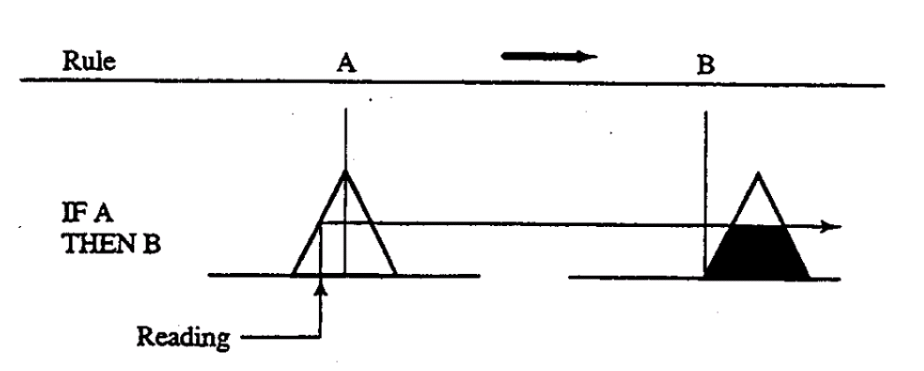
FUZZY SYSTEMS
Max-Min Inference
Max-min inference

Slide 17
FUZZY SYSTEMS
Multi-Premises Rules
If A ∧ B then C
C_{A}’ = A’ ° M_{AC}
C_{B}’ = B’ ° M_{BC}
C’ = C_{A}’ ∧ C_{B}’ = min(μ_{CA’} , μ_{CB’})
C_{B’}
C_{A’}
C_{B’}
C_{A’}

Slide 18
FUZZY SYSTEMS
Multi-Premises Rules
If A ∨ B then C
C’ = C_{A}’ ∨ C_{B}’
= max(μ_{CA’} , μ_{CB’})
C_{B’}
C_{B’}
C_{A’}
C_{A’}

Slide 19
FUZZY SYSTEMS
Multiple Fuzzy Rules
In a regular rule-based system, if two rules are simultaneously satisfied, a conflict resolution policy decides the precedence
The system proceeds sequentially, with one rule firing at a time
In fuzzy rule based systems, all rules are executed during each pass through the system

Slide 20
FUZZY SYSTEMS
Fuzzy Inference: Combining Multiple Rules

Slide 21
FUZZY SYSTEMS
Multiple Fuzzy Rules
In Fuzzy systems many rules may have non zero values because, contrary to Crisp systems where a condition is either true or false; many conditions may have some some membership value close to zero, but not zero
Example:
If temperature is normal or pressure is low then velocity is medium
If temperature is normal and pressure is normal then velocity is low

Slide 22
FUZZY SYSTEMS
Multiple Fuzzy Rules
A given value of temperature may have some membership in the normal-temperature fuzzy sets. A given value of pressure may have some membership in both low-pressure and normal-pressure fuzzy sets
Hence a fuzzy set for medium velocity and another for low velocity will be inferred
This can be combined as:
C’ = C₁’ ∨ C₂’ ∨ C₃’ …
= max{C₁’(x), C₂’(x), C₃’(x), …} for all x ∈ X,
where X = domain of C

Slide 23
FUZZY SYSTEMS
Multiple Fuzzy Rules

Slide 24
FUZZY SYSTEMS
Multiple Fuzzy Rules

Slide 25
FUZZY SYSTEMS
Fuzzy Inference: Defuzzification

Slide 26
FUZZY SYSTEMS
Defuzzification
In most applications we need to obtain a crisp value after inferring a fuzzy set B’
The most popular defuzzification technique used is the
fuzzy centroid method

Slide 27
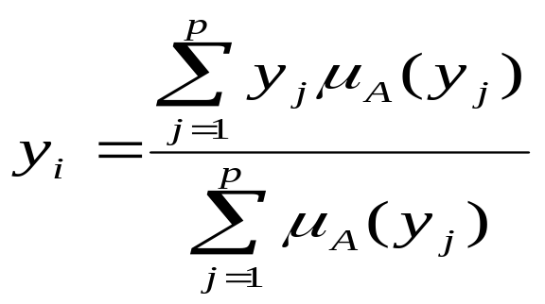
FUZZY SYSTEMS
Defuzzification
Fuzzy Centroid Method
Let B’ = [0/10, 0.3/20, 0.5/30, 0.3/40, 0/50]
then y = 10*0 + 20*0.3 + 30*0.5 + 40*0.3 + 50*0
0 + 0.3 + 0.5 + 0.3 + 0
= 6 + 15 + 12 = 33/1.1 = 30
1.1

Slide 28
FUZZY SYSTEMS
References
Engelbrecht Chapter 18 & 20

