Slide 1

FUZZY SYSTEMS
Fuzzy Expert Systems

Slide 2
FUZZY SYSTEMS
Fuzzy Expert System
Steps involved in designing a Fuzzy Expert System
1. Define the problem
2. Define linguistic variables
3. Define fuzzy sets
4. Define fuzzy rules
5. Build the system
6. Test the system
7. Tune the system

Slide 3
FUZZY SYSTEMS
Fuzzy Washing Machine
Step 1: Define the Problem We consider only one control variable: the operating time of the machine for each given load of clothes
In conventional washing machine, the time of each run is set by the user, which may be over or under the ideal time

Slide 4
FUZZY SYSTEMS
Fuzzy Washing Machine
Step 2: Define Variables
The operating time is supposed to depend on two input properties:
how dirty the clothes are, and
what type of dirtiness is present

Slide 5
FUZZY SYSTEMS
Fuzzy Washing Machine
The degree of dirtiness is measured by a special sensor via the degree of water transparency.
The less transparent the water, the dirtier the clothes

Slide 6
FUZZY SYSTEMS
Fuzzy Washing Machine
The type of dirtiness is determined by measuring the time needed, after the machine has started, to reach a state in which the water transparency remains virtually constant.
This time, called saturation time, is different for different types of dirtiness.
For example, it is shorter for muddy clothes than for oily clothes

Slide 7
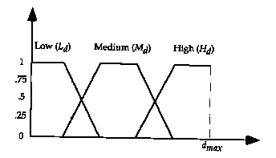
FUZZY SYSTEMS
Fuzzy Washing Machine
Step 3: Define Fuzzy Sets
Assume that the degree of dirtiness, d, is expressed by a number in the interval [0, d_{max}]
Assume further that we define three fuzzy sets on this interval: high, medium, low (levels of dirtiness)

Slide 8
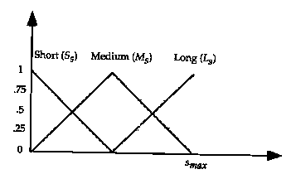
FUZZY SYSTEMS
Fuzzy Washing Machine
Assume now that the saturation time, s, is expressed by a number in the interval [0, s_{max}]
Here also we define three sets: short, medium and long

Slide 9
FUZZY SYSTEMS
Fuzzy Washing Machine
The required washing time is in the interval [0, t_{max}]
Five fuzzy sets: very short, short, medium, long, very long

Slide 10
FUZZY SYSTEMS
Fuzzy Washing Machine
Step 4: Define Fuzzy Rules
We can now express knowledge of experienced users of washing machines by conditional fuzzy propositions (fuzzy rules) of the form
If Dirtiness = x and Soil = xx, then Time = xxx
Where appropriate states of the three linguistic variables are placed in the place of xs
Since Dirtiness and Soil have three states each, therefore the total possible rules are 9

Slide 11
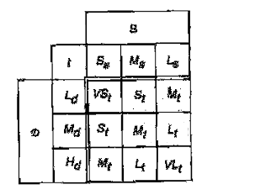
FUZZY SYSTEMS
Fuzzy Washing Machine
Suppose that we have defined the following rules
(represented graphically in the matrix)

Slide 12
FUZZY SYSTEMS
Fuzzy Washing Machine
Step 5: Build the System
The rules are stored as fuzzy associations

Slide 13
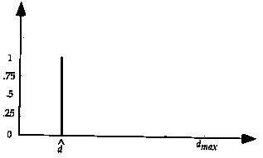
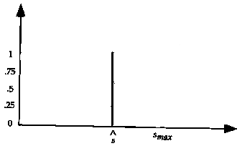
FUZZY SYSTEMS
Fuzzy Washing Machine
Step 6: Test the System
Specific measured values of D and S are received by the controller, at some pre-defined time

Slide 14
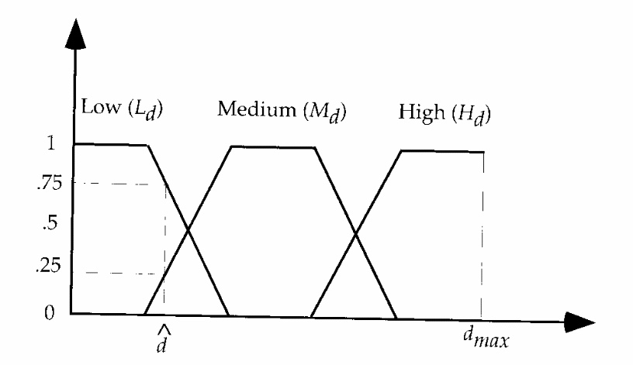
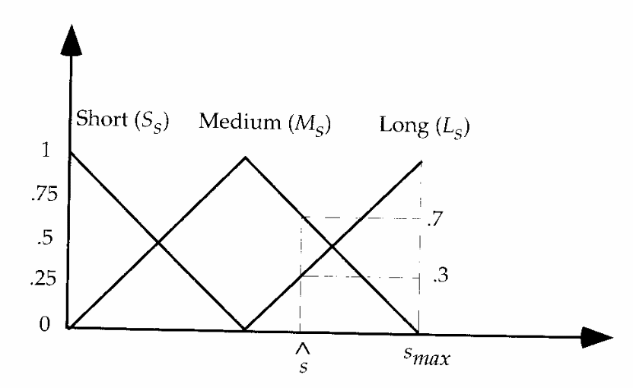
FUZZY SYSTEMS
Fuzzy Washing Machine
The measured d^ is compatible with low D, medium D and high D to the degrees 0.75, 0.25, 0, respectively
Similarly, the measured value s^ is compatible with short S, medium S and long S to the degrees of 0, 0.7, 0.3 respectively

Slide 15

FUZZY SYSTEMS
Fuzzy Washing Machine
Either we take only those rules which have all non-zero antecedents, otherwise they will themselves get zero during calculations
Four rules are fired in our
example (shown by circles)

Slide 16
FUZZY SYSTEMS
Fuzzy Washing Machine
Fuzzy Inference

Slide 17
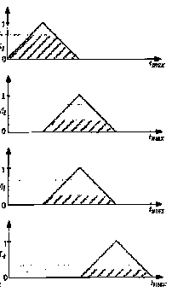
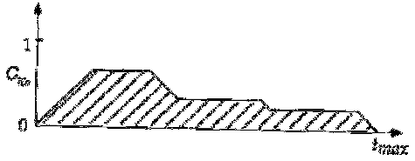
FUZZY SYSTEMS
Fuzzy Washing Machine
Given conclusions obtained by the individual fuzzy inference rules, we obtain the overall conclusion by taking the union of all the individual conclusions

Slide 18
FUZZY SYSTEMS
Fuzzy Washing Machine
Defuzzification
Its purpose is to convert the fuzzy set representing the overall conclusion into a real number that, in some sense, best represents the fuzzy sets
The washing timer
is set to this value

Slide 19
FUZZY SYSTEMS
Fuzzy Washing Machine
Step 7: Tune the System
The shape of the fuzzy set(s) and their quantity is modified if the output values are below expectations

Slide 20
FUZZY SYSTEMS
References
Engelbrecht Chapter 18, 19 & 20
Scan of Fuzzy Washing Machine on Folder

