Slide 1
Artificial Intelligence
CS 401
Genetic Programming
Dr. Kashif Zafar
FAST-NU

Slide 2
GENETIC PROGRAMMING
Introduction
Genetic Programming can be viewed as a specialization of genetic algorithms
The main difference between the two is in the representation scheme used
Where GAs use string representations, GP represents individuals as executable programs (represented as trees)
The aim of the GP is to evolve computer programs

Slide 3
GENETIC PROGRAMMING
Introduction
The general Genetic Algorithm also applies to GP
The differences between the two approaches are mainly in the representation scheme, fitness evaluation, cross-over operators and mutation operators

Slide 4
GENETIC PROGRAMMING
Chromosome Representation
Each individual, or chromosome, represents one computer program, represented using a tree structure
For this purpose we need to define two sets: a terminal set and a function set
The terminal set specifies all the variables and constants
The function set contains all the functions that can be applied to the elements of the terminal set. These functions may include mathematical, arithmetic and/or Boolean functions. Decision structures such as if-then-else can also be included

Slide 5
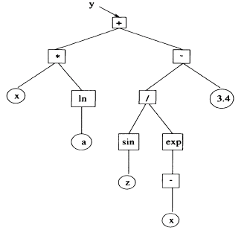
GENETIC PROGRAMMING
Chromosome Representation
Using tree terminology, elements of the terminal set form the leaf nodes of the evolved tree, and elements of the function set form the non-leaf nodes
Example:
Terminal set is {a, x, z, 3.4}
Minimal function set is
{-, +, *, /, sin, exp, ln}
The optimum solution is illustrated in the figure

Slide 6
GENETIC PROGRAMMING
Chromosome Representation
Each individual in a GP population represents a program, which is an element of the program space formed by all possible programs that can result from the given grammar (as defined by the terminal and function sets)
The aim of the GP is then to search for a program within the program space that gives the best approximation to the objective (the true) program

Slide 7
GENETIC PROGRAMMING
Chromosome Representation
Trees within a population are of variable size, however sometimes fixed size trees are also used
A restriction on maximum depth is usually placed

Slide 8
GENETIC PROGRAMMING
Initial Population
The initial population is generated randomly within the restrictions of a maximum depth and semantics as expressed by the given grammar
For each individual, a root is randomly selected from the set of function elements

Slide 9
GENETIC PROGRAMMING
Initial Population
For each non-root node, the initialization algorithm randomly selects an element either from the terminal set or the function set
As soon as an element from the terminal set is selected, the corresponding node becomes a leaf node and is no longer considered for expansion

Slide 10
GENETIC PROGRAMMING
Fitness Function
Fitness function used for GP is problem dependent
As an example, assume we have no prior knowledge about the structure of the program, other than the given terminal and function sets
In addition, a data set is available, consisting of a number of data patterns, where each data pattern consists of input values for each of the variables and a target value

Slide 11
GENETIC PROGRAMMING
Fitness Function
The evaluation of each individual program (chromosome) entails
Calculating the output of that individual given the values of inputs
Calculating the error made
At the end, the mean-square-error (MSE) over the given data set is a valid quantification of the fitness of that individual

Slide 12
GENETIC PROGRAMMING
Selection Operators
Any of the selection operators used in GAs can also be used here

Slide 13
GENETIC PROGRAMMING
Crossover Operator
One or two offspring can be created by selecting a node randomly in each of the two parents
The corresponding sub-trees are swapped to create the two offspring
If one offspring is desired, then a sub-tree of one of the parents is replaced by a sub-tree of another parent

Slide 14
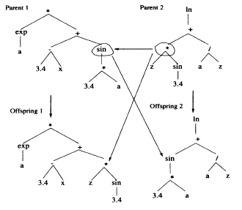
GENETIC PROGRAMMING
Crossover Operator

Slide 15
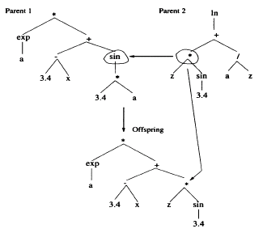
GENETIC PROGRAMMING
Crossover Operator

Slide 16
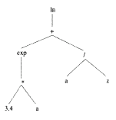
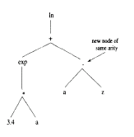
GENETIC PROGRAMMING
Mutation Operators
Several mutation operators have been developed for the GP
Function node mutation: A function node is randomly selected and replaced with a node of the same arity, randomly selected from the function set

Slide 17
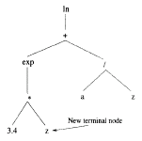
GENETIC PROGRAMMING
Mutation Operator
Terminal node mutation: A randomly selected terminal node is replaced with a new terminal node randomly selected from the terminal set

Slide 18
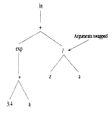
GENETIC PROGRAMMING
Mutation Operator
Swap mutation: A function node is randomly selected and the arguments of that node are swapped

Slide 19
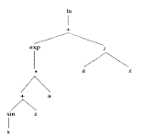
GENETIC PROGRAMMING
Mutation Operator
Grow mutation: A node is randomly selected and replaced by a randomly generated sub-tree. The new sub-tree is restricted by a predetermined depth

Slide 20
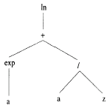
GENETIC PROGRAMMING
Mutation Operator
Trunc mutation: A function node is randomly selected and replaced by a random terminal node. This effectively performs a pruning of the tree

Slide 21
GENETIC PROGRAMMING
Mutation Operator
Individuals to be mutated are selected according to a mutation probability p_{m}
Nodes within the selected tree are mutated according to a probability p_{n}
The larger the probability p_{n}, the more the genetic build-up of that individual is changed
The larger the mutation probability p_{m}, the more individuals will be mutated

Slide 22
GENETIC PROGRAMMING
References
Engelbrecht Chapter 8 & 9

