Slide 1
Artificial Intelligence – CS 401
Clustering – III
(Hierarchical Clustering Approach)
Lecture No. 22
November 12, 2018

Slide 2


Supervised learning
Training set:

Slide 3
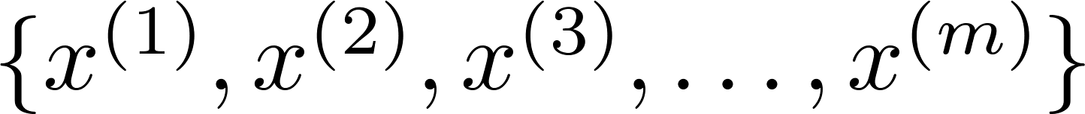
Unsupervised learning
Training set:

Slide 4


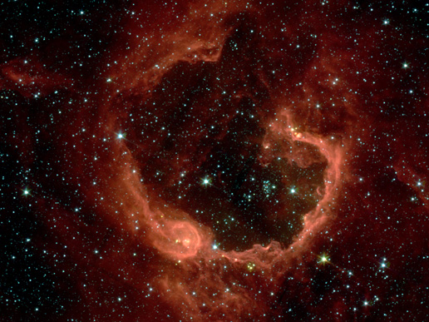
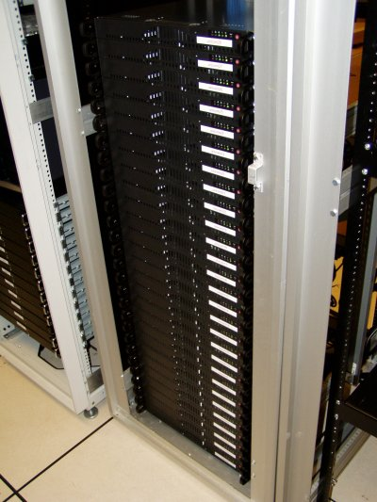
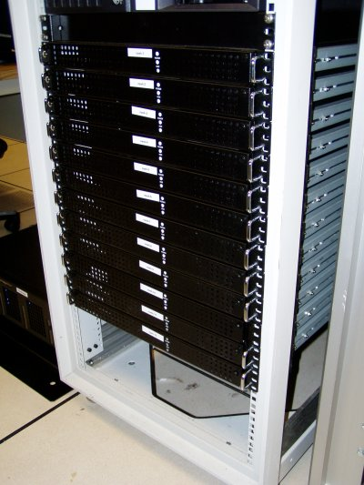
Applications of clustering
Market segmentation
Social network analysis
Image credit: NASA/JPL-Caltech/E. Churchwell (Univ. of Wisconsin, Madison)
Organize computing clusters
Astronomical data analysis
Notes:
Swap: market seg and organize clusters

Slide 5
K-means Algorithm
Clustering

Slide 6
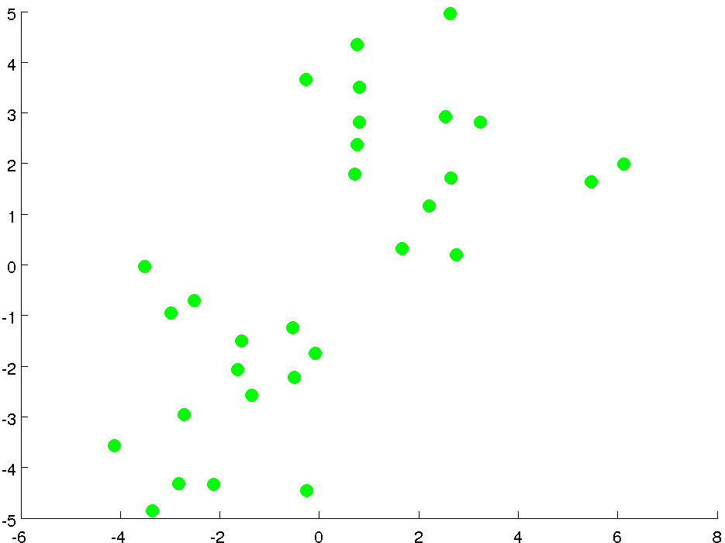

Slide 7
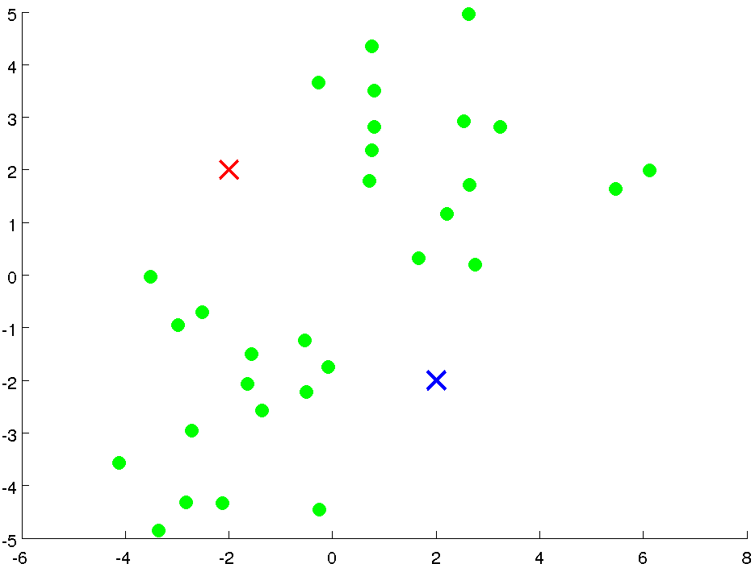

Slide 8
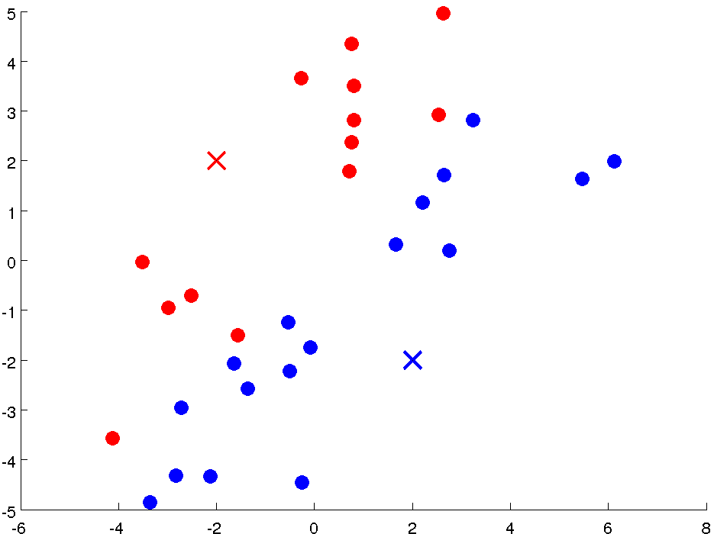

Slide 9
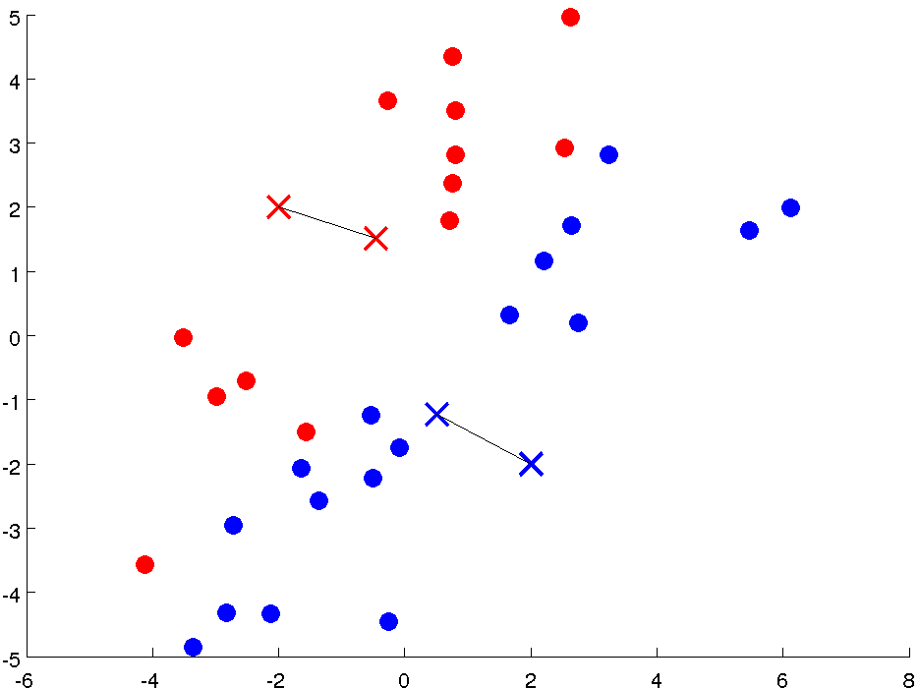

Slide 10
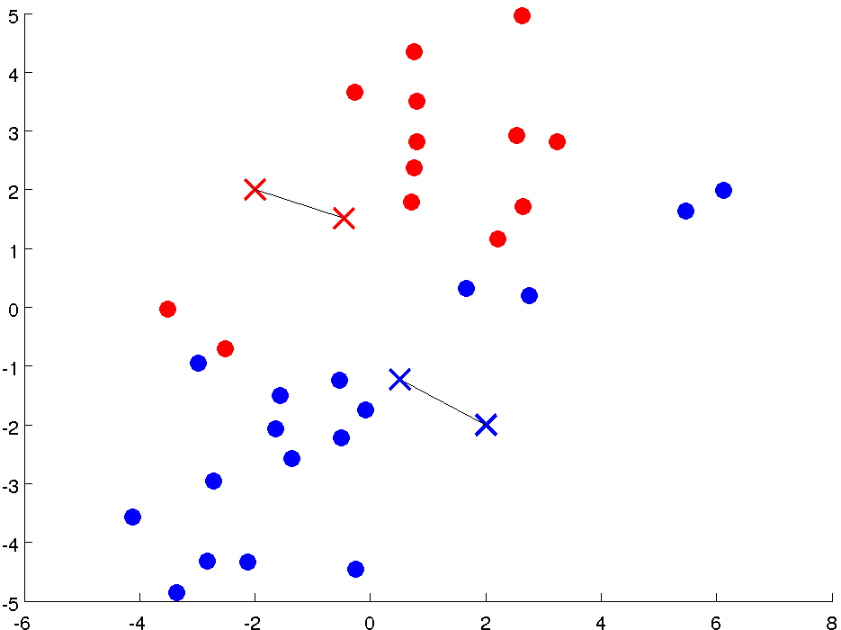

Slide 11
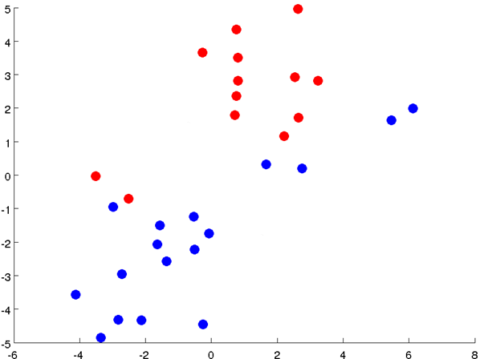

Slide 12
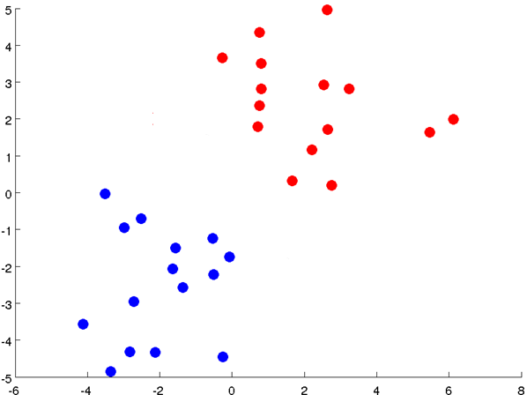

Slide 13
Notes:
Get rid of the legacy points

Slide 14
Notes:
Get rid of the legacy points

Slide 15

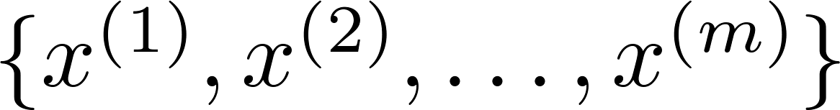
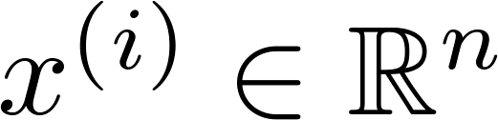

K-means algorithm
Input:
(number of clusters)
Training set
(drop convention)

Slide 16

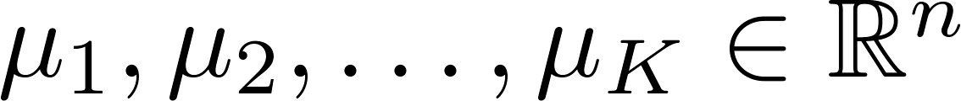



K-means algorithm
Randomly initialize cluster centroids
Repeat {
for = 1 to
:= index (from 1 to ) of cluster centroid
closest to
for = 1 to
:= average (mean) of points assigned to cluster
}
Notes:
Replace with normal text, size with LATEX fonts

Slide 17
K-means for non-separated clusters
T-shirt sizing
Weight
Height

Slide 18
Optimization Objective
Clustering

Slide 19



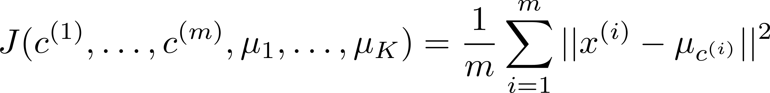
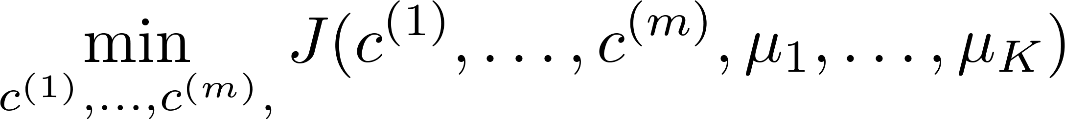

K-means optimization objective
= index of cluster (1,2,…, ) to which example is currently assigned
= cluster centroid ( )
= cluster centroid of cluster to which example has been assigned
Optimization objective:
Notes:
Change numbers to LATEX as well

Slide 20


K-means algorithm
Randomly initialize cluster centroids
Repeat {
for = 1 to
:= index (from 1 to ) of cluster centroid
closest to
for = 1 to
:= average (mean) of points assigned to cluster
}
Notes:
Replace as previous; change spacing to fill page

Slide 21
Random Initialization
Clustering

Slide 22
K-means algorithm
Randomly initialize cluster centroids
Repeat {
for = 1 to
:= index (from 1 to ) of cluster centroid
closest to
for = 1 to
:= average (mean) of points assigned to cluster
}
Notes:
Replace as previous; change spacing to fill page

Slide 23


Random initialization
Should have
Randomly pick training
examples.
Set equal to these
examples.
Notes:
LATEX font

Slide 24
Local optima

Slide 25
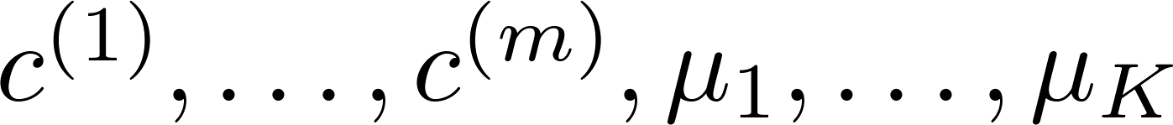
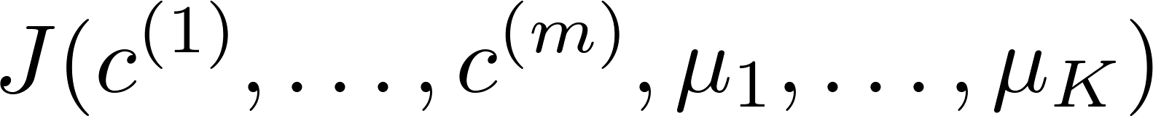
Random initialization
For i = 1 to 100 {
Randomly initialize K-means.
Run K-means. Get .
Compute cost function (distortion)
}
Pick clustering that gave lowest cost

Slide 26
Choosing the number of clusters
Clustering

Slide 27
What is the right value of K?

Slide 28

Choosing the value of K
Elbow method:
Cost function
Cost function
(no. of clusters)
(no. of clusters)

Slide 29
Choosing the value of K
Sometimes, you’re running K-means to get clusters to use for some later/downstream purpose. Evaluate K-means based on a metric for how well it performs for that later purpose.
E.g.
T-shirt sizing
T-shirt sizing
Weight
Weight
Height
Height

Slide 30
Hierarchical and Ensemble Clustering
By Ke Chen

Slide 31
Outline
Introduction
Cluster Distance Measures
Agglomerative Algorithm
Example and Demo
Key Concepts in Hierarchal Clustering
Clustering Ensemble via Evidence Accumulation
Summary

Slide 32
Introduction
Hierarchical Clustering Approach
A typical clustering analysis approach via partitioning data set sequentially
Construct nested partitions layer by layer via grouping objects into a tree of clusters (without the need to know the number of clusters in advance)
Use (generalised) distance matrix as clustering criteria
Agglomerative vs. Divisive
Agglomerative: a bottom-up strategy
Initially each data object is in its own (atomic) cluster
Then merge these atomic clusters into larger and larger clusters
Divisive: a top-down strategy
Initially all objects are in one single cluster
Then the cluster is subdivided into smaller and smaller clusters
Clustering Ensemble
Using multiple clustering results for robustness and overcoming weaknesses of single clustering algorithms.

Slide 33
Introduction: Illustration
Illustrative Example: Agglomerative vs. Divisive
Agglomerative and divisive clustering on the data set {a, b, c, d ,e }
Step 0
Step 1
Step 2
Step 3
Step 4
Agglomerative
a
a b
Cluster distance
Termination condition
b
a b c d e
c
c d e
d
d e
e
Divisive
Step 4
Step 3
Step 2
Step 1
Step 0

Slide 34
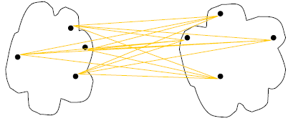
Cluster Distance Measures
Single link: smallest distance between an element in one cluster and an element in the other, i.e., d(C_{i}, C_{j}) = min{d(x_{ip}, x_{jq})}
Complete link: largest distance between an element in one cluster and an element in the other, i.e., d(C_{i}, C_{j}) = max{d(x_{ip}, x_{jq})}
Average: avg distance between elements in one cluster and elements in the other, i.e.,
d(C_{i}, C_{j}) = avg{d(x_{ip}, x_{jq})}
single link
(min)
complete link
(max)
average
d(C, C)=0
Notes:
Define D(C, C)=0, the distance between two exactly same clusters is ZERO!

Slide 35
Cluster Distance Measures
Example: Given a data set of five objects characterized by a single continuous feature, assume that there are two clusters: C1: {a, b} and C2: {c, d, e}.
1. Calculate the distance matrix . 2. Calculate three cluster distances between C1 and C2.
 | a | b | c | d | e
Feature | 1 | 2 | 4 | 5 | 6
 | a | b | c | d | e
a | 0 | 1 | 3 | 4 | 5
b | 1 | 0 | 2 | 3 | 4
c | 3 | 2 | 0 | 1 | 2
d | 4 | 3 | 1 | 0 | 1
e | 5 | 4 | 2 | 1 | 0
Single link
Complete link
Average
Notes:
For distance matrix, single feature regardless of p: (|x-y|^p)^(1/p)=|x-y|, x, y scalar!

Slide 36
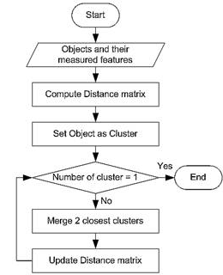
Agglomerative Algorithm
The Agglomerative algorithm is carried out in three steps:
Convert all object features into a distance matrix
Set each object as a cluster (thus if we have N objects, we will have N clusters at the beginning)
Repeat until number of cluster is one (or known # of clusters)
Merge two closest clusters
Update “distance matrix”

Slide 37
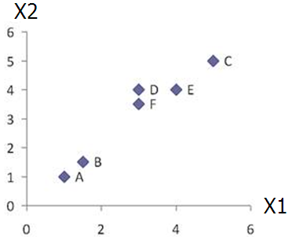
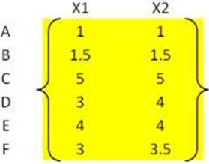
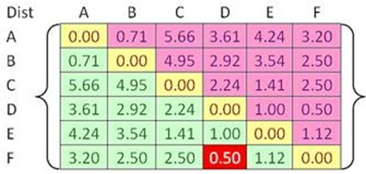


Example
Problem: clustering analysis with agglomerative algorithm
data matrix
Euclidean distance
distance matrix

Slide 38
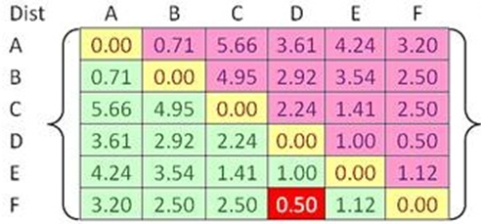
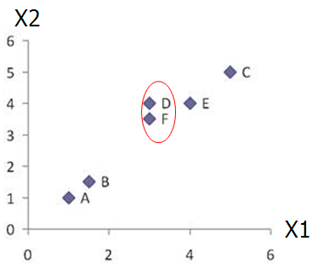
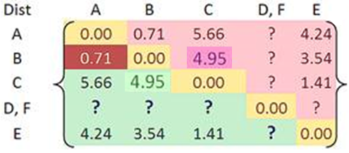

Example
Merge two closest clusters (iteration 1)

Slide 39
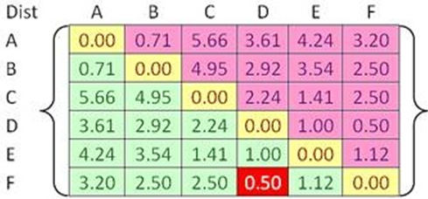

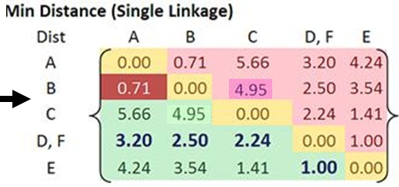
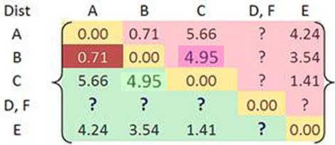
Example
Update distance matrix (iteration 1)

Slide 40
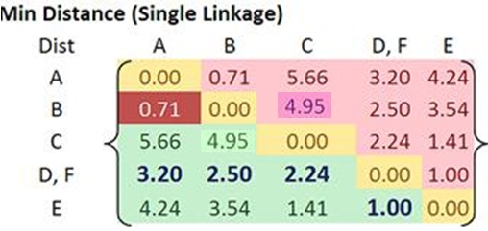
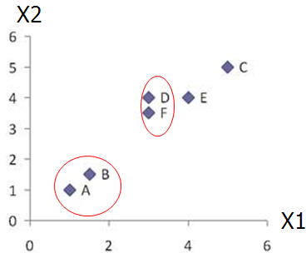
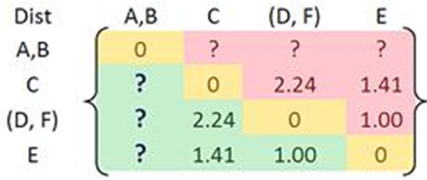
Example
Merge two closest clusters (iteration 2)

Slide 41
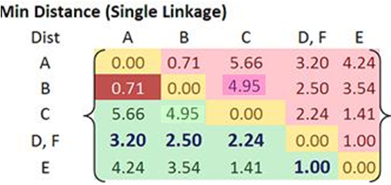
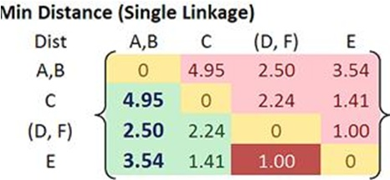

Example
Update distance matrix (iteration 2)

Slide 42
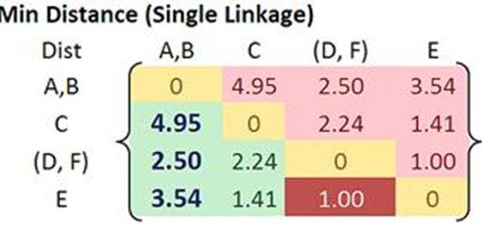
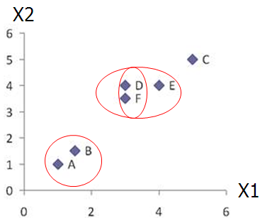
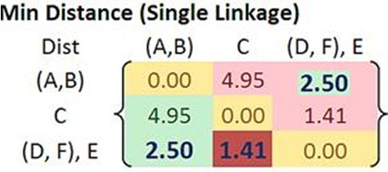

Example
Merge two closest clusters/update distance matrix (iteration 3)

Slide 43
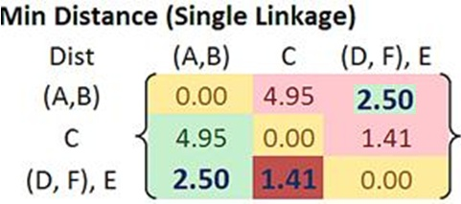
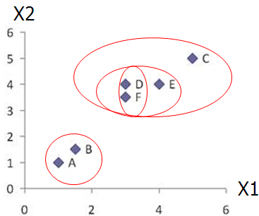
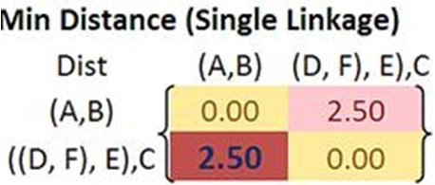

Example
Merge two closest clusters/update distance matrix (iteration 4)

Slide 44
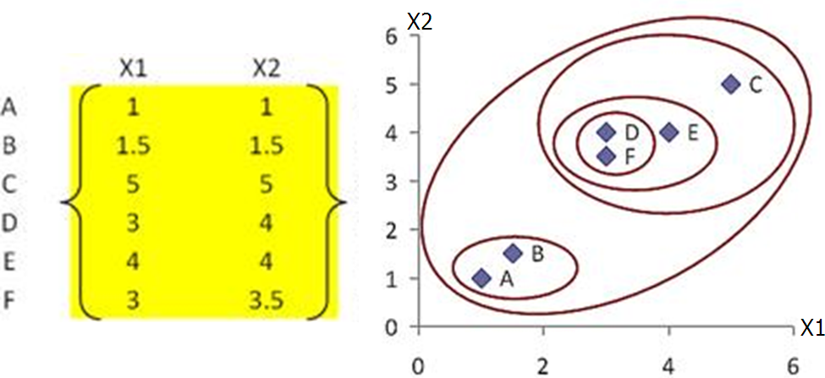
Example
Final result (meeting termination condition)

Slide 45
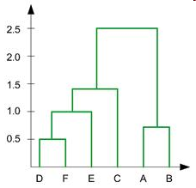
Key Concepts in Hierarchal Clustering
Dendrogram tree representation
In the beginning we have 6
clusters: A, B, C, D, E and F
We merge clusters D and F into
cluster (D, F) at distance 0.50
We merge cluster A and cluster B
into (A, B) at distance 0.71
We merge clusters E and (D, F)
into ((D, F), E) at distance 1.00
We merge clusters ((D, F), E) and C
into (((D, F), E), C) at distance 1.41
We merge clusters (((D, F), E), C)
and (A, B) into ((((D, F), E), C), (A, B))
at distance 2.50
The last cluster contain all the objects,
thus conclude the computation
6
lifetime
5
4
3
2
object
Notes:
For a dendrogram tree, its horizontal axis indexes all objects in a given data set, while its vertical axis expresses the lifetime of all possible cluster formation.
The lifetime of a cluster (individual cluster) in the dendrogram is defined as a distance interval from the moment that the cluster is created to the moment that it disappears by merging with other clusters.

Slide 46
Key Concepts in Hierarchal Clustering
Lifetime vs K-cluster Lifetime
Lifetime
The distance between that a cluster is created and that it disappears (merges with other clusters during clustering).
e.g. lifetime of A, B, C, D, E and F are 0.71, 0.71, 1.41,
0.50, 1.00 and 0.50, respectively, the life time of (A, B) is
2.50 – 0.71 = 1.79, ……
K-cluster Lifetime
The distance from that K clusters emerge to that K clusters
vanish (due to the reduction to K-1 clusters).
e.g.
5-cluster lifetime is 0.71 - 0.50 = 0.21
4-cluster lifetime is 1.00 - 0.71 = 0.29
3-cluster lifetime is 1.41 – 1.00 = 0.41
2-cluster lifetime is 2.50 – 1.41 = 1.09
6
lifetime
5
4
3
2
object
Notes:
Emphasize the difference between individual cluster lifetime and K-cluster lifetime!

Slide 47
Relevant Issues
How to determine the number of clusters
If the number of clusters known, termination condition is given!
The K-cluster lifetime as the range of threshold value on the dendrogram tree
that leads to the identification of K clusters
Heuristic rule: cut a dendrogram tree with maximum life time to find a “proper” K
Major weakness of agglomerative clustering methods
Can never undo what was done previously
Sensitive to cluster distance measures and noise/outliers
Less efficient: O (n² logn), where n is the number of total objects
There are several variants to overcome its weaknesses
BIRCH: scalable to a large data set
ROCK: clustering categorical data
CHAMELEON: hierarchical clustering using dynamic modelling

Slide 48
Summary
Hierarchical algorithm is a sequential clustering algorithm
Use distance matrix to construct a tree of clusters (dendrogram)
Hierarchical representation without the need of knowing # of clusters (can set termination condition with known # of clusters)
Major weakness of agglomerative clustering methods
Can never undo what was done previously
Sensitive to cluster distance measures and noise/outliers
Less efficient: O (n² logn), where n is the number of total objects
Online tutorial: how to use hierarchical clustering functions in Matlab:
https://www.youtube.com/watch?v=aYzjenNNOcc

