Slide 1
Multi Agent Systems II
Autonomous Agents
Dr. Kashif Zafar
FAST-NU

Slide 2
Readings
Chapter 2 from AI, a modern approach Russell & Norvig
Multi-agent systems, a modern approach to Distributed AI edited by Gerhard Weiss

Slide 3
Why study intelligent agents?
When a space probe is returning to earth, any runtime decision by crew can be extremely costly and simply not practical
Searching internet for a specific query can be long and tedious process, why not allow an agent to handle it? Information filtering and gathering
e-Commerce and electronic markets, where buyer and seller agents buy and sell on behalf of users
Real-time monitoring of telecom networks e.g. for call forwarding and transmission
Modeling and optimization of in-house in-town or national/world wide transportation systems or goods transportation

Slide 4
Cont’d
Solving complex distributed problem e.g. urban traffic
Automated meeting scheduling where agents act on behalf of users
Optimization of industrial manufacturing and production processes like shop floor scheduling or supply chain management
VR based games
Design and re-engineering of information and control flow in large scale natural, technical and hybrid organizations
Social aspects of intelligence
Notes:
Virtual reality

Slide 5
Ideas common to all problems
Inherent distribution
  Spatial: Arise at different geographical locations
  Temporal: Arise at different times
  Semantic: Structured in clusters which require familiarity with different ontologies and languages
  Functional: Structured in clusters which require different perceptual, effectual and cognitive capabilities
Inherent complexity
  Too large to solve by a single centralized system
  Too difficult or time consuming and costly.
  Would result in brittle solutions which become useless as soon as requirement change.

Slide 6
What is an agent?
An agent is anything that can be viewed as perceiving its environment through sensors and acting upon that environment through actuators.
Is a human an agent?
Yes
Is a robot an agent?
Yes
Is a software service an agent?
Yes
Is a car an agent?
Depends upon what we consider as sensors or how advanced we make the car.

Slide 7
Types of agents
Software agent: An autonomous process capable of reacting to, and initiating changes in, its environment, possibly in collaboration with users and other agents.
Collaborative agent: Agent that forms part of a multi-agent system, where agents can either seek a common goal through collaboration.
Mobile agents: An agent having capability to move between machines.
Interface agents: Agents which assist an end user in the use of one or more applications. (Generally has learning capabilities)
Information agents: Agents which manage information from various sources e.g. filtering, ordering etc.
etc.

Slide 8
But . . .
If all of these are agents, then which ones are we interested in?
We are (in this course) interested in autonomous/intelligent agents (i.e. Division in terms of their relevance to AI)
However these agents can be e.g. mobile, collaborative or competitive and so on.

Slide 9
Definitions
Environment: Different for different kinds of agents
Percepts: Input to the agent e.g. information from our 5 (or 6) senses.
Actuators: The means by which an agent acts on the environment
Percept sequence: Example of the human being.

Slide 10
Rational agents
Definition: An agent which does the right thing. (Or tries to do the right thing?)
Question: How do we define the right thing?
Answer: Apart from Philosophically different point of views prevalent for humans, we need to have a good performance measure for our agents.

Slide 11
A vacuum world agent
Let us see what an extremely simple vacuum world agent would behave like:
It would have a percept sequence as e.g.:

Slide 12
Cont’d
Let’s say its world only has 2 locations A and B
A, Clean, Action: Right
A, Dirty, Action: Suck
B, Clean, Action: Left
B, Dirty, Action: Suck
. . .

Slide 13
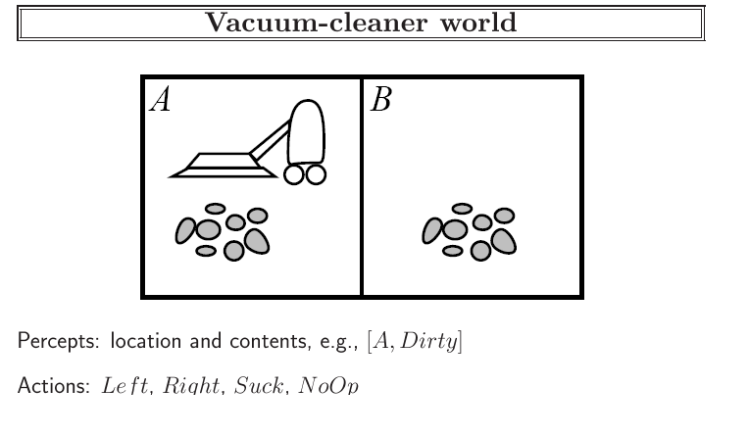

Slide 14
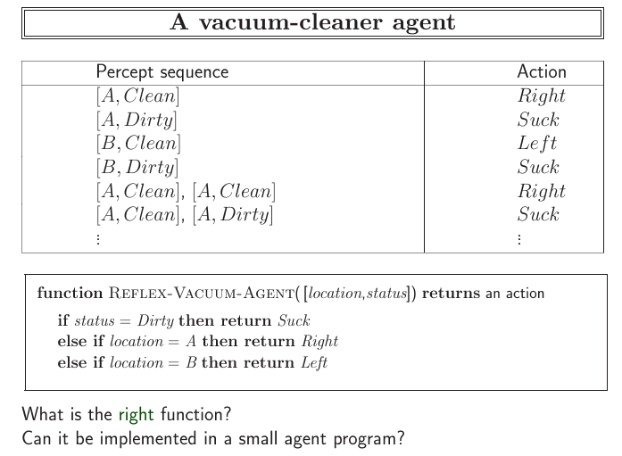

Slide 15
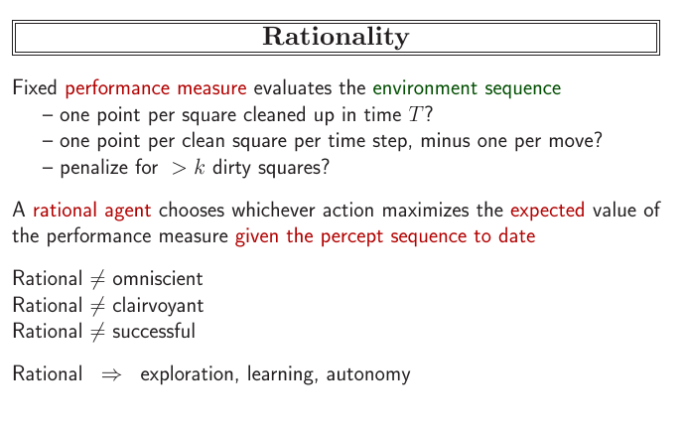

Slide 16
What is rationality?
What is rational at any given time depends on 4 things:
The performance measure that defines the criterion of success
The agent’s previous knowledge of the environment
The actions that an agent can perform
The agent’s percept sequence to date

Slide 17
Finally, a definition of a rational agent
For each possible percept sequence, a rational agent should select an action that is expected to maximize its performance measure, given the evidence provided by the percept sequence and whatever built-in knowledge the agent has.

Slide 18
e.g. For the vacuum world agent
Let us assume, the performance measure is to award one point for each clean square at each time step, over a life time of 1000 steps.
We know the geography in advance but the dirt situation and the agent location is not known.
Clean square stay clean and sucking cleans the current square
Only available actions are left, right, suck and no op.
Agent correctly perceives its location and whether that location contains dust.

Slide 19
Task environments
PEAS
Performance
Environment
Actuators
Sensors

Slide 20
PEAS for a taxi driver
Agent type:
Taxi driver
Performance measure:
Safe, fast, legal, comfortable trip, maximize points
Environment:
Roads, other traffic, pedestrians, customers
Actuators:
Steering, accelerator, brake, signal, horn, display
Sensors:
Cameras, sonar, speedometer, GPS, odometer, accelerometer, engine sensors, keyboard etc.

Slide 21
Properties of task environments
Fully observable (If sensors give access to the complete environment) vs partially observable
Deterministic (Completely determined by the current state) vs Stochastic
Episodic (If agent’s experience is divided in atomic episodes) vs sequential
Static vs Dynamic
Discrete (e.g. discrete states such as chess game with finite distinct states) vs Continuous (taxi)
Single vs multiagent (Chess would be a competitive multiagent vs taxi driving is a mix of competitive and cooperative multiagent)

Slide 22
Structure of agents
The goal would be to design an agent program which implements the agent function mapping percepts to actions.
We assume that the program will run on some sort of computing device with physical sensors and actuators. This is called the architecture
Agent = Architecture + program

Slide 23
Agent structure cont’d
If the program is going to recommend actions like Walk then the architecture better have legs.
It could be an ordinary PC or a robotic car with a ton of onboard computers, cameras and other sensors.
So, in general the architecture makes the percepts available to the percepts from the sensors available to the program, runs the program and feeds the program’s choices to the actuators as they are generated.

Slide 24
Software Agents in Distributed Systems
Property | Common to all agents? | Description
Autonomous | Yes | Can act on its own
Reactive | Yes | Responds timely to changes in its environment
Proactive | Yes | Initiates actions that affects its environment
Communicative | Yes | Can exchange information with users and other agents
Continuous | No | Has a relatively long lifespan
Mobile | No | Can migrate from one site to another
Adaptive | No | Capable of learning
Some important properties by which different types of agents can be distinguished.

Slide 25
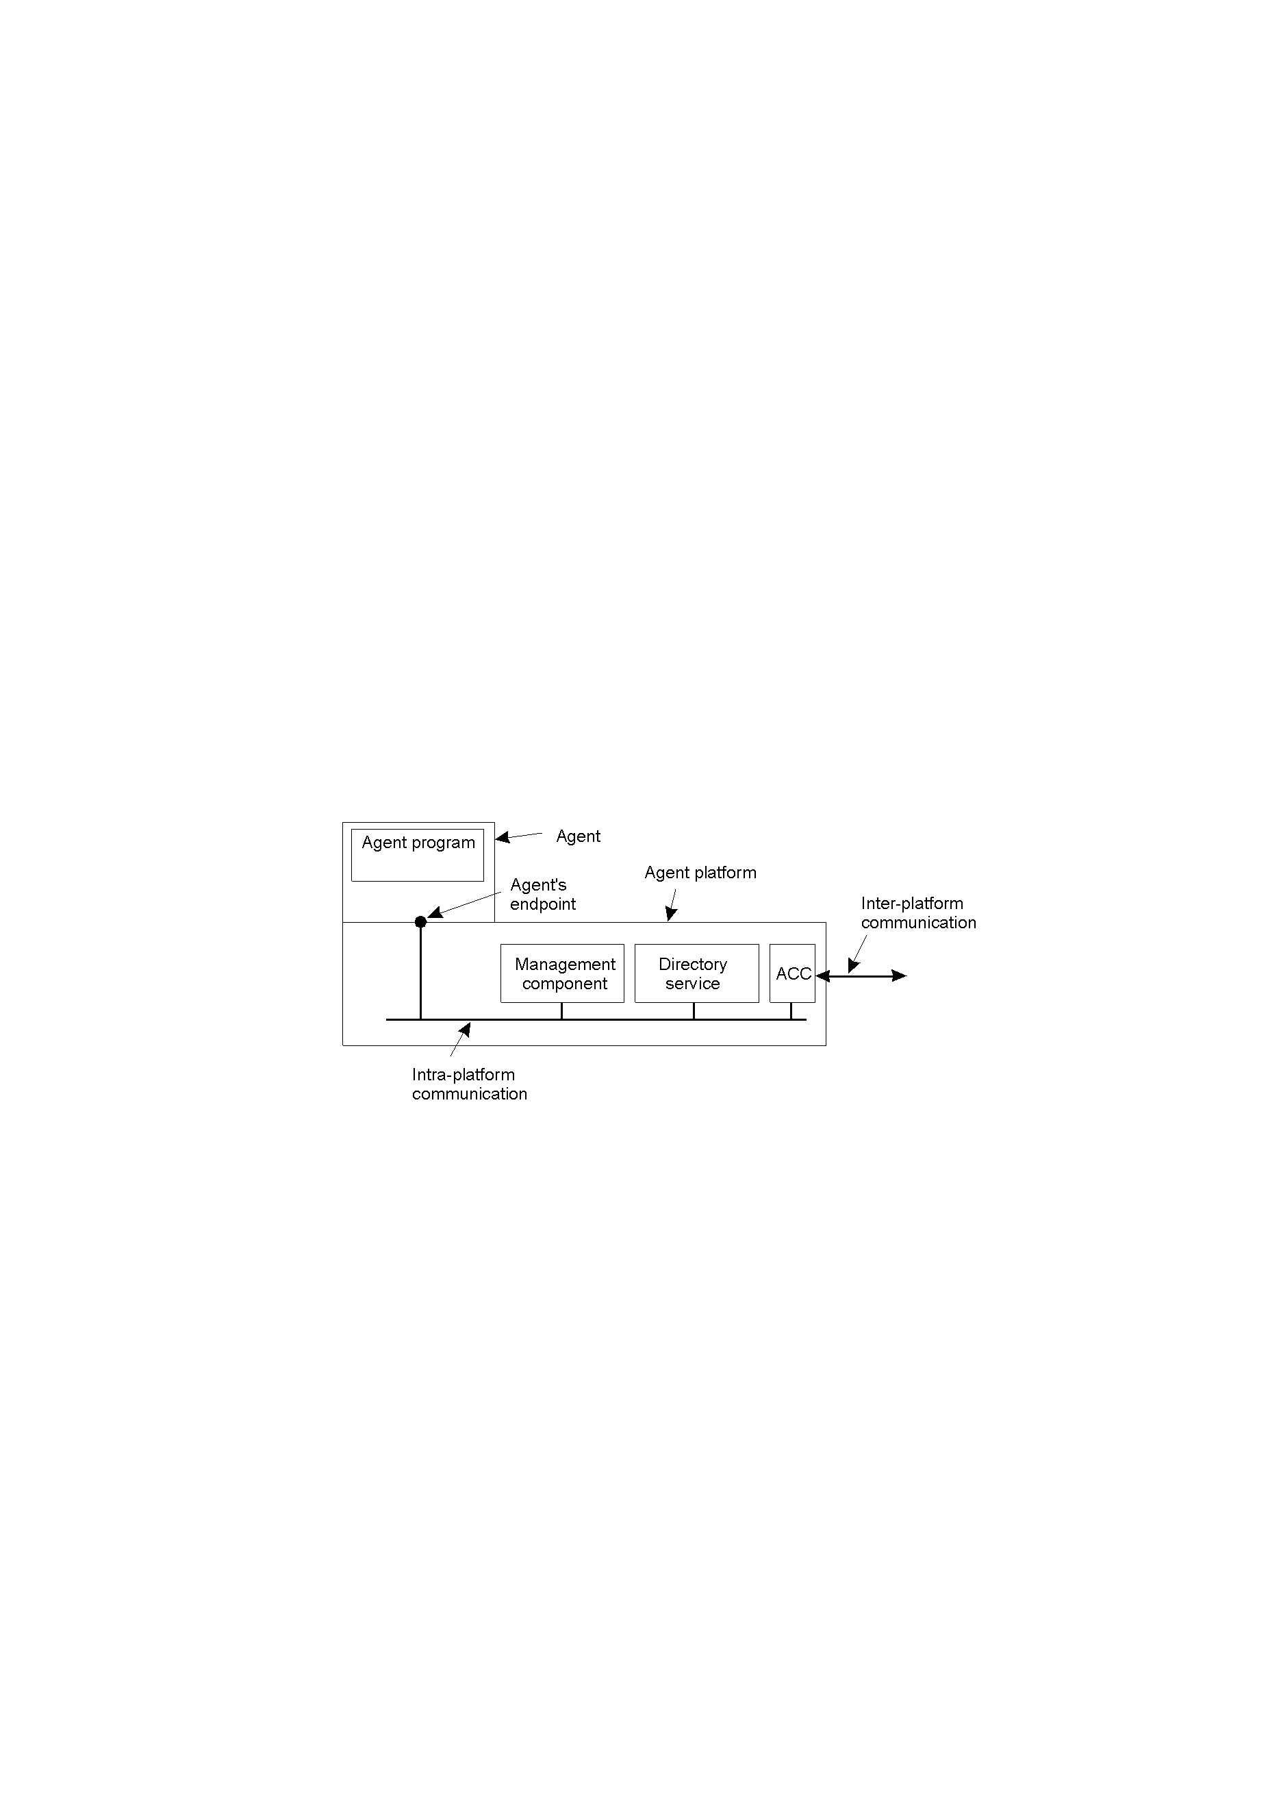
Agent Technology
The general model of an agent platform (adapted from [fipa98-mgt]).
General model of an agent platform (FIPA Foundation for Intelligent Physical Agents)
ACC is Agent Communication Channel

Slide 26
Agent Communication Languages (1)
Examples of different message types in the FIPA ACL [fipa98-acl], giving the purpose of a message, along with the description of the actual message content.
Message purpose | Description | Message Content
INFORM | Inform that a given proposition is true | Proposition
QUERY-IF | Query whether a given proposition is true | Proposition
QUERY-REF | Query for a give object | Expression
CFP | Ask for a proposal | Proposal specifics
PROPOSE | Provide a proposal | Proposal
ACCEPT-PROPOSAL | Tell that a given proposal is accepted | Proposal ID
REJECT-PROPOSAL | Tell that a given proposal is rejected | Proposal ID
REQUEST | Request that an action be performed | Action specification
SUBSCRIBE | Subscribe to an information source | Reference to source

Slide 27
Agent Communication Languages (2)
Field | Value
Purpose | INFORM
Sender | max@http://fanclub-beatrix.royalty-spotters.nl:7239
Receiver | elke@iiop://royalty-watcher.uk:5623
Language | Prolog
Ontology | genealogy
Content | female(beatrix),parent(beatrix,juliana,bernhard)
A simple example of a FIPA ACL message sent between two agents using Prolog to express genealogy information.

