Slide 1
Minimax Search and Alpha-Beta Pruning:
Player 1 vs. Player 2
Reference Lecture 8
Fall 2018

Slide 2
Motivations
Breadth-first, depth-first, hill-climbing, best-first, and A* assume a non-hostile search space.
The goals just sit there somewhere in the graph.
The goals do not try to elude you.
The 8-puzzle game did not try to stop you from reaching the goal.
Your tic-tac-toe opponents reacted to your moves randomly.
But in a real 2-person game, your opponent does try to beat you and make it difficult for you to reach your goal.
Minimax search can be applied in an adversarial search space.
Alpha-beta pruning can be used to cut bad branches (moves) in the game tree to improve minimax search time.

Slide 3
Objectives
Adversarial search space: MAX vs. MIN
A simple game tree: Nim-7
Minimax on Nim-7
Minimax on tic-tac-toe looking 3 plies ahead
Alpha-beta pruning

Slide 4
Two people games
Solved games
  Tic-tac-toe
  Four In A Line
  Checkers
Impressive games played by robots
  Othello bot is much stronger than any human player
  Computer chess beat the human world champions
  TD-Gammon ranked among top 3 players in the backgammon world
Future bot challenges to humans
  Poker bots play respectfully at world-class level
  Computer bridge programs play competitively at national level
  Go bots are getting more serious in the amateur ranking

Slide 5
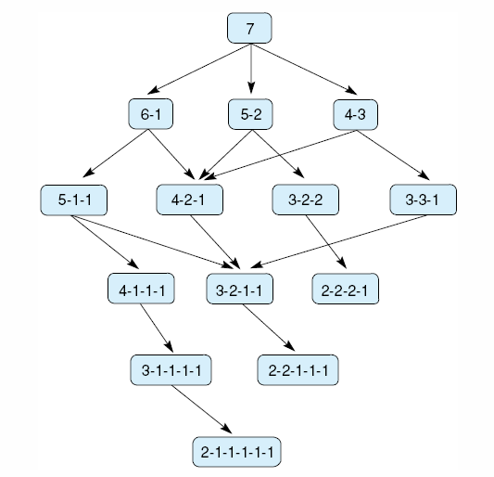
Complete game tree for Nim-7
7 coins are placed on a table between the two opponents
A move consists of dividing a pile of coins into two nonempty piles of different sizes
For example, 6 coins can be divided into piles of 5 and 1 or 4 and 2, but not 3 and 3
The first player who can no longer make a move loses the game
P1 starts
P2 replies
P1
P2
P2 loses
P1
P1 loses
P2 loses

Slide 6
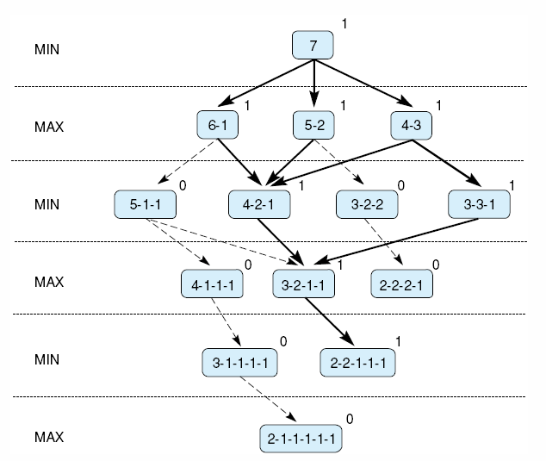
MIN vs. MAX in a Nim game
The best that MIN (Player1) can do is to lose unless Player2 makes a mistake.
moves first to minimize
to maximize
Node score = 0 means MIN wins.
1 means MAX wins.
Bold edges indicate forced win for MAX, Player2.
MIN wins
MAX wins
MIN wins
Notes:
Insert fig 4.20

Slide 7
Minimax to fixed ply depth
Instead of Nim-7, image the chess game tree.
Chess game tree is too deep.
  cannot expand the current node to terminating (leaf) nodes for checkmate.
Use fixed ply depth look-ahead.
  Search from current position to all possible positions that are, e.g., 3-plies ahead.
Use heuristic to evaluate all these future positions.
  P=1, N=B=3, R=5, Q=9
  Assign certain weight to certain features of the position (dominance of the center, mobility of the queen, etc.)
  summarize these factors into a single number.
Then propagating the scores back to the current node.

Slide 8
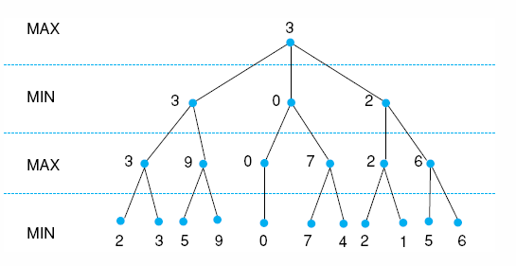
MAX calculates the current node score
Look 3 plies ahead.
= current node score
Back propagate the scores up the tree.
also hopes for the best
hopes for the best
Use heuristic h(n) for each of these future positions.
A stronger heuristic will beat a weaker heuristic.
A farther look-ahead will beat a near-sighted look-ahead.
Computer chess routinely uses complex heuristics analyzing material and positional advantages and looks 40 plies ahead.
Notes:
Insert fig 4.21

Slide 9
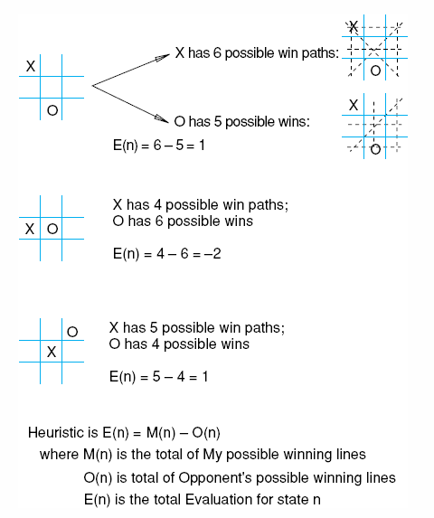
Heuristic measuring for adversarial tic-tac-toe
Maximize E(n)
E(n) = 0 when my opponent and I have equal number of possibilities.

Slide 10
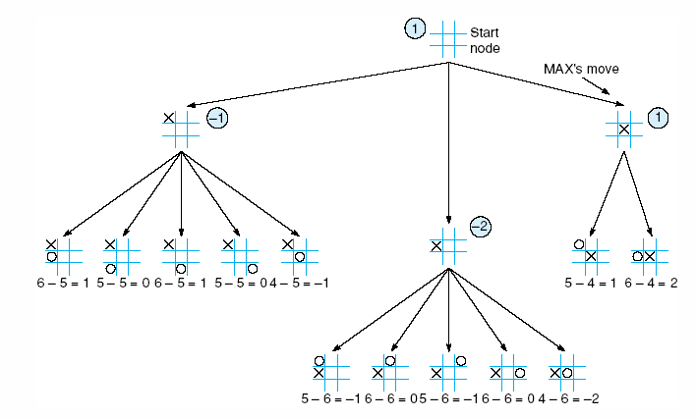
Tic-tac-toe, MAX vs MIN, 2-ply look-ahead
MAX's score at the opening is 1. So according to this heuristic, Play 1 has advantage.
MAX hopes to win by maximizing.
MIN tries his best to minimize.
MIN tries his best to minimize.
MIN tries his best to minimize.
Fig. 4.23

Slide 11
MAX makes his first move
MAX hopes to win by maximizing.
MAX though MIN's best reply was
But MIN then builds another minimax tree with 2 plies look-ahead from here and decided to reply with

Slide 12
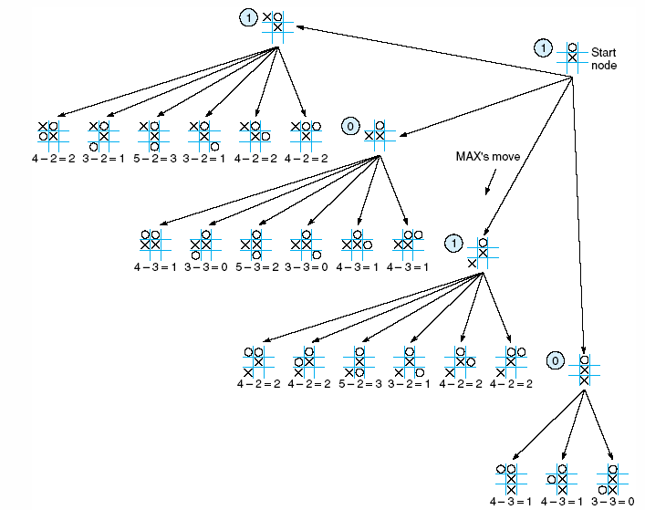
MAX's 2nd move: look ahead analysis
Fig. 4.24

Slide 13
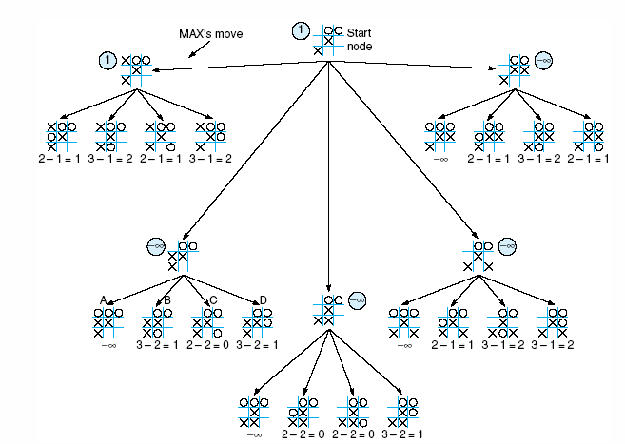
MAX's 3rd move: look ahead analysis
−∞ means MIN wins.
+∞ means MAX wins.
Fig. 4.25

Slide 14
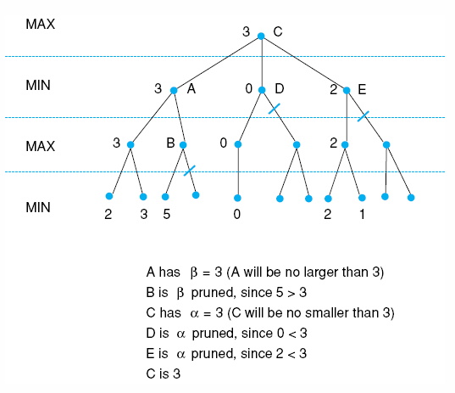
Alpha-beta pruning example
Minimax without pruning
F
Depth-first search
Visit C, A, F,
Visit G, heuristics evaluates to 2
Visit H, heuristics evaluates to 3
Back up {2,3} to F. max(F)=3
Back up to A. β(A)=3. Temporary min(A) is 3.
3 is the ceiling for node A's score.
Visit B according to depth-first order.
Visit I. Evaluates to 5.
Max(B)>=5. α(B)=5.
It does not matter what the value of J is, min(A)=3. β-prune J.
Alpha-beta pruning improves search efficiency of minimax without sacrificing accuracy.
G
H
I
J
Unevaluated nodes

Slide 15
Alpha-beta pruning
min(A) = -1
max(S) must >= -1
Lower bound: α-value of S = -1
h(C) = -2
min (B) <= -2
Upper bound: β-value = -2
Final value of B can never exceed current value of S. We can prune the other children of B.
α-value of S = -1
max(S)≥-1
MAX
S
β-value = -2
min(B)≤-2
A
-1
MIN
B
C
α-prune
1
0
-1
1
-2
Proceed in a depth-first fashion in the n-ply look-ahead search tree.
Find the score for the top of this tree.
During the search, creates two values alpha and beta
α-value associated with MAX can never decrease
  MAX's eventually score is at least as good as the current α-value
β-value associated with of MIN can never increase
  MIN's eventually score is at least as good as the current β-value
α-prune: β-value <= α-value of a MAX ancestor
β -prune: Any MAX node having α-value <= β-value of any MIN ancestor

Slide 16
Conclusion
Minimax search is designed for the adversarial search space, MAX vs MIN.
Before MAX makes a move, he looks n plies ahead in a DFS manner.
Apply heuristic function for the states at the end of the look ahead level.
Propagate these values back up to the current state.
  Use alpha-beta pruning to cut bad branches (moves) in the game tree to improve search time.
Choose the move that maximizes the current node score.
Then it is MIN's turn of doing similar look-ahead and pruning to decide his move.
The players alternate until game over.

