Slide 1
Introduction to Java OOP

Slide 2
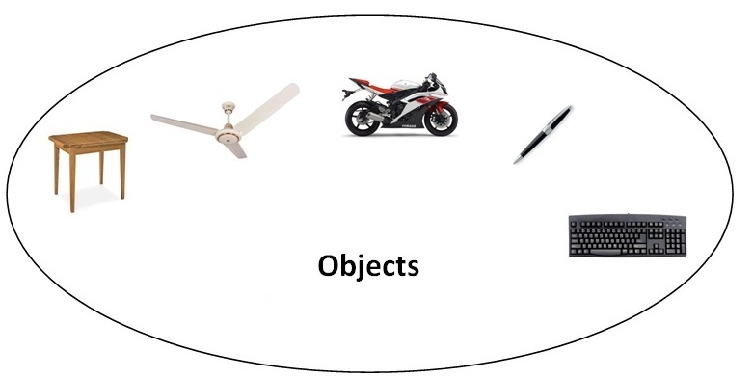
Java OOPs Concepts
OOPs (Object Oriented Programming System)
  Object
    means a real word entity such as pen, chair, table etc.

Slide 3
Java OOPs Concepts
OOPs (Object Oriented Programming System)
  Object-Oriented Programming
    a methodology or paradigm to design a program using classes and objects
    simplifies the software development and maintenance by providing some concepts:
      Object
      Class
      Inheritance
      Polymorphism
      Abstraction
      Encapsulation

Slide 4
Java OOPs Concepts
Object
  Any entity that has state and behavior
  Examples: chair, pen, table, keyboard, bike etc.
  It can be physical and logical.
Class
  Collection of objects
  Template for creating objects
  Logical entity

Slide 5
Java OOPs Concepts
Inheritance (``IS-A” relationship)
  When one object acquires properties and behaviors of parent object.
  Defining a new class based on an existing class is called derivation.
  It provides code reusability.
  The derived class is also called the direct subclass of the base or super class.
Shape
TwoDimensionalShape
ThreeDimensionalShape
Circle
Square
Triangle
Sphere
Cube
Tetrahedron

Slide 6
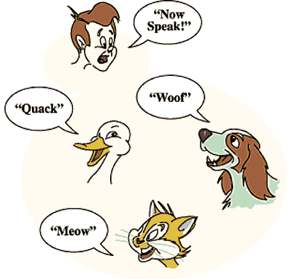
Java OOPs Concepts
Polymorphism
  Poly means many and morph means forms
  Ability to assume different forms or shapes
  When one task is performed by different ways
  In java, we use method overloading and method overriding to achieve polymorphism.
  Examples:
    to speak something e.g. cat speaks meow, dog barks woof
    to draw something e.g. shape or rectangle etc.

Slide 7
Java OOPs Concepts
Abstraction
  Hiding internal details and showing functionality
  Seeing the big picture
  In java, we use abstract class and interface to achieve abstraction.
Encapsulation
  A technique of making the fields in a class private and providing access to the fields via public methods.
  Hiding the fields within the class (known as data-hiding).
  Benefits of Encapsulation:
    The fields of a class can be made read-only or write-only.
    A class can have total control over what is stored in its fields.
    The users of a class do not know how the class stores its data. A class can change the data type of a field and users of the class do not need to change any of their code.

Slide 8
Java OOPs Concepts
Advantage of OOPs over Procedure-oriented programming language
  OOPs makes development and maintenance easier where as in Procedure-oriented programming language it is not easy to manage if code grows as project size grows.
  OOPs provides data hiding whereas in Procedure-oriented programming language a global data can be accessed from anywhere.
  OOPs provides ability to simulate real-world event much more effectively. We can provide the solution of real word problem if we are using the Object-Oriented Programming language.

