Slide 1
RMI
Remote Method Invocation

Slide 2
Introduction of RMI
What is Remote Method Invocation?
Bulb is a remote object
public class LightBulb
{
private boolean lightOn;
public void on()
{
lightOn = true;
}
public void off()
{
lightOn = false;
}
public boolean isOn()
{
return lightOn;
}
}
Bulb
Server
Bulb.on()
Bulb.off()
client
client

Slide 3
Introduction of RMI
What is Remote Method Invocation?
Bulb is a remote object
public class LightBulb
{
private boolean lightOn;
public void on()
{
lightOn = true;
}
public void off()
{
lightOn = false;
}
public boolean isOn()
{
return lightOn;
}
}
Bulb
Server
Bulb.on()
Bulb.off()
client
client
How to identify a remote object and its methods?
How to invoke a method of a remote object (e.g., parameters passing, result returning)?
How to locate a remote object?

Slide 4
Introduction of RMI
Primary goal of RMI
  Allow programmers to develop distributed Java programs with the same syntax and semantic used for non-distributed programs
  RMI is for Java only, allowing Java objects on different JVM to communicate each other
  RMI is object-oriented
    Input parameters could be objects
      These objects could be executed in a remote host
    Return value could be an object as well

Slide 5
RMI Architecture
Each remote object has two separate parts
  Definition of its behavior
    Clients are concerned about the definition of a service
    Coded using a Java interface, which defines the behavior
  Implementation of its behavior
    Servers are focused on providing the service
    Coded using a Java class, which defines the implementation

Slide 6
RMI Layers
Client Code
Server Code
Stubs
Skeletons
RMI
System
Remote Reference Layer
Remote Reference Layer
Transport Layer (TCP/IP)
Each remote object has two interfaces
  Client interface – a stub/proxy of the object
  Server interface – a skeleton of the object
The communication of stub and skeleton is done across the RMI link
  Read parameters/make call/accept return/write return back to the stub
Remote reference layer defines and supports the invocation semantics of the RMI connection

Slide 7
What is needed for RMI
Java makes RMI (Remote Method Invocation) fairly easy, but there are some extra steps
To send a message to a remote “server object,”
  The “client object” has to find the object
    Do this by looking it up in a registry
  The client object then has to marshal the parameters (prepare them for transmission)
    Java requires Serializable parameters
    The server object has to unmarshal its parameters, do its computation, and marshal its response
  The client object has to unmarshal the response
Much of this is done for you by special software

Slide 8
Terminology
A remote object is an object on another computer
The client object is the object making the request (sending a message to the other object)
The server object is the object receiving the request
As usual, “client” and “server” can easily trade roles (each can make requests of the other)
The rmiregistry is a special server that looks up objects by name
  Hopefully, the name is unique!
rmic is a special compiler for creating stub (client) and skeleton (server) classes

Slide 9
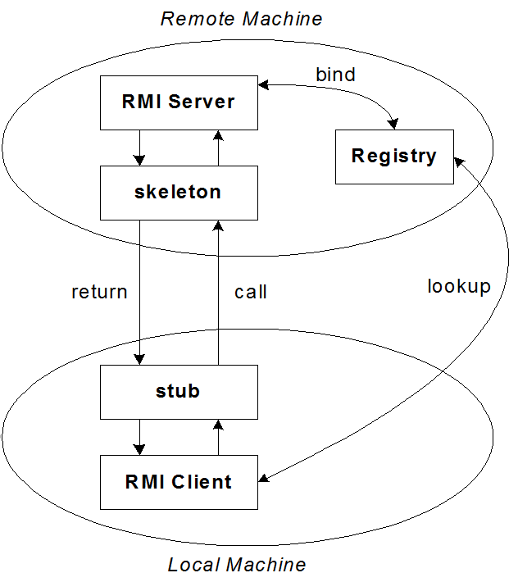

Slide 10
RMI Components
RMI registry
  Each remote object needs to register their location
  RMI clients find remote objects via the lookup service
Server hosting a remote object
  Construct an implementation of the object
  Provide access to methods via skeleton
  Register the object to the RMI registry
Client using a remote object
  Ask registry for location of the object
  Construct stub
  Call methods via the object’s stub
RMIRegistry
2. look for
server object
register server
objects
3. return
server stub
client
server
3. call and data
communication

Slide 11
Steps of Using RMI
Create Service Interface
Implement Service Interface
Create Stub and Skeleton Classes
Create RMI Server
Create RMI Client
1. Define Service Interface
5. Develop Client program
2. Develop Service Implementation
4. Create and register Server Object
3. rmic
stub
skeleton

Slide 12
1. Defining RMI Service Interface
Declare an Interface that extends java.rmi.Remote
  Stub, skeleton, and implementation will implement this interface
  Client will access methods declared in the interface
Example
public interface RMILightBulb extends java.rmi.Remote {
public void on () throws java.rmi.RemoteException;
public void off() throws java.rmi.RemoteException;
public boolean isOn() throws java.rmi.RemoteException;
}

Slide 13
2. Implementing RMI Service Interface
Provide concrete implementation for each methods defined in the interface
public class RMILightBulbImpl extends java.rmi.server.UnicastRemoteObject implements RMILightBulb
{
public RMILightBulbImpl() throws java.rmi.RemoteException
{setBulb(false);}
private boolean lightOn;
public void on() throws java.rmi.RemoteException { setBulb(true); }
public void off() throws java.rmi.RemoteException {setBulb(false);}
public boolean isOn() throws java.rmi.RemoteException
{ return getBulb(); }
public void setBulb (boolean value) { lightOn = value; }
public boolean getBulb () { return lightOn; }
}

Slide 14
3. Generating Stub & Skeleton Classes
Simply run the rmic command on the implementation class
Example:
  rmic RMILightBulbImpl
  creates the classes:
    RMILightBulbImpl_Stub.class
      Client stub
    RMILightBulbImpl_Skeleton.class
      Server skeleton

Slide 15
4. Creating RMI Server
Create an instance of the service implementation
Register with the RMI registry (binding)
import java.rmi.*;
import java.rmi.server.*;
public class LightBulbServer {
public static void main(String args[]) {
try {
RMILightBulbImpl bulbService = new RMILightBulbImpl();
RemoteRef location = bulbService.getRef();
System.out.println (location.remoteToString());
String registry = "localhost";
if (args.length >=1) {
registry = args[0];
}
String registration = "rmi://" + registry + "/RMILightBulb";
Naming.rebind( registration, bulbService );
} catch (Exception e) { System.err.println ("Error - " + e); } } }

Slide 16
5. Creating RMI Client
Obtain a reference to the remote interface
Invoke desired methods on the reference
import java.rmi.*;
public class LightBulbClient {
public static void main(String args[]) {
try { String registry = "localhost";
if (args.length >=1) { registry = args[0]; }
String registration = "rmi://" + registry + "/RMILightBulb";
Remote remoteService = Naming.lookup ( registration );
RMILightBulb bulbService = (RMILightBulb) remoteService;
bulbService.on();
System.out.println ("Bulb state : " + bulbService.isOn() );
System.out.println ("Invoking bulbservice.off()");
bulbService.off();
System.out.println ("Bulb state : " + bulbService.isOn() );
} catch (NotBoundException nbe) {
System.out.println ("No light bulb service available in registry!");
} catch (RemoteException re) { System.out.println ("RMI - " + re);
} catch (Exception e) { System.out.println ("Error - " + e); }
}
}

Slide 17
Steps of Running RMI
Make the classes available in the server host's, registry host's, and client host's classpath
  Copy, if necessary
Start the registry
  rmiregistry
Start the server
  java LightBulbServer reg-hostname
Start the client
  java LightBulbClient reg-hostname

Slide 18
Another Example: Compute Server
Client
Client
Task
Result
result
Task
Task
task
Server
An Example of Corporate Server

Slide 19
Task interface
public interface Task
{
Object run();
}
When run is invoked, it does some computation
and returns an object that contains the results

Slide 20
Remote Interface of ComputeServer
import java.rmi.*
public interface ComputeServer extends Remote
{
Object compute(Task task) throws RemoteException;
}
The only purpose of this remote interface is to allow
a client to create a task object and send it to the
Server for execution, returning the results

Slide 21
Remote Object ComputeServerImpl
import java.rmi.*;
Import java.rmi.server.*;
public class ComputeServerImpl extends UnicastRemoteObject implements ComputeServer
{
public ComputeServerImpl() throws RemoteException { }
public Object compute(Task task) { return task.run(); }
public static void main(String[] args) throws Exception
{
ComputeServerImpl server = new ComputeServerImpl();
Naming.rebind(“ComputeServer”, server);
}
}

Slide 22
A Task Example
public class MyTask implements Task, Serializable
{
double data[];
MyTask()
{
ReadFile(data, “c:\data.txt”);
}
double run()
{
// some CPU-intensive operations on data[];
}
}

Slide 23
Submitting a Task
public class RunTask
{
public static void main(String[] args) throws Exception
{
Mytask myTask = new MyTask();
// set the data[] of myTask;
// submit to the remote compute server and get result back
Remote cs = Naming.lookup(“rmi://localhost/ComputeServer”);
Double result = (ComputeServer) cs).compute(myTask);
}
}

Slide 24
RMI vs CORBA
CORBA (Common Object Request Broker Architecture) has long been king
  CORBA supports object transmission between virtually any languages
  Objects have to be described in IDL (Interface Definition Language), which looks a lot like C++ data definitions
  CORBA is complex
Standard RMI is purely Java-specific
  Java to Java communications only
  As a result, RMI is much simpler than CORBA

Slide 25
Summary
RMI is a Java middleware to deal with remote objects based on RPC communication protocol
  Interface defines behaviour and class defines implementation
  Remote objects are pass across the network as stubs and nonremote objects are copies

Slide 26
Further Reading and Examples
http://www.ejbtutorial.com/category/java-rmi
http://www.javatpoint.com/RMI

