Slide 1
Java Servlets
Readings:
http://www.javatpoint.com/servlet-tutorial

Slide 2
Servlet Technology
Servlet technology is used to create web application (resides at server side and generates dynamic web page).
Before Servlet, CGI (Common Gateway Interface) scripting language was popular as a server-side programming language.
Servlet API is Standard Java Extension API, (NOT part of core Java) and available as add-on package.

Slide 3
What is Servlet?
Servlet can be described in many ways, depending on the context.
Servlet is a technology i.e. used to create web application.
Servlet is an API that provides many interfaces and classes including documentations.
Servlet is an interface that must be implemented for creating any servlet.
Servlet is a class that extend the capabilities of the servers and respond to the incoming request. It can respond to any type of requests.
Servlet is a web component that is deployed on the server to create dynamic web page.
Servlet & JSP

Slide 4
What is Servlet?
Servlet can be described in many ways, depending on the context.
Servlet is a technology i.e. used to create web application.
Servlet is an API that provides many interfaces and classes including documentations.
Servlet is an interface that must be implemented for creating any servlet.
Servlet is a class that extend the capabilities of the servers and respond to the incoming request. It can respond to any type of requests.

Slide 5
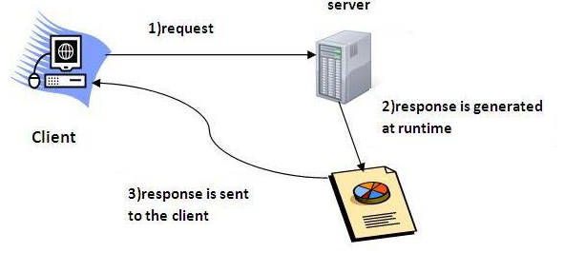
What is a Servlet?
Servlet is a web component that is deployed on the server to create dynamic web page.

Slide 6
What is web application?
A web application is an application accessible from the web.
A web application is composed of web components like Servlet, JSP etc. and other components such as HTML.
The web components typically execute in Web Server and respond to HTTP request.

Slide 7
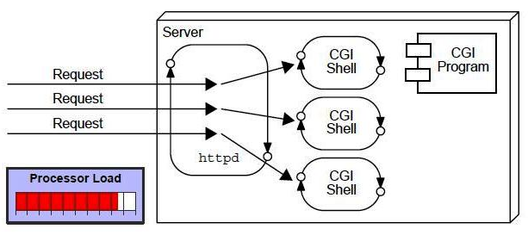
CGI (Commmon Gateway Interface)
CGI technology enables the web server to call an external program and pass HTTP request information to the external program to process the request.
For each request, it starts a new process.

Slide 8
CGI (Commmon Gateway Interface)
Disadvantages
There are many problems in CGI technology:
If number of clients increases, it takes more time for sending response.
For each request, it starts a process and Web server is limited to start processes.
It uses platform dependent language e.g. C, C++, perl.

Slide 9
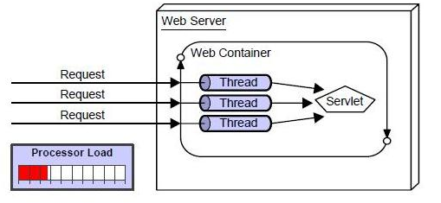
Advantages of Servlet

Slide 10
Advantages of Servlet
There are many advantages of servlet over CGI.
The basic benefits of servlet are as follows:
better performance: because it creates a thread for each request not process.
Portability: because it uses java language.
Robust: Servlets are managed by JVM so we don't need to worry about memory leak, garbage collection etc.
Secure: because it uses java language..

Slide 11
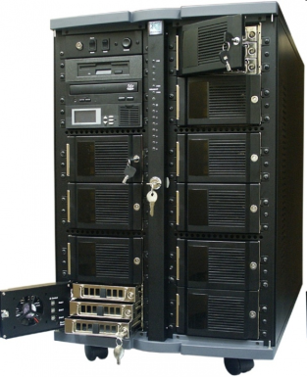
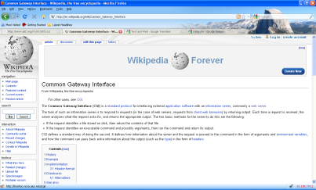
Server-side Java for the web
a servlet is a Java program which outputs an html page; it is a server-side technology
HTTP Request
Server-side Request
Java Servlet
Java Server Page
HTTP Response
Response Header +
Html file
browser
web server
servlet container (engine) - Tomcat

Slide 12
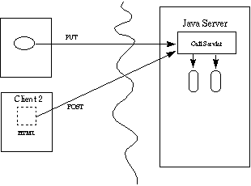
Servlets Overview
Protocol and Platform-independent server side Java components
Clients may range from simple HTML forms to Java applets.
Used as middle tiers for distributed application systems.
Servlet & JSP

Slide 13
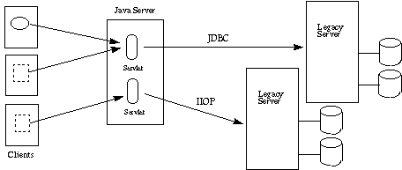
Three Tier Applications.
Servlet & JSP

Slide 14
Client - Server - DB
Trigger Servlet, JSP (Request)
Client (browser)
Through internet
Web server (Apache, JWS)
Return html file (Response)
Request data
JDBC, intranet
Return data
Database server (DB2)

Slide 15
Life Cycle of Servlet
servlet
GenericServlet
HttpServlet
init(ServletConfig);
doGet(HttpServletRequest,
HttpServletResponse);
service(ServletRequest,
ServletResponse);
doPost(HttpServletRequest,
HttpServletResponse);
…….
destroy();

Slide 16
Servlet Execution Life Cycle
Servlet Class
First Request
Servlet Instance in Memory
init()
Subsequent
Requests (can be from different users and sessions)
doPost()
service()
doGet()
Notes:
For protocol architecture, refer to any network or telecommunication books

Slide 17
Response and Request Message
Web servers and web clients communicate through HTTP messages (protocols)
  Request message: client → server
  Response message: server → client
HTTP message consists of header and body
  HTTP header: information describing the message and the context of the message
  HTTP body: content usually for display

Slide 18
Request Processing
Major request method type
  Get
    User data is sent as part of the request URL
    No request message body
    Triggering actions: address bar (in browser), link, form, …
  Post
    User data is sent in the request message body
    Triggering actions: form, …

Slide 19
Interaction with Client
HttpServletRequest
  String getParameter(String)
  Enumeration getParameters(String[])
HttpServletResponse
  Writer getWriter()
  ServletOutputStream getOutputStream()
Handling GET and POST Requests

Slide 20
First java servlet
import java.io.*;
import java.util.*;
import javax.servlet.*;
import javax.servlet.http.*;
public class FirstServlet extends HttpServlet {
public void doGet(HttpServletRequest request, HttpServletResponse response)
throws IOException, ServletException
{
response.setContentType("text/html");
PrintWriter out = response.getWriter();
out.println("<html>");
out.println("<head>");
out.println("<title>First servlet</title>");
out.println("</head>");
out.println("<body>");
out.println("It works...<hr>");
out.println("</body>");
out.println("</html>");
}
}

Slide 21
What is a java servlet ?
a java servlet is a java class extending HTTPServlet class
a java servlet class implements the doGet(), doPost() or other equivalent HTTP method and (usually) prints at the standard output an html file
a java servlet class can contain any kind of java code the JDK can compile
a java servlet class needs to be compiled prior to using it; it must use servlet-api.jar

Slide 22
Apache Tomcat
the most well known servlet/jsp container
is a web server + implementation of Java Servlet and JSP (Java Server Pages) APIs
is developed by Apache Software Foundation
available at http://tomcat.apache.org/ under Apache Software License

Slide 23
Installing Tomcat
1. Download the binary zip distribution (e.g. apache-
tomcat-6.0.20.zip) in a local folder (we will use c:\temp
in the rest of the guide)
2. Set the environment variables JAVA_HOME=path_to_JDK_installation_folder
CATALINA_HOME=path_to_tomcat_installation_folder
either as Windows system variables or in the files
startup.bat and shutdown.bat from the bin directory
Ex. place the following lines in the beginning of startup.bat and shutdown.bat:
set JAVA_HOME=c:\progra~1\java\jdk1.6.0
set CATALINA_HOME=c:\temp\apache-tomcat-6.0.20

Slide 24
Starting/shutting down Tomcat
start Tomcat from a cmd prompter (window):
c:\temp\apache-tomcat-6.0.20\bin\startup.bat
verify startup by pointing a browser to the url http://localhost:8080
shutting down Tomcat from a cmd prompter (window):
c:\temp\apache-tomcat-6.0.20\bin\shutdown.bat

Slide 25
Tomcat standard folders
bin – contains executable files for controlling the server (start, shut down etc.)
conf – contains configuration files; most important server.xml for configuring the server and web.xml a general configuration file for web applications
lib – libraries (jars) used by tomcat and deployed web applications
logs – log files
temp – temporary files
webapps – contains the web applications deployed
work – contains files created by tomcat during running (e.g. it crates a servlet from each jsp file)

Slide 26
Format of a web application
web applications are stored in the webapps folder, either as a folder or as a .war archive
a web application (either a folder or a .war archive) must contain the following files:
  WEB-INF folder
  WEB-INF\web.xml: a configuration file
optionally the WEB-INF folder can contain the following subfolders:
  classes: which contain servlets
  lib: which contains jars used by the web application
html, jsp and resource files can be placed anywhere in the web application home folder
servlets must be placed in the folder or subfolders of WEB-INF\classes

Slide 27
A very simple web.xml example
<?xml version="1.0" encoding="ISO-8859-1"?>
<web-app xmlns="http://java.sun.com/xml/ns/javaee"
xmlns:xsi="http://www.w3.org/2001/XMLSchema-instance"
xsi:schemaLocation=http://java.sun.com/xml/ns/javaee http://java.sun.com/xml/ns/javaee/web-app_2_5.xsd version="2.5">
</web-app>

Slide 28
Configuring servlets
for JSPs (Java Server Pages) no additional configuration needs to be done
for java servlets additional lines must be placed in the web.xml file:
<servlet>
<servlet-name>ServletsName</servlet-name>
<servlet-class>The_Class_Name_of_the_Servlet</servlet-class>
</servlet>
<servlet-mapping>
<servlet-name> ServletsName </servlet-name>
<url-pattern>/URL_of_the_servlet</url-pattern>
</servlet-mapping>

Slide 29
First JSP file
<html>
<body>
<%
out.println(“First JSP… It works<br/>");
%>
</body>
</html>

Slide 30
What is a Java Server Page (JSP)
an html file containing parts of java code; the java code is placed inside the “<% … %>” tags or some other related tags
Tomcat will create a servlet from the jsp file (which will be saved in the work folder)
when the jsp is requested the servlet is executed and the output of the server is sent back to the client

Slide 31
Java Server Pages (JSP)
Client’s Computer
1.Browser requests HTML
7. Server sends HTML
back to browser
Server
6. Java Engine sends HTML to server
servlet
servlet
2. Server sends requests to Java Engine
class
5.The servlet runs and generates HTML
3. If needed, the Java Engine
reads the .jsp file
4. The JSP is turned into a
servlet, compiled, and loaded
Java Engine

Slide 32
Readings
for Servlets:
http://www.javatpoint.com/servlet-tutorial
http://www.cs.ubbcluj.ro/~florin/PDPJ/ExempleSurseDocumentatii/07JavaServlet.pdf
for JSP:
http://www.cs.ubbcluj.ro/~florin/PDPJ/ExempleSurseDocumentatii/08JavaServerPages.pdf
examples of both:
http://www.cs.ubbcluj.ro/~forest/wp/JSP%20Servlet%20examples

