Slide 1
HIBERNATE

Slide 2
Object-Relational Mapping
It is a programming technique for converting object-type data of an object oriented programming language into database tables.
Hibernate is used convert object data in JAVA to relational database tables.

Slide 3
What is Hibernate?
It is open source object-relational mapping (ORM) for Java.
Hibernate is responsible for making data persistent by storing it in a database.

Slide 4
Why Hibernate and not JDBC?
JDBC maps Java classes to database tables (and from Java data types to SQL data types)
Hibernate automatically generates the SQL queries.
Hibernate provides data query and retrieval facilities and can significantly reduce development time as more time is required to manually handle data in SQL and JDBC.
It makes an application portable to all SQL databases.

Slide 5
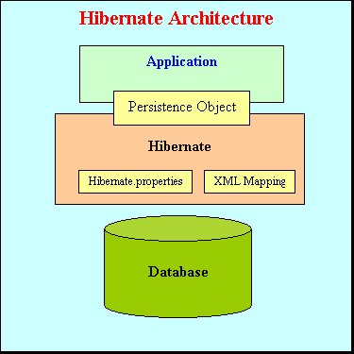
Architecture
Hibernate sits between your code and the database
Maps persistent objects to tables in the database

Slide 6
Hibernate
Configuration Object:
  The Configuration object is the first Hibernate object you create in any Hibernate application and usually created only once during application initialization. The Configuration object provides two keys components:
  Database Connection: This is handled through one or more configuration files supported by Hibernate. These files are hibernate.properties and hibernate.cfg.xml.
  Class Mapping Setup
  This component creates the connection between the Java classes and database tables.
SessionFactory Object:
  Configuration object is used to create a SessionFactory object which inturn configures Hibernate for the application using the supplied configuration file and allows for a Session object to be instantiated.
  SessionFactory is a thread safe object and used by all the threads of an application.
  The SessionFactory is heavyweight object so usually it is created during application start up and kept for later use.
  You would need one SessionFactory object per database using a separate configuration file. So if you are using multiple databases then you would have to create multiple SessionFactory objects.

Slide 7
Hibernate
Session Object:
  A Session is used to get a physical connection with a database.
  It is lightweight and designed to be instantiated each time an interaction is needed with the database. Persistent objects are saved and retrieved through a Session object.
  The session objects should not be kept open for a long time because they are not usually thread safe and they should be created and destroyed as needed.
Transaction Object:
  A Transaction represents a unit of work with the database and most of the RDBMS supports transaction functionality. Transactions in Hibernate are handled by an underlying transaction manager and transaction (from JDBC or JTA).
  This is an optional object and Hibernate applications may choose not to use this interface, instead managing transactions in their own application code.
Query Object:
  Query objects use SQL or Hibernate Query Language (HQL) string to retrieve data from the database and create objects. A Query instance is used to bind query parameters and to execute the query.

Slide 8
References
www.hibernate.org
http://www.tutorialspoint.com/hibernate/hibernate_architecture.htm
http://www.javatpoint.com/hibernate-tutorial

