Slide 1
JavaScript

Slide 2
During Today’s Lecture …
We will have a more formal introduction to JavaScript and client-side scripting
We will become able to appreciate the concept of objects in JavaScript
We will learn about the properties of those objects, and about how to read & modify them

Slide 3
Introduction
JavaScript is an object-based scripting language that is lightweight and cross-platform.
JavaScript is not compiled but translated. The JavaScript Translator (embedded in browser) is responsible to translate the JavaScript code.
Where JavaScript is used
  JavaScript is used to create interactive websites. It is mainly used for:
  Client-side validation
  Dynamic drop-down menus
  Displaying data and time
  Displaying popup windows and dialog boxes (like alert dialog box, confirm dialog box and prompt dialog box)
  Displaying clocks etc.

Slide 4
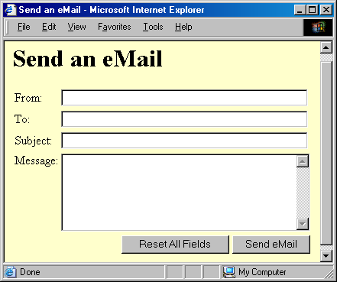
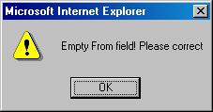

Slide 5
The main code segment that goes between the <SCRIPT>, </SCRIPT> tags:
function checkForm() {
if ( document.sendEmail.sender.value.length < 1) {
window.alert( “Empty From field! Please correct” );
}
}
The JavaScript code included as an attribute of the “Send eMail” button:
onMouseOver=“checkForm()”

Slide 6
<HTML>
<HEAD>
<TITLE>Send an eMail</TITLE>
<SCRIPT> function checkForm(){ if (document.sendEmail.sender.value.length < 1) { window.alert('Empty From field! Please correct');
}
}
</SCRIPT>
</HEAD>
<BODY bgcolor="#FFFFCC">
<H1>Send an eMail</H1>
<FORM name="sendEmail" method="post" action=sendMailScriptURL>
<TABLE><TR> <TD>From: </TD>
<TD><INPUT type="text" name="sender" size="50" ></TD>
</TR><TR> <TD>To: </TD>
<TD><INPUT type="text" name="receiver" size="50"></TD>
</TR><TR><TD>Subject: </TD>
<TD><INPUT type="text" name="subject" size="50"></TD>
</TR><TR><TD valign="top">Message: </TD>
<TD><TEXTAREA name="message" cols="38" rows="6"></TEXTAREA></TD>
</TR><TR><TD colspan="2" align="right">
<INPUT type="reset" name="reset" value="Reset All Fields">
<INPUT type="submit" name="sendEmail" value="Send eMail" onMouseOver="checkForm()">
</TD></TR></TABLE></FORM>
</BODY>
</HTML>

Slide 7
New Concept: Client-Side Scripts
Small programs that are a part of the Web page and run on the user’s (client’s) computer
They interact with the user to collect info or to accomplish other tasks
Once it has been collected, they may help pass the collected info on to a server-side script
We’ll use JavaScript to do client-side scripting.

Slide 8
Advantages of Client-Side Scripting
Reduced server load as it does not have to send messages to the user’s browser about missing or incorrect data
Reduced network traffic as the form’s data is sent only once instead of many to’s and fro’s

Slide 9
Disadvantages
Client-side scripts do not work with all browsers
Some user intentionally turn scripting off on their browsers
This increases the complexity of the Web page, as it now has to support both situations: browsers with scripting capability, and those not having that capability

Slide 10
JavaScript
A programming language specifically designed to work with Web browsers
It is designed to be used for developing small programs – called scripts – that can be embedded in HTML Web pages
JavaScript:
  Is an interpreted language
  Supports event-driven programming
  Is object-based

Slide 11
3 Places to put JavaScript code
Between the body tag of html
Between the head tag of html
In .js file (external javaScript)
External JavaScript file
  message.js
  function msg(){
  alert("Hello Javatpoint");
  }
  Index.html
  <html>
  <head>
  <script type="text/javascript" src="message.js"></script>
  </head>
  <body>
  <p>Welcome to JavaScript</p>
  <form>
  <input type="button" value="click" onclick="msg()"/>
  </form>
  </body>
  </html>

Slide 12
Case Sensitivity
HTML is not case sensitive. The following mean the same to the browser:
  <HTML> -- <html>
  <Html> -- <htMl>
JavaScript is case sensitive. Only the first of the following will result in the desired function – the rest will generate an error or some other undesirable event:
  onMouseClick -- OnMouseClick
  onmouseclick -- ONMOUSECLICK

Slide 13
JavaScript
A programming language specifically designed to work with Web browsers
It is designed to be used for developing small programs – called scripts – that can be embedded in HTML Web pages
JavaScript:
  Is an interpreted language
  Supports event-driven programming
  Is object-based

Slide 14
JavaScript is Object-Based
Everything that JavaScript manipulates, it treats as an object – e.g. a window or a button
An object has properties – e.g. a window has size, position, status, etc.
Objects are modified with methods that are associated with that object – e.g. a resize a window with resizeTo(150, 200)

Slide 15
Not Object-Oriented!
JavaScript is not a true object-oriented language like C++ or Java
It is so because it lacks two key features:
  A formal inheritance mechanism
  Strong typing
Nevertheless, it does include many key concepts that are part of almost all object-oriented languages, and therefore is referred as an object-based language

Slide 16
Object: A named collection of properties (data, state) & methods (instructions, behavior)
A collection of properties & methods
All objects have the “name” property: it holds the name of the object (collection)
name
method 2
prop 1
prop 3
prop 5
prop 2
method 3
method 1
prop 4

Slide 17
Example: A Bicycle
name
accelerate()
color
pressure
direction
height
park()
turn()
inflate()
speed

Slide 18
Example: JavaScript’s “window” Object
name
open()
width
document
status
height
alert()
close()
location

Slide 19
Properties
Objects may have a single or several properties
A property may have one of the following values:
  Number -- Text -- Boolean
  Array -- Functions
  Objects (Example: “document” – a property of the “window” object – is an object in itself. A “document” in turn may contain a “form” object as a property, and then that “form” may contain a “button” property, which, once again, is an object in itself)

Slide 20
Referring to a Property
dot
objectName.propertyName
Examples:
window.width
button.value

Slide 21
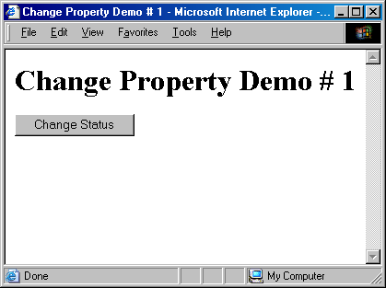

Slide 22


Slide 23
<HTML>
<HEAD>
<TITLE>Change Property Demo # 1</TITLE>
<SCRIPT> function changeStatus() { window.status = “Mouse has touched the button”;
}
</SCRIPT>
</HEAD>
<BODY>
<H1>Change Property Demo # 1</H1>
<FORM name=“dummy” method=“” action=“”>
<INPUT type=“submit” name=“” value=“Change Status“ onMouseOver=“changeStatus()”>
</FORM>
</BODY>
</HTML>

Slide 24
The main code segment that goes between the <SCRIPT>, </SCRIPT> tags in the HEAD:
function changeStatus() {
window.status=“Mouse has touched the button”;
}
The JavaScript code included as an attribute of the “Submit” button:
onMouseOver=“changeStatus()”
new value
property

Slide 25
The main code segment that goes between the <SCRIPT>, </SCRIPT> tags in the HEAD:
function gotoURL() {
window.location=“http://www.nu.edu.pk/”;
}
The JavaScript code included as an attribute of the “Go to NU” button:
onMouseOver=“gotoURL()”
new value
property

Slide 26
You should be connected to the Internet for the successful execution of the example that we just discussed

Slide 27
Browser Object Model (BOM)
The Browser Object Model (BOM) is used to interact with the browser.
The default object of browser is window means you can call all the functions of window by specifying window or directly. For example:
window.alert("hello world");
is same as:
alert("hello world");

Slide 28
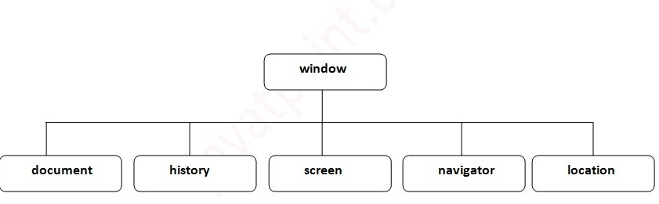
Browser Object Model (BOM)
You can use a lot of properties (other objects) defined underneath the window object like document, history, screen, navigator, location, innerHeight, innerWidth etc.

Slide 29
Window Object
The window object represents a window in browser.
An object of window is created automatically by the browser.
Method | Description
alert() | displays the alert box containing message with ok button.
confirm() | displays the confirm dialog box containing message with ok and cancel button.
prompt() | displays a dialog box to get input from the user.
open() | opens the new window.
close() | closes the current window.
setTimeout() | performs action after specified time like calling function, evaluating expressions etc.

Slide 30
History Object
The JavaScript history object represents an array of URLs visited by the user. By using this object, you can load previous, forward or any particular page.
  history.back(); //for previous page
  history.forward(); //for next page
  history.go(2); //for next 2nd page
  history.go(-2); //for previous 2nd page
No. | Method | Description
1 | forward() | loads the next page.
2 | back() | loads the previous page.
3 | go() | loads the given page number.

Slide 31
JavaScript Navigation Object
The JavaScript navigator object is used for browser detection. It can be used to get browser information such as appName, appCodeName etc.
Example code:
<script>
document.writeln("<br/>navigator.appCodeName: "+navigator.appCodeName);
document.writeln("<br/>navigator.appName: "+navigator.appName);
document.writeln("<br/>navigator.appVersion: "+navigator.appVersion);
document.writeln("<br/>navigator.cookieEnabled: "+navigator.cookieEnabled);
document.writeln("<br/>navigator.language: "+navigator.language);
document.writeln("<br/>navigator.userAgent: "+navigator.userAgent);
document.writeln("<br/>navigator.platform: "+navigator.platform);
document.writeln("<br/>navigator.onLine: "+navigator.onLine);
</script>

Slide 32
Screen Object
The JavaScript screen object holds information of browser screen. It can be used to display screen width, height, colorDepth, pixelDepth etc.
Example code:
  <script>
  document.writeln("<br/>screen.width: "+screen.width);
  document.writeln("<br/>screen.height: "+screen.height);
  document.writeln("<br/>screen.availWidth: "+screen.availWidth);
  document.writeln("<br/>screen.availHeight: "+screen.availHeight);
  document.writeln("<br/>screen.colorDepth: "+screen.colorDepth);
  document.writeln("<br/>screen.pixelDepth: "+screen.pixelDepth);
  </script>

Slide 33
Document Object Model
The document object represents the whole html document.
When html document is loaded in the browser, it becomes a document object. It is the root element that represents the html document.
Methods of document object (We can access and change the contents of document by its methods)
Method | Description
write("string") | writes the given string on the doucment.
writeln("string") | writes the given string on the doucment with newline character at the end.
getElementById() | returns the element having the given id value.
getElementsByName() | returns all the elements having the given name value.
getElementsByTagName() | returns all the elements having the given tag name.
getElementsByClassName() | returns all the elements having the given class name.

Slide 34
Document Object Model
Accessing the field value by document object
  <script type="text/javascript">
    function printvalue(){
    var name=document.form1.name.value;
    alert("Welcome: "+name);
    }
  </script>
  <form name="form1">
    Enter Name: <input type="text" name="name"/>
    <input type="button" onclick="printvalue()" value="print name"/>
  </form>

Slide 35
Example:
Let us try to change the background color of the window

Slide 36


Slide 37
The main code segment that goes between the <SCRIPT>, </SCRIPT> tags in the HEAD:
function changeBgcolor() {
oldColor = window.document.bgColor;
window.document.bgColor = “pink”;
window.alert("The old color was " + oldColor);
}
The JavaScript code included as an attribute of the “Change Color” button:
onMouseOver=“changeBgcolor()”

Slide 38
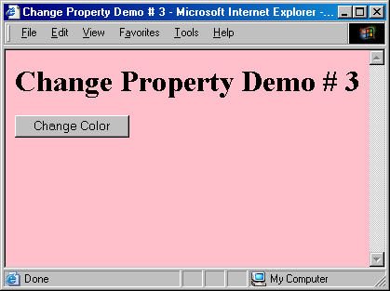

Slide 39
The main code segment that goes between the <SCRIPT>, </SCRIPT> tags in the HEAD:
function changeBgcolor() {
window.document.bgColor = “pink”;
}
The JavaScript code included as an attribute of the “Change Color” button:
onMouseOver=“changeBgcolor()”
new value
property

Slide 40
In addition to “bgColor”, there are many other properties of the “document” object, e.g.
fgColor
linkColor
title
URL
referrer
lastModified
cookie
forms[ ]
images[ ]
links[ ]
…
…
…

Slide 41
Javascript - innerHTML
The innerHTML property can be used to write the dynamic html on the html document.
It is used mostly in the web pages to generate the dynamic html such as registration form, comment form, links etc.
  <script type="text/javascript" >
  function showcommentform() {
  var data="Name:<input type='text' name='name'><br>Comment:<textarea rows='5' cols='80'></textarea><br><input type='submit' value='comment'>";
  document.getElementById('mylocation').innerHTML=data;
  }
  </script>
  <form name="myForm">
  <input type="button" value="comment" onclick="showcommentform()">
  <div id="mylocation"></div>
  </form>

Slide 42
Javascript - innerText
The innerText property can be used to write the dynamic text on the html document. Here, text will not be interpreted as html text but a normal text.
  <script type="text/javascript" >
  function validate() {
    var msg;
    if(document.myForm.userPass.value.length>5){
    msg="good";
    }
    else{
    msg="poor";
    }
    document.getElementById('mylocation').innerText=msg;
  }
  </script>
  <form name="myForm">
  <input type="password" value="" name="userPass" onkeyup="validate()">
  Strength:<span id="mylocation">no strength</span>
  </form>

Slide 43
Javascript - innerText
The innerText property can be used to write the dynamic text on the html document. Here, text will not be interpreted as html text but a normal text.
  <script type="text/javascript" >
  function validate() {
    var msg;
    if(document.myForm.userPass.value.length>5){
    msg="good";
    }
    else{
    msg="poor";
    }
    document.getElementById('mylocation').innerText=msg;
  }
  </script>
  <form name="myForm">
  <input type="password" value="" name="userPass" onkeyup="validate()">
  Strength:<span id="mylocation">no strength</span>
  </form>

Slide 44
Event Handlers
Objects are made up of properties and associated methods
Many objects also have “event handlers” associated with them
“Events” are actions that occur as a result of user’s interaction with the browser
We use “event handlers” [e.g. onMouseOver(), onClick()] to design Web pages that can react to those events

Slide 45
Events for Javascript
Events | Description
onclick | occurs when element is clicked.
ondblclick | occurs when element is double-clicked.
onfocus | occurs when an element gets focus such as button, input, textarea etc.
onblur | occurs when form looses the focus from an element.
onsubmit | occurs when form is submitted.
onmouseover | occurs when mouse is moved over an element.
onmouseout | occurs when mouse is moved out from an element (after moved over).
onmousedown | occurs when mouse button is pressed over an element.
onmouseup | occurs when mouse is released from an element (after mouse is pressed).
onload | occurs when document, object or frameset is loaded.
onunload | occurs when body or frameset is unloaded.
onscroll | occurs when document is scrolled.
onresized | occurs when document is resized.
onreset | occurs when form is reset.
onkeydown | occurs when key is being pressed.
onkeypress | occurs when user presses the key.
onkeyup | occurs when key is released.

