Slide 1
JQuery

Slide 2
JavaScript was a initially introduced in Netscape 2.0B3 in Dec 1995,
a.k.a. Mocha, LiveScript, Jscript, however, it’s official name is
ECMAScript

Slide 3
JavaScript is a C-family, world’s worst named, extremely powerful language (not a script), totally unrelated to Java

Slide 4
JavaScript is a weakly typed, classless, prototype based OO language, that can also be used outside the browser. It is not a browser DOM.

Slide 5

Introduction to jQuery

Slide 6
A Quality of Life by jQuery:
$(“#firstName”).text(“Joe Black”);
$(“button”).click(function() {alert “Clicked”;});
$(“.content”).hide();
$(“#main”).load(“content.htm”);
$(“<div/>”).html(“Loading…”).appendTo(“#content”);
Very compact and fluent programming model

Slide 7
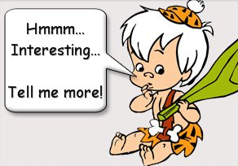
What is jQuery?

Slide 8
jQuery is a lightweight, open-source JavaScript library that simplifies interaction between HTML and JavaScript

Slide 9
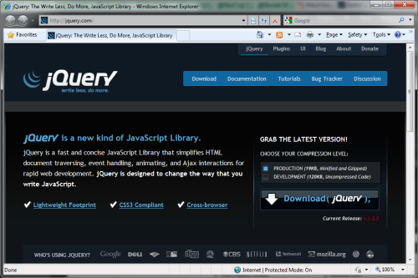
Download the latest version from
http://jquery.com

Slide 10
Reference it in your markup
  <script src=“jquery.js”/>

Slide 11
You can also reference it from Google
  <script src=“http://ajax.googleapis.com/
  ajax/libs/jquery/1.2.6/
  jquery.min.js”>
  </script>

Slide 12
What jQuery Does
“JavaScript – separation of behavior from structure
CSS – separation of style from structure
Allows adding JavaScript to your web pages
Advantages over just JavaScript
  Much easier to use
  Eliminates cross-browser problems

Slide 13
5 Things jQuery Provides
Select DOM (Document Object Model) elements on a page – one element or a group of them
Set properties of DOM elements, in groups (“Find something, do something with it”)
Creates, deletes, shows, hides DOM elements
Defines event behavior on a page (click, mouse movement, dynamic styles, animations, dynamic content)
AJAX calls

Slide 14
The DOM
Document Object Model
jQuery is “DOM scripting”
Heirarchal structure of a web page
You can add and subtract DOM elements on the fly
You can change the properties and contents of DOM elements on the fly

Slide 15
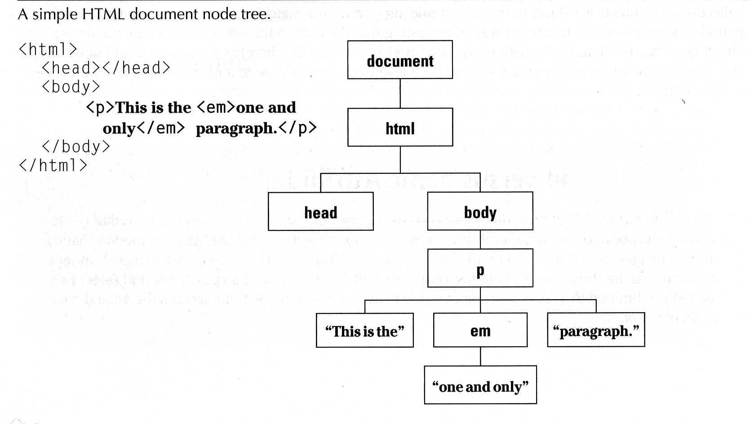
The DOM
“The Document Object Model (DOM) is a cross-platform and language-independent convention for representing and interacting with objects in HTML and XML documents.

Slide 16
jQuery Core Concepts

Slide 17
The Magic $() function
  var el = $(“<div/>”)
Create HTML elements on the fly

Slide 18
The Magic $() function
  $(window).width()
Manipulate existing DOM elements

Slide 19
The Magic $() function
  $(“div”).hide();
  $(“div”, $(“p”)).hide();
Selects document elements
(more in a moment…)

Slide 20
The Magic $() function
  $(function(){…});
Fired when the document is ready for programming.
Better use the full syntax:
  $(document).ready(function(){…});

Slide 21
The full name of $() function is
  jQuery(“div”);
It may be used in case of conflict with other frameworks.

Slide 22
The library is designed to be isolated
  (function(){
  var
  jQuery=window.jQuery=window.$=function(){
  // …
  };
  })();

Slide 23
Avoid $() conflict with other frameworks
  var foo = jQuery.noConflict();
  // now foo() is the jQuery main function
  foo(“div”).hide();
  // remove the conflicting $ and jQuery
  var foo = jQuery.noConflict(true);

Slide 24
jQuery’s programming philosophy is:
GET >> ACT
  $(“div”).hide()
  $(“<span/>”).appendTo(“body”)
  $(“:button”).click()

Slide 25
Almost every function returns jQuery, which provides a fluent programming interface and chainability:
  $(“div”).show()
  .addClass(“main”)
  .html(“Hello jQuery”);

Slide 26


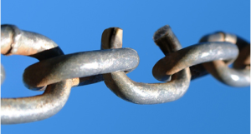
Three Major Concepts of jQuery
The $() function
Get > Act
Chainability

Slide 27
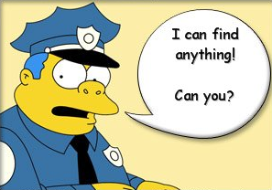
jQuery Selectors

Slide 28
All Selector
  $(“*”) // find everything
Selectors return a pseudo-array of jQuery elements

Slide 29
Basic Selectors
By Tag:
  $(“div”)
  // <div>Hello jQuery</div>
By ID:
  $(“#usr”)
  // <span id=“usr”>John</span>
By Class:
  $(“.menu”)
  // <ul class=“menu”>Home</ul>

Slide 30
More Precise Selectors
  $(“div.main”) // tag and class
  $(“table#data”) // tag and id

Slide 31
Combination of Selectors
  // find by id + by class
  $(“#content, .menu”)
  // multiple combination
  $(“h1, h2, h3, div.content”)

Slide 32
Hierarchy Selectors
  $(“table td”) // descendants
  $(“tr > td”) // children
  $(“label + input”) // next
  $(“#content ~ div”) // siblings

Slide 33
Selection Index Filters
  $(“tr:first”) // first element
  $(“tr:last”) // last element
  $(“tr:lt(2)”) // index less than
  $(“tr:gt(2)”) // index gr. than
  $(“tr:eq(2)”) // index equals

Slide 34
Visibility Filters
  $(“div:visible”) // if visible
  $(“div:hidden”) // if not

Slide 35
Attribute Filters
  $(“div[id]”) // has attribute
  $(“div[dir=‘rtl’]”) // equals to
  $(“div[id^=‘main’]”) // starts with
  $(“div[id$=‘name’]”) // ends with
  $(“a[href*=‘msdn’]”) // contains

Slide 36
Forms Selectors
  $(“input:checkbox”) // checkboxes
  $(“input:radio”) // radio buttons
  $(“:button”) // buttons
  $(“:text”) // text inputs

Slide 37
Forms Filters
  $(“input:checked”) // checked
  $(“input:selected”) // selected
  $(“input:enabled”) // enabled
  $(“input:disabled”) // disabled

Slide 38
Find Dropdown Selected Item
  <select name=“cities”>
    <option value=“1”>Tel-Aviv</option>
    <option value=“2” selected=“selected”>Yavne</option>
    <option value=“3”>Raanana</option>
  </select>
  $(“select[name=‘ddl’] option:selected”).val()

Slide 39
SELECTORS DEMO

Slide 40
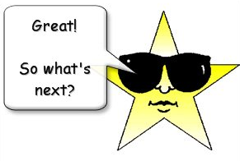

Slide 41
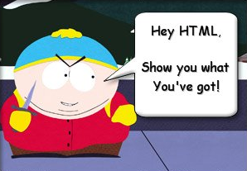
Document Traversal

Slide 42
A Selector returns a pseudo array of jQuery objects
  $(“div”).length
Returns number of selected elements.
It is the best way to check selector.

Slide 43
Getting a specific DOM element
  $(“div”).get(2) or $(“div”)[2]
Returns a 2nd DOM element of the selection

Slide 44
each(fn) traverses every selected element calling fn()
  var sum = 0;
  $(“div.number”).each(
  function(){
  sum += (+this.innerHTML);
  });
this – is a current DOM element

Slide 45
each(fn) also passes an indexer
  $(“table tr”).each(
  function(i){
  if (i % 2)
  $(this).addClass(“odd”);
  });
$(this) – convert DOM to jQuery
i - index of the current element

Slide 46
Traversing HTML
  .next(expr) // next sibling
  .prev(expr) // previous sibling
  .siblings(expr) // siblings
  .children(expr) // children
  .parent(expr) // parent

Slide 47
Check for expression
  $(“table td”).each(function() {
  if ($(this).is(“:first-child”)) {
  $(this).addClass(“firstCol”);
  }
  });

Slide 48
Find in selected
  // select paragraph and then find
  // elements with class ‘header’ inside
  $(“p”).find(“.header”).show();
  // equivalent to:
  $(“.header”, $(“p”)).show();

Slide 49
Advanced Chaining
  $(“<li><span></span></li>”) // li
  .find(“span”) // span
  .html(“About Us”) // span
  .andSelf() // span, li
  .addClass(“menu”) // span,li
  .end() // span
  .end() // li
  .appendTo(“ul.main-menu”);

Slide 50
Get Part of Selected Result
  $(“div”)
  .slice(2, 5)
  .not(“.green”)
  .addClass(“middle”);

Slide 51
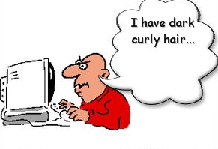
HTML Manipulation

Slide 52
Getting and Setting Inner Content
  $(“p”).html(“<div>Hello $!</div>”);
  // escape the content of div.b
  $(“div.a”).text($(“div.b”).html());

Slide 53
Getting and Setting Values
  // get the value of the checked checkbox
  $(“input:checkbox:checked”).val();
  // set the value of the textbox
  $(“:text[name=‘txt’]”).val(“Hello”);
  // select or check lists or checkboxes
  $(“#lst”).val([“NY”,”IL”,”NS”]);

Slide 54
Handling CSS Classes
  // add and remove class
  $(“p”).removeClass(“blue”).addClass(“red”);
  // add if absent, remove otherwise
  $(“div”).toggleClass(“main”);
  // test for class existance
  if ($(“div”).hasClass(“main”)) { //… }

Slide 55
Inserting new Elements
  // select > append to the end
  $(“h1”).append(“<li>Hello $!</li>”);
  // select > append to the beginning
  $(“ul”).prepend(“<li>Hello $!</li>”);
  // create > append/prepend to selector
  $(“<li/>”).html(“9”).appendTo(“ul”);
  $(“<li/>”).html(“1”).prependTo(“ul”);

Slide 56
Replacing Elements
  // select > replace
  $(“h1”).replaceWith(“<div>Hello</div>”);
  // create > replace selection
  $(“<div>Hello</div>”).replaceAll(“h1”);

Slide 57
Replacing Elements while keeping the content
  $(“h3”).each(function(){
  $(this).replaceWith(“<div>” + $(this).html()
  + ”</div>”);
  });

Slide 58
Deleting Elements
  // remove all children
  $(“#mainContent”).empty();
  // remove selection
  $(“span.names”).remove();
  // change position
  $(“p”).remove(“:not(.red)”) .appendTo(“#main”);

Slide 59
Handling attributes
  $(“a”).attr(“href”,”home.htm”);
  // <a href=“home.htm”>…</a>
  // set the same as the first one
  $(“button:gt(0)”).attr(“disabled”, $(“button:eq(0)”).attr(“disabled));
  // remove attribute - enable
  $(“button”).removeAttr(“disabled”)

Slide 60
Setting multiple attributes
  $(“img”).attr({
  “src” : “/images/smile.jpg”,
  “alt” : “Smile”,
  “width” : 10,
  “height” : 10
  });

Slide 61
CSS Manipulations
  // get style
  $(“div”).css(“background-color”);
  // set style
  $(“div”).css(“float”, “left”);
  // set multiple style properties
  $(“div”).css({“color”:”blue”,
  “padding”: “1em”
  “margin-right”: “0”,
  marginLeft: “10px”});

Slide 62
Dimensions
  // get window height
  var winHeight = $(window).height();
  // set element height
  $(“#main”).height(winHeight);
  //.width() – element
  //.innerWidth() – .width() + padding
  //.outerWidth() – .innerWidth() + border
  //.outerWidth(true) – including margin
The default unit is Pixel (px)

Slide 63
Positioning
  // from the document
  $(“div”).offset().top;
  // from the parent element
  $(“div”).position().left;
  // scrolling position
  $(window).scrollTop();

Slide 64
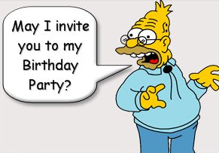
Events

Slide 65
When the DOM is ready…
  $(document).ready(function(){
  //…
  });
Fires when the document is ready for programming.
Uses advanced listeners for detecting.
window.onload() is a fallback.

Slide 66
Attach Event
  // execute always
  $(“div”).bind(“click”, fn);
  // execute only once
  $(“div”).one(“click”, fn);
Possible event values:
blur, focus, load, resize, scroll, unload, beforeunload, click, dblclick, mousedown, mouseup, mousemove, mouseover, mouseout, mouseenter, mouseleave, change, select, submit, keydown, keypress, keyup, error
(or any custom event)

Slide 67
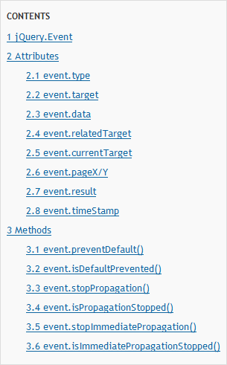
jQuery.Event object

Slide 68
Detaching Events
  $(“div”).unbind(“click”, fn);
(Unique ID added to every attached function)

Slide 69
Events Triggering
  $(“div”).trigger(“click”);
Triggers browser’s event action as well.
Can trigger custom events.
Triggered events bubble up.

Slide 70
Events Helpers
  // attach / trigger
  elem.blur(fn) / elem.blur()
  elem.focus(fn) / elem.focus()
  elem.click(fn) / elem.click()
  elem.change(fn) / elem.change()
And many others…

Slide 71
Preventing Browser Default Action
  // use different triggering function
  $(“div”).triggerHandler(“click”);
  // prevent default action in handler
  function clickHandler(e) {
  e.preventDefault();
  }
  // or just return false
  function clickHandler(e) {return false;}

Slide 72

Preventing Bubbling
  // stop bubbling, keep other handler
  function clickHandler(e) {
  e.stopPropagation();
  }
  // stop bubbling and other handlers
  function clickHandler(e) {
  e.stopImmediatePropagation();
  }
  // or just return false
  function clickHandler(e) {return false;}

Slide 73
Live Events
  // attach live event
  (“div”).live(“click”, fn);
  // detach live event
  (“div”).die(“click”, fn);
Currently supported events:
click, dblclick, mousedown, mouseup, mousemove, mouseover, mouseout, keydown, keypress, keyup

Slide 74
EVENTS DEMO

Slide 75
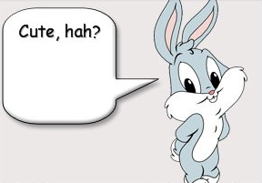
Effects

Slide 76
Showing or Hiding Element
  // just show
  $(“div”).show();
  // reveal slowly, slow=600ms
  $(“div”).show(“slow”);
  // hide fast, fast=200ms
  $(“div”).hide(“fast”);
  // hide or show in 100ms $(“div”).toggle(100);

Slide 77
Sliding Elements
  $(“div”).slideUp();
  $(“div”).slideDown(“fast”);
  $(“div”).slideToggle(1000);

Slide 78
Fading Elements
  $(“div”).fadeIn(“fast”);
  $(“div”).fadeOut(“normal”);
  // fade to a custom opacity
  $(“div”).fadeTo (“fast”, 0.5);
Fading === changing opacity

Slide 79
Detecting animation completion
  $(“div”).hide(“slow”, function() {
  alert(“The DIV is hidden”);
  });
  $(“div”).show(“fast”, function() {
  $(this).html(“Hello jQuery”);
  }); // this is a current DOM element
Every effect function has a (speed, callback) overload

Slide 80
Custom Animation
  // .animate(options, duration)
  $(“div”).animate({
  width: “90%”,
  opacity: 0.5,
  borderWidth: “5px”
  }, 1000);

Slide 81
Chaining Animation
  $(“div”).animate({width: “90%”},100)
  .animate({opacity: 0.5},200)
  .animate({borderWidth: “5px”});
By default animations are queued and than performed one by one

Slide 82
Controlling Animations Sync
  $(“div”)
  .animate({width: “90%”},
  {queue:false, duration:1000})
  .animate({opacity : 0.5});
The first animation will be performed immediately without queuing

Slide 83
EFFECTS DEMO

Slide 84

AJAX with jQuery

Slide 85
Loading content
  $(“div”).load(“content.htm”);
  // passing parameters
  $(“#content”).load(“getcontent.aspx”,
  {“id”:”33”, “type”:”main”});

Slide 86
Sending GET/POST requests
  $.get(“test.aspx”, {id:1},
  function(data){alert(data);});
  $.post(“test.aspx”, {id:1},
  function(data){alert(data);});

Slide 87
Retrieving JSON Data
  $.getJSON(“users.aspx”, {id:1},
  function(users)
  {
  alert(users[0].name);
  });

Slide 88
Retrieving JS Files
  $.getScript(“script.js”,
  function()
  {
  doSomeFunction();
  });

Slide 89
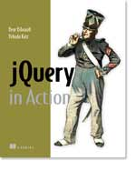
Where to go next
jQuery web-site: http://jquery.com
jQuery API: http://api.jquery.com
Many many blogs
jQuery in Action book:

