Slide 1
Variables, Data types and Operators in Java

Slide 2
Agenda
Variables
Data Types
Literals
Type cast
Operators

Slide 3
Variable
Variable is name of reserved area allocated in memory.
Named space in memory used to store data of one particular type.
Example: int count = 50;
Reserved Area
50
RAM

Slide 4
Variable
Identifiers
  Names for variables
Naming Convention
  Can be of any length
  Must start with a letter, $ or _
  Rest of identifier can include any character except those used as operators in java(+,*etc)
  Case sensitive i.e., one and One are different
  Cannot have blanks/spaces in identifiers
  Keywords cannot be used as identifiers

Slide 5
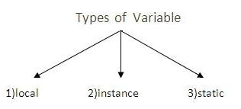
Types of Variables
Three types of variables in Java
  local variable
  instance variable
  static variable
Local Variable
  A variable that is declared inside the method is called local variable.
Instance Variable
  A variable that is declared inside the class but outside the method is called instance variable.
  It is not declared as static.
Static variable
  A variable that is declared as static is called static variable. It cannot be local.

Slide 6
Types of Variables
Example
class A {
int data = 100; //instance variable
static int m = 200; //static variable
void method() {
int n = 90; //local variable
}
} //end of class

Slide 7
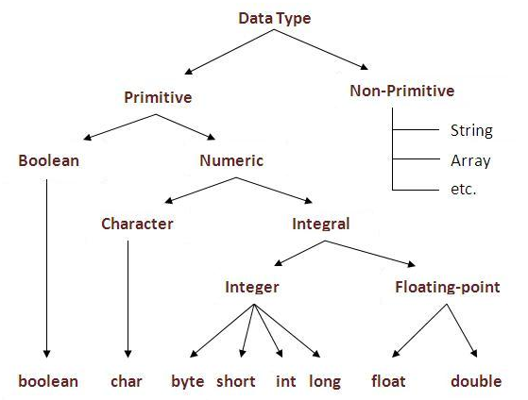
Data Types
What are Data Types:
  A classification in programming
  languages which indicates the type of value a variable can store.
Two types of data types
  primitive data types
  non-primitive data types
    Objects (Classes & Interfaces)
    and Arrays

Slide 8
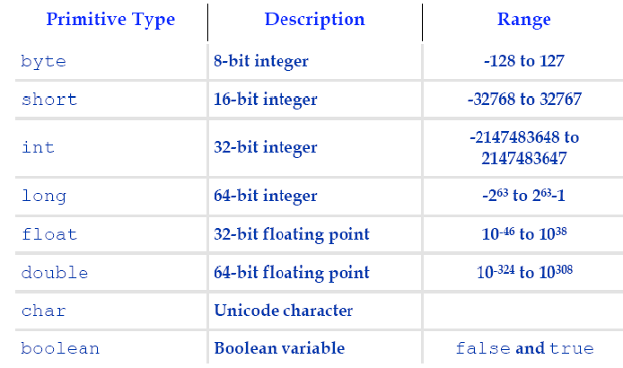
Java Primitive Data Types

Slide 9
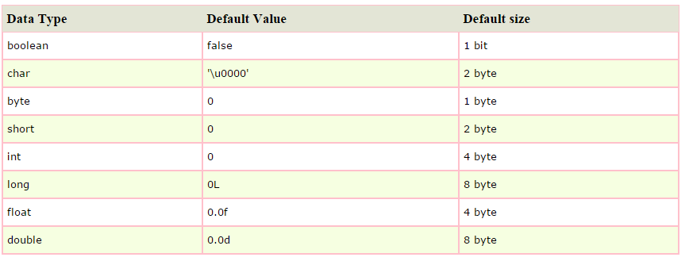
Java Primitive Data Types

Slide 10
Literals
A literal is a value that may be assigned to a variable of primitive data type or passed as an argument to a method call.
By literal we mean any number, text, or other information that represents a value.
Example
boolean result = true;
char capitalC = 'C';
byte b = 100;
short s = 10000;
int i = 100000;

Slide 11
Types of Literals
Integer literals
  Integer literal that you specify is of type int by default
  To specify a long value use L or l
Floating-point literals
- Identified by one of the followings:
  A decimal point
  The letter E or e indicating scientific notation
  The Suffix F or f indicating a float literal
  The Suffix D or d indicating a double literal
  - etc 1.414, 4.23E+21, 1.828f, 1234d
- Floating point literal is of type double by default

Slide 12
Types of Literals
Character literals
  Can be expressed by enclosing the desired character in single quotes
  If character not available on keyboard, use four Unicode hexadecimal digits preceded by \u
- 'N’, ‘+’, ‘\u4567’
Boolean literals
  True or false
String literals
  “Welcome to Uni”

Slide 13
Variable Declaration
For declaring a variable
  Specify the Data type and give it a name(identifier)
  Type identifier [= value][, identifier [= value] ….];
  Examples
    int x ;
    double cost, income = 120.50;
    char ch = ‘y’;

Slide 14
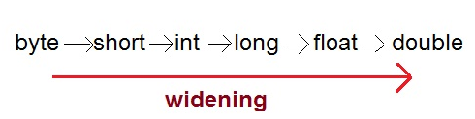
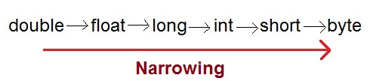
Type Casting
Assigning a value of one type to a variable of another type is known as Type Casting.
Example:
int x = 20;
byte y = (byte) x;
Two Types of Casting
  Widening Casting(Implicit)
  Narrowing Casting(Explicitly done)

Slide 15
Type Casting
Widening or Automatic type conversion
- Automatic Type casting take place when,
  the two types are compatible
  the target type is larger than the source type
  Example:
Narrowing or Explicit type conversion
- When assigning a larger type value to a variable of smaller type, then we need to perform explicit type casting.
Q. What is the value stored in b?
Ans: 20
byte a = 20;
byte b = 40;
byte c = 4;
int d = a*c/b;
double a = 20.795;
int b = (int) a;

Slide 16
Type Casting
Q: suppose you want to round the number?
Ans:
output: 21
Illegal to assign a floating-point expression to an integer variable
Error
Explicit Casts: used to convert a value to a different type
double a = 20.795;
int b = (int) Math.round(a);
double a = 20.795;
int b = a;
double a = 20.795;
int b = (int) a;

Slide 17
Type Casting
Q: What will be the output?
Compile time error
cannot assign any int to a byte
Q. What will be the solution to the above situation?
byte b = 40;
b = b*5;
byte b = 40;
b = (byte) (b*5);

Slide 18
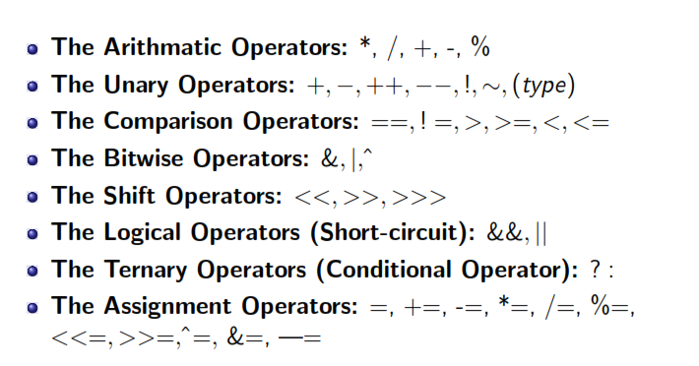
Operators in Java

Slide 19
Unary Operators
Increment / decrement operators
  ++ --
  Prefix and postfix versions
Unary plus (+) and unary minus (-)
  Multiplies the value by +1 or –1
  e.g. short x=11; x=-x;
Bitwise inversion operator ( ~ )
  Applied to integral types
  Converts all the 1 bits in a binary value to 0s and all the 0 bits to 1s.
  01100001 converted to 10011110

Slide 20
Unary Operators
Boolean complement operator (!)
  Inverts value of boolean expression
  e.g. if(!(x==5))
Cast operator (type)
  Explicit conversion of the type of expression
  e.g. double number=20.5;
  int num = (int) (number);
  Cannot be used with boolean data type

Slide 21
Arithmatic Operators
+ Operator is used to add two operands
– Operator is used to subtract the right operand from the left operand
* Operator is used to multiply the two operands
/ Operator is used to divide the left operand by right operand.
% (Modulo) Operator is used to get the remainder by dividing the left operand by right operand.

Slide 22
Shift Operators
Shifting is used for efficient multiplication and division by powers of two.
Take the binary representation of the number and move the bit pattern either left or right following some rules.
Syntax: value << num
<< (Left Shift Operator) shifts the bits to left and adds a 0 on the right (least significant bit).
>> (Right Shift Operator) shifts the bits to right and adds a 0 on the left (most significant bit) but 1 in case of signed numbers.
>>> (Unsigned Right Shift Operator) shifts the bits to
right and adds a 0 on the left (most significant bit).

Slide 23
Comparison Operators
Always evaluate to boolean result
Three types
  Ordinal: < <= > >=
  Equality: == !=
  Object: instanceof
< (Less than Operator) compares the two numeric values and returns true if left value is less than right value. Otherwise it returns false.
<= (Less than equal to Operator) compares the two numeric values and returns true if left value is less than or equal to right value. Otherwise it returns false.
> (Greater than Operator) returns true if left value is greater than right value. Otherwise it returns false.

Slide 24
Comparison Operators
>= (Greater than equal to Operator) compares the two numeric values and returns true if left value is greater than or equal to right value. Otherwise it returns false.
== (Equal to equal to Operator) compares the two numeric values and returns true if both are equal. Otherwise it returns false.
!= (Not equal to Operator) compares the two numeric values and returns true if both the values are not equal. Otherwise it returns false.
A instanceof Operator compares the left identifier with the right Class Name and returns true if left identifier is an object of right Class Name type. Otherwise it returns false.

Slide 25
Bitwise Operators
Can be used with both integral and boolean type
With boolean values, Bitwise Operators return true or false ( both operands must be boolean)
& (Bitwise AND Operator) compares each bit of the two integer values and returns the new integer value based on AND Operation on bits.
| (Bitwise OR Operator) compares each bit of the two integer values and returns a new integer value based on OR Operation on bits.
^ (Exclusive OR Operator) compares each bit of the two integer values and returns a new integer value based on XOR Operation on the bits.

Slide 26
Short-Circuit Logical Operators
&& (Logical AND Operator) compares two boolean values and returns a true value if both the boolean values are true. Otherwise it returns false.
|| (Logical OR Operator) compares two boolean values and returns false if both the boolean values are false. Otherwise it returns true.
What is the difference between && and &?
The difference of && and &, and || and | is that in && and ||, the right value might not be evaluated.

Slide 27
Ternary Operators
? : (Ternary Operator) is a compact version of if then else construct.
e.g. (boolean expression) ? value1 : value2 ;
a = (x>y) ? x : y ;
x and y should be of compatible type and a should be assignment compatible with both x and y.

Slide 28
Assignment Operators
op= ( Arithmetic assignment Operator). Where op can be any binary non-boolean operator.
e.g x *= y; is equivalent to x = x * y ;

Slide 29
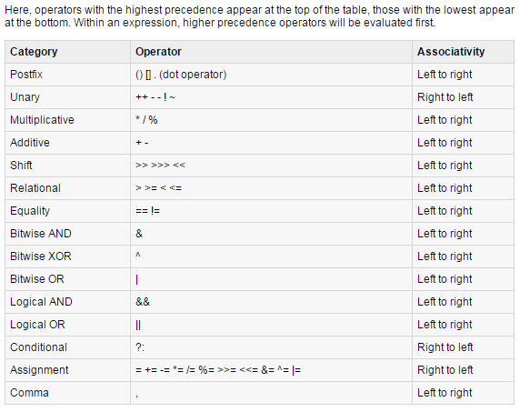
Precedence of Java Operators
Operator precedence determines the grouping of terms in an expression. This affects how an expression is evaluated.

Slide 30
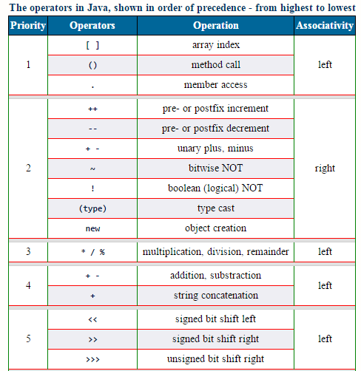
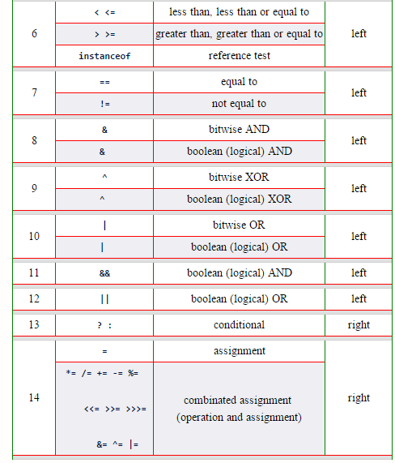
Precedence of Java Operators

