Slide 1

Barani Institute of Information Technology
Final Year Project Presentation
BIIT Social Forum
Presented By: Haris Jamil
Supervisor: Shahid Jamil

Slide 2
Introduction
BIIT Social Forum is the social networking application that connected to BIIT community.
Help’s Teacher and Student for Social Communication.
Just BIIT community can only register in the application.
View BIIT Alerts on a single Tab.
Application Consist of 6 walls BIIT Wall, Class Wall, Personal Wall, Session Wall, Teacher Wall and More.

Slide 3
Objectives and Functionalities
User must complete the successful login process before coming the Walls
Student/Teacher can Communicate.
Student/teacher can share their Ideas or information.
Student/teacher can share their images.
Student can view their Time table.
Teacher can Send intelligent post for their student how they teach.

Slide 4

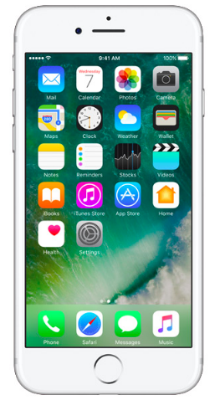
Conceptual Diagram
Request
Request
WEB SERVICE
Response
Response
Request
Response
User
Mobile
SQL DataBase

Slide 5
Tools and Technology
X-CODE (8.3.1), SWIFT 3
VISUAL STUDIO (2012)
SQL SERVER (2008 r2)

Slide 6
Data Flow Diagram
Level 0
O
BIIT SOCIAL FORUM
User
Database
Request
Request
Response
Response

Slide 7
Level 1
1
Login
Login Request
Admin
Student
Teacher
Accept/Reject
Login Request
Account
Accept/Reject
2
Activate
Account
Login Request
Accept/Reject

Slide 8
Level 2
1.1
Post
Create
Request
Admin
Student
Teacher
Response
Response
Post
1.2
View Walls
Request
Request
Response
Response
Notes:
djfhgkdfjhgkd

Slide 9
Entity Relation Diagram
Student
Register
Teacher
Friends
Account
Friend Request
Like
Add /
view
Post
Comment

Slide 10
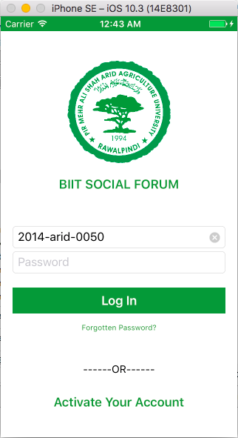
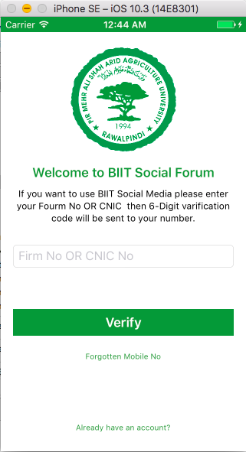
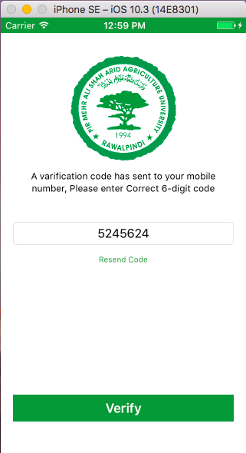
SNAP Shots
Login And Account Activation

Slide 11
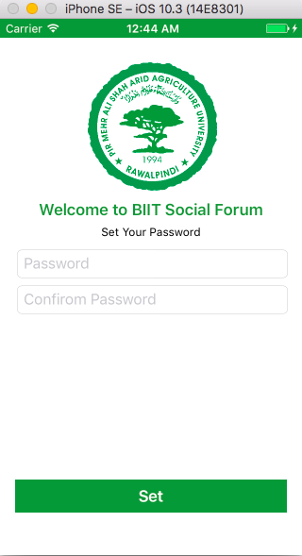
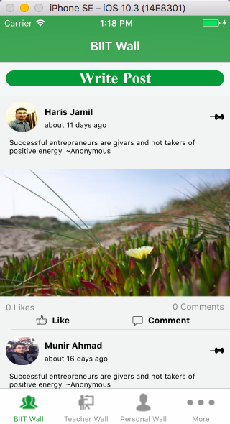
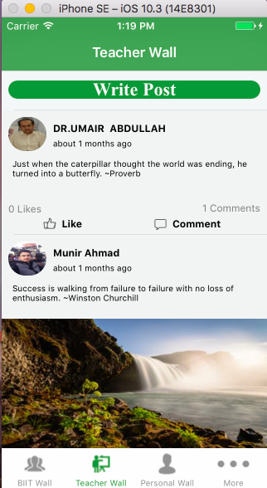
After Login Process
Set Password BIIT Wall Teacher Wall

Slide 12
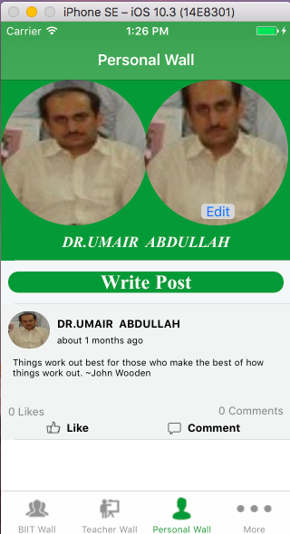
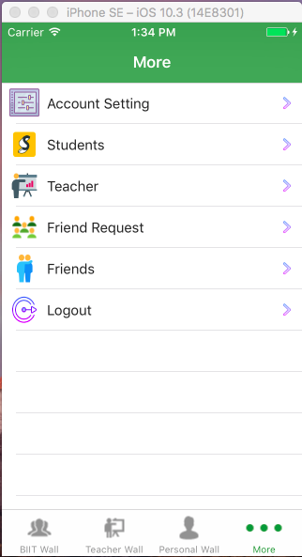
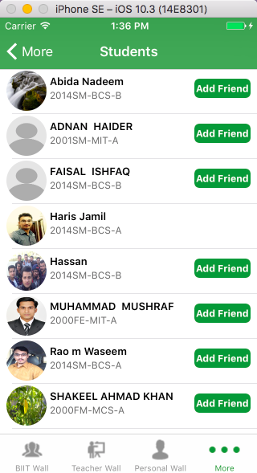
Teacher View
Personal Wall More View Students

Slide 13
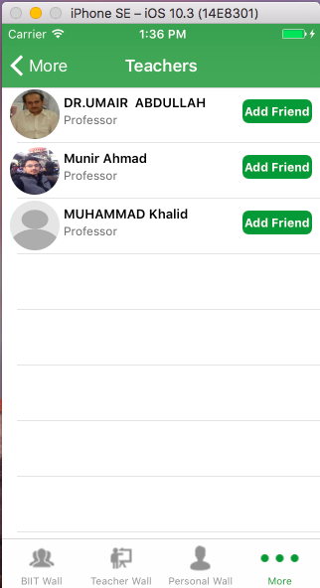
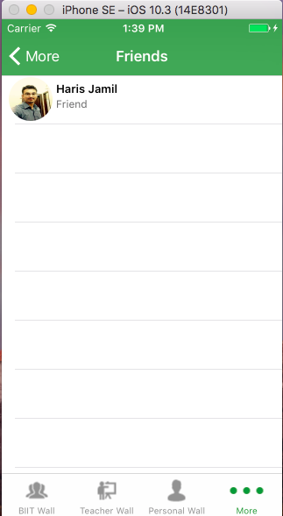
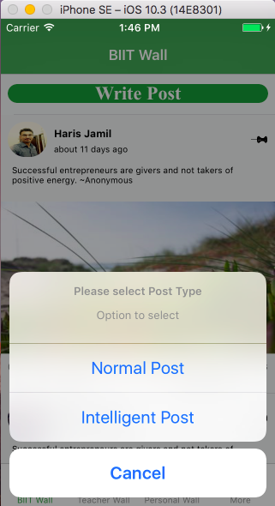
Teacher View
View Teacher View Friends Teacher Post Types

Slide 14
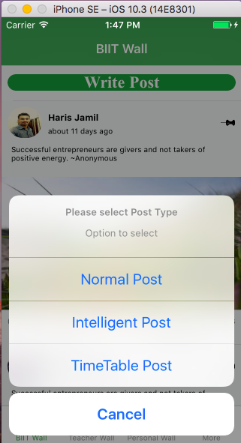
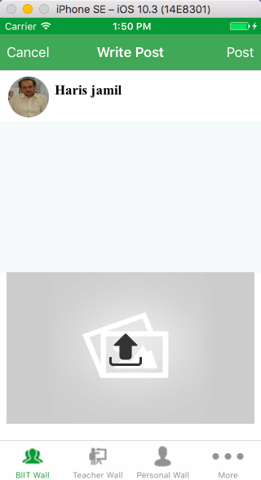
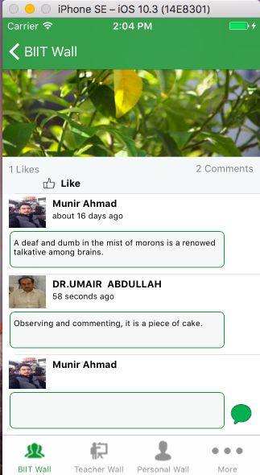
Teacher View
Admin Post Types Create Post View/Write Comment

Slide 15
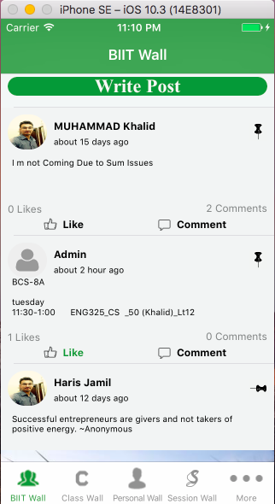
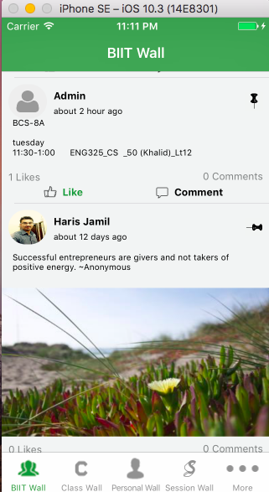
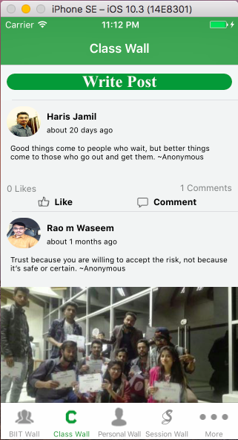
Student View
BIIT Wall Class Wall

Slide 16
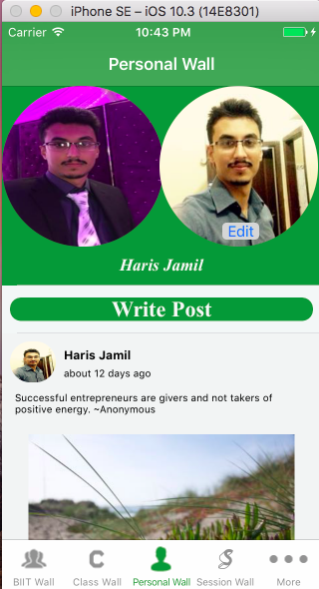
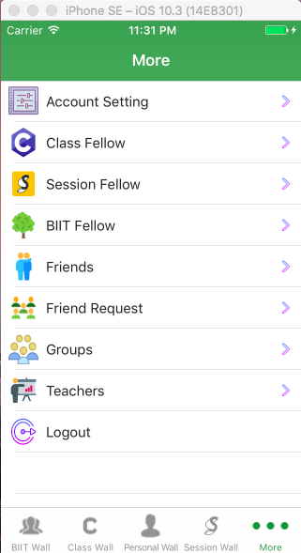
Student View
Personal Wall Session Wall More

Slide 17
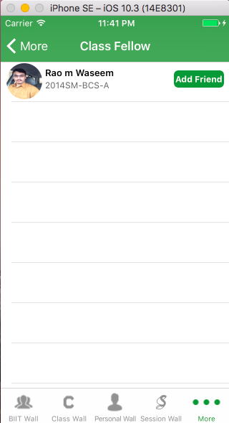
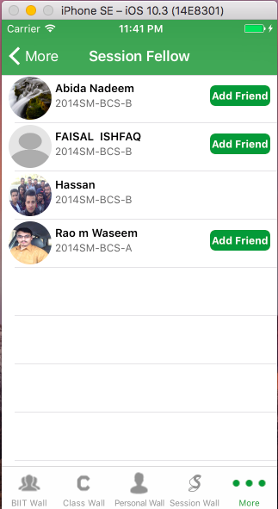
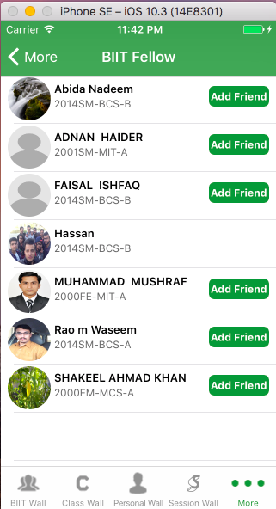
Student View
View Class fellow View Session Fellow BIIT Fellow

Slide 18
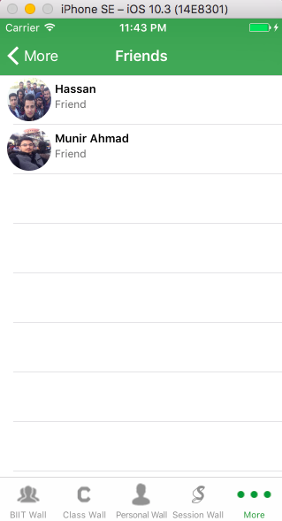
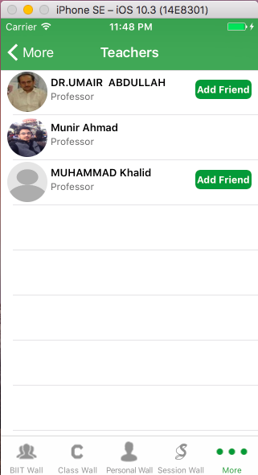
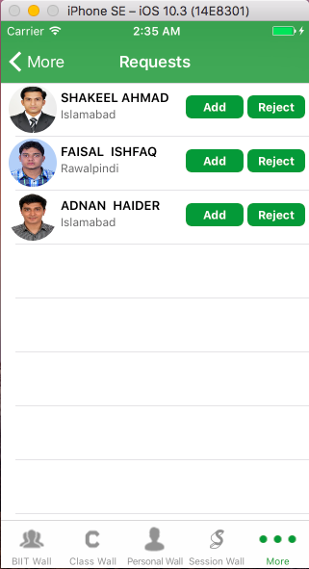
Student View
Friends View Teacher View Friends Request

Slide 19
THANK you

