Slide 1
EN
ENSHIELD REVAMP — EXEC BRIEF
The 4-minute version — what it is, what's wrong, what we do
Prepared for Mike

Slide 2
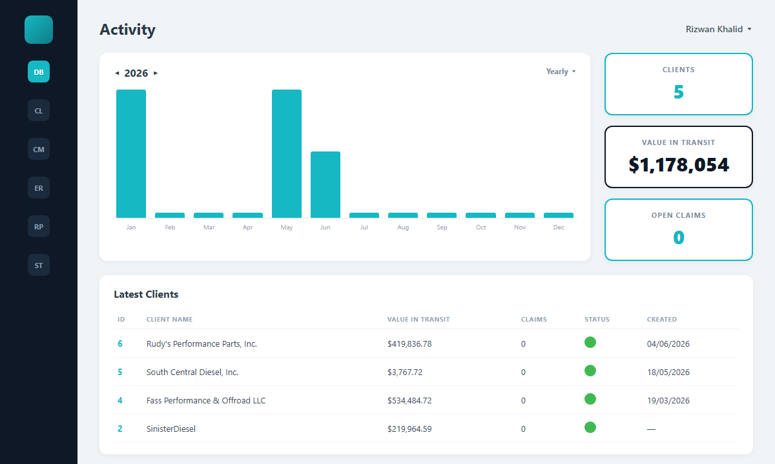
What We Have Today
Insanelab-built dashboard pulling Shopify data via Gadget — Activity, KPI cards, client table.

Slide 3
The Problem & The Plan
What's holding it back
What we do about it
▸ Efficiency — heavy Shopify reads on every load; no caching layer
▸ Stale surfaces — KPIs recomputed client-side, slow to render
▸ Hard to extend — new features mean touching raw Gadget data each time
▸ Design drift — dashboard doesn't match the Enshield brand site
▸ Aggregate in Gadget — pre-compute KPIs, dashboard just reads
▸ Cache + incremental sync — cut redundant Shopify calls
▸ Modular feature slots — add surfaces without schema surgery
▸ Re-skin to brand — match the Enshield public-site language

Slide 4
What I Need From You
▸ Feature wishlist — the exact surfaces you want added to the revamped dashboard
▸ Access confirmed — Gadget + DigitalOcean + Shopify (done — full audit complete)
▸ Priority call — efficiency-first refactor, or new features first?
Phased plan: 1) aggregate & cache → 2) re-skin → 3) new features
Full 11-slide blueprint available on request.

