Slide 1
EN
ENSHIELD SYSTEM BLUEPRINT
How Gadget · DigitalOcean · Shopify · Dashboard fit together
Findings & Architecture — prepared for Mike

Slide 2
The Big Picture (TL;DR)
We traced the whole Enshield stack end-to-end. There are two separate front-end surfaces, one Gadget backend holding the data & logic, a DigitalOcean droplet running a parallel dashboard, and Shopify as the source of truth for stores, orders & checkout.
SHOPIFY
GADGET
DIGITALOCEAN
DASHBOARD
Source of truth
Backend brain
Hosting / legacy
Two front ends
Stores, orders, carts, checkout, protection product
Syncs data, holds models, auto-generates the API
Droplet running a parallel dashboard
Embedded settings page + standalone admin UI
ENSHIELD · System Blueprint
2

Slide 3
The Four Systems
1 SHOPIFY
2 GADGET
Source of truth
Backend / brain
▸ Merchants install the Enshield app on their stores
▸ Owns shops, orders, line items, carts, checkout
▸ Protection product injected at checkout
▸ Enshield reads this — it does not replace Shopify
▸ App: enshield-shipping-protection (built on Gadget)
▸ Continuously syncs Shopify data into its models
▸ Models: shopifyShop, shopifyOrder, shopifyCart,
▸ shippingInsuranceProduct / Setting, sync, session
▸ Auto-generates the access-controlled API
3 FRONT ENDS
4 DIGITALOCEAN
Two surfaces (key finding)
Hosting / legacy
▸ A) Embedded Shopify app — 1 Polaris settings page
▸ B) Standalone admin dashboard — the dark UI with
▸ Value in Transit, Clients, Claims, Reports
▸ B is the real revamp target
▸ Droplet runs a version of the dashboard/backend
▸ Accessed via SSH to confirm prod setup
▸ Revamp decision: keep on DO, move to Gadget,
▸ or hybrid hosting
ENSHIELD · System Blueprint
3

Slide 4
How Data Flows
Merchant's Shopify Store
installs app · checkout adds protection
SHOPIFY
orders · carts · shops · checkout
webhooks / sync →
GADGET BACKEND
models + auto-generated, access-controlled API
hosted on / near DigitalOcean
A) Embedded Settings Page
B) Standalone Admin Dashboard
Polaris · inside Shopify admin · 1 screen
Value in Transit · Clients · Claims · Reports
ENSHIELD · System Blueprint
4

Slide 5
Dashboard KPIs → Gadget Data
Every number on the dark dashboard maps directly back to a Gadget model:
KPI
Comes from
Example
Clients
count of connected shopifyShop records
5
Value in Transit
Σ active shippingInsuranceProduct across open orders
$1,178,054
Open Claims
claims count from the claims workflow
0
Latest Clients
shopifyShop list w/ per-shop value, claims, status
table
ENSHIELD · System Blueprint
5

Slide 6
What This Means for the Revamp
▸ The embedded Shopify app is tiny — basically one settings screen. Easy to modernize.
▸ The real revamp target is the standalone admin dashboard (the dark UI). Rebuild it against the Gadget API so it always reflects live synced data.
▸ Gadget is the backend we build on — add aggregation/computed actions for the KPIs and expose clean, access-controlled reads.
▸ DigitalOcean is a hosting decision — keep, migrate to Gadget hosting, or hybrid.
ENSHIELD · System Blueprint
6

Slide 7
Phased Plan & Open Questions
Phased Plan
Need from Brain
Phase 1 — Architecture lock-in
▸ Feature list — what to add/change?
▸ Target surface — dashboard, embedded app, or both?
▸ Hosting — DigitalOcean, Gadget, or hybrid?
▸ Where the revamped code lives?
confirm target surface + hosting; reuse audit report as baseline
Phase 2 — Backend (Gadget)
aggregation actions for KPIs; clean access-controlled read API
Phase 3 — Frontend revamp
rebuild dashboard on Gadget API; modernize settings page
Phase 4 — New features
implement Brain's feature list
ENSHIELD · System Blueprint
7

Slide 8
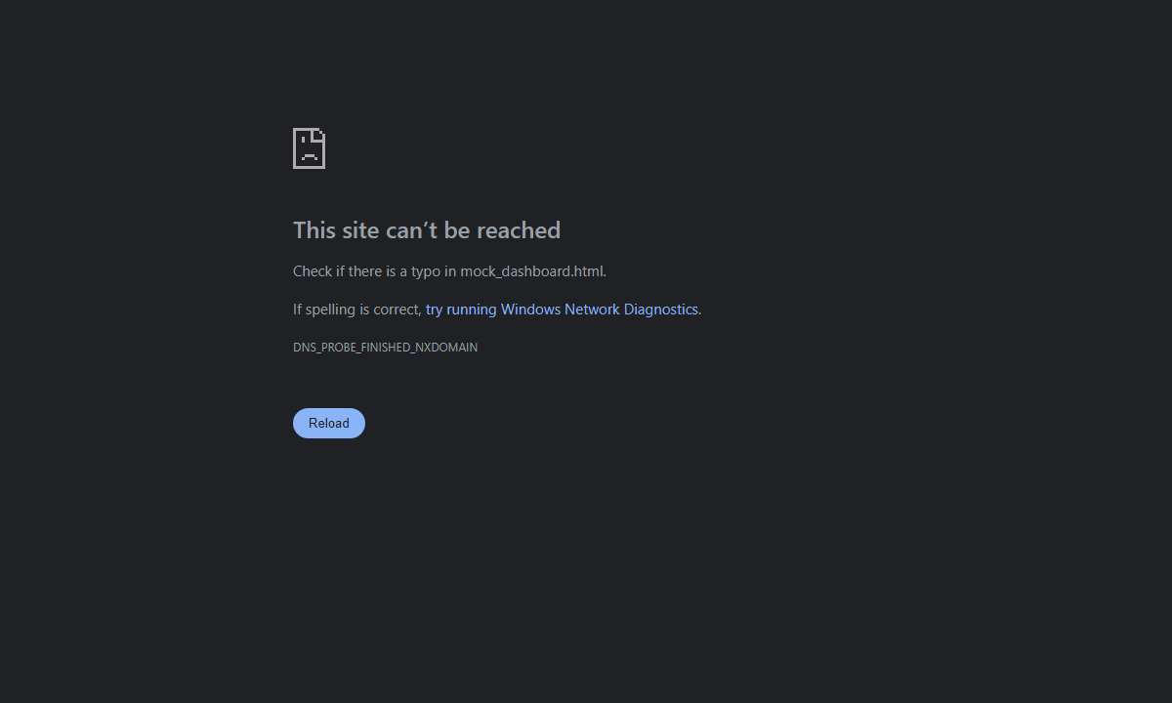
The Dashboard Today
Current Insanelab dashboard — Activity chart, KPI cards (Clients · Value in Transit · Open Claims), Latest Clients table. This is what we're revamping.

Slide 9

The Public Site
Enshield marketing homepage — the brand/design language the revamped dashboard should echo.

Slide 10

The Gadget Backend
Gadget apps list — per-merchant Shopify apps + the enshield-shipping-protection core. This is the real data source behind the dashboard.

Slide 11
One system. Four moving parts.
Shopify feeds Gadget · Gadget powers the dashboards · DO hosts them.
Answer the four questions and we start building.

