Slide 1
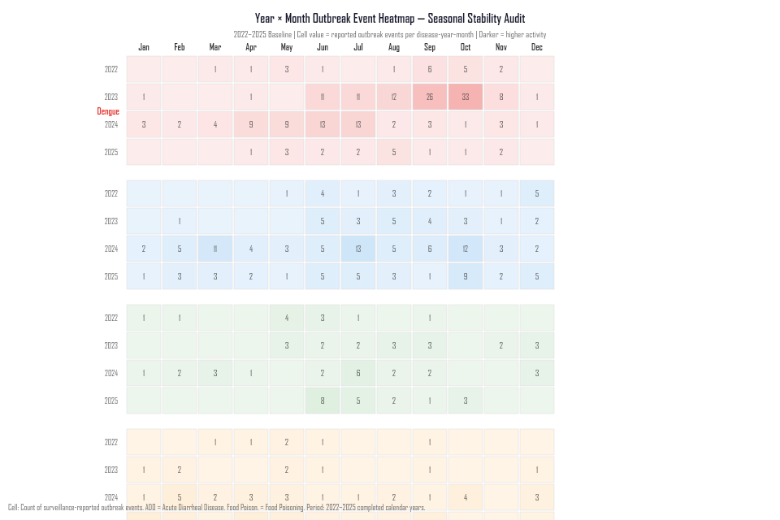
COMPARATIVE PROFILES // INTER-ANNUAL CONCORDANCE
Observed Calendar Concentration & Kendall’s W Stability
Measuring four-year monthly ranking consistency across 2022–2025 (tested at α = 0.05)
KENDALL’S W CONCORDANCE ANALYSIS
EXHIBIT: INTER-ANNUAL STABILITY HEATMAP
DISEASE FAMILY
CR3 (TOP 3 MO)
W-STAT
p-VALUE
Acute Diarrheal Dis.
43.1% (Jun–Aug)
0.530
0.016*
Statistically significant inter-annual concordance (p < 0.05)
Dengue
50.5% (Aug–Oct)
0.405
0.086
Non-significant (annual peak shifts between Sep and Oct)
Malaria
51.4% (May–Jul)
0.319
0.229
Non-significant (early-monsoon elevation with variable timing)
Food Poisoning
44.9% (Apr/May/Feb)
0.260
0.380
Non-significant (bimodal, sensitive to mass-case events)
Chikungunya
41.9% (May/Jun/Sep)
0.221
0.490
Non-significant (low baseline frequency across the year)
* Kendall’s W measures rank concordance (0 = no agreement, 1 = complete concordance). Tested at α = 0.05 across 4 completed years.
Figure: Kendall's W Rank Concordance across 2022–2025 (Phase 5C Analysis).
SOURCE: PHASE 5C ADVANCED STATISTICAL ANALYSIS | KENDALL'S W TESTING
06 / 10
Notes:
VIVA SCRIPT (35s):
This slide presents the results of our non-parametric Kendall's W concordance test across the four baseline years.
The critical empirical finding:
Only Acute Diarrheal Disease demonstrates statistically significant inter-annual concordance (W = 0.530, p = 0.016). This means ADD's monthly ranking is the most reliably repeated year after year.
Dengue (W = 0.405, p = 0.086), Malaria (W = 0.319, p = 0.229), and Food Poisoning (W = 0.260, p = 0.380) did not meet the α = 0.05 significance threshold.
DEFENSE POINT: Why did Dengue not achieve statistical significance despite high seasonal concentration? Because its exact peak month oscillates between September and October in different years.

