Slide 1
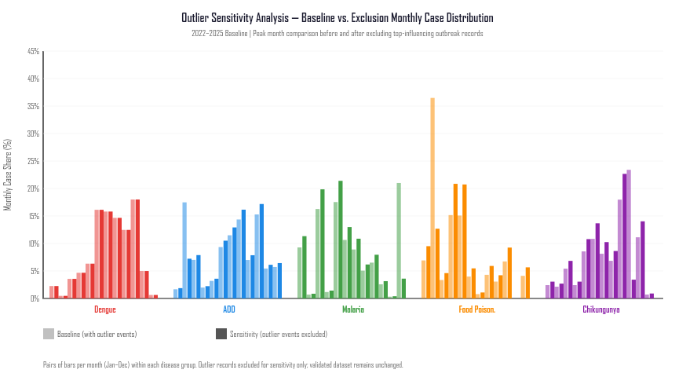
SENSITIVITY ANALYSIS // EVENT VS. CASE-VOLUME DIVERGENCE
How Three Records Shape Four-Year Case Totals
Demonstrating the critical separation between outbreak frequency and patient enumeration
THREE MASS-EXPOSURE OUTBREAK RECORDS
EXHIBIT: SENSITIVITY DECOMPOSITION
651
629
335
KOLHAPUR DISTRICT
PARBHANI DISTRICT
SOLAPUR DISTRICT
2024 Week 07
2025 Week 06
2023 Week 06
COMBINED IMPACT: 1,615 CASES FROM 3 OUTBREAKS
74.7%
27.3%
15.9%
SHARE OF FEBRUARY CASES
SHARE OF 4-YEAR TOTAL
FEBRUARY EVENT RATIO
1,615 of 2,162 Feb cases
1,615 of 5,927 total cases
Only 11 of 69 events
CRITICAL METHODOLOGICAL TAKEAWAY:
Event frequency and patient case volumes measure fundamentally distinct phenomena. Without sensitivity testing, February would appear to be a massive seasonal transmission peak, when it is actually driven by 3 localized high-volume cluster reports. No causal assumptions (e.g. catering) are made.
Figure: Monthly Food Poisoning cases with vs. without 3 outlier events (Phase 5C Analysis).
SOURCE: PHASE 5C OUTLIER SENSITIVITY ANALYSIS | NCDC IDSP SURVEILLANCE RECORDS
07 / 10
Notes:
VIVA SCRIPT (35s):
This slide demonstrates a core data science lesson: event frequency and case volume must never be conflated.
In Food Poisoning, February appears to have a huge spike in case volume. However, sensitivity analysis reveals that 1,615 of the 2,162 February cases came from just three records: Kolhapur (651), Parbhani (629), and Solapur (335).
These three records account for 74.7% of all February cases, and 27.3% of the four-year total across Maharashtra.
As shown in the exhibit on the right, removing these three events flattens the February peak completely.
ONE SENTENCE YOU MUST NOT SAY: Do not speculate about causes (weddings, hostels, street food). We have no source data for food types or gathering types.

