Slide 1
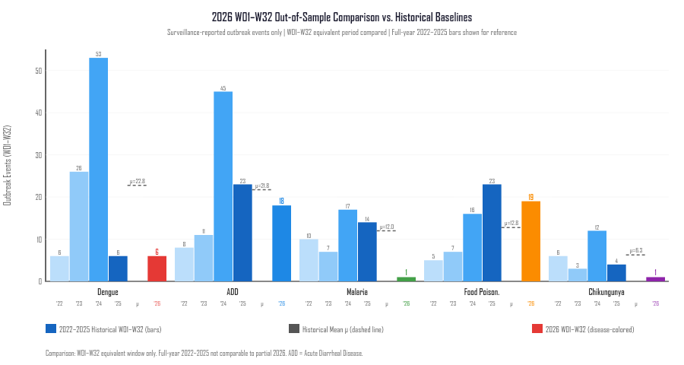
OUT-OF-SAMPLE COMPARISON // PARTIAL-YEAR SURVEILLANCE
2026 Surveillance Check (Weeks 01–32)
Evaluating out-of-sample data under explicit temporal truncation boundaries
PARTIAL-YEAR WINDOW // WEEKS 01–32 ONLY
EXHIBIT: 2026 SURVEILLANCE COMPARISON
45
1,118
0
RECORDS
CASES
DEATHS
W01–W32 primary cohort
Enumerated in clusters
Primary cohort to W32
1. DENGUE // TEMPORAL TRUNCATION BIAS
Dengue recorded 6 events (36 cases) up to Week 32. However, four-year baseline data demonstrates that 55.4% of all Dengue outbreaks occur after Week 32 (Sep–Dec). The 2026 observation window terminates before the historical surge window opens; week-32 totals are thus inherently incomplete.
2. FOOD POISONING // DIAGNOSTIC CLASSIFICATION EFFECT
Food Poisoning recorded 19 events (375 cases) in W01–W32, exceeding the historical early-year mean of 12.8 events (+49.0%). Notably, 100% of these 19 records were labeled 'Suspected' in source PDFs, indicating how syndromic reporting thresholds impact surveillance counts.
BOUNDARY: 2026 data is an out-of-sample check, not a validation or forecast.
Figure: 2026 W01–W32 event counts compared to historical 2022–2025 baseline (Phase 5C Analysis).
SOURCE: PHASE 5C OUT-OF-SAMPLE SURVEILLANCE COMPARISON | 2026 W01–W32
08 / 10
Notes:
VIVA SCRIPT (35s):
We evaluate 2026 strictly as an out-of-sample surveillance comparison covering Weeks 01 to 32. It cannot be directly compared to full calendar years.
Two critical observations emerge:
First, Dengue recorded only 6 events. This does not indicate a true disease decline — historical baseline analysis shows 55.4% of Dengue outbreaks occur after Week 32.
Second, Food Poisoning recorded 19 events, higher than the historical early-year mean. Crucially, 100% of these records were classified as 'Suspected' in source bulletins.
WHAT NOT TO SAY: Do not say '2026 confirms our model' or 'This proves disease decline.' It is a partial-year observation demonstrating surveillance dynamics.

