Slide 1
J
F
M
A
M
J
J
A
S
O
N
D
RP INSTITUTE · UNIVERSITY OF MUMBAI · B.SC. DATA SCIENCE — SEMESTER III
Analysis of Seasonal
Disease Patterns
Using Government Health Data: An Epidemiological Surveillance Study in Maharashtra
CANDIDATE & PROGRAMME
PRIMARY SURVEILLANCE SOURCE
EMPIRICAL SURVEILLANCE SCOPE
Khan Umar
NCDC / IDSP Weekly Outbreak Bulletins
Maharashtra (36 Districts)
B.Sc. Data Science · Sem III
Government of India Health Portals
2022–2025 Baseline + 2026 W01–W32
01 / 10
Notes:
VIVA SCRIPT (30s):
Respected examiners, good morning. I am Khan Umar, presenting my B.Sc. Data Science Semester III Field Project at RP Institute, affiliated to the University of Mumbai.
Our research title is 'Analysis of Seasonal Disease Patterns Using Government Health Data'.
We analyze official weekly outbreak surveillance reports published by the National Centre for Disease Control (NCDC / IDSP) across Maharashtra, establishing a rigorous 4-year empirical baseline (2022–2025) and evaluating a partial-year comparison for 2026.
WHAT NOT TO OVERCLAIM: This is secondary analysis of official government outbreak bulletins — not clinical laboratory fieldwork or population incidence estimation.

Slide 2
CENTRAL RESEARCH QUESTION // ANALYTICAL FRAMEWORK
Investigating Outbreak Seasonality in Maharashtra
PRIMARY RESEARCH INQUIRY
“What seasonal patterns are evident in selected disease outbreak reports in Maharashtra, and how do these patterns vary across diseases and seasons?”
01
TEMPORAL CONCENTRATION
02
INTER-ANNUAL STABILITY
03
EVENT / VOLUME DIVERGENCE
3-Month Concentration Ratio (CR3)
Kendall’s W Coefficient of Concordance
Sensitivity & Outlier Decomposition
Determines whether outbreak events cluster within specific calendar months or disperse uniformly across the surveillance year.
Tests whether monthly disease ranking repeats reliably across four completed years (2022–2025) or exhibits volatile, random shifts.
Evaluates how isolated mass-exposure outbreaks distort aggregate case volumes without altering underlying event frequency distributions.
RESEARCH METHODOLOGY // RP INSTITUTE // B.SC. DATA SCIENCE VIVA DEFENSE
02 / 10
Notes:
VIVA SCRIPT (35s):
Our research addresses one precise scientific inquiry: What seasonal patterns are evident in selected disease outbreak reports in Maharashtra?
To answer this with data-scientific rigor, we evaluate three analytical lenses:
1. Temporal concentration — calculating exact calendar-month clustering via 3-month concentration ratios (CR3).
2. Inter-annual stability — determining whether seasonal profiles repeat across years using Kendall's W concordance.
3. Event frequency versus case volume divergence — isolating how single mass-case events can distort monthly totals.
DEFENSE NOTE: This is framed as an administrative surveillance study. We do not hypothesize or claim biological causality.

Slide 3
DATA ENGINEERING PIPELINE // PROVENANCE & HARMONIZATION
From Weekly Government Reports to Structured Data
237
809
116
56
30
5
PDF BULLETINS
→
RAW RECORDS
→
DISEASE STRINGS
→
CLEAN LABELS
→
SYNDROMIC FAMILIES
→
PRIMARY COHORT
NCDC weekly surveillance archives
Maharashtra outbreak rows extracted
Spelling & formatting variants
Normalized nomenclature
Consolidated disease groups
93.9% of all baseline records
ADDITIVE NORMALIZATION // RAW STRINGS PRESERVED
FORENSIC AUDITABILITY // PDF PROVENANCE RETAINED
Source Disease Nomenclature Never Overwritten
Every Tabular Record Linked to Source Bulletin
• 116 unique raw strings (e.g. 'Dengue?', 'Dengue fever', 'Dengue Shock') mapped to canonical labels.
• Direct hyperlinkage to specific NCDC PDF filename and publication week number.
• Original source string preserved in every record under 'disease_raw' for total reproducibility.
• Table page number and reporting district cross-verified against official archives.
• Zero arbitrary alterations: ambiguous labels retained with full transformation audit rules.
• Automated integrity checks flag missing weeks, non-standard tables, and reporting anomalies.
DATA PIPELINE PROVENANCE // PHASE 5A DISEASE AUDIT & HARMONIZATION
03 / 10
Notes:
VIVA SCRIPT (35s):
A foundational contribution of this project is our reproducible data harmonization pipeline.
We processed 237 weekly government PDF bulletins from the NCDC, extracting 809 raw outbreak rows for Maharashtra.
Because official reports lack standardized spelling, we encountered 116 unique disease strings. We harmonized these into 56 clean labels and 30 syndromic families, selecting five primary families that account for 93.9% of all baseline outbreak records.
CRITICAL VIVA POINT: Every transformation is additive. The original disease_raw string was never overwritten, and each record maintains forensic provenance back to its specific source PDF and page number.

Slide 4
EMPIRICAL BASELINE // 2022–2025 COMPLETED YEARS
Four-Year Outbreak Surveillance Baseline (Maharashtra)
539
21,955
266
OUTBREAK RECORDS
REPORTED CASES
REPORTED FATALITIES
Investigated Clusters (2022–2025)
Enumerated Outbreak Patients
Surveillance Outbreak Deaths
District surveillance investigations across Maharashtra
Aggregated across official cluster reports (5 primary families)
Case fatality ratio: 1.21% across primary cohort
DENGUE
ACUTE DIARRHEAL DISEASE
MALARIA
FOOD POISONING
CHIKUNGUNYA
204 records
153 records
70 records
69 records
43 records
3,144 cases · 93 deaths
9,050 cases · 93 deaths
2,133 cases · 51 deaths
5,927 cases · 29 deaths
701 cases · 0 deaths
Peak: Oct (Aug–Oct CR3 50.5%)
Peak: Jun–Aug (CR3 43.1%)
Peak: May–Jul (CR3 51.4%)
Bimodal: Jan–Feb & Apr–May
Dispersed: May, Jun, Sep
NOTE: Reported cases represent patients in investigated outbreak clusters. These figures do not measure population disease incidence or community prevalence.
SOURCE: NCDC / IDSP WEEKLY OUTBREAK REPORTS (2022–2025 ANALYTICAL BASELINE)
04 / 10
Notes:
VIVA SCRIPT (35s):
Across the four completed calendar years 2022 to 2025, our primary analytical cohort comprises exactly 539 outbreak records, 21,955 reported cases, and 266 reported deaths.
A key observation is the divergence between event frequency and case enumeration:
- Dengue leads in event frequency with 204 records, but resulted in 3,144 cases.
- Acute Diarrheal Disease had 153 events but generated 9,050 cases.
- Food Poisoning caused 5,927 cases from just 69 events.
WHAT NOT TO OVERCLAIM: Do not refer to 21,955 as 'disease incidence'. These are patients enumerated within investigated outbreak clusters.

Slide 5

SEASONAL PATTERN ANALYSIS // EMPIRICAL BASELINE 2022–2025
Five Diseases. Five Distinct Temporal Signatures.
Calendar-month concentration curves derived from 539 investigated outbreak events
OBSERVED TEMPORAL CONCENTRATIONS
EXHIBIT: 4-YEAR MONTHLY EVENT DISTRIBUTIONS
1. DENGUE
Late-Monsoon / Post-Monsoon Peak
October peak (40 events). 82.8% of all events occur Jun–Oct. Aug–Oct CR3 = 50.5%.
2. ACUTE DIARRHEAL DISEASE
Early Monsoon Plateau + Oct Rise
Sustained elevation Jun–Aug (18-20 events/mo) with secondary Oct rise. CR3 = 43.1%.
3. MALARIA
Pre-Monsoon & Early Monsoon
Concentrates earlier in May–July (12–14 events/mo). May–Jul CR3 = 51.4%.
4. FOOD POISONING
Bimodal Non-Monsoon Windows
Two distinct peaks: Jan–Feb and Apr–May. Demonstrates no monsoon concentration.
5. CHIKUNGUNYA
Low-Count Dispersed Distribution
Low baseline frequency without a single dominant month (CR3 = 41.9%).
BOUNDARY: Calendar concentrations reflect surveillance reporting; no climate/rainfall causality is inferred.
Figure: Monthly outbreak event counts aggregated across 2022–2025 (Phase 5B Analysis).
SOURCE: PHASE 5B MONTHLY AGGREGATION MATRIX | NCDC OUTBREAK RECORDS
05 / 10
Notes:
VIVA SCRIPT (40s):
This is our core empirical visualization: five disease families exhibit five fundamentally distinct temporal signatures across Maharashtra.
As shown in the official analytical chart on the right:
1. Dengue concentrates heavily in late monsoon and post-monsoon (August to October), peaking in October with 40 recorded events. 82.8% of all Dengue events fall between June and October.
2. Acute Diarrheal Disease maintains sustained elevation across June to August (18–20 events monthly) with an October secondary peak.
3. Malaria concentrates earlier, in May to July.
4. Food Poisoning exhibits a bimodal profile in non-monsoon months (Jan–Feb and Apr–May).
5. Chikungunya is dispersed at low event counts throughout the year.
ONE SENTENCE YOU MUST NOT SAY: Do not say 'Monsoon rainfall caused the Dengue outbreak.' Meteorological data was not co-modeled. We report observed calendar clustering.

Slide 6
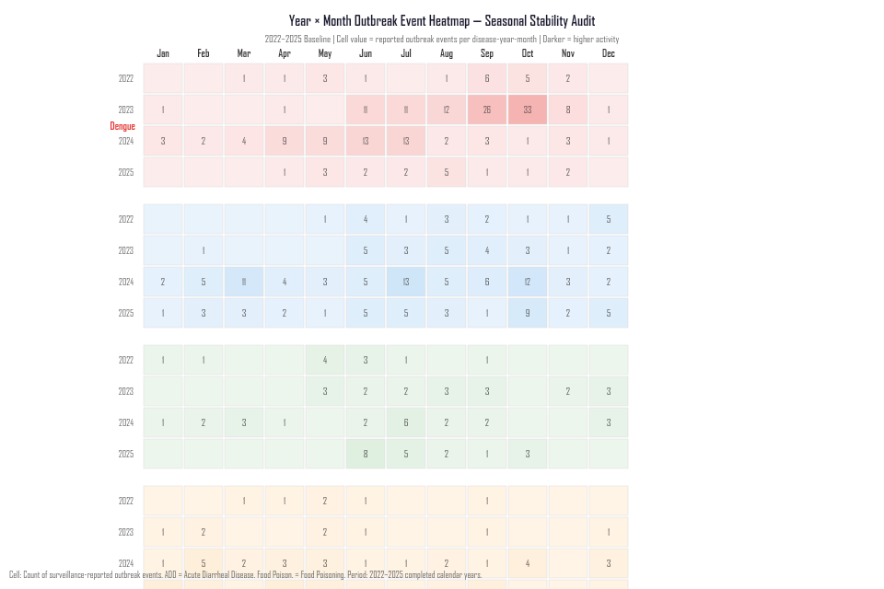
COMPARATIVE PROFILES // INTER-ANNUAL CONCORDANCE
Observed Calendar Concentration & Kendall’s W Stability
Measuring four-year monthly ranking consistency across 2022–2025 (tested at α = 0.05)
KENDALL’S W CONCORDANCE ANALYSIS
EXHIBIT: INTER-ANNUAL STABILITY HEATMAP
DISEASE FAMILY
CR3 (TOP 3 MO)
W-STAT
p-VALUE
Acute Diarrheal Dis.
43.1% (Jun–Aug)
0.530
0.016*
Statistically significant inter-annual concordance (p < 0.05)
Dengue
50.5% (Aug–Oct)
0.405
0.086
Non-significant (annual peak shifts between Sep and Oct)
Malaria
51.4% (May–Jul)
0.319
0.229
Non-significant (early-monsoon elevation with variable timing)
Food Poisoning
44.9% (Apr/May/Feb)
0.260
0.380
Non-significant (bimodal, sensitive to mass-case events)
Chikungunya
41.9% (May/Jun/Sep)
0.221
0.490
Non-significant (low baseline frequency across the year)
* Kendall’s W measures rank concordance (0 = no agreement, 1 = complete concordance). Tested at α = 0.05 across 4 completed years.
Figure: Kendall's W Rank Concordance across 2022–2025 (Phase 5C Analysis).
SOURCE: PHASE 5C ADVANCED STATISTICAL ANALYSIS | KENDALL'S W TESTING
06 / 10
Notes:
VIVA SCRIPT (35s):
This slide presents the results of our non-parametric Kendall's W concordance test across the four baseline years.
The critical empirical finding:
Only Acute Diarrheal Disease demonstrates statistically significant inter-annual concordance (W = 0.530, p = 0.016). This means ADD's monthly ranking is the most reliably repeated year after year.
Dengue (W = 0.405, p = 0.086), Malaria (W = 0.319, p = 0.229), and Food Poisoning (W = 0.260, p = 0.380) did not meet the α = 0.05 significance threshold.
DEFENSE POINT: Why did Dengue not achieve statistical significance despite high seasonal concentration? Because its exact peak month oscillates between September and October in different years.

Slide 7
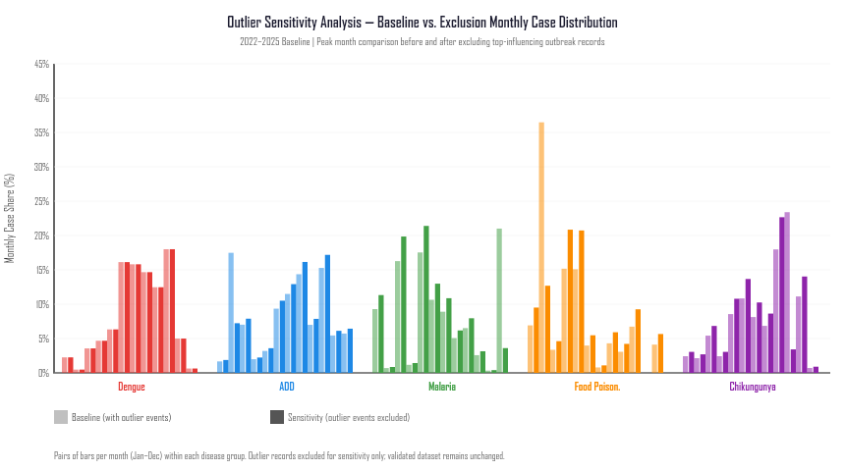
SENSITIVITY ANALYSIS // EVENT VS. CASE-VOLUME DIVERGENCE
How Three Records Shape Four-Year Case Totals
Demonstrating the critical separation between outbreak frequency and patient enumeration
THREE MASS-EXPOSURE OUTBREAK RECORDS
EXHIBIT: SENSITIVITY DECOMPOSITION
651
629
335
KOLHAPUR DISTRICT
PARBHANI DISTRICT
SOLAPUR DISTRICT
2024 Week 07
2025 Week 06
2023 Week 06
COMBINED IMPACT: 1,615 CASES FROM 3 OUTBREAKS
74.7%
27.3%
15.9%
SHARE OF FEBRUARY CASES
SHARE OF 4-YEAR TOTAL
FEBRUARY EVENT RATIO
1,615 of 2,162 Feb cases
1,615 of 5,927 total cases
Only 11 of 69 events
CRITICAL METHODOLOGICAL TAKEAWAY:
Event frequency and patient case volumes measure fundamentally distinct phenomena. Without sensitivity testing, February would appear to be a massive seasonal transmission peak, when it is actually driven by 3 localized high-volume cluster reports. No causal assumptions (e.g. catering) are made.
Figure: Monthly Food Poisoning cases with vs. without 3 outlier events (Phase 5C Analysis).
SOURCE: PHASE 5C OUTLIER SENSITIVITY ANALYSIS | NCDC IDSP SURVEILLANCE RECORDS
07 / 10
Notes:
VIVA SCRIPT (35s):
This slide demonstrates a core data science lesson: event frequency and case volume must never be conflated.
In Food Poisoning, February appears to have a huge spike in case volume. However, sensitivity analysis reveals that 1,615 of the 2,162 February cases came from just three records: Kolhapur (651), Parbhani (629), and Solapur (335).
These three records account for 74.7% of all February cases, and 27.3% of the four-year total across Maharashtra.
As shown in the exhibit on the right, removing these three events flattens the February peak completely.
ONE SENTENCE YOU MUST NOT SAY: Do not speculate about causes (weddings, hostels, street food). We have no source data for food types or gathering types.

Slide 8
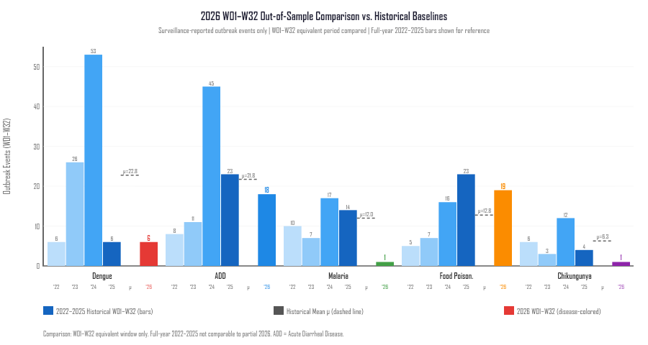
OUT-OF-SAMPLE COMPARISON // PARTIAL-YEAR SURVEILLANCE
2026 Surveillance Check (Weeks 01–32)
Evaluating out-of-sample data under explicit temporal truncation boundaries
PARTIAL-YEAR WINDOW // WEEKS 01–32 ONLY
EXHIBIT: 2026 SURVEILLANCE COMPARISON
45
1,118
0
RECORDS
CASES
DEATHS
W01–W32 primary cohort
Enumerated in clusters
Primary cohort to W32
1. DENGUE // TEMPORAL TRUNCATION BIAS
Dengue recorded 6 events (36 cases) up to Week 32. However, four-year baseline data demonstrates that 55.4% of all Dengue outbreaks occur after Week 32 (Sep–Dec). The 2026 observation window terminates before the historical surge window opens; week-32 totals are thus inherently incomplete.
2. FOOD POISONING // DIAGNOSTIC CLASSIFICATION EFFECT
Food Poisoning recorded 19 events (375 cases) in W01–W32, exceeding the historical early-year mean of 12.8 events (+49.0%). Notably, 100% of these 19 records were labeled 'Suspected' in source PDFs, indicating how syndromic reporting thresholds impact surveillance counts.
BOUNDARY: 2026 data is an out-of-sample check, not a validation or forecast.
Figure: 2026 W01–W32 event counts compared to historical 2022–2025 baseline (Phase 5C Analysis).
SOURCE: PHASE 5C OUT-OF-SAMPLE SURVEILLANCE COMPARISON | 2026 W01–W32
08 / 10
Notes:
VIVA SCRIPT (35s):
We evaluate 2026 strictly as an out-of-sample surveillance comparison covering Weeks 01 to 32. It cannot be directly compared to full calendar years.
Two critical observations emerge:
First, Dengue recorded only 6 events. This does not indicate a true disease decline — historical baseline analysis shows 55.4% of Dengue outbreaks occur after Week 32.
Second, Food Poisoning recorded 19 events, higher than the historical early-year mean. Crucially, 100% of these records were classified as 'Suspected' in source bulletins.
WHAT NOT TO SAY: Do not say '2026 confirms our model' or 'This proves disease decline.' It is a partial-year observation demonstrating surveillance dynamics.

Slide 9
EPIDEMIOLOGICAL METHODOLOGY // RESEARCH BOUNDARIES
Five Methodological Boundaries of This Analysis
Explicit scientific scope constraints ensuring academic rigor and defensibility
01
SURVEILLANCE ≠ POPULATION INCIDENCE
Government outbreak bulletins capture officially investigated disease clusters through passive administrative channels. Mild, treated-at-home, or uninvestigated endemic cases across the broader community are not enumerated.
02
NO CAUSAL OR CLIMATE ATTRIBUTION
This analysis identifies observed calendar-month outbreak concentrations only. Meteorological covariates (precipitation, humidity, temperature) were not co-modeled, precluding direct causal attribution to weather variables.
03
DIAGNOSTIC & REPORTING HETEROGENEITY
Diagnostic thresholds vary across districts and seasons. Clinical syndromic labels (e.g. 'Suspected' food poisoning) coexist with serologically confirmed entries in source PDFs, producing inherent reporting variance.
04
TEMPORAL TRUNCATION (2026 SURVEILLANCE)
The 2026 dataset spans Weeks 01–32 only. Diseases exhibiting second-half seasonal surge dynamics (notably Dengue, where 55.4% of historical events occur after W32) cannot be evaluated across this truncated window.
05
INSTITUTIONAL SURVEILLANCE SCOPE
Surveillance records capture public-sector investigation alerts. Outpatient consultations and private-sector clinical encounters that do not trigger formal IDSP rapid-response team deployments are not captured in these data.
METHODOLOGICAL BOUNDARIES // RP INSTITUTE // B.SC. DATA SCIENCE VIVA DEFENSE
09 / 10
Notes:
VIVA SCRIPT (35s):
A rigorous scientific presentation must define its boundaries clearly.
We state five explicit limitations:
1. Surveillance data reflects investigated clusters, not community incidence.
2. We make no causal claims — we report calendar clustering without meteorological co-modeling.
3. Diagnostic thresholds vary, including syndromic versus confirmed classifications.
4. 2026 data is truncated at Week 32, precluding full-year evaluation for late-season diseases like Dengue.
5. The dataset reflects public health surveillance records; private clinic treatments are outside its scope.
DEFENSE STRENGTH: Stating these boundaries proactively demonstrates mature scientific methodology and statistical integrity to the viva examiners.

Slide 10
SYNTHESIS // RESEARCH CONCLUSIONS
What the Four-Year Analysis Demonstrates
Summary of empirical findings across 539 investigated outbreak events in Maharashtra
01
DISTINCT TEMPORAL SIGNATURES
The five disease families exhibit fundamentally different calendar distributions: Dengue concentrates in Jun–Oct (Oct peak); Malaria in May–Jul; ADD shows sustained Jun–Aug elevation with Oct secondary activity; Food Poisoning is bimodal (Jan–Feb, Apr–May); Chikungunya is dispersed.
02
EVENT FREQUENCY VS. CASE VOLUME DIVERGENCE
Outbreak event counts and patient case totals can diverge substantially. A small number of mass-exposure records can dominate aggregate case volumes without altering underlying event frequency distributions.
03
STATISTICALLY SIGNIFICANT INTER-ANNUAL CONCORDANCE
Acute Diarrheal Disease demonstrates the only statistically significant inter-annual monthly ranking stability (Kendall’s W = 0.530, p = 0.016). All other disease families return non-significant concordance values.
04
OUTLIER SENSITIVITY IN CASE TOTALS
Food Poisoning case totals are overwhelmingly driven by three mass-exposure records (1,615 cases) accounting for 74.7% of all February cases and 27.3% of four-year baseline cases across Maharashtra.
05
PARTIAL-YEAR SURVEILLANCE BOUNDARIES
2026 Weeks 01–32 provides a partial out-of-sample comparison, not a full annual validation. Diseases with historical post-Week 32 surge patterns (notably Dengue) cannot be evaluated over this partial observation window.
SURVEILLANCE IMPLICATION
Historical concentration windows can assist public health authorities in prioritizing surveillance vigilance and logistical pre-positioning, while remaining strictly subject to reporting coverage constraints and source-data boundaries.
RESEARCH SYNTHESIS // KHAN UMAR // B.SC. DATA SCIENCE, RP INSTITUTE
10 / 10
Notes:
VIVA SCRIPT (40s):
In conclusion, four completed years of NCDC outbreak surveillance data across Maharashtra demonstrates five findings:
1. Disease families exhibit distinct calendar distributions rather than a single shared monsoon surge.
2. Event frequency and case volume are distinct metrics that diverge substantially during mass outbreaks.
3. Acute Diarrheal Disease demonstrates the only statistically significant inter-annual rank stability (W = 0.530, p = 0.016).
4. Food Poisoning case totals are heavily influenced by three localized mass-case records (74.7% of February cases).
5. 2026 W01–W32 is a partial-year comparison, not a full annual validation.
The operational implication: historical concentration windows can inform pre-positioning and vigilance timing, subject to reporting limitations.
Thank you, examiners. I welcome your questions.
WHAT NOT TO SAY: Do not prescribe medical interventions, clinical treatments, or use the word 'proves'.

