Slide 1
J
F
M
A
M
J
J
A
S
O
N
D
RP INSTITUTE · UNIVERSITY OF MUMBAI · B.SC. DATA SCIENCE — SEMESTER III
Analysis of Seasonal
Disease Patterns
Using Government Health Data: An Epidemiological Surveillance Study in Maharashtra
CANDIDATE & PROGRAMME
PRIMARY SURVEILLANCE SOURCE
EMPIRICAL SURVEILLANCE SCOPE
Khan Umar
NCDC / IDSP Weekly Outbreak Bulletins
Maharashtra (36 Districts)
B.Sc. Data Science · Sem III
Government of India Health Portals
2022–2025 Baseline + 2026 W01–W32
01 / 10
Notes:
VIVA SCRIPT (30s):
Respected examiners, good morning. I am Khan Umar, presenting my B.Sc. Data Science Semester III Field Project at RP Institute, affiliated to the University of Mumbai.
Our research title is 'Analysis of Seasonal Disease Patterns Using Government Health Data'.
We analyze official weekly outbreak surveillance reports published by the National Centre for Disease Control (NCDC / IDSP) across Maharashtra, establishing a rigorous 4-year empirical baseline (2022–2025) and evaluating a partial-year comparison for 2026.
WHAT NOT TO OVERCLAIM: This is secondary analysis of official government outbreak bulletins — not clinical laboratory fieldwork or population incidence estimation.

Slide 2
CENTRAL RESEARCH QUESTION // ANALYTICAL FRAMEWORK
Investigating Outbreak Seasonality in Maharashtra
PRIMARY RESEARCH INQUIRY
“What seasonal patterns are evident in selected disease outbreak reports in Maharashtra, and how do these patterns vary across diseases and seasons?”
01
TEMPORAL CONCENTRATION
02
INTER-ANNUAL STABILITY
03
EVENT / VOLUME DIVERGENCE
3-Month Concentration Ratio (CR3)
Kendall’s W Coefficient of Concordance
Sensitivity & Outlier Decomposition
Determines whether outbreak events cluster within specific calendar months or disperse uniformly across the surveillance year.
Tests whether monthly disease ranking repeats reliably across four completed years (2022–2025) or exhibits volatile, random shifts.
Evaluates how isolated mass-exposure outbreaks distort aggregate case volumes without altering underlying event frequency distributions.
RESEARCH METHODOLOGY // RP INSTITUTE // B.SC. DATA SCIENCE VIVA DEFENSE
02 / 10
Notes:
VIVA SCRIPT (35s):
Our research addresses one precise scientific inquiry: What seasonal patterns are evident in selected disease outbreak reports in Maharashtra?
To answer this with data-scientific rigor, we evaluate three analytical lenses:
1. Temporal concentration — calculating exact calendar-month clustering via 3-month concentration ratios (CR3).
2. Inter-annual stability — determining whether seasonal profiles repeat across years using Kendall's W concordance.
3. Event frequency versus case volume divergence — isolating how single mass-case events can distort monthly totals.
DEFENSE NOTE: This is framed as an administrative surveillance study. We do not hypothesize or claim biological causality.

Slide 3
DATA ENGINEERING PIPELINE // PROVENANCE & HARMONIZATION
From Weekly Government Reports to Structured Data
237
809
116
56
30
5
PDF BULLETINS
→
RAW RECORDS
→
DISEASE STRINGS
→
CLEAN LABELS
→
SYNDROMIC FAMILIES
→
PRIMARY COHORT
NCDC weekly surveillance archives
Maharashtra outbreak rows extracted
Spelling & formatting variants
Normalized nomenclature
Consolidated disease groups
93.9% of all baseline records
ADDITIVE NORMALIZATION // RAW STRINGS PRESERVED
FORENSIC AUDITABILITY // PDF PROVENANCE RETAINED
Source Disease Nomenclature Never Overwritten
Every Tabular Record Linked to Source Bulletin
• 116 unique raw strings (e.g. 'Dengue?', 'Dengue fever', 'Dengue Shock') mapped to canonical labels.
• Direct hyperlinkage to specific NCDC PDF filename and publication week number.
• Original source string preserved in every record under 'disease_raw' for total reproducibility.
• Table page number and reporting district cross-verified against official archives.
• Zero arbitrary alterations: ambiguous labels retained with full transformation audit rules.
• Automated integrity checks flag missing weeks, non-standard tables, and reporting anomalies.
DATA PIPELINE PROVENANCE // PHASE 5A DISEASE AUDIT & HARMONIZATION
03 / 10
Notes:
VIVA SCRIPT (35s):
A foundational contribution of this project is our reproducible data harmonization pipeline.
We processed 237 weekly government PDF bulletins from the NCDC, extracting 809 raw outbreak rows for Maharashtra.
Because official reports lack standardized spelling, we encountered 116 unique disease strings. We harmonized these into 56 clean labels and 30 syndromic families, selecting five primary families that account for 93.9% of all baseline outbreak records.
CRITICAL VIVA POINT: Every transformation is additive. The original disease_raw string was never overwritten, and each record maintains forensic provenance back to its specific source PDF and page number.

Slide 4
EMPIRICAL BASELINE // 2022–2025 COMPLETED YEARS
Four-Year Outbreak Surveillance Baseline (Maharashtra)
539
21,955
266
OUTBREAK RECORDS
REPORTED CASES
REPORTED FATALITIES
Investigated Clusters (2022–2025)
Enumerated Outbreak Patients
Surveillance Outbreak Deaths
District surveillance investigations across Maharashtra
Aggregated across official cluster reports (5 primary families)
Case fatality ratio: 1.21% across primary cohort
DENGUE
ACUTE DIARRHEAL DISEASE
MALARIA
FOOD POISONING
CHIKUNGUNYA
204 records
153 records
70 records
69 records
43 records
3,144 cases · 93 deaths
9,050 cases · 93 deaths
2,133 cases · 51 deaths
5,927 cases · 29 deaths
701 cases · 0 deaths
Peak: Oct (Aug–Oct CR3 50.5%)
Peak: Jun–Aug (CR3 43.1%)
Peak: May–Jul (CR3 51.4%)
Bimodal: Jan–Feb & Apr–May
Dispersed: May, Jun, Sep
NOTE: Reported cases represent patients in investigated outbreak clusters. These figures do not measure population disease incidence or community prevalence.
SOURCE: NCDC / IDSP WEEKLY OUTBREAK REPORTS (2022–2025 ANALYTICAL BASELINE)
04 / 10
Notes:
VIVA SCRIPT (35s):
Across the four completed calendar years 2022 to 2025, our primary analytical cohort comprises exactly 539 outbreak records, 21,955 reported cases, and 266 reported deaths.
A key observation is the divergence between event frequency and case enumeration:
- Dengue leads in event frequency with 204 records, but resulted in 3,144 cases.
- Acute Diarrheal Disease had 153 events but generated 9,050 cases.
- Food Poisoning caused 5,927 cases from just 69 events.
WHAT NOT TO OVERCLAIM: Do not refer to 21,955 as 'disease incidence'. These are patients enumerated within investigated outbreak clusters.

Slide 5

SEASONAL PATTERN ANALYSIS // EMPIRICAL BASELINE 2022–2025
Five Diseases. Five Distinct Temporal Signatures.
Calendar-month concentration curves derived from 539 investigated outbreak events
OBSERVED TEMPORAL CONCENTRATIONS
EXHIBIT: 4-YEAR MONTHLY EVENT DISTRIBUTIONS
1. DENGUE
Late-Monsoon / Post-Monsoon Peak
October peak (40 events). 82.8% of all events occur Jun–Oct. Aug–Oct CR3 = 50.5%.
2. ACUTE DIARRHEAL DISEASE
Early Monsoon Plateau + Oct Rise
Sustained elevation Jun–Aug (18-20 events/mo) with secondary Oct rise. CR3 = 43.1%.
3. MALARIA
Pre-Monsoon & Early Monsoon
Concentrates earlier in May–July (12–14 events/mo). May–Jul CR3 = 51.4%.
4. FOOD POISONING
Bimodal Non-Monsoon Windows
Two distinct peaks: Jan–Feb and Apr–May. Demonstrates no monsoon concentration.
5. CHIKUNGUNYA
Low-Count Dispersed Distribution
Low baseline frequency without a single dominant month (CR3 = 41.9%).
BOUNDARY: Calendar concentrations reflect surveillance reporting; no climate/rainfall causality is inferred.
Figure: Monthly outbreak event counts aggregated across 2022–2025 (Phase 5B Analysis).
SOURCE: PHASE 5B MONTHLY AGGREGATION MATRIX | NCDC OUTBREAK RECORDS
05 / 10
Notes:
VIVA SCRIPT (40s):
This is our core empirical visualization: five disease families exhibit five fundamentally distinct temporal signatures across Maharashtra.
As shown in the official analytical chart on the right:
1. Dengue concentrates heavily in late monsoon and post-monsoon (August to October), peaking in October with 40 recorded events. 82.8% of all Dengue events fall between June and October.
2. Acute Diarrheal Disease maintains sustained elevation across June to August (18–20 events monthly) with an October secondary peak.
3. Malaria concentrates earlier, in May to July.
4. Food Poisoning exhibits a bimodal profile in non-monsoon months (Jan–Feb and Apr–May).
5. Chikungunya is dispersed at low event counts throughout the year.
ONE SENTENCE YOU MUST NOT SAY: Do not say 'Monsoon rainfall caused the Dengue outbreak.' Meteorological data was not co-modeled. We report observed calendar clustering.

Slide 6
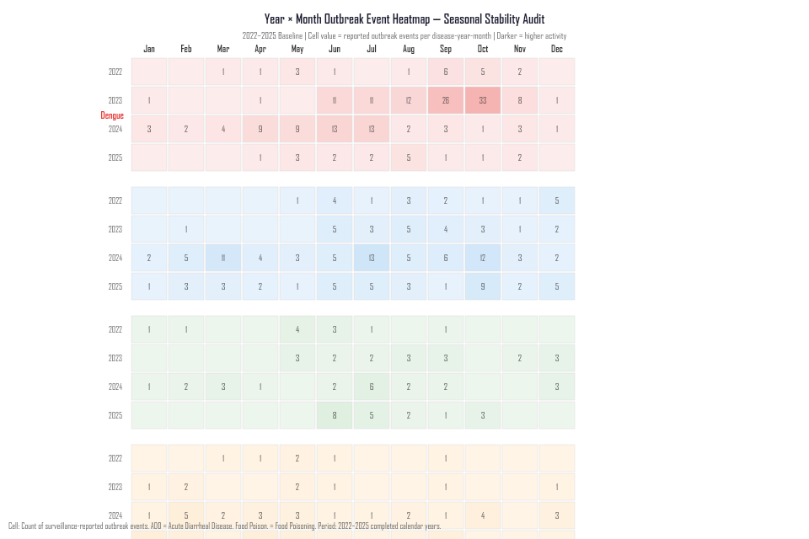
COMPARATIVE PROFILES // INTER-ANNUAL CONCORDANCE
Observed Calendar Concentration & Kendall’s W Stability
Measuring four-year monthly ranking consistency across 2022–2025 (tested at α = 0.05)
KENDALL’S W CONCORDANCE ANALYSIS
EXHIBIT: INTER-ANNUAL STABILITY HEATMAP
DISEASE FAMILY
CR3 (TOP 3 MO)
W-STAT
p-VALUE
Acute Diarrheal Dis.
43.1% (Jun–Aug)
0.530
0.016*
Statistically significant inter-annual concordance (p < 0.05)
Dengue
50.5% (Aug–Oct)
0.405
0.086
Non-significant (annual peak shifts between Sep and Oct)
Malaria
51.4% (May–Jul)
0.319
0.229
Non-significant (early-monsoon elevation with variable timing)
Food Poisoning
44.9% (Apr/May/Feb)
0.260
0.380
Non-significant (bimodal, sensitive to mass-case events)
Chikungunya
41.9% (May/Jun/Sep)
0.221
0.490
Non-significant (low baseline frequency across the year)
* Kendall’s W measures rank concordance (0 = no agreement, 1 = complete concordance). Tested at α = 0.05 across 4 completed years.
Figure: Kendall's W Rank Concordance across 2022–2025 (Phase 5C Analysis).
SOURCE: PHASE 5C ADVANCED STATISTICAL ANALYSIS | KENDALL'S W TESTING
06 / 10
Notes:
VIVA SCRIPT (35s):
This slide presents the results of our non-parametric Kendall's W concordance test across the four baseline years.
The critical empirical finding:
Only Acute Diarrheal Disease demonstrates statistically significant inter-annual concordance (W = 0.530, p = 0.016). This means ADD's monthly ranking is the most reliably repeated year after year.
Dengue (W = 0.405, p = 0.086), Malaria (W = 0.319, p = 0.229), and Food Poisoning (W = 0.260, p = 0.380) did not meet the α = 0.05 significance threshold.
DEFENSE POINT: Why did Dengue not achieve statistical significance despite high seasonal concentration? Because its exact peak month oscillates between September and October in different years.

