Slide 1
PRESENTATION OF STUDENT MANAGEMENT SYSTEM # INTERNSHIP PROJECT-TASK -2 @SYNTECXHUB

Slide 2

IT IS USED TO STORE THE DATA IN FILE ..

Slide 3
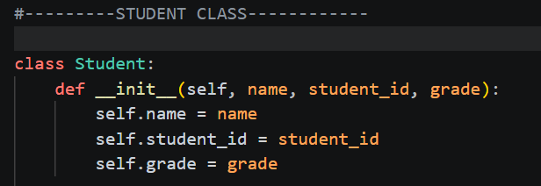
WE ARE CREATING THIS STUDENT CLASS TO REPRESENT THE EACH STUDENT AS AN OBJECT WITH PROPERTIES LIKE
NAME,STUDENT_ID,GRADE ..

Slide 4
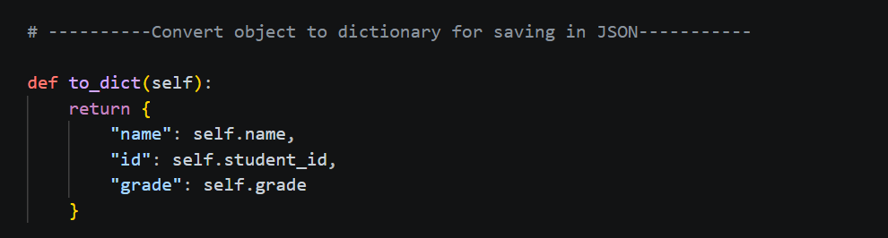
WE ARE CREATING THIS CODE BECAUSE JSON cannot store Python objects directly THAT WHY WE ARE CONVERTING OBJECTS TO DICTIONARY..

Slide 5
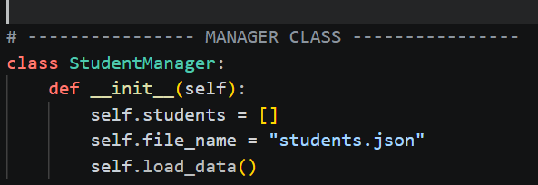
WE ARE WRITING THIS CODE BECAUSE TO STORE THE DATA AND TO LOAD THE DATA WHEN ITS Start the program..

Slide 6
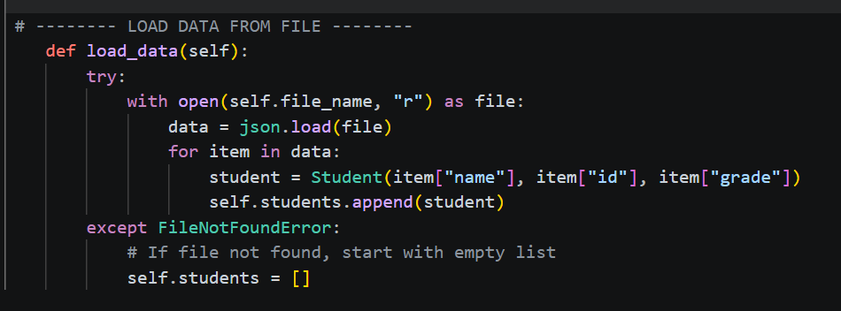
The purpose of this code is to load previously saved student data from a file and store it inside the program so it can be used again..

Slide 7
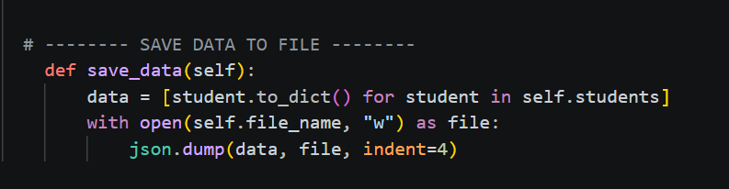
The purpose of this function is to save all student data from the program into a file so it is not lost..

Slide 8
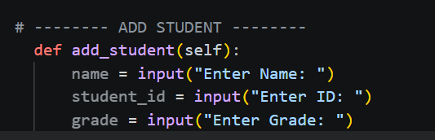
WE ARE WRITING THIS CODE BECAUSE to take student details (name, ID, grade) from the user so a new student can be added to the system..

Slide 9
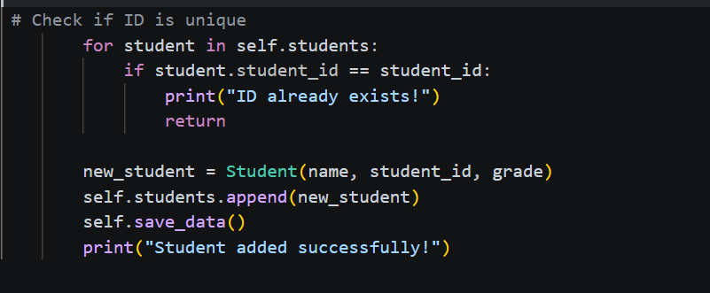
This code checks that the student ID is unique, then creates a new student, adds it to the list, saves it to the file, and confirms success..

Slide 10
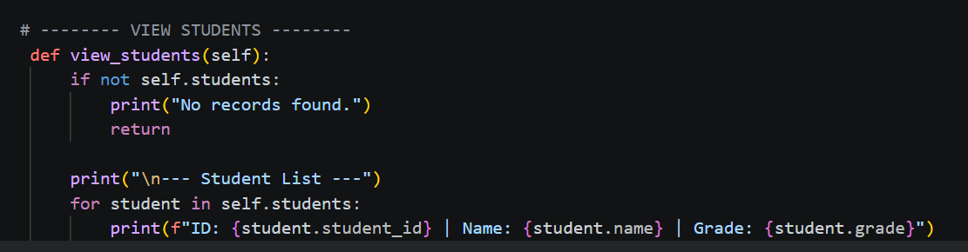
The purpose of this code is to display all student records stored in the system in a readable format..

Slide 11
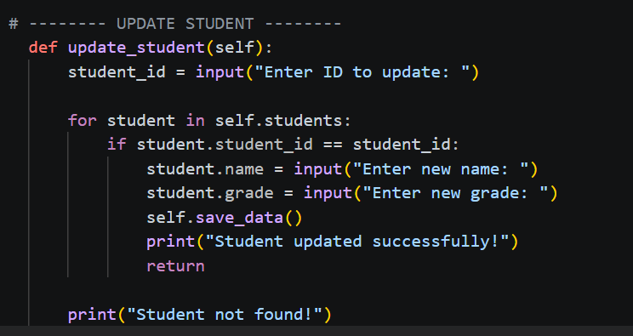
The purpose of this code is to find a student using their ID and update their details (name and grade), then save the changes..

Slide 12
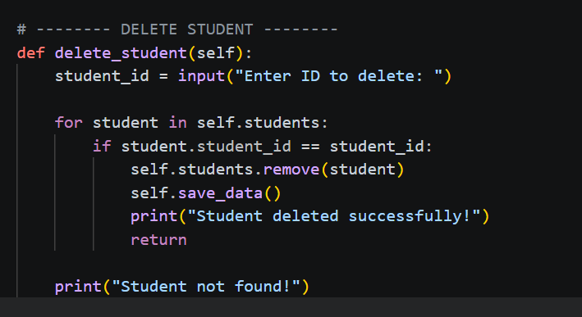
The purpose of this code is to find a student by their ID, remove them from the system, and update the file..

Slide 13
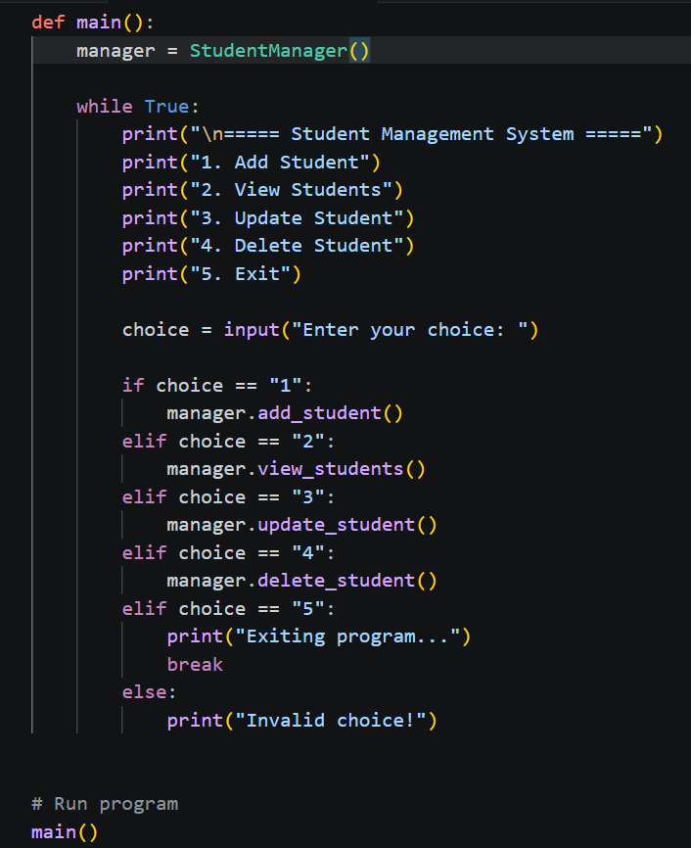
The purpose of this code is to run the program, show the menu, take user input, and call the correct function based on the user’s choice.

Slide 14
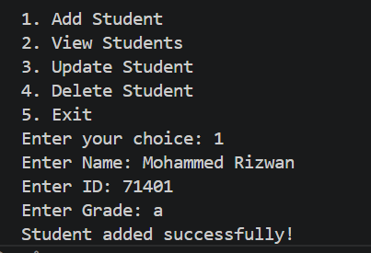
SUCCESSFULLY ADDED STUDENT NAME ID AND GRADE

Slide 15
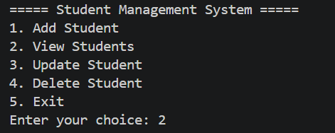
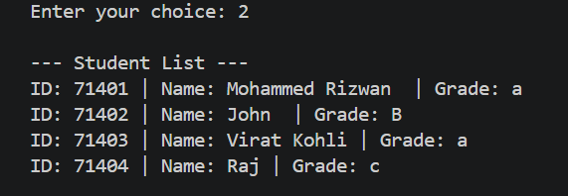
FIRST ADDED THE STUDENT DETAILS THEN VIEWED STUDENT DETAILS

Slide 16
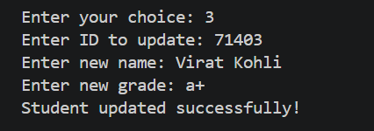
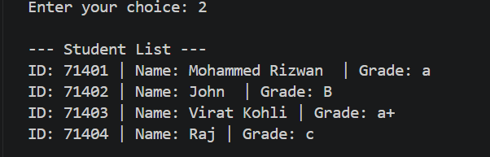
UPDATE THE GRADE DETAILS OF VIRAT KOHLI AS YOU CAN SEE IN THIS PRESENTATION..

Slide 17
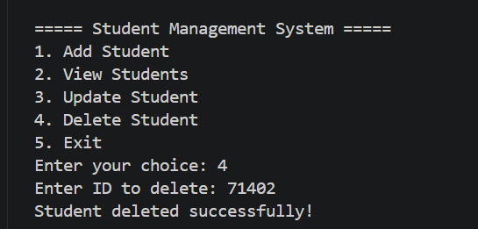
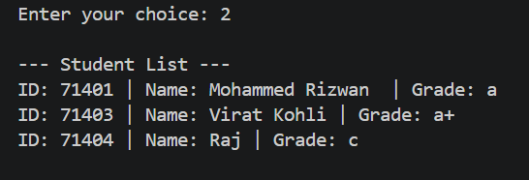
DELETED THE STUDENT DETAIL ID IS 71402 AND VIEWED THE STUDENT DETAILS AFTER DELETING AND IT HAS DELETED SUCCESSFULLY!!

Slide 18
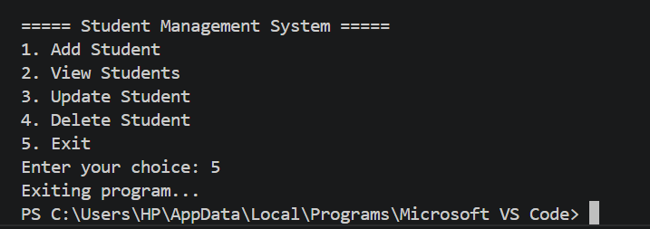
AFTER PERFORMING ALL OPERATIONS I HAVE SUCCESSFULLY EXITED THE PROGRAM

