Slide 1
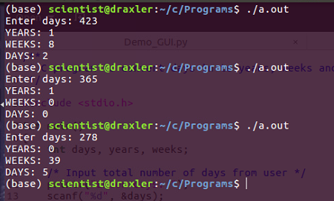
Problem 1 (20 Marks)
Write a C program to convert: Number of years, weeks and days given that total number of days by user.

Slide 2
Problem 2 (10 + 10 = 20 Marks)
Write a C program to calculate and print Simple (10 Marks) as well as Compound interest. (10 Marks)
Input:
Principle : 1200
Time: 2
Rate: 5.4
Output:
Simple Interest = 129.600006
Compound Interest = 1333.099243

Slide 3
Problem 3.1 (10 Marks)
Write a C Program to display the table of number (till 10th count) given that number is suggested by the user. (Table should in proper printing format. Perform this assignment without using loop concept.) (10 Marks)
Input:
Enter Number: 3
Output:
3 x 1 = 3
3 x 2 = 6
3 x 3 = 9
3 x 4 = 12
3 x 5 = 15
3 x 6 = 18
3 x 7 = 21
3 x 8 = 24
3 x 9 = 27
3 x 10 = 30

Slide 4
Problem 3.2 (10 + 10 = 20 Marks)
Write a C program to swap the value of two variables using temporary variable (10 Marks) and without temporary variable (10 Marks).
Input:
Number 1 = 20
Number 2 = 25
Output:
Number 1 = 25
Number 2 = 20

Slide 5
Problem 4 (30 Marks)
Given three corner points of a triangle, and one more point P. Write a C program to check whether point P lies within the triangle or not. Take three points as (X, Y) coordinates from user.
Input: (X, Y)
Point 1 – (0, 0)
Point 2 – (20, 0)
Point 3 – (10,30)
Point P – (10,15)
Output:
Point P lies within a triangle.

Slide 6
Problem 5.1 (10 Marks)
Given N, the number of non-parallel lines. Write a C program to find the maximum number of regions in which these lines can divide a plane.
Input :
N = 3
Output : 7 Regions
Input :
N = 2
Output : 4 Regions

Slide 7
Problem 5.2 (20 Marks)
Write a C Program to find number of squares of all size in a chessboard.
Input:
N = 2
Total Squares: 5
N = 3
Total Squares: 14

