Slide 1
Software Requirements
Version 1.0.0

Slide 2
Index
Revision History
GUI Design
Functionality

Slide 3
1. Revision History
Revision Number | Description | Author
1.0.0 | Initial version | Rushabh Jain

Slide 4
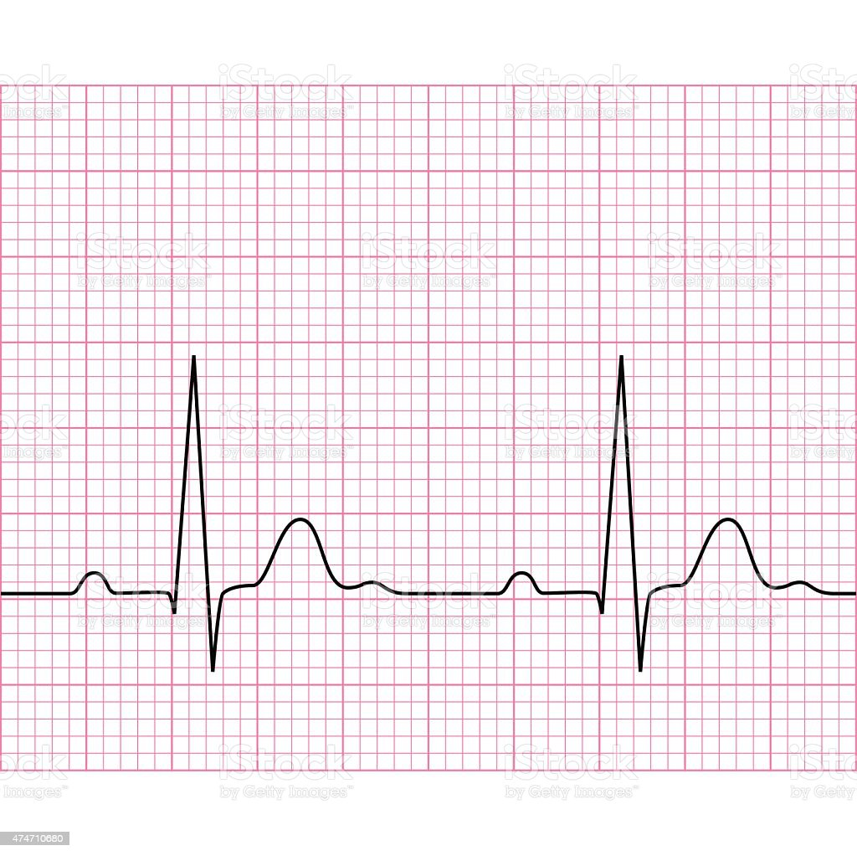
2. GUI Design
START
STOP

Slide 5
3. Functionality
3.1.1 The Software shall have one button for Starting the measurement and one button for Stopping the measurement.
3.1.2 The Software shall read the data from the USB port.
3.1.3 The Software shall have a window for displaying the real time heart-beat data.
3.1.4 On the graph, x axis will show time and y axis will show the amplitude (in Millivolts).
3.1.5 The resolution for the x axis and y axis shall be decided during implementation.

Slide 6
3. Functionality (Cont…)
3.2.1 When start button is clicked the software shall display the real time data on the graph as well as it will create a new csv file and start appending the data in the file(logging of the data).
3.2.2 The naming convention of the csv file will be “HBM_<ddmmyy>_<hhmmss>.csv”. The time will in 24 Hrs format.
3.2.3 When the stop button is clicked the software shall freeze the graph, stop taking the data from the device and it will save the csv file.
3.2.4 If the start button is pressed the second time the software shall not create a new csv file and will continue with it’s normal functionality.

