Slide 1

EVOLUTION
OF
MONEY

Slide 2

Barter System
Barter is an act of trading goods or services between two or more parties without the use of money.
Direct Barter – two or more parties directly trading items or services.
Managed Barter or Retail Barter –conducted between small businesses via a locally organized Trade Exchange.

Slide 3
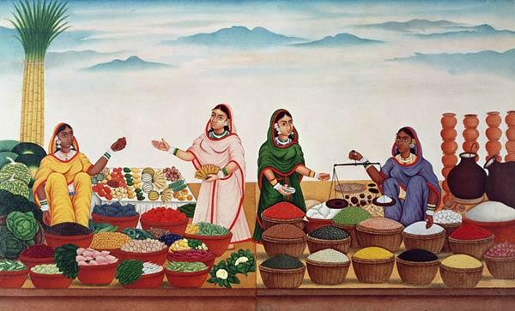
History of bartering dates all the way back to 6000 BC.
Introduced by Mesopotamia tribes, bartered goods to those located in various other cities across oceans.
Salt was an extremely valuable commodity which would be traded for a variety of goods.

Slide 4
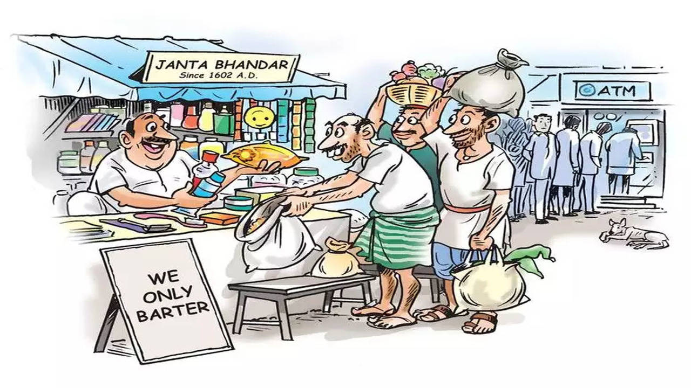
Advantages and Disadvantages of
barter system
Advantages :
It enables those who are lacking hard currency
to obtain goods and services.
The case of a simple barter transaction, there
will be no cost
Disadvantges :
Inflexibility; it may not always be possible to
find the right ‘match’
Lack of a common measure of value.

Slide 5
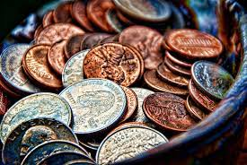
METALLIC MONEY
It is made of metals such as gold, silver copper etc.
There are two kinds of metallic money.
  Standard Metallic Money
  Token Metallic Money
metallic money faced many difficulties like weight & Value.
To solve this problem the metallic coins used with specific weight and shape.

Slide 6
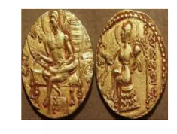
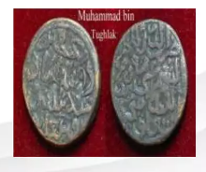
Token Metallic Money
It is made of a coin whose face value is greater than its intrinsic value.
Standard Metallic Money
It is the coin whose face value is equal to its intrinsic value.
This means that the value of the metal in the market is exactly the same as the value of the coin

Slide 7
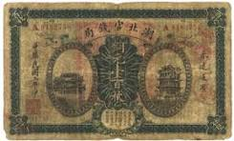
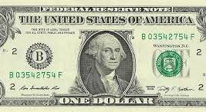
Paper Money
Refers to the notes issued by the
state or by the bank, usually the
central bank .
Paper money has its origins in 7th
century China during the Tang
Dynasty,The first recorded use was as
a form of promisory note.
The concept of paper money evolved
over time and spread to other regions
and civilizations.

Slide 8
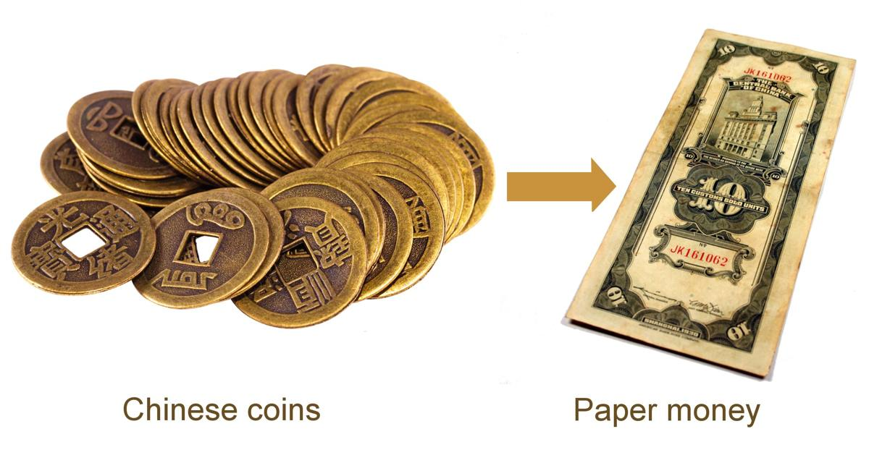
The switch from coins to paper money was influenced by several factors.
Paper money is lighter and more convenient to carry in large amounts, and it's also easier and cheaper to produce.

Slide 9
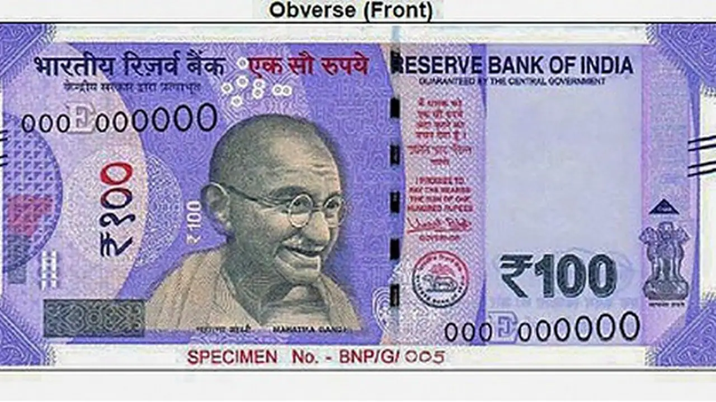
Indian Rupee (INR):
Common denominations include 10, 20, 50, 100, 200, 500, and 2000 rupee notes.
United States Dollar (USD):
Common denominations include 1, 5, 10, 20, 50, and 100 dollar bills.
US Dollar (USD): Around 75-80 INR
WHY?..........

Slide 10


Online Transaction
Dan Kohn, an entrepreneur who sold a Sting CD online in 1994 and was paid by use of a credit card to complete the transaction.
PayPal Founded in 1998, PayPal is among the world's first online payments companies
Unified Payments Interface is an Indian instant payment system developed by the National Payments Corporation of India in 2016

Slide 11
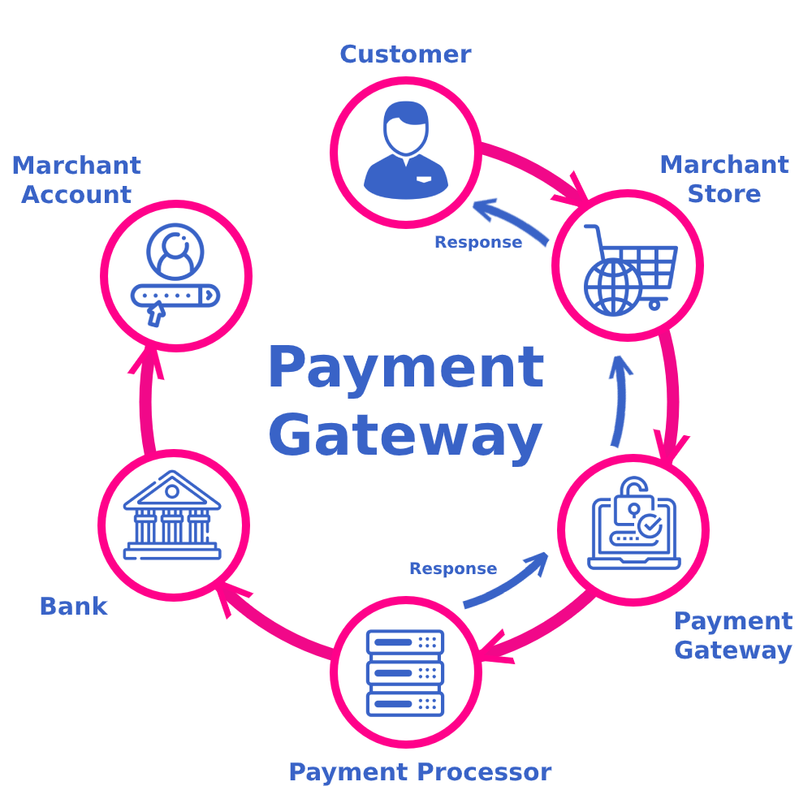
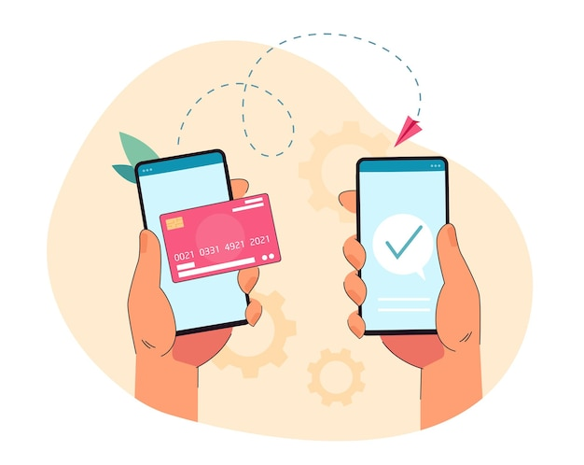
How it works and why it is needed ?
Buyers do not need to handle physical cash, as online payments allow them to make cashless purchases.
Instant process of payment verification.
No more worries on building a complex system for your business.

Slide 12
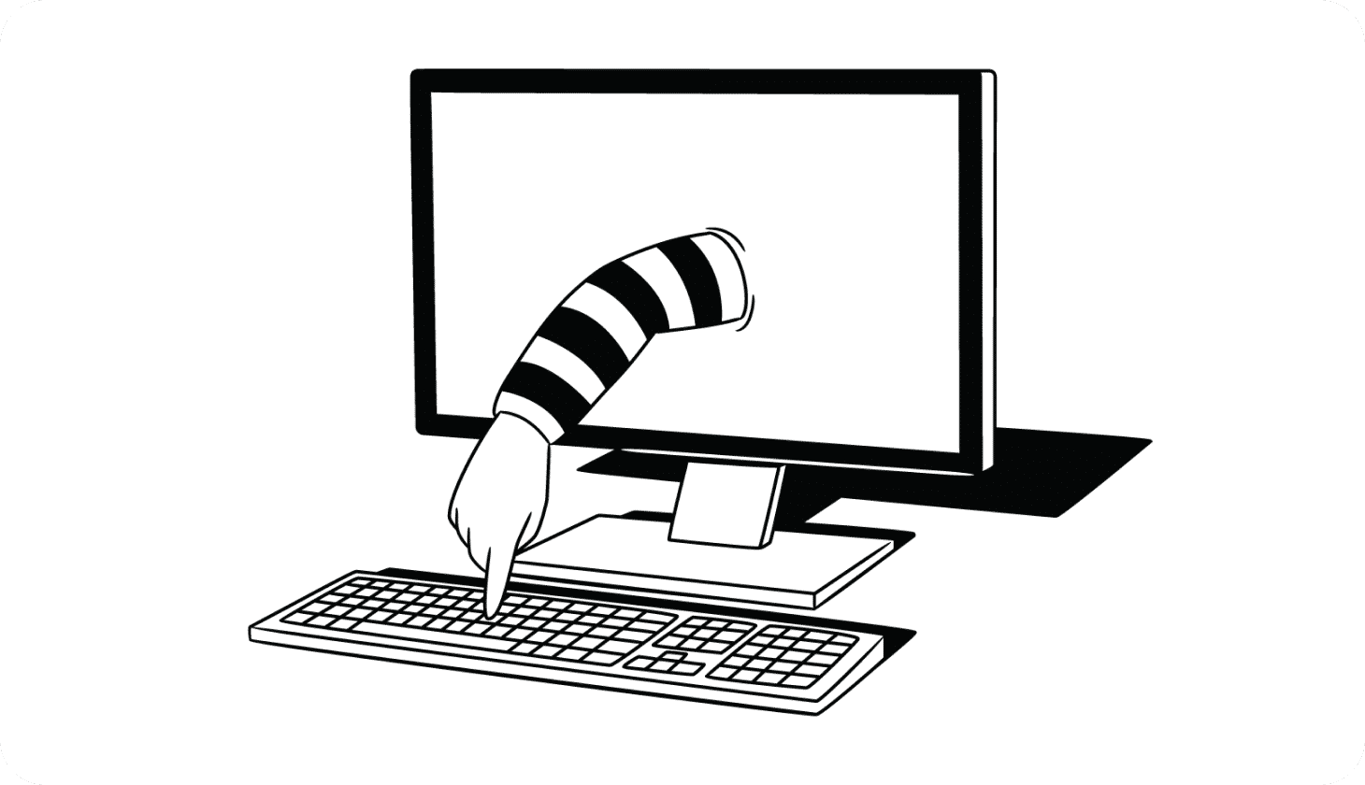
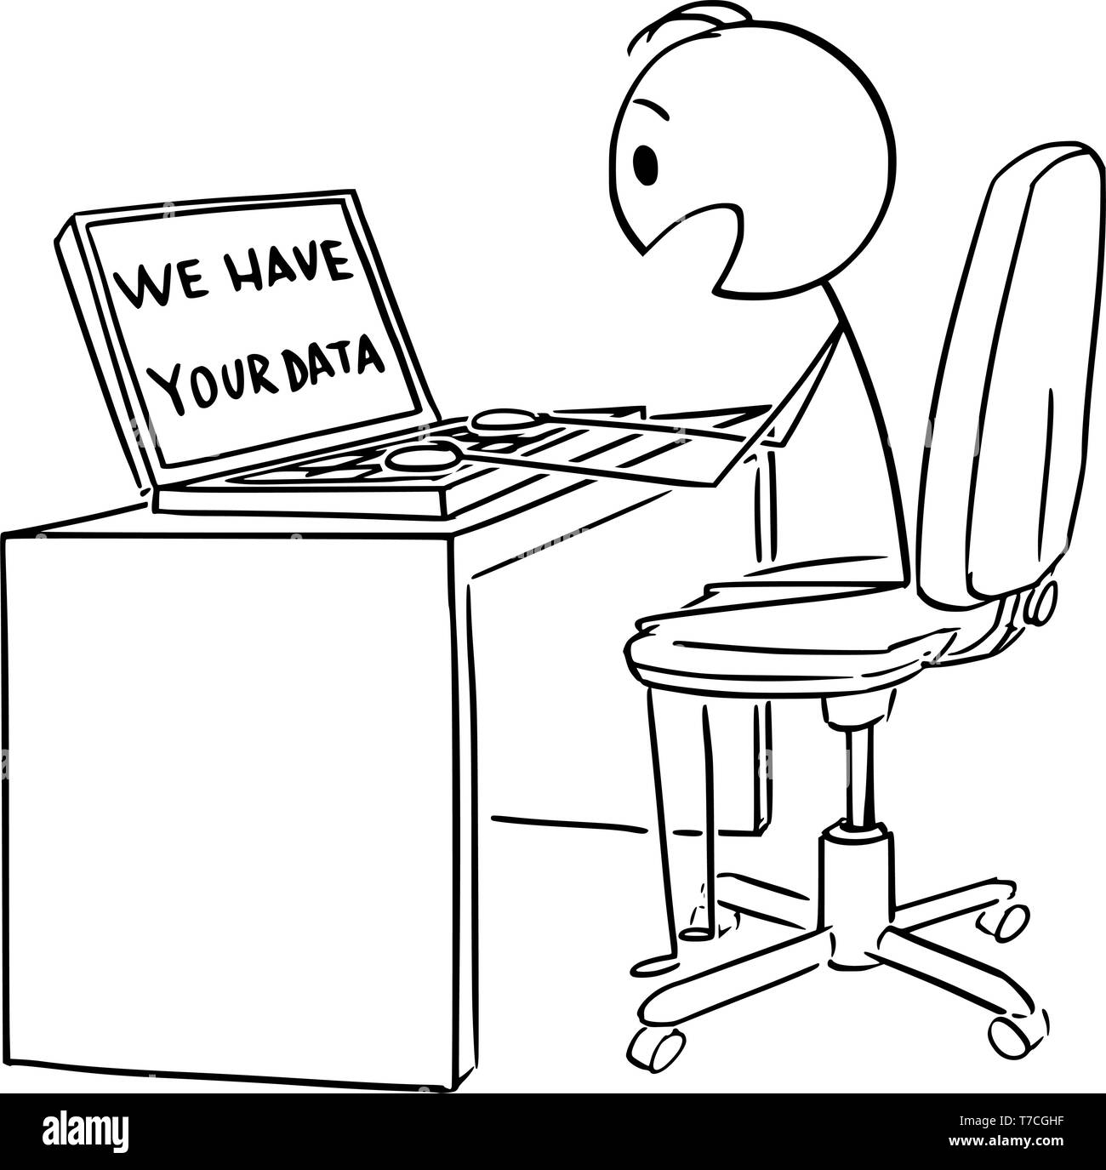
Disadvantages of Online payments
Lack of technology literacy
Threats to passwords
Cost of fraud
Misidentification

Slide 13

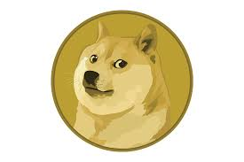
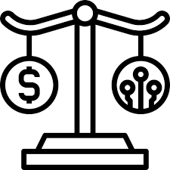
Future Money
Why we have the need for other form of money?
    Improve security
    Reduce corruption and Black money
Legality
    Might not be accepted by all countries
    Might be heavy loss while transferring to traditional way of transaction.

Slide 14

Cryptocurrency
Why Crypto is the best solution for future money?
    Decentralized system
History of Cryptocurrency
    January 2009 Bitcoin was created by anonymous person and his internet name was Satoshi Nakamoto
What makes Centralization and De Centralization differ?
decentralized system

Slide 15
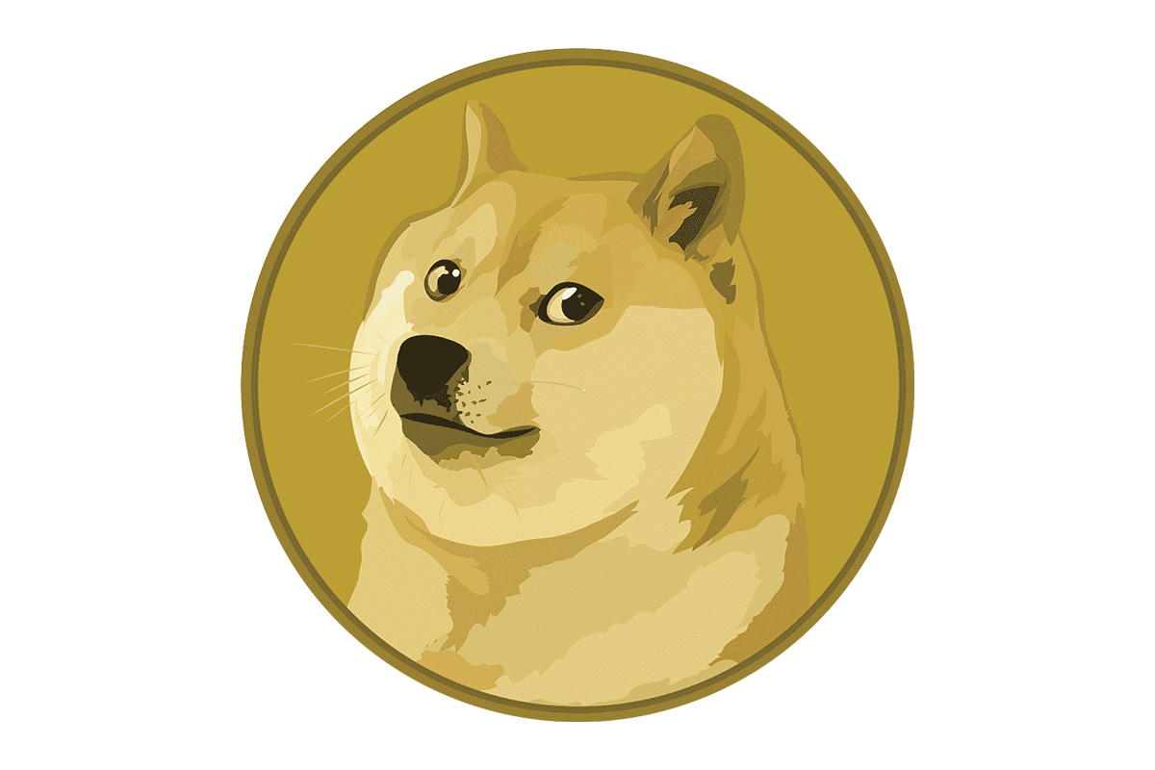


Different Types Of Cryptocurrency
Name : Bitcoin
Value : 36,39,292.04 INR
Founded by: unknown
Mined upto : 2140
Name : Etherum
Value : 1,91,192.73 INR
Founded by: Vitalik Buterin
Mined upto : Unknown
Name: Dodge-Coin
Value : 7.7 INR
Founded by: Billy Markus
Mined upto : Unknown

Slide 16
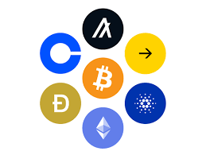
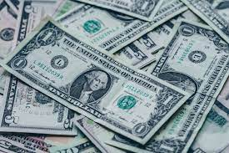
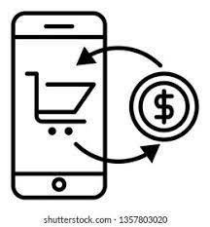

Conclusion
Barter system the ancient one
Metallic Coins
Paper Money
Online transaction
Crypto
Importance of money

Slide 17
Thank you

Slide 18

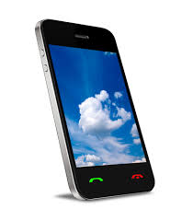

Slide 19
METALLIC MONEY
Metallic Money
It is made of metals such as gold, silver copper etc.
There are two kinds of metallic money.
Standard Metallic Money
Token Metallic Money
metallic money faced many difficulties like weight & Value.
To solve this problem the metallic coins used with specific weight and shape.

