Slide 1
CEO Pay at NSE 100 companies
Equipay Partners – your partner in all matters pay
www.equipaypartners.com
E: partner@equipaypartners.com

Slide 2
Index
CEO Pay
Short Term Incentive
Long Term Incentive
About Us
Methodology

Slide 3
Our approach
We have analysed the top 100 companies on the NSE (also known as NSE 100). Considering the development around increased disclosure requirements and scrutiny for listed Indian organisations, we think this report will provide relevant information for senior executives, Chairs of Boards and Compensation Committees as well as Chief Human Resources Officers.
As would be expected, there is significant variance among different sectors, organisation ownership and type and organisation sizes in the dataset.
The data presented in this report has been presented mainly at the Base Pay or Fixed Remuneration level as disclosure in the annual reports corresponding to incentive payout (opportunity vs actual pay) is relatively obscure.
For this report, we have combined CEO, Managing Director roles although we note pay differences between the 2 roles.
In addition to Fixed Pay information, we have also provided structural information about STI and LTI that is more prominently found in similar sized organisations.
This report, although has been produced with the NSE100 companies, can be used as a reference point for organisations outside the top 100.
Although not provided exclusively, the typical STI and LTI ranges for the CEO are as follows:
 | Short-Term Incentive | Long-Term Incentive
Target (as % of Base) | 50%-70% | 75%-100%
Maximum (as % of Base) | 75%-100% | 150%-200%

Slide 4
CEO Pay Data – different slices of NSE100

Slide 5
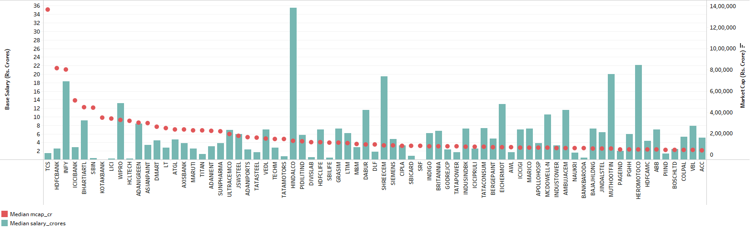
CEO pay as a function of company size (Market capitalization)

Slide 6
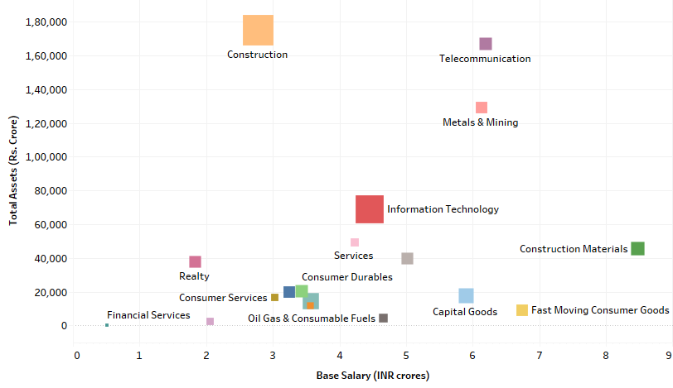
CEO pay as a function of company size (Total Assets and Sector)

Slide 7
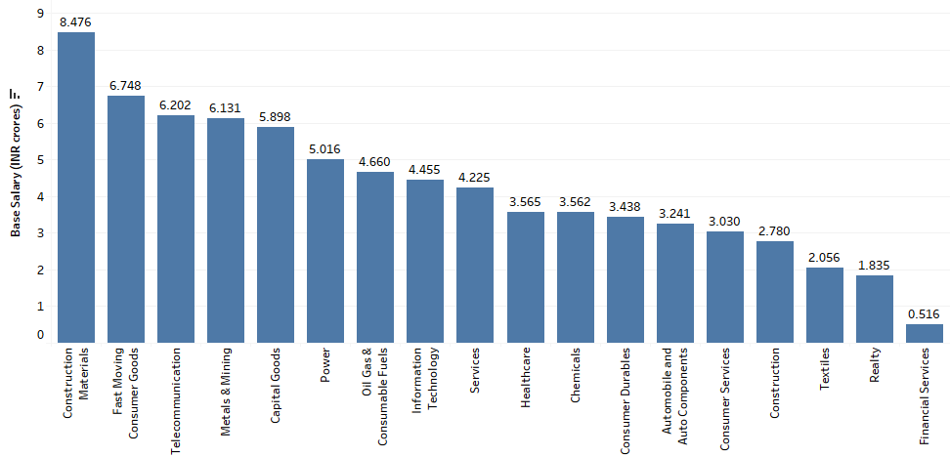
CEO pay as a function of sector

Slide 8
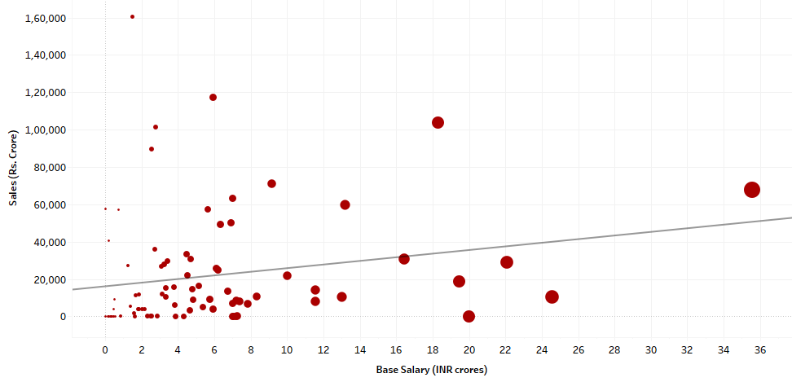
CEO pay as a function of short-term company performance (Sales)

Slide 9
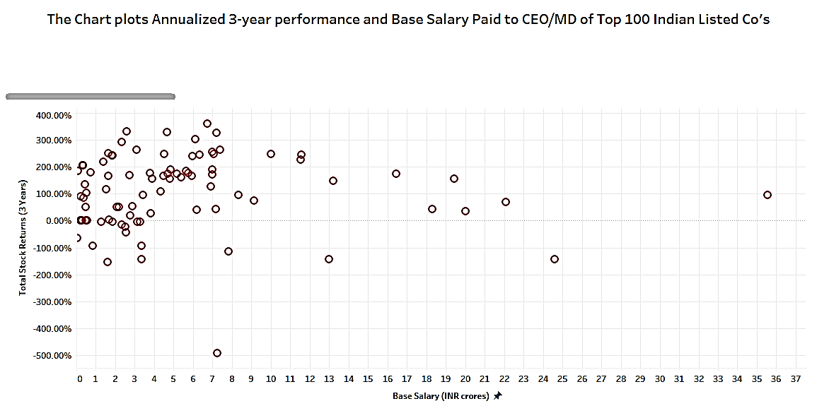
CEO pay as a function of long-term company performance (Total Shareholder/Stock Return)

Slide 10
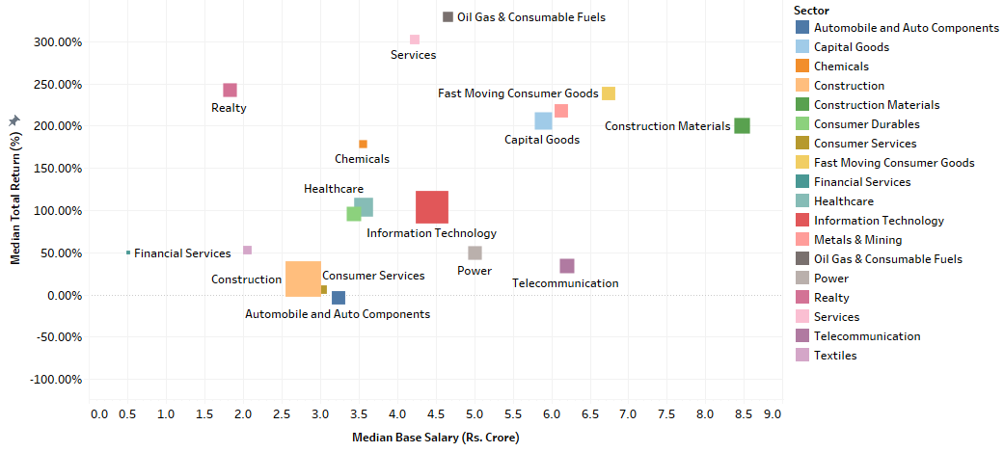
CEO pay as a function of long-term company performance (Total Shareholder/Stock Return) and sector

Slide 11
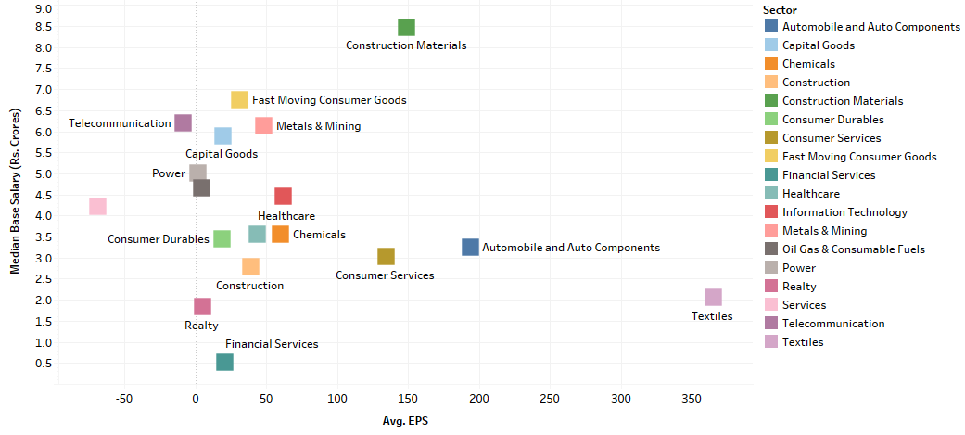
CEO pay as a function of long-term company performance (EPS) and Sector

Slide 12
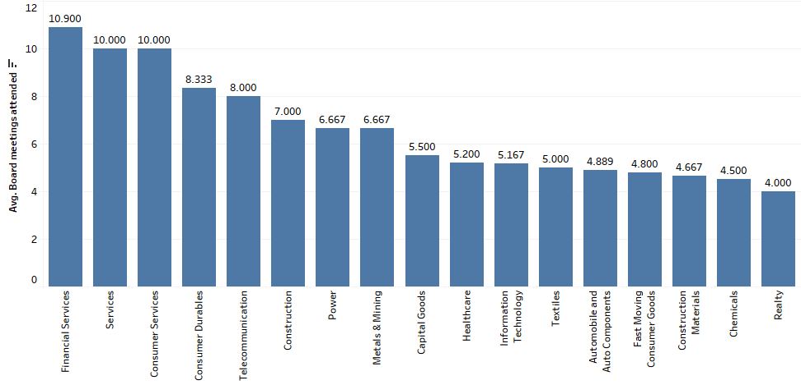
Number of Board meetings by sector

Slide 13
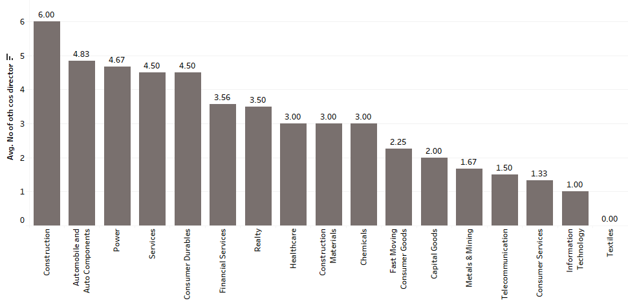
Board membership of CEO by Sector

Slide 14
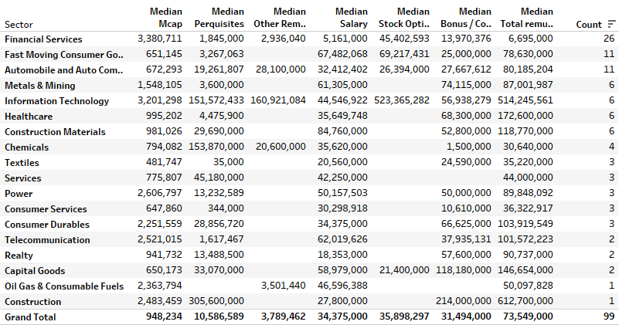
CEO typical pay components

Slide 15
Structure of Short-Term Incentive Plans

Slide 16
STI Market Practice – some key statistics for NSE 100
Majority of organisations (> 95%) have in place an STI Plan; with about 65% of those organisations having multiple STI Plans
Almost all sectors had an strong acceptance of the STI Plans
The STI Plans were offered across the organisation and where there were multiple plans, special care was made to align the plans
Typically, this is an annual bonus (offered each year and has a one-year performance period)
The STI is offered predominantly in cash, with some part of it being deferred as form of RSUs
STI is either top-down or bottom-up
Either a pool of money gets determined based on performance against corporate scorecard or mix of corporate and individual measures made up the overall scorecard
Most scorecards had a majority of financial metrics although some of the metrics (about 40%) could be non-financial metrics. Typically, the financial metrics are EBITDA, Cashflow, NPAT, Net Sales while the non-financial metrics are customer, employee, safety measures
It is also becoming increasingly common to have a gateway based on behaviour and achievement of some financial bottom-line number

Slide 17
Structure of Long-Term Incentive Plans

Slide 18
LTI Market Practice – some key statistics for NSE 100
Majority of organisations (> 65%) have in place an LTI Plan; with about 50% of those organisations having multiple LTI Plans
The sectors where LTI Plans are most commonly used:
Technology
Telecommunications
Financial Services
FMCG
Although offered primarily to the executive roles, where these are also offered to other roles based on seniority and contribution to strategy
Typically, more than 75% of the companies offer an LTI each year
The majority of organisations offered stock options/share appreciation
Approximately 80% of organisations had more than three-year performance period
The main measures which are used are either TSR/EPS or bottom-line metrics (like EBITDA). Some organisations are starting to use ESG measures and rarely, have individual KPIs
The leverage (maximum to target ratio) depends on probability of vesting, nature of instrument and types of measures

Slide 19
About us

Slide 20
About Us
We are an executive compensation consulting firm based out of India and have consulted large, listed and private organisations across US, Asia Pacific, Australia and India.
Our senior partners have all more than 15 years advising CEOs, CHROs, Board directors in matters of corporate governance, compensation and performance.
We have extensive data captured from annual reports as well as have access to multiple executive salaries, due to our working with clients and partnerships and relationships.
Our methodology for executive benchmarking uses combination of position matching (to similar roles), evaluating the roles and using custom built paylines specific to each organisation and role against a relevant hand selected peer group. This peer group creation process is central to our approach, and we consider similar organisations having regard to size, sector, business stage and maturity, value chain, nature of products/service and ownership structure (listed, private, international subsidiaries and so on)
Typically, our benchmarking encompasses CEO/MD, their direct reports (all CXO roles) and potentially one level below (GM or President/Director) as well as Board directors. We often advice clients on designing Pay for Performance frameworks and assist Boards in having stakeholder and proxy advisor conversations.
We have designed many incentive programs, for senior executives and broader organisation – Short Term Incentive, Long Term Incentive, Sales Incentive, Retention programs and Project specific Incentives. We also consult organisations on more complex plans like Transformation Incentive and Combined Incentive Plans.

