Slide 1

Investigating Temperature Distribution of Kathmandu City Using Markov Chain Monte Carlo (MCMC) Approach
Ram Krishna Pudasaini (24)

Slide 2
Outline
Introduction
Objectives
Data Source
Literature Review
Methodology
Results and Discussions
Conclusions and Future Works
Reference

Slide 3
Introduction
Background of Kathmandu City
Elevation of approximately 1400 meters
latitude 27.700769 and longitude 85.300140
Kathmandu faces various environmental challenges, including air pollution, rapid population growth, and climate change impacts
Importance of Studying Temperature Distribution
Temperature is a key climatic variable
Influences various aspects of urban life, including public health, energy consumption, agriculture, and infrastructure planning.
Adaptation of climate strategies plans in advance

Slide 4
Objectives
● To analyze distribution of temperature within Kathmandu City based on available time series data from 1982 to 2023.
● To perform the statistical analysis of the temperature variable.
● To understand the correlations of temperature with other variables
● To understand the monthly average temperature distribution of Kathmandu city.
● To identify the extreme temperature points of Kathmandu city by analyzing the historical data and extreme temperature threshold.
● To investigate and forecast the long-term temperature trends in Kathmandu City using Markov Chain Monte Carlo (MCMC) methods.

Slide 5
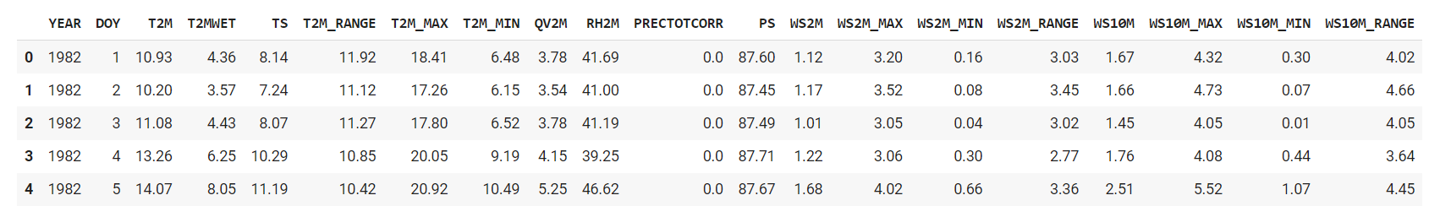
Data Source
Project: NASA Langley Research Center (LaRC) POWER Project
Data Set: NASA/POWER CERES/MERRA2 Native Resolution Daily Data
Data Access Viewer API: The Data Access Viewer API allows for programmatically accessing and retrieving climate data based on specified geographic coordinates.

Slide 6
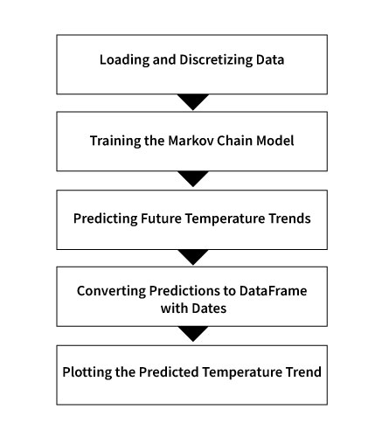
Methodology - Markov
Chain
Wikipedia Definition
A Markov chain or Markov process is a stochastic model describing a sequence of possible events in which the probability of each event depends only on the state attained in the previous event. Informally, this may be thought of as, "What happens next depends only on the state of affairs now.

Slide 7
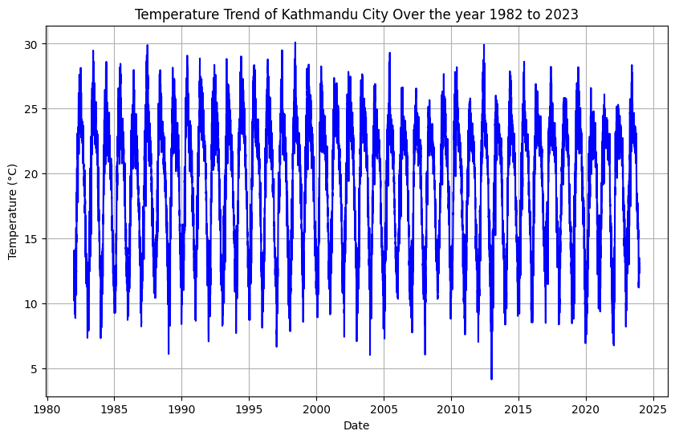
Key Findings

Slide 8
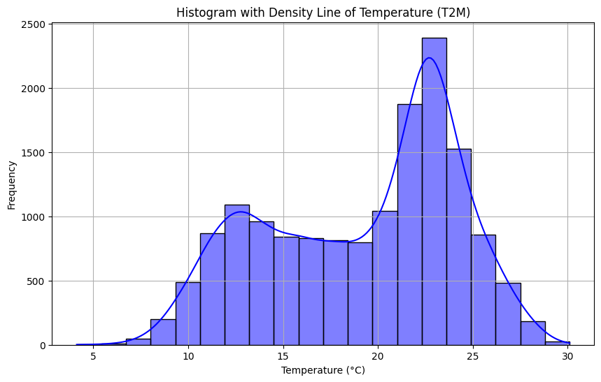
Distribution

Slide 9
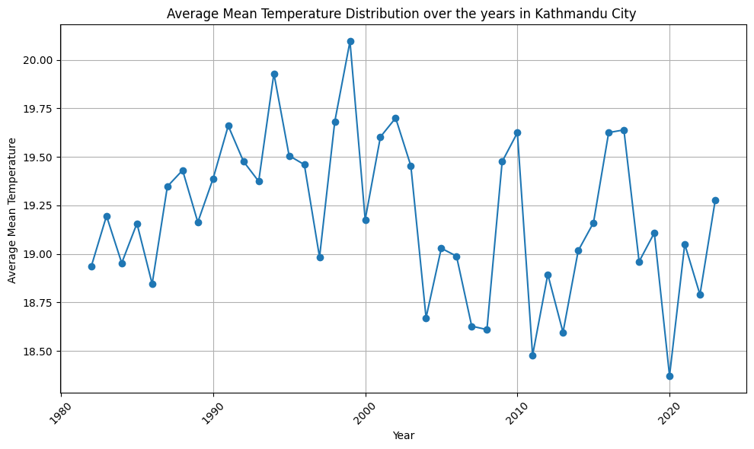
Average Mean Temperature

Slide 10
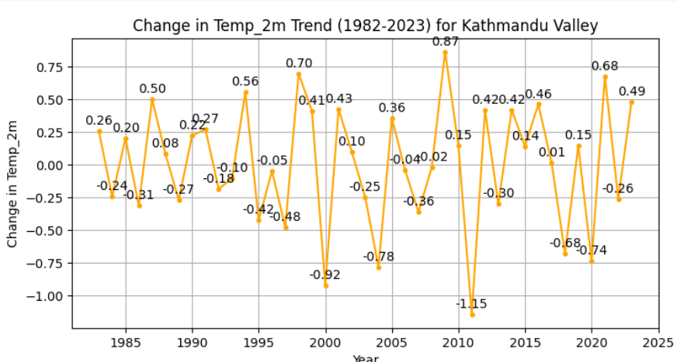
Change in Temperature

Slide 11
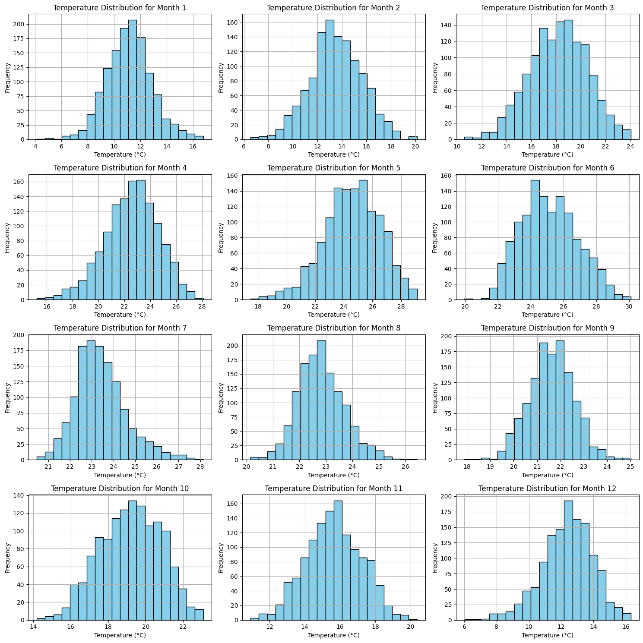
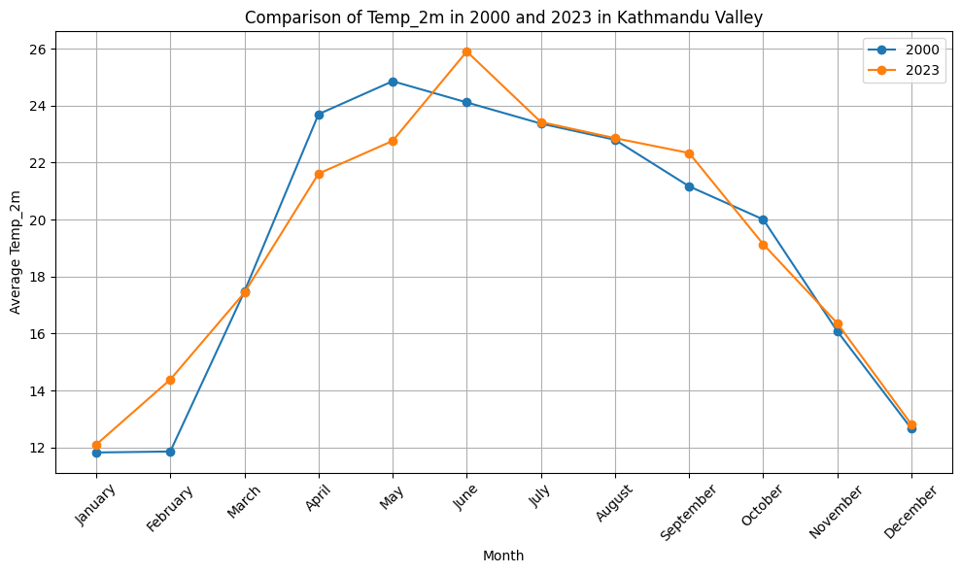
Monthwise Distribution

Slide 12
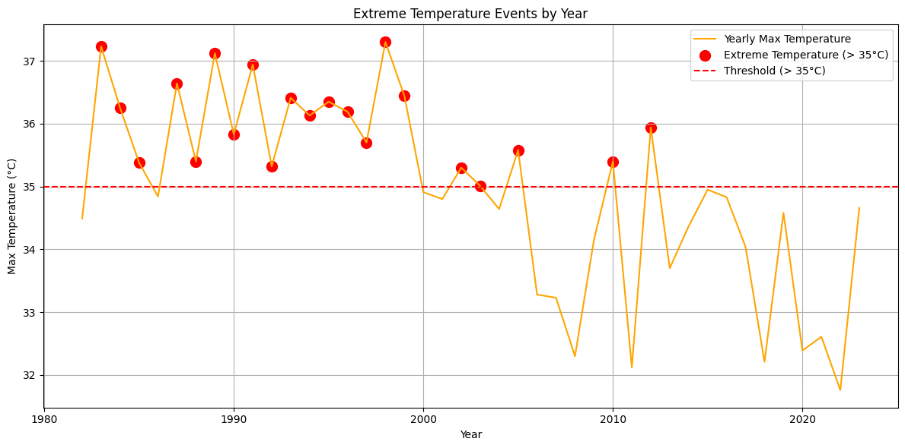
Extreme Events

Slide 13
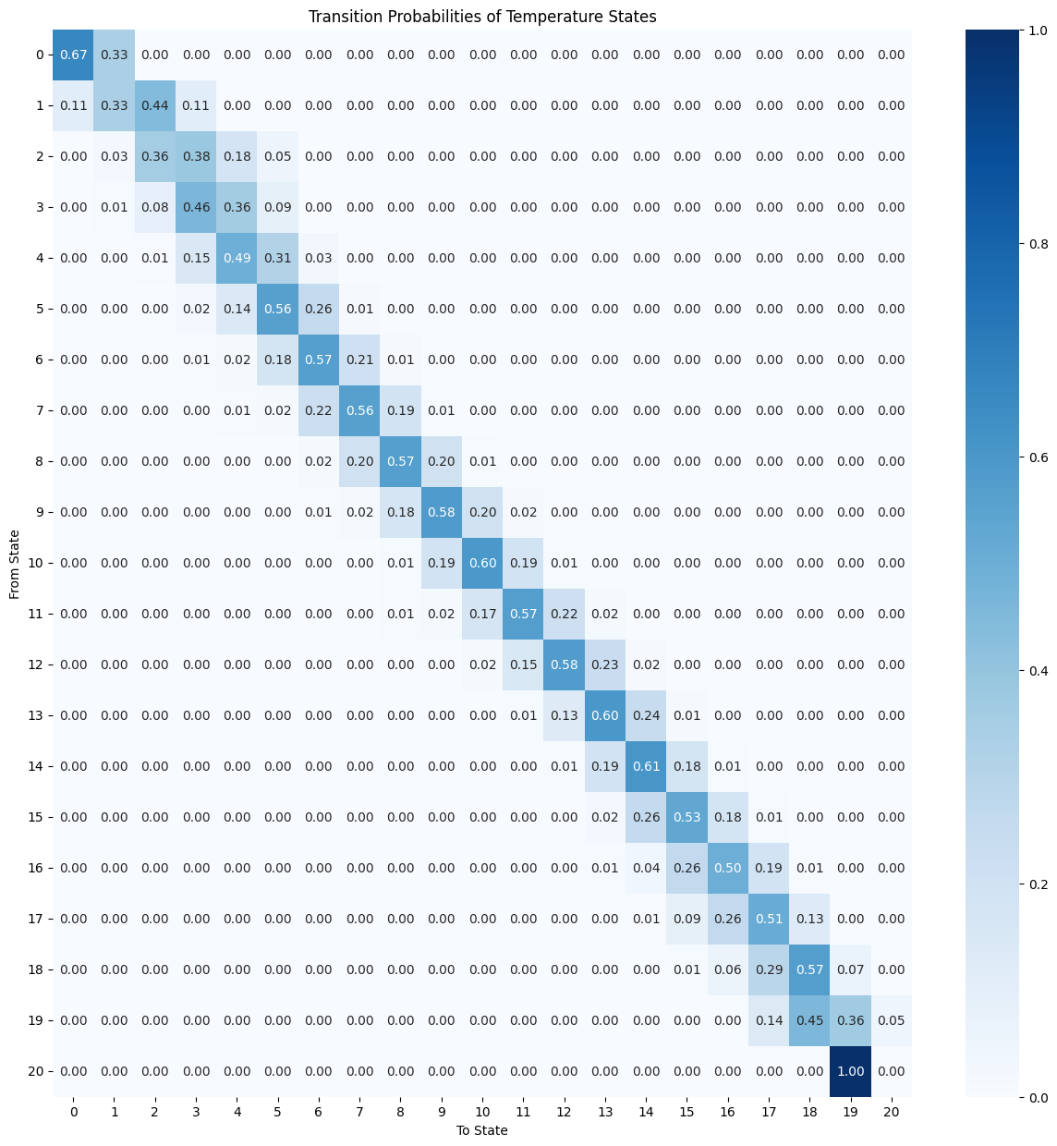
Forecasting Using Markov Chain
In this study Markov Chain model is used to forecast the temperature of Kathmandu city. The dataset is splitted into training and testing dataset with training data consisting data from 1982 to 2020 and testing data consisting data from 2021 to 2023.
Training data shape: (14245, 19)
Testing data shape: (1095, 19)

Slide 14
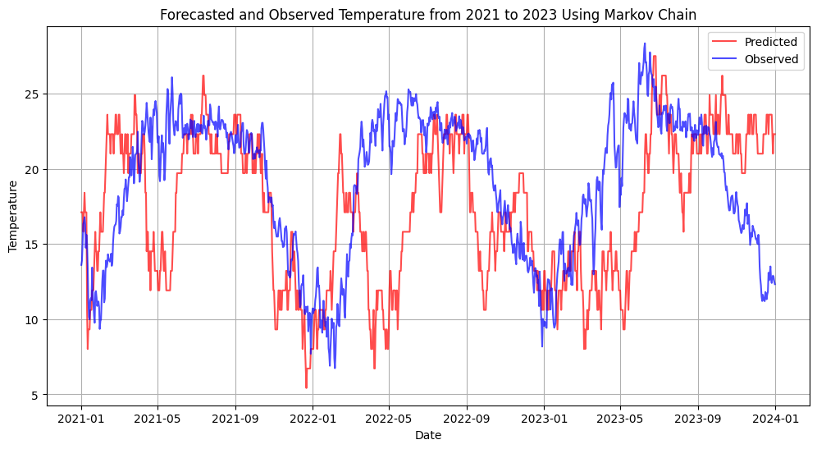

Slide 15
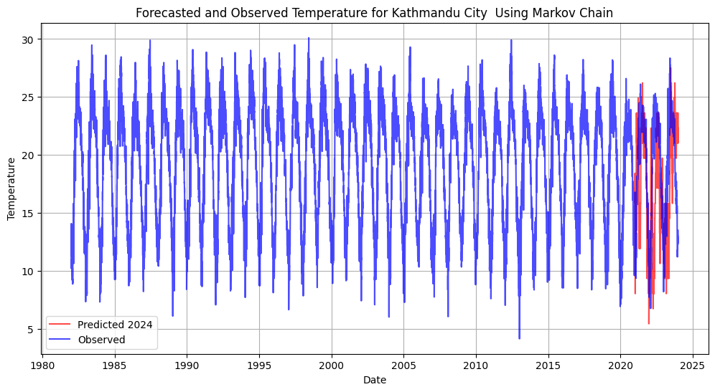

Slide 16
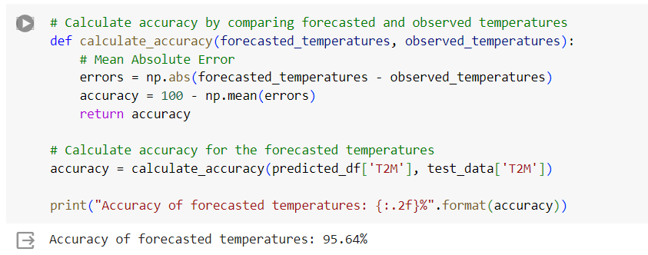
Accuracy

Slide 17
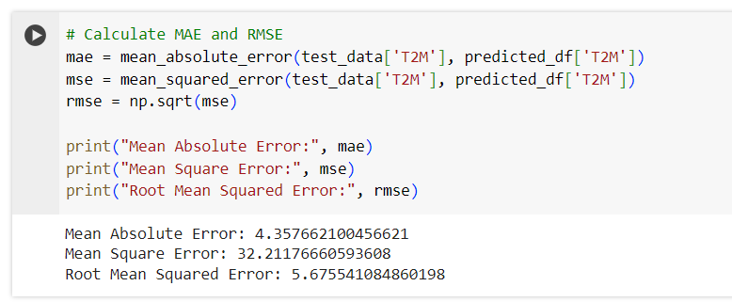
Errors

Slide 18
Conclusions
Concluded that Markov Chain can also be used to study the time series phenomenon where we can analyze the historical past data and predict the future trend.
Here we have studied the temperature at 2 meter surface range.
Further work can be proceeded to study the trend of other variables like rainfall, humidity that are included in this dataset.
One can also apply a different approach like Bayesian approach or LSTM for the prediction of such time series data.

Slide 19
Reference
[1]:https://www.researchgate.net/profile/Chhabi-Chidi /publication/350133573_Urban_Heat_Island/links/60 52faaf92851cd8ce4b75f3/Urban-Heat-Island.pdf
[2]:https://portal.tu.edu.np/publications/122/Grid_Ba sed_Temperature_and_Rel_2023_09_12_10_17_35.p d
[3]:https://en.wikipedia.org/wiki/Markov_chain

Slide 20
THANK YOU

