Slide 1
Price Negotiator Ecommerce ChatBot System

Slide 2
Overview
Our Objectives
Roles and Responsibilities
Technologies to be used
Methodology
Road Map
Difficulties faced
Conclusion

Slide 3
Our Objective
Design an automated agent for negotiation of e-commerce products between consumers and sellers to increase the payoff .
Precise prediction of user next purchase sequence by applying new methodologies.
Data-driven and user-centric approach for market basket prediction.
Using machine learning, automated agent will learn about human negotiational behaviour.

Slide 4
Roles and Responsibilities
Rinkal Singh - Designing and implementation of model as well as optimization and testing using various tools in a scenario to simulate real life situations.
Javid Akhtar and Shivashish Prasad - Finding out, learning, implementing other state-of-the-art techniques used in the industry to solve the same problem and figure out how to incorporate with our solution.
Nair Tejas Deepak - Testing and training data-set for each algorithm.

Slide 5
Technologies to be Used
Github
Jupyter Notebook
Django
Natural Language Processing
CNN, Tensorflow
Front-End :
HTML, Css, Javascript
Back-End :
Python
Database :
Mysql/Sqlite

Slide 6
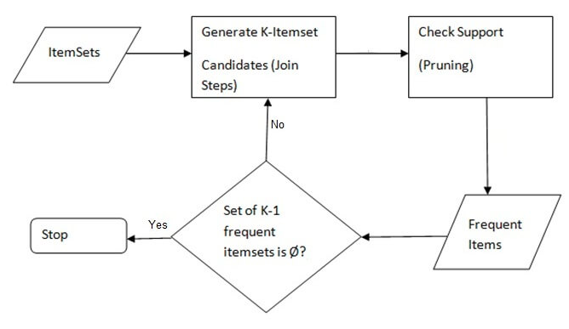
Methodology
Algorithm for Finding Purchase Sequence of User:

Slide 7
Continued ...
Algorithm To Display Offers On Products:
Find the purchase sequence using above Apriori algorithm.
Get Last date of purchase.
Set the value of D as threshold number of days.
If ( Difference is greater than D days ):
“Display according to purchase sequence”.
Else :
“Display last transactions remaining departments &&
star offers.

Slide 8
Continued ...
Algorithm to Negotiate for Better Deals:
Get Product details
Set profit_margin1, profit_margin2
Accept user response.
If (user accepts the offer) :
then “add product to cart”
else :
calculate d=MRP-CP
deduct profit_margin n% of d from MRP and increase the quantity by m

Slide 9
Continued ...
if(user accepts the offers) :
“add products to cart”
else :
deduct profit_margin n* % of d from MRP and
increase the quantity by m* &&
show some subcategory options
Increase the negotiation step based on mining.

Slide 10
Continued ...
Algorithm to Generate User Cart Bill:
TOTAL BILL AMOUNT = ∑^{n}_{i-1}((∑ QiPi −dp i)) ....(1)
Where,
Pi = price of the product per item
Qi = quantity of the product i
Dpi = discount price on the product i

Slide 11
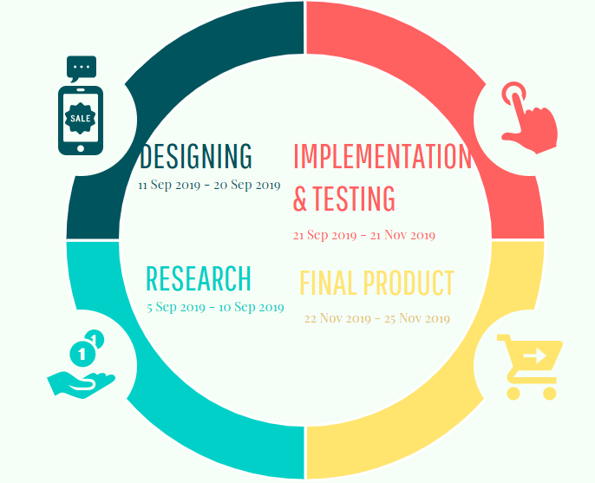
Project Plan

Slide 12
Difficulties faced so far
Unavailability of dataset.
Human behaviour and sentiment is complex.

Slide 13
Conclusion
The system proposed will help users negotiate the prices of the products in real time with chatbot. Hence providing better shopping experience to the customers as well as a better business enhancing opportunity to the shopkeepers.
Not efficient for small scale but ideal for large scale .
As people are very conscious in quality and rate of the particular product, having a best price which is not a fixed one will increase the payoff among sellers and buyers.

Slide 14
Thank you

