Slide 1
Text-Based Classification of Movie Reviews
Team members
Raed Karkoub
Contact member
Raed Karkoub
B13

Slide 2


Background
IMDB and RottenTomatoes are the two biggest movie critics out there
Research Question:
Can we accurately classify whether a movie review originates from IDMB or rottentomatoes using text-based features?

Slide 3
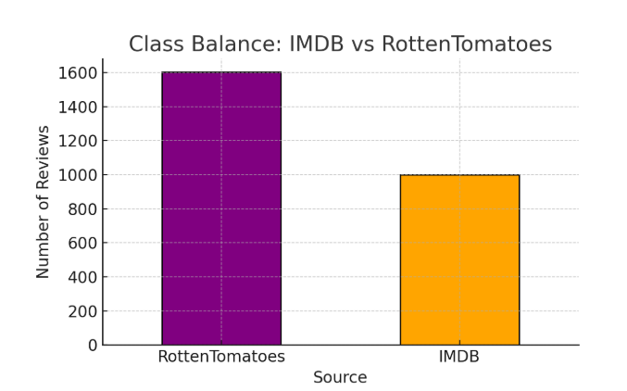
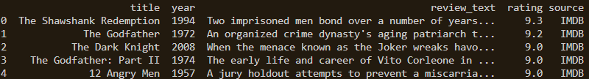
Methods - Data
Combined two separate datasets, matching columns together
IMDB Top 1000 movies
Series_title, Overview, IMDB_rating, Released_year
RottenTomatoes Top movies
Title, synopsis, critic_score, year

Slide 4
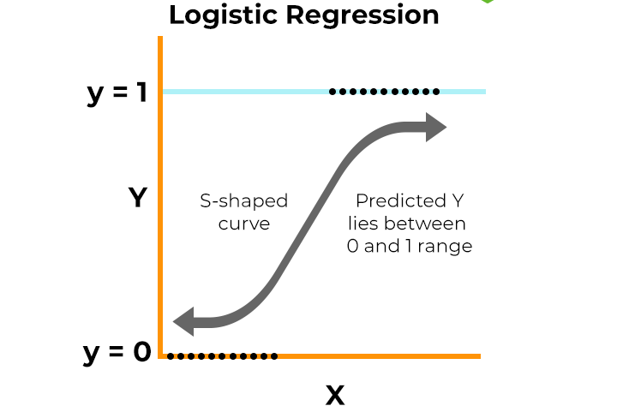
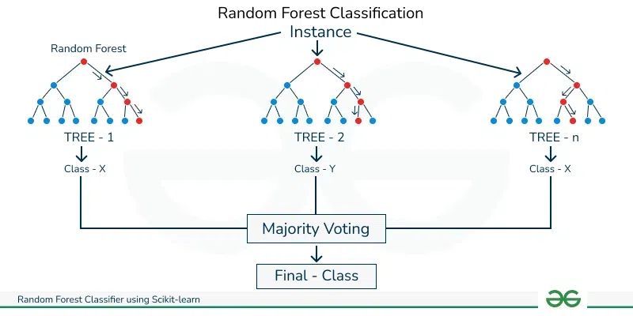
Methods - Approach
Models used:
Logistic regression (Baseline Linear Classifier)
Random Forest classification (ensemble method)
80/20 training split

Slide 5
Methods – Use of ChatGPT
I used chatgpt to find datasets with similar feature names
Chatgpt helped me improve slides, including wording of titles and sections
Chatgpt helped me improve the code, I create the pipeline individually then it enhanced it by debugging and adding safety measures.

Slide 6
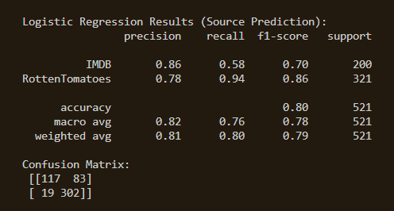
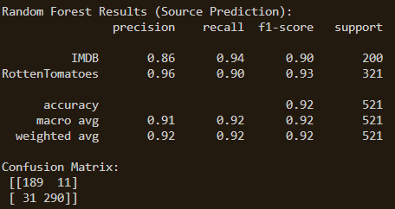
Results

Slide 7
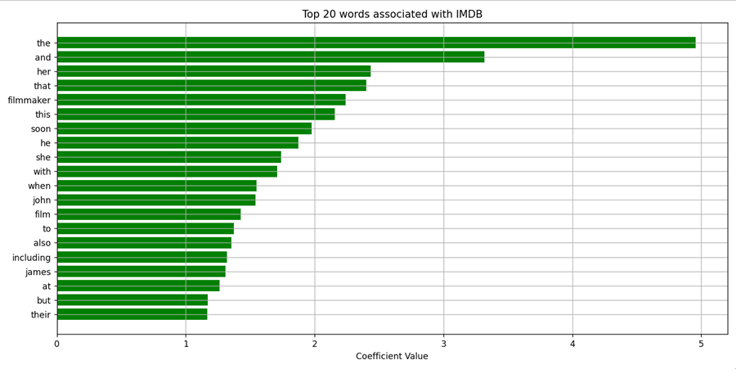
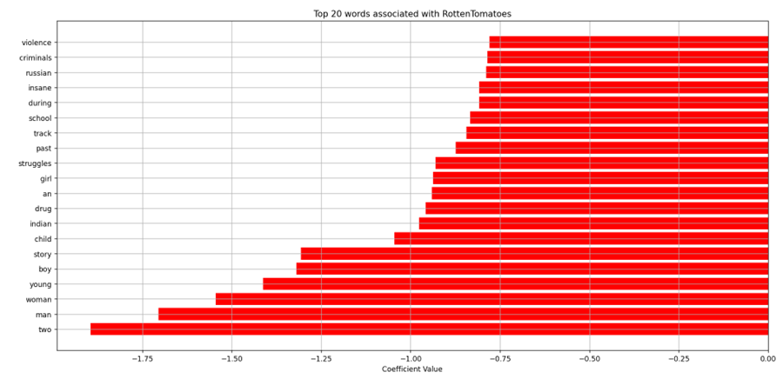
Post-Hoc Analysis
Text Processing:
TF-IDF vectorization (top 5000 features used if applicable)

Slide 8
Improvements
Add a weighing factor to the models to integrate with eachother
Expand datasets
Instead of merging datasets, I could join datasets to evaluate how IMDB and Rottentomatoes differ on the same movies
Improve TF-IDF by removing common words

Slide 9
Why the project fits the DS320 requirements?
The project fits the requirements because:
Uses data fusion to combine multi-views into one large dataset
Aligned schemas to merge into one dataset and added labels to track origin
Applied predictive models (logistic regression and random forest)
Reported multiple metrics
Post-hoc analysis

Slide 10
Links to Project
IMDB dataset (https://www.kaggle.com/datasets/harshitshankhdhar/imdb-dataset-of-top-1000-movies-and-tv-shows)
RottenTomatoes dataset(https://www.kaggle.com/datasets/thedevastator/rotten-tomatoes-top-movies-ratings-and-technical)
Github Link (https://github.com/Rkarkoub03/DS320.git)

