Slide 1
IMDB vs RottenTomatoes
Raed Karkoub

Slide 2


Introduction
Movie review text varies between different platforms
Goal: Classify whether a movie review comes from IMDB or RottenTomatoes, purely through text

Slide 3
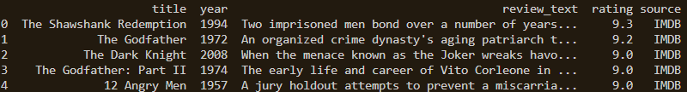
Data fusion
IMDB top 1000 movies:
Obtained from Kaggle
Titles, years, overviews, IMDB ratings, critic review
RottenTomatoes Top movies:
Obtained from Kaggle
Titles, years, synopsis, critic scores
Combined Dataset:
Individual datasets were cleaned
Combined to include all movies
Similar feature names (synopses, overviews) were mapped to each other
~2000 reviews with source labels
80
70
78
60
50
40
30
20
10
BAR GRAPH INFO 1
BAR GRAPH INFO 1
BAR GRAPH INFO 1
BAR GRAPH INFO 1

Slide 4
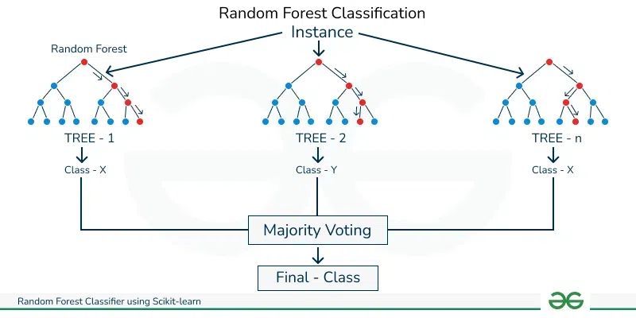
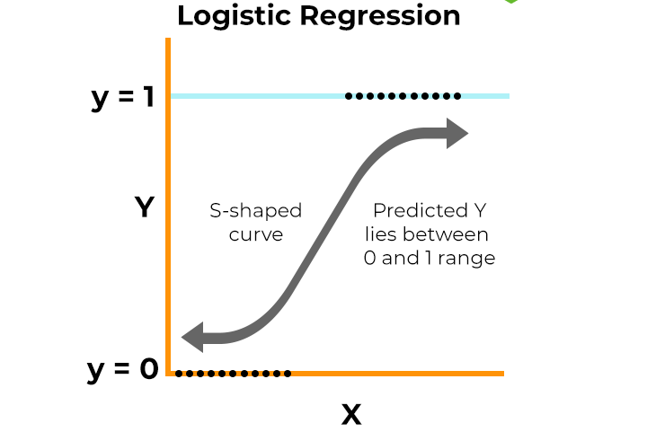
Methods Used
Text Preprocessing:
TF-IDF vectorization (top 5000 features)
Models used for classification
Logistic regression (baseline linear classifier)
Random Forest classification (ensemble method)
Training:
80/20 train/test split

Slide 5
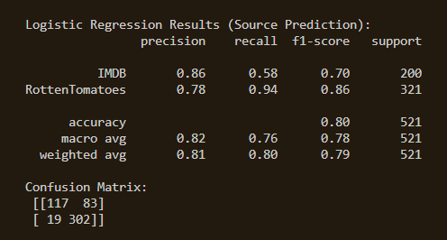
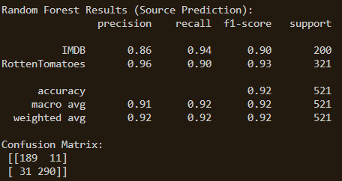
Model Results

Slide 6
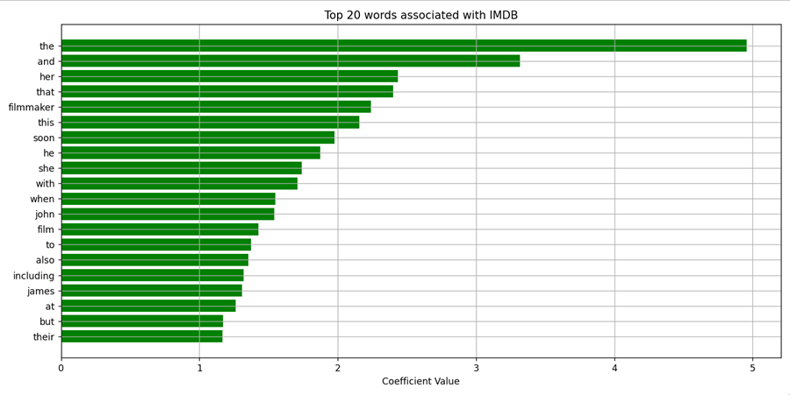
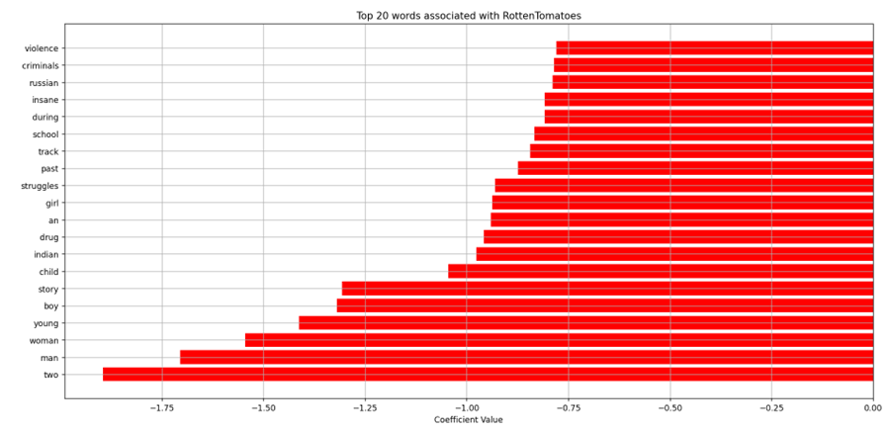
Post-hoc Analysis
Identifies the top words of each platform (feature importance)

Slide 7
Conclusion
Results:
Successfully demonstrated feasibility of source classification using text alone
Random forest outperformed logistic classification by ~12%
Challenges:
Dataset sizes are relatively small
Only uses text for feature importance
Future Work:
Increase imdb and rottentomatoes sample sizes by fusing publicly available data
Use web scraping to generate more up-to-date samples
Include deep learning or additional metadata in training

Slide 8
THANK YOU
Raed Karkoub

