Slide 1

Open-Source FPGA Tools
Presented by : Kashif Raza

Slide 2
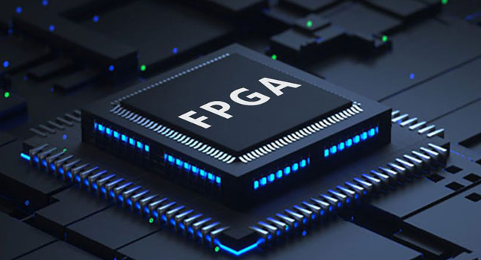
Introduction
What are FPGAs?
Reconfigurable hardware used in AI, IoT, and embedded systems.
Adaptable for different applications after manufacturing.
Challenges:
Proprietary tools are expensive and restrictive.
Why Open-Source Tools?
Affordable and flexible solutions.
Encourage collaboration, learning, and innovation.

Slide 3
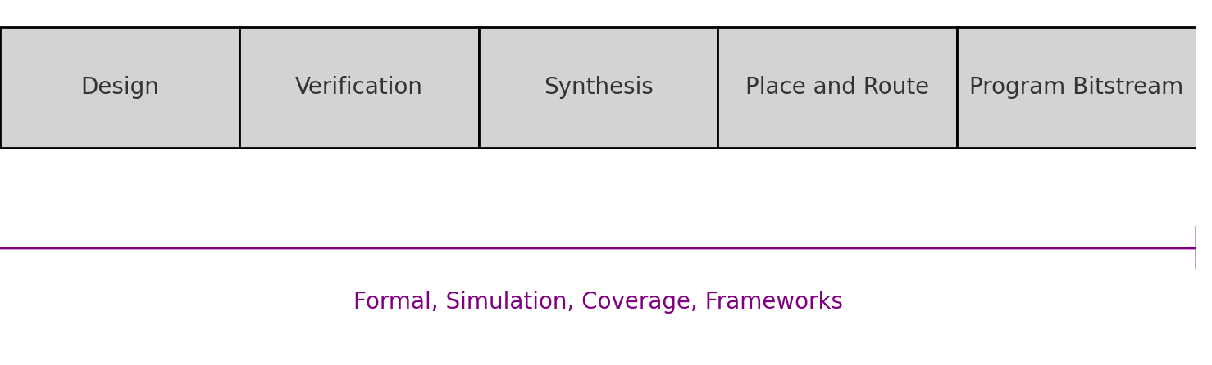
What is FPGA Tooling?
FPGA Development Steps
FPGA development involves several key steps, each of which transforms an idea into a working hardware design:
These steps are complex and require precise execution. FPGA tools automate much of the process, ensuring accuracy and efficiency.

Slide 4
What is FPGA Tooling
Comparison of Proprietary and Open-Source Tools
Proprietary Tools
Often provided by FPGA manufacturers like Xilinx or Intel.
Feature-rich but expensive, with restrictive licenses.
Operate as "black boxes," limiting users' ability to modify or optimize designs.
Open-Source Tools
Free and community-driven, offering accessibility to students, researchers, and startups.
Flexible and modifiable, allowing developers to tailor tools to specific needs.
Enable cross-platform compatibility.

Slide 5
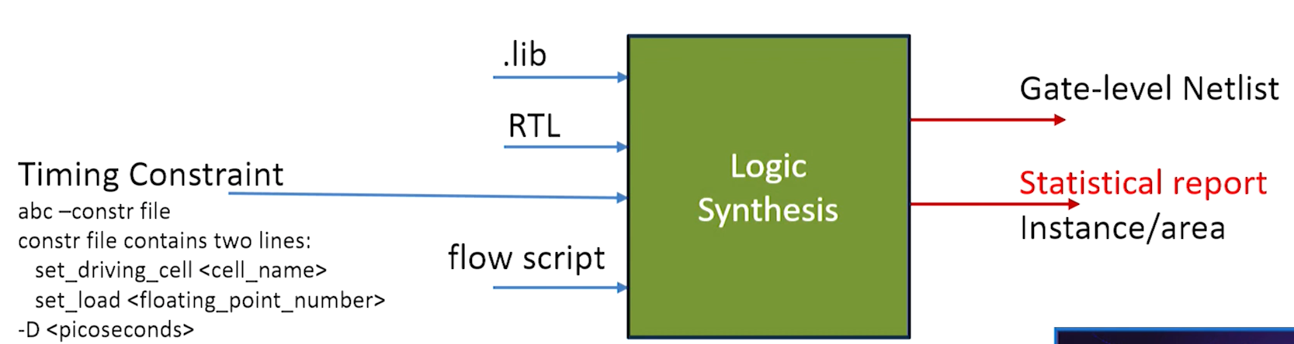
Open-source FPGA Toolchain Yosys
What is Yosys?
An open-source synthesis tool for FPGA development.
Translates high-level designs (Verilog) into gate-level netlists (blueprints of logic gates).
How It Works
Takes a Verilog design file as input.
Parses and optimizes the design.
Outputs a netlist describing the design's implementation.
Key Features
Verilog Focus: Excellent native support for Verilog designs.
Partial VHDL Support: Achieved via integration with GHDL.
Formal Verification: Ensures correctness of designs.
Synthesis targets are supported by Yosys
Lattice iCE40, ECP5 FPGAs, Xilinx 7-Series FPGAs, experimental flows for many others

Slide 6
Open-source FPGA Toolchain GHDL
What is GHDL?
An open-source tool for simulating and synthesizing VHDL designs.
Complements Yosys by enabling VHDL synthesis workflows.
Supports most VHDL standards, including VHDL-1993, VHDL-2008, and more.
How It Links with Yosys
GHDL works with Yosys to synthesize VHDL designs into gate-level netlists.
GHDL Analyzes and elaborates VHDL designs.
Yosys Converts the analyzed design into a netlist for FPGA implementation.
Key Features:
Simulation: Allows testing of VHDL designs before implementation.
Synthesis Integration: Works seamlessly with Yosys for FPGA workflows.
Open-Source: Free and flexible for academic and research use.

Slide 7
Open-source FPGA Toolchain Nextpnr
Role in FPGA Development
Assigns physical locations on the FPGA to logic gates from Yosys’s blueprint.
Establishes connections between the gates through routing.
How It Works
Input: Receives netlist from Yosys and FPGA architecture details.
Placement: Optimizes the location of gates to minimize delays.
Routing: Determines efficient paths for signal connections.
Output: Generates updated netlist and routing data for bitstream generation.
Key Features
Supports Multiple Architectures: Lattice iCE40, ECP5, Xilinx Series-7, and more.
Graphical Interface: Visualizes placement and routing for easy debugging.
Flexibility: Customizable and adaptable for new FPGA families.

Slide 8
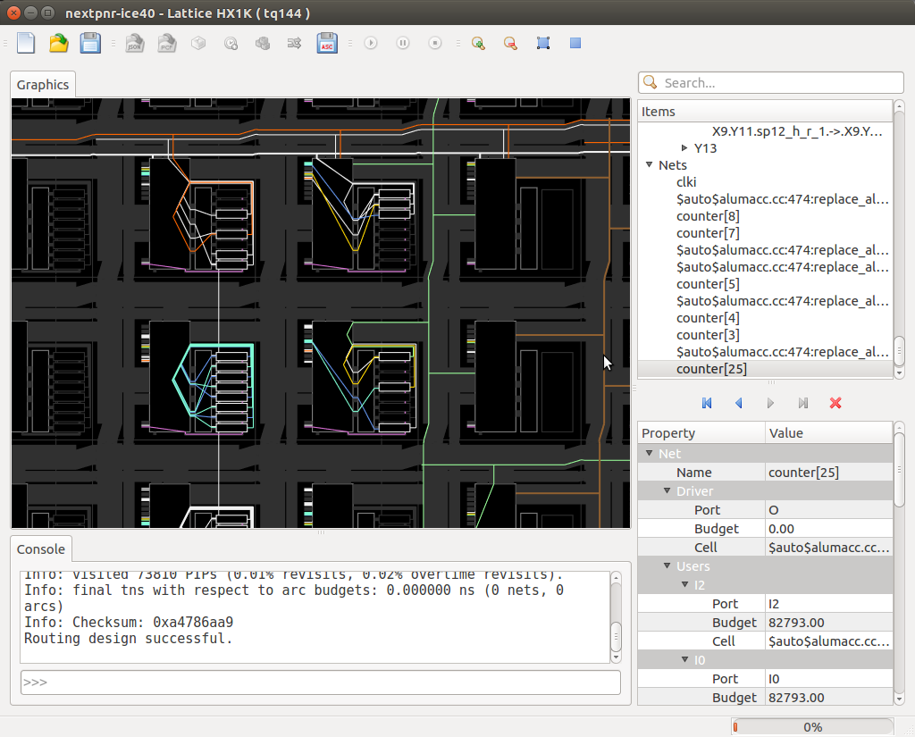
Open-source FPGA Toolchain Nextpnr

Slide 9
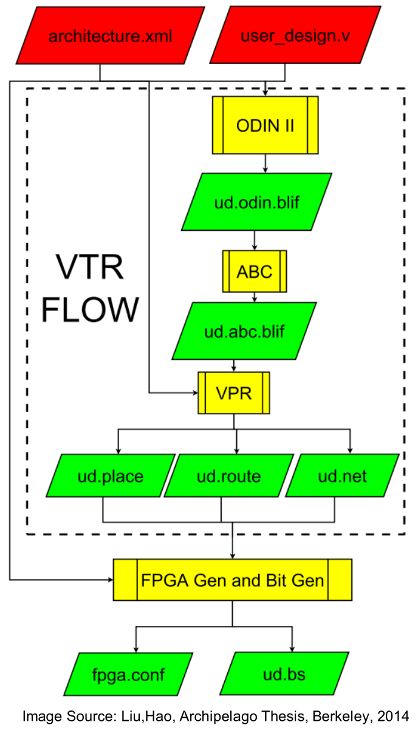
Open-source FPGA Toolchain VTR (Verilog-to-Routing)
What It Is?
An open-source framework for FPGA research and experimentation.
Focused on exploring new FPGA architectures and CAD flows.
How It Works
Input: Starts with a Verilog design describing circuit functionality.
Synthesis: Uses Odin II to optimize and map the design to logic gates.
Architecture Exploration: VPR (Versatile Place and Route) maps logic gates to FPGA layouts based on a customizable architecture file.
Output: Provides detailed performance metrics like timing, area, and power usage.

Slide 10
Open-source FPGA Toolchain Project IceStorm: Toolchain for Lattice iCE40 (whole design Flow)
Project IceStorm
An open-source toolchain for Lattice iCE40 FPGAs.
Includes tools for synthesis, place-and-route, and bitstream generation.
How It Works
Synthesis: Uses Yosys to convert Verilog designs into a netlist of logic gates.
Place-and-Route: Nextpnr places logic gates on the FPGA and routes signals between them.
Bitstream Generation: IcePack creates the binary file (bitstream) to configure the FPGA.
Programming: IceProg uploads the bitstream to the FPGA.
.
IceTime: For Timing Analysis
https://clifford.at/icestorm

Slide 11
Open-source FPGA Toolchain SymbiFlow (whole design Flow)
What It Is
An open-source FPGA toolchain supporting multiple FPGA brands (e.g., Lattice, Xilinx).
Combines tools like Yosys, Nextpnr, Project Trellis, and Project X-Ray.
How It Works
Synthesis: Uses Yosys to translate Verilog designs into logic gates.
Placement and Routing: Nextpnr maps the logic onto the FPGA hardware.
Architecture Files: Projects like Trellis and X-Ray provide FPGA-specific details.
Unified Workflow: Integrates synthesis, place-and-route, and bitstream generation.
Key Features
Multi-Vendor Support: Works with multiple FPGA families.
Modular Design: Easily adaptable for new FPGA platforms.
Community-Driven: Built on open-source tools and contributions.

Slide 12
Open-source FPGA Toolchain F4PGA: The Framework
F4PGA
An open-source FPGA development platform.
Combines multiple tools into a modular, cohesive framework.
Supports various FPGA families like Lattice iCE40, ECP5, and Xilinx Series-7.
Architecture Definitions: Uses files from projects like IceStorm (iCE40), Trellis (ECP5), and X-Ray (Xilinx Series-7).
Tool Integration: Incorporates tools like Yosys for synthesis and Nextpnr for place-and-route.
Modular Design: Allows adding or updating tools and FPGA architecture files independently.
Output: Generates a bitstream to program the FPGA.

Slide 13
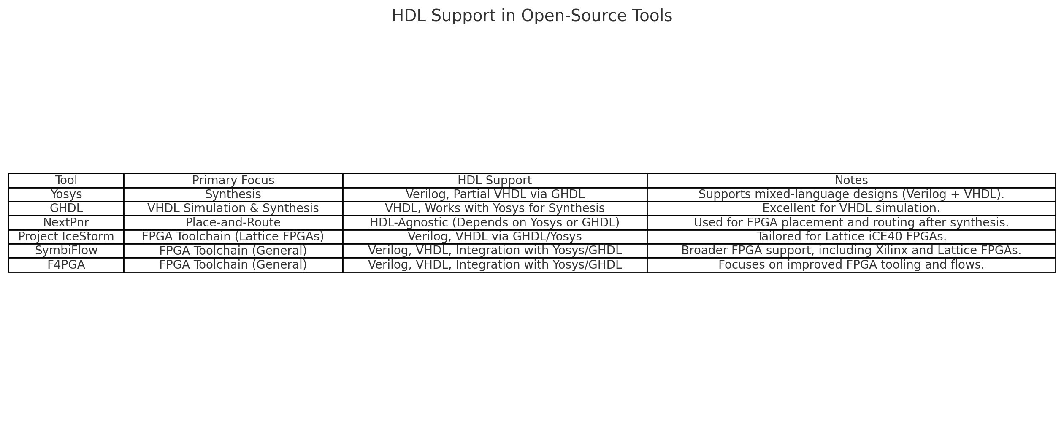
HDL Support in Open-Source Tools:

Slide 14
Challenges and Limitations for Open-Source FPGA Tools
Limited Vendor Support
Relies on reverse-engineered architecture files.
Gaps in functionality compared to vendor-provided tools.
VHDL Support
Less mature compared to Verilog support.
Integration challenges for legacy VHDL-based designs.
Performance and Optimization
Struggles with timing closure and optimization for complex designs.
Proprietary tools are more optimized for specific devices.
Toolchain Integration Complexity
Requires manual setup of tools like Yosys, GHDL, and Nextpnr.
Steep learning curve for new users.
Advanced Features
Limited support for power analysis and advanced timing optimization.
Lack of proprietary IP cores and other high-performance features.
Hardware Support
Restricted to specific FPGA families like Lattice iCE40, ECP5, and Xilinx Series-7.
Does not support many newer or less common FPGA devices.

Slide 15
Conclusion
Open-Source FPGA Tools Revolutionize Development
Cost-effective and accessible alternatives to proprietary toolchains.
Community-driven, fostering innovation and collaboration.
Tools like Yosys, GHDL, Nextpnr, Project IceStorm, SymbiFlow, and F4PGA cover all FPGA development stages.
Empowering Developers
Lower financial and technical barriers for students, researchers, and small-scale developers.
Encourage experimentation and flexibility in design workflows.
Future Outlook
Continued community efforts to address limitations.
Driving innovation and democratizing FPGA development for all.

Slide 16
References
C. Wolf, “Project IceStorm: Open-Source Toolchain for Lattice iCE40 FPGAs,” accessed Jan. 6, 2025. [Online]. Available: https://clifford.at/icestorm
“ghdl-yosys-plugin: VHDL Synthesis Integration for Yosys,” GHDL and Yosys Plugin, accessed Jan. 6, 2025. [Online]. Available: https://github.com/ghdl/ghdl-yosys-plugin
“SymbiFlow Documentation: Open-Source FPGA Toolchain,” accessed Jan. 6, 2025. [Online]. Available: https://symbiflow.github.io
YosysHQ, “Nextpnr: Open-Source Place-and-Route Tool,” accessed Jan. 6, 2025. [Online]. Available: https://github.com/YosysHQ/nextpnr
“F4PGA: Modular FPGA Development Framework,” accessed Jan. 6, 2025. [Online]. Available: https://f4pga.org
“Verilog-to-Routing (VTR) Framework Documentation,” accessed Jan. 6, 2025. [Online]. Available: https://vtr-verilog-to-routing.readthedocs.io

Slide 17
THANK YOU

