Slide 1

d.i.n.e Digital Interactive Network for Eating
Ammar Imran Khan – 2210022
Bhavesh – 2210013
Kashif Raza – 2210021

Slide 2
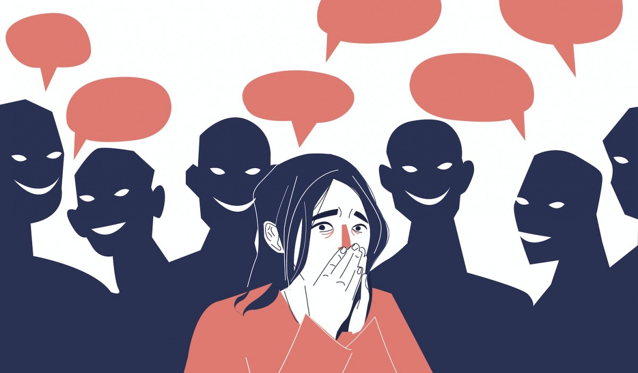
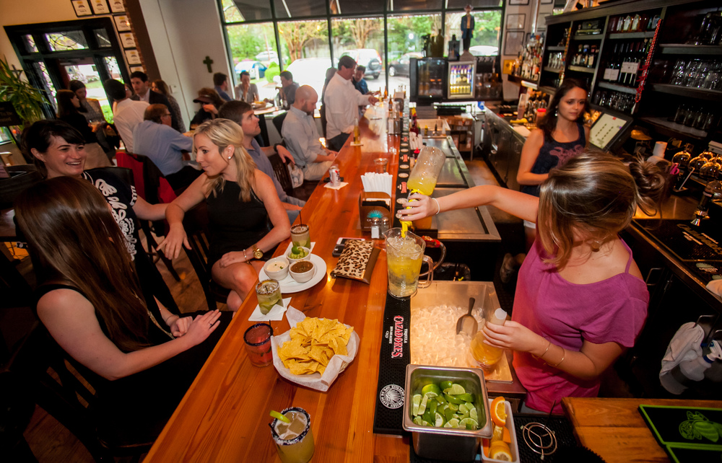
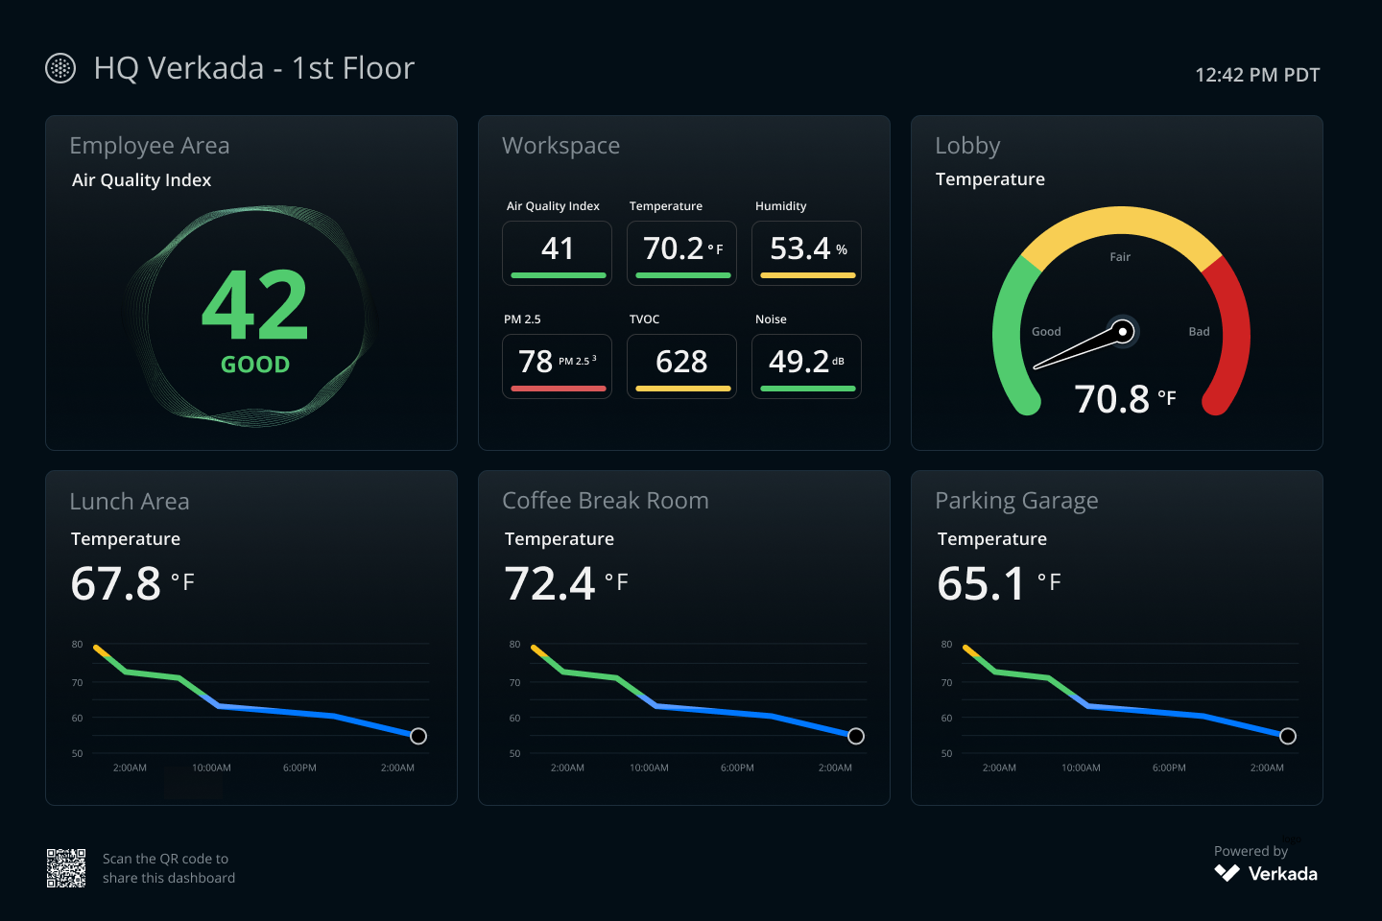
Why do we need this system?
Social anxiety
Rush hour
Iterative feedback
Visualizing live data

Slide 3

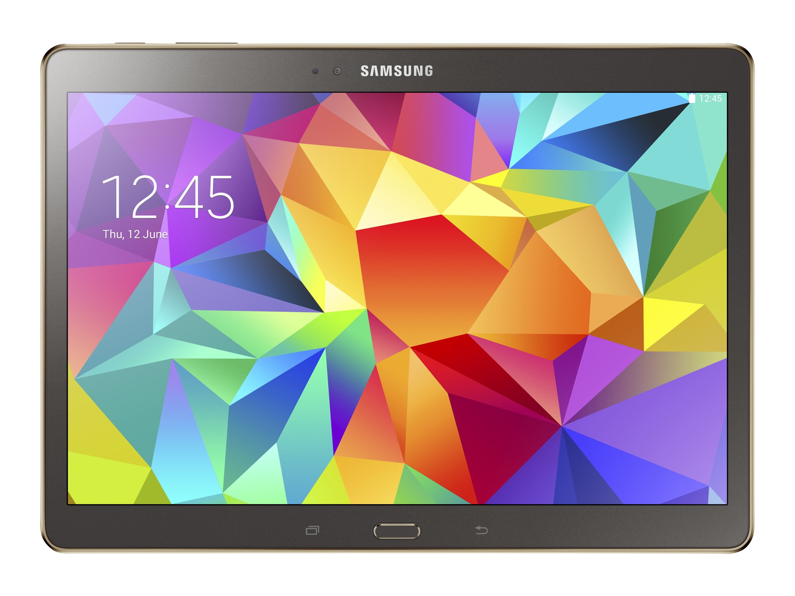
customer interaction
Customer
Keypad 1 to 9
Spaghetti
Chef
Button
Assistance
Order acknowledged OR Help is on the way OR Order complete

Slide 4

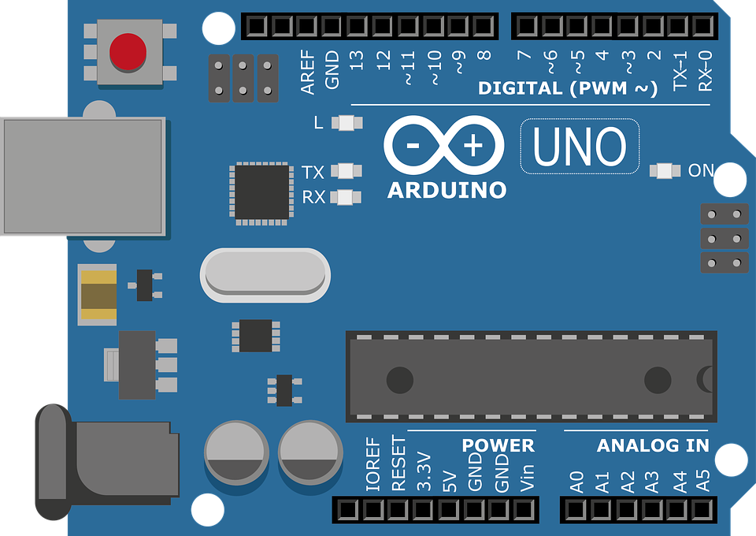
environment sensors
Temperature
Celsius
Flame
Detection
Photoresistor
Light Level
Ultrasonic
Table Reservation
Chef

