Slide 1

d.i.n.e Digital Interactive Network for Eating
Ammar Imran Khan – 2210022
Bhavesh – 2210013
Kashif Raza – 2210021

Slide 2

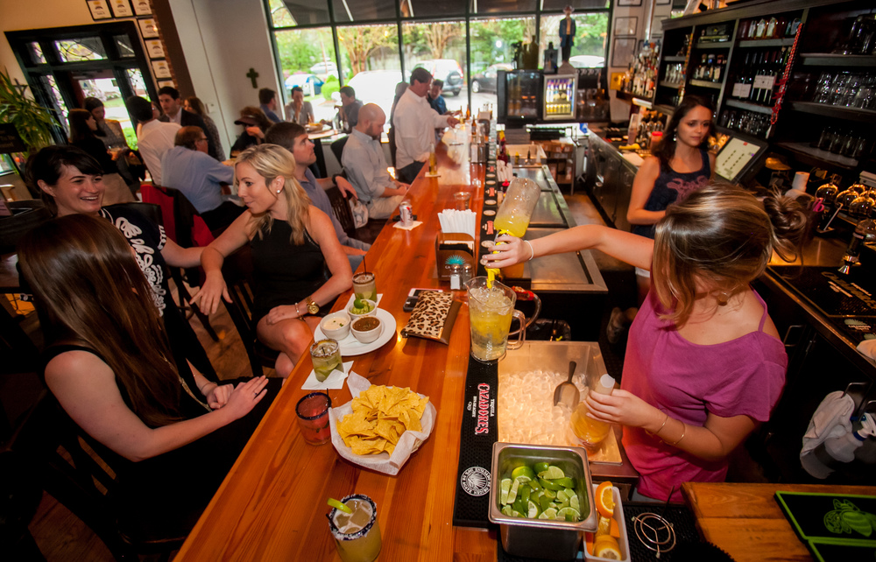
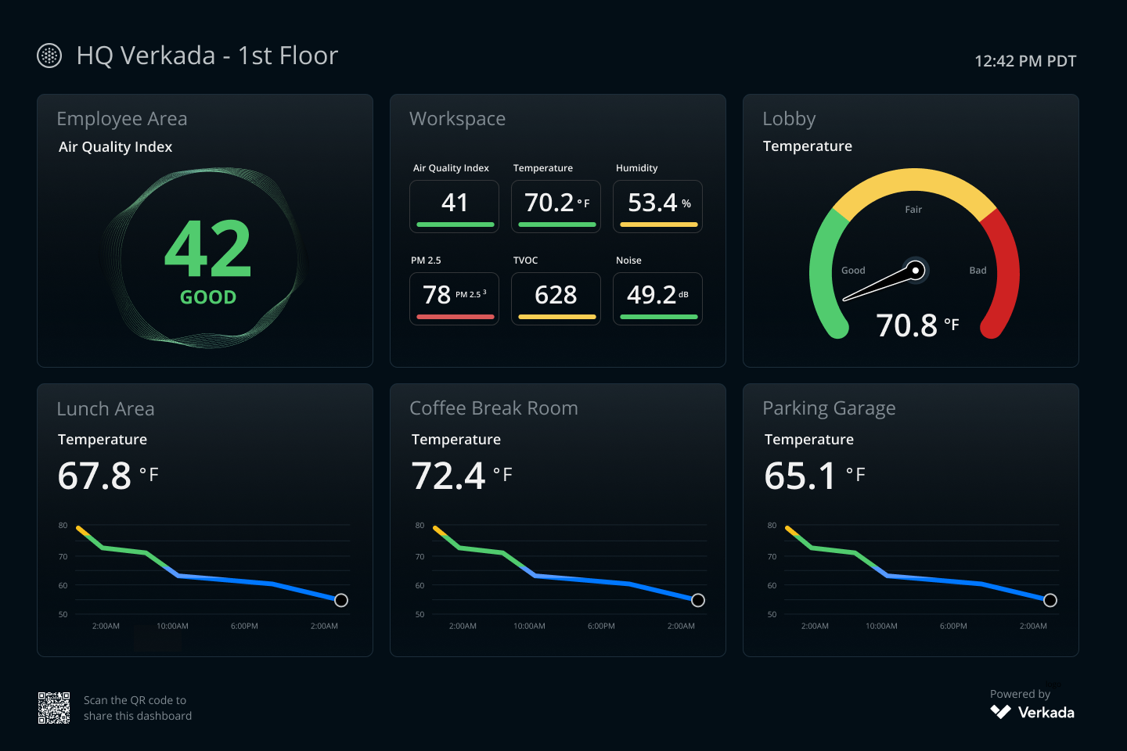
Why do we need this system?
Social anxiety
Rush hour
Iterative feedback
Visualizing live data

Slide 3

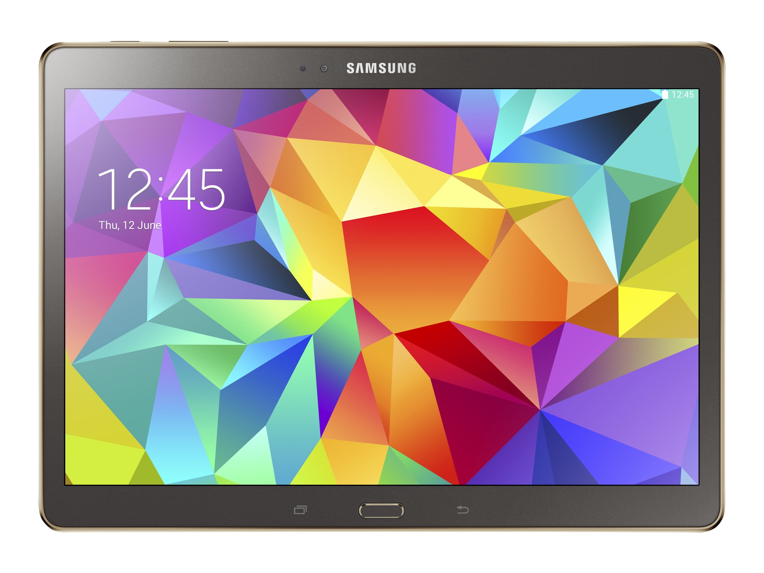
customer interaction
Customer
Keypad 1 to 9
Spaghetti
Chef
Button
Assistance
Order acknowledged OR Help is on the way OR Order complete

Slide 4
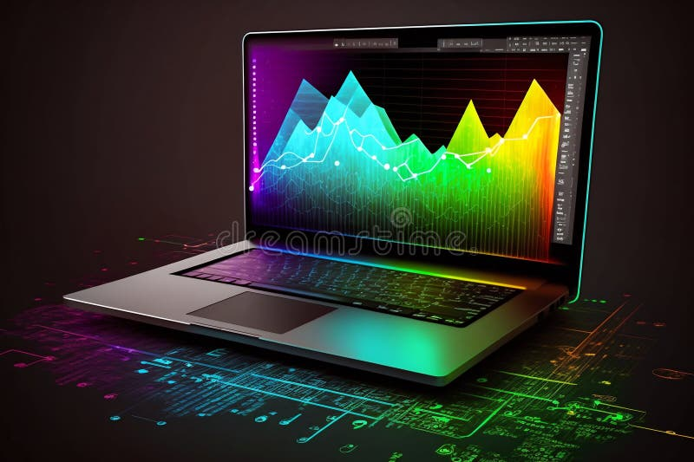
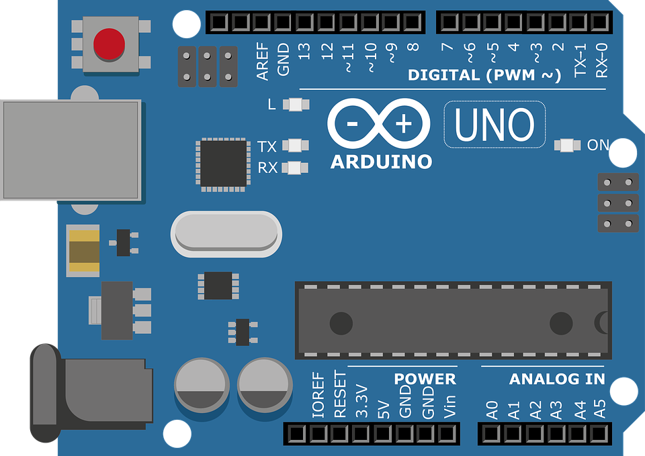
environment sensors
Temperature
Celsius
Flame
Detection
Photoresistor
Light Level
Ultrasonic
Table Reservation
Chef

Slide 5
MQTT Broker & DATA VISUALIZATION
Broker
Message Broker
Scalability
Real-Time Communication
Influx-DB
Time-Series Database
Schema-Free
Efficient Storage
Grafana
Visualization Tool
Multi-Source Compatibility
Interactive Dashboards

Slide 6
Integration of MQTT Broker, Influx-DB, and Grafana
Seamless Data Flow: MQTT broker receives sensor data, which is then stored in Influx-DB and visualized using Grafana.
Real-Time Monitoring: Provides real-time insights and monitoring capabilities through Grafana dashboards.
Scalable Solution: Supports scalable data ingestion and visualization for IoT and monitoring applications.

