Slide 1

ECE 368
Programming Assignment 01
10/2/2021

Slide 2
Learning objective:
An understanding of basic data structures like array and linked list.
An ability to apply shell sort for a given application

Slide 3
Tasks to do:
Implement shell sort on an array
Implement shell sort on a linked list

Slide 4
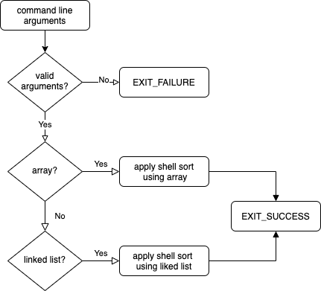
Code Flow Chart

Slide 5
Array
long *Array_Load_From_File(char *filename, int *size)
Load the array from binary input file
void Array_Shellsort(long *array, int size, long *n comp)
Apply shell sort to the array
int Array_Save_To_File(char *filename, long *array, int size)
Save the sorted array to binary output file

Slide 6
Linked list
Node *List_Load_From_File(char *filename)
Load list from binary input file
Node *List_Shellsort(Node *list, long *n comp)
Apply shell sort to the list
int List_Save_To_File(char *filename, Node *list)
Save the sorted list to binary output file

Slide 7
Validation on command line arguments
argc
The number of arguments passed
argv[]
A pointer array which points to each argument passed to the program
strcmp(const char *str1, const char *str2)
Compare the string pointed by str1 with the string pointed by str2

Slide 8
long *Array_Load_From_File(char *filename, int *size)
Remember to add fclose() if fopen()
To know the size of array
Count the number of long integers by reading them from the input file using a while loop one by one
Remember to move file pointer back to the beginning (fseek)

Slide 9
long *Array_Load_From_File(char *filename, int *size)
If the input file is empty, an array of size 0 should still be created and *size be assigned 0.
You should return a NULL address and assign 0 to *size if you could not open the file or fail to allocate sufficient memory

Slide 10
void Array_Shellsort(long *array, int size, long *n comp)
Find max K
Iterate down through array of k values and do insertion (bubble) sort on each subarray

Slide 11
int Array_Save_To_File(char *filename, long *array, int size)
Remember to add fclose() if fopen()
If array is NULL or size is 0, an empty output file should be created.

Slide 12
Node *List_Load_From_File(char *filename)
Remember to add fclose() if fopen()
To know the size of list
Count the number of long integers by reading them from the input file using a while loop one by one
In the same loop, add a new node to list whenever reading a new long integers.

Slide 13
Node *List_Load_From_File(char *filename)
The long integers should be stored in the same order in the linked-list as they are stored in the file
An empty input file or an invalid input filename both will result in an empty linked list

Slide 14
Node *List_Shellsort(Node *list, long *n comp)
Find max K
Iterate down through array of k values and do insertion (bubble) sort on each sub-list (you may divide a list into sub-lists and use lists of linked-list)
Array should not appear in this function

Slide 15
Node *List_Shellsort(Node *list, long *n comp)
The List_Shellsort function must perform sorting by manipulating the next fields of the Nodes
Each long integer should be always stored in the value field of the same Node with same address

Slide 16
int List_Save_To_File(char *filename, Node *list)
Remember to add fclose() if fopen()

Slide 17
Reminder
You are not allowed to define new structures except the structures defined by instructors in header file
It is your responsibility to make sure that your submission can be complied successfully on ecegrid
Your final zip file should not contain a folder. It should only contain shell_array.c, shell_list.c, and pa1.c

Slide 18
Reminder
In main function
Free the memory allocated for the array
Free the linked list by traversing the list and free each node
Use valgrind to check memory issues
keep your code valgrind-clean at any stage of programming

Slide 19
Thank You

