Slide 1

Visualizing Data with R: From Basics to Publication-Ready Graphics
Nevada Bioinformatics Center

Slide 2

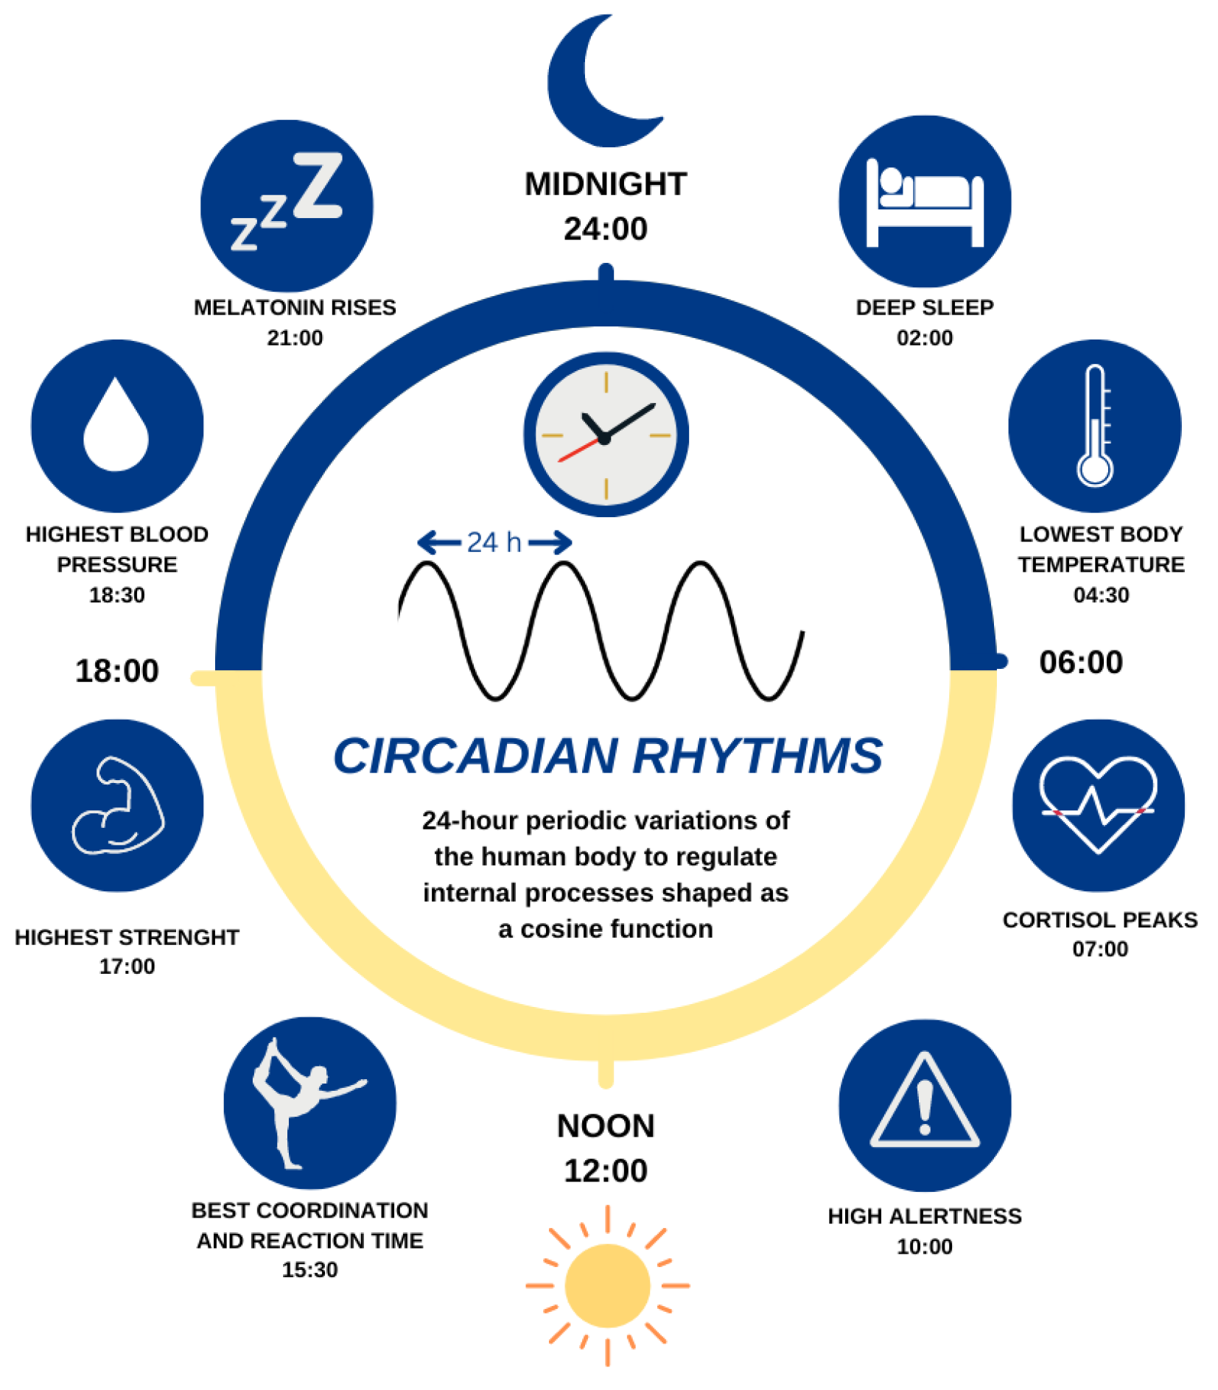
Cassandra Hui, Ph.D.

Slide 3
Outline
Data Visualization Presentation-–Carlos Ramirez-Reyes, PhD
Visualizing Data with R
Part 1
Introduction to Data Visualization
Getting started plotting
Part 2
Summarizing Data
Plotting Raw Data
Customizing Figures
Part 3
Combining Plots
Showing Significance
Saving Plots
More Advanced Figures

