Slide 1
Exploratory Data Analysis (EDA) for Real Estate Pricing.
Rakesh Devendrasing Pardeshi
Next Hikes IT Solution

Slide 2
Introduction
Objective: Uncover key factors influencing residential house prices by exploring patterns, trends,
and correlations in real estate data.
Tools: Utilize Python's Pandas, Matplotlib, and Seaborn libraries for data manipulation and visualization.
Techniques Applied:
Merging Datasets: Integrate property data from various sources (e.g., location, amenities, market trends) into a unified dataset.
Handling Missing Values: Detect and address missing or incomplete entries to maintain data integrity.
Removing Irrelevant Columns: Discard redundant or non-contributing fields to streamline the dataset.
Data Type Conversion: Ensure each feature is of the correct data type for meaningful analysis.
Outlier Detection: Identify anomalies in pricing and property features that could skew results.
Skewness and Correlation Analysis: Analyze variable distributions and interrelationships to understand pricing drivers.
Outcome: Enable data-driven decisions for pricing strategies, investment opportunities, and competitive positioning in the real estate market.

Slide 3
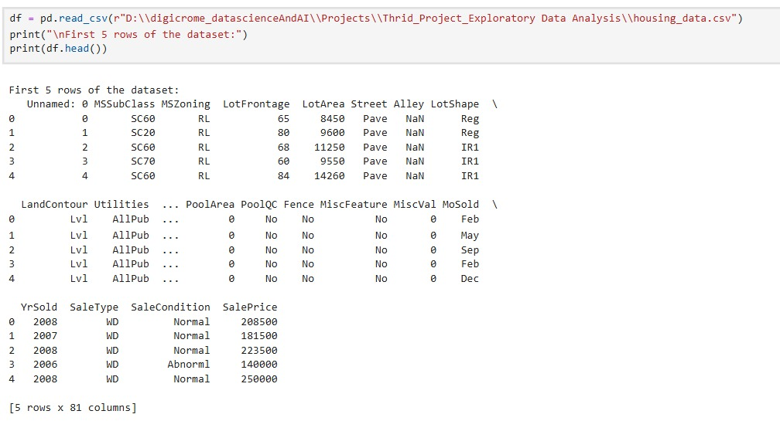
DATASET Loading :

Slide 4
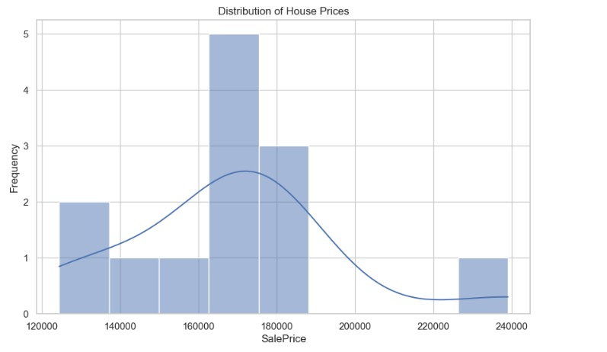
Univariate Analysis :

Slide 5
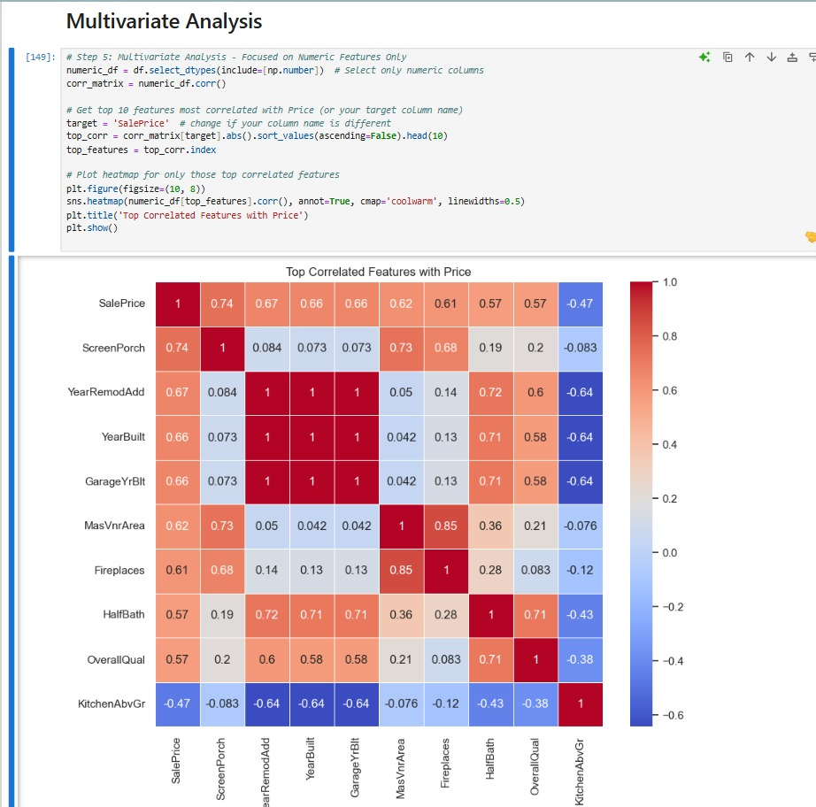
Multivariate Analysis :

Slide 6
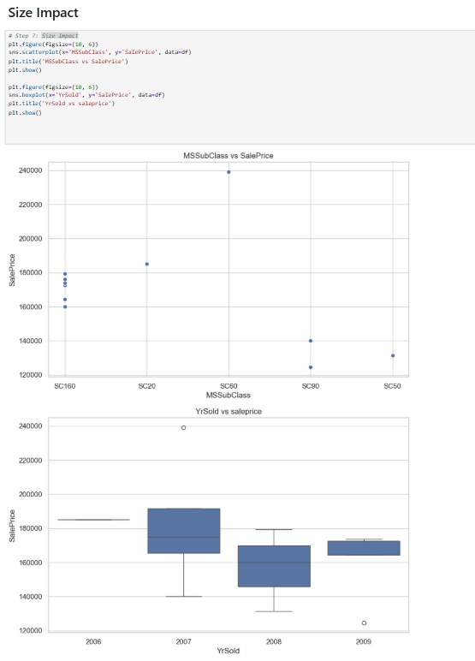
Size Impact :

Slide 7
Adaquetes
Enables accurate, data-driven pricing by identifying key factors like location, size, and amenities that influence house values. Reveals market trends and outliers, helping optimize pricing strategy and reduce risks in property valuation. Supports informed business decisions for property acquisition, sales, and customer targeting in a competitive market.

Slide 8
Thank You !

