Slide 1
Text Encryption and Decryption
Submitted To:
Mr. Ravi kumar
Assistant Professor
Computer science and Engineering
R.V Institute of Technology Bijnor
Developed By:
Ravi kumar(Lateral Entry)
Dipanshu (Lateral Entry)

Slide 2
Contents
1-Introduction
Cryptography--------------------------------------------------------------------1
Encrpytion & Decryption---------------------------------------------2
2-Technologic
Python Language-------------------------------------------------------2-3
Python modules--------------------------------------------------------3-6
3-System Requirements
Software requirement------------------------------------------------6-7
Hardware requirement-------------------------------------------------7-8
4-SOFTWARE REQUIREMENT ANALYSIS
ASCII Table-----------------------------------------------------------9-10
Output Screens-----------------------------------------------------15-16
Testing---------------------------------------------------------------------16-17

Slide 3
INTRODUCTION
Plain text is the term used to refer to the information in plain language that the sender desires to send to one or more receiving computers or individuals. Also referred to as clear text, plain text is commonly referred to as the input to a cipher or encryption algorithm.
Encryption Algorithm
Plain
Text
Cipher Text
Decryption Algorithm
Plain Text

Slide 4
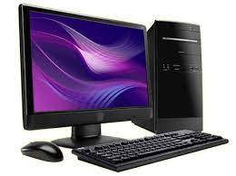
Cryptography
The cryptography is the Science of encryption and decryption Information to Prevent unauthorized access. The decryption process Should be known to both the sender and the receiver.
Sonu send encrypted
Message
Message is captured by Ram
Sonu
Himanshu reads message
Ram
Ram cannot read message
Cryptography as a flow model

Slide 5
Type of Cryptography:-
1.Symmetric:-
Single key both encryption and decryption of data.
Less secure than asymmetric but relatively faster.
2.Asymmetric
A server user a private key to encrypt data.
Web Browser use to server public key to decrypt.

Slide 6
Encryption & Decryption
Encryption:-
The process of converting plaintext into cipher text
. Decryption:-
The process of converting cipher text into plaintext.
Plain Text
message
Encryption
Cipher Text
message
Decryption

Slide 7
Text Encryption:-
Is a process where by plaintext is converted into or Cipher text .
Key K
Plaintext X Cipher Text Y
Encryption
Text Decryption:-
Is the reverse process of encryption or encipherment
, which is to Convert cipher text back to its original form of plaintext
Key K
Plain Text X
Decryption
Cipher Text Y

Slide 8
Technologic
Python Introduction:-
Python is a popular programming language.
It was created by Guido van Rossum, and released in 1991 and further developed by the Python Software Foundation.
Python is a General Purpose, High level Programming language.
Python is a dynamic.
Python modules:-
Consider a module to be the same as a code library.
A file containing a set of functions you want to include in your application.
1-Tkinter:-
Tkinter is Python de-facto standard GUI (Graphical User Interface) package.
It is a standard Python interface to the Tk GUI toolkit shipped with Python

Slide 9
2-Base64:-
Base64 is a group of similar Binary to text encoding schemes that represent binary data in an ASCII string format by translating it into a radix-64 representation.
3.MessageBox:-
The message box module is used to display the message boxes in the python applications.
4.Imagetk
The ImageTk module contains support to create and modify Tkinter BitmapImage and PhotoImage objects from PIL images.

Slide 10
System Requirements
Software requirement:-
The software configurations used are
Operating System: Windows 10
Programming Language : Python
Code Editor:- visual studio code
Hardware Requirements:-
Processor: INTEL i5 4th Gen.
RAM: Minimum of 4 GB or higher
HDD: 240GB or higher
Keyboard: Standard 110 keys keyboard

Slide 11
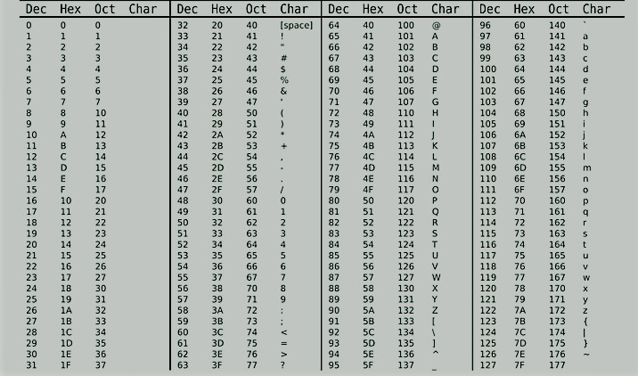
SOFTWARE REQUIREMENT ANALYSIS
ASCII :-
The ascii() function returns a readable version of any object (Strings, Tuples, Lists, etc)
The ascii() function will replace any non-ascii characters

Slide 12
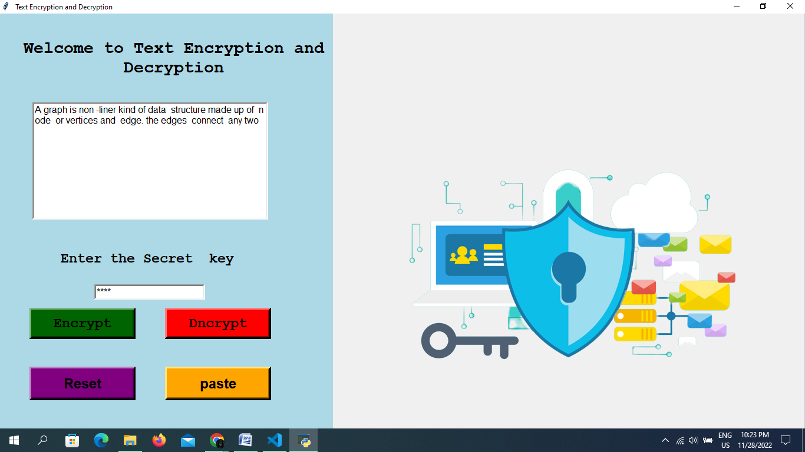
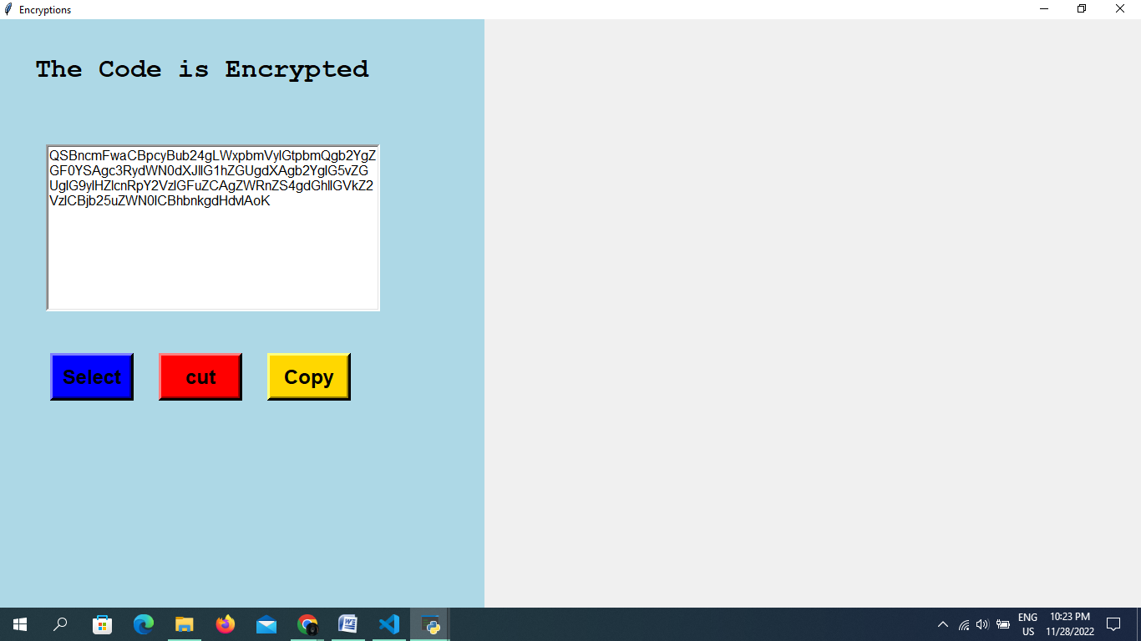
Output Screens

Slide 13
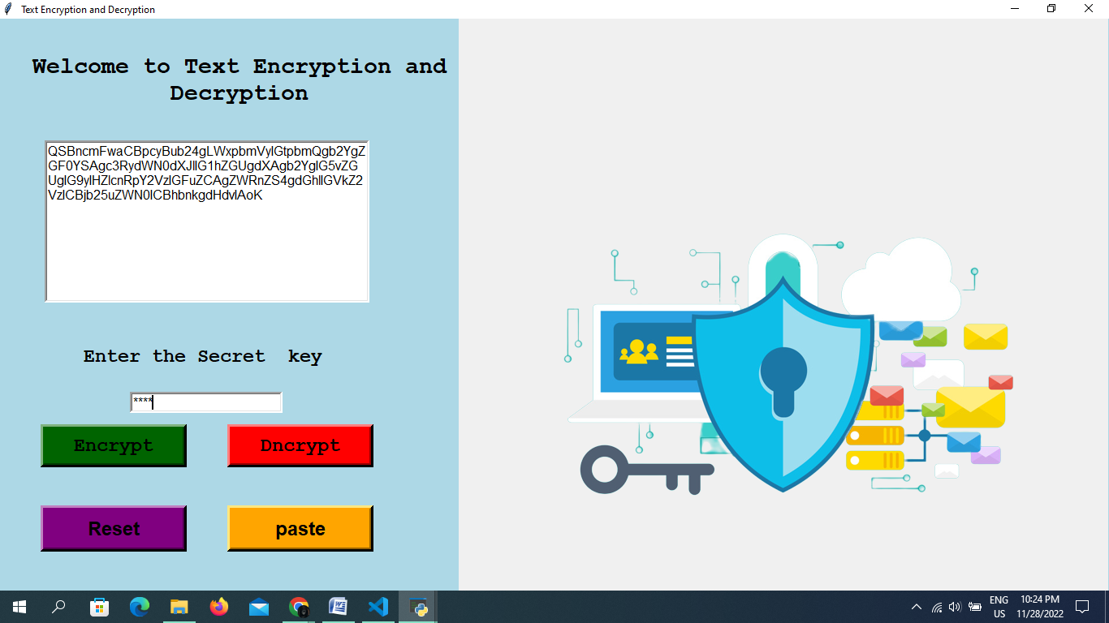
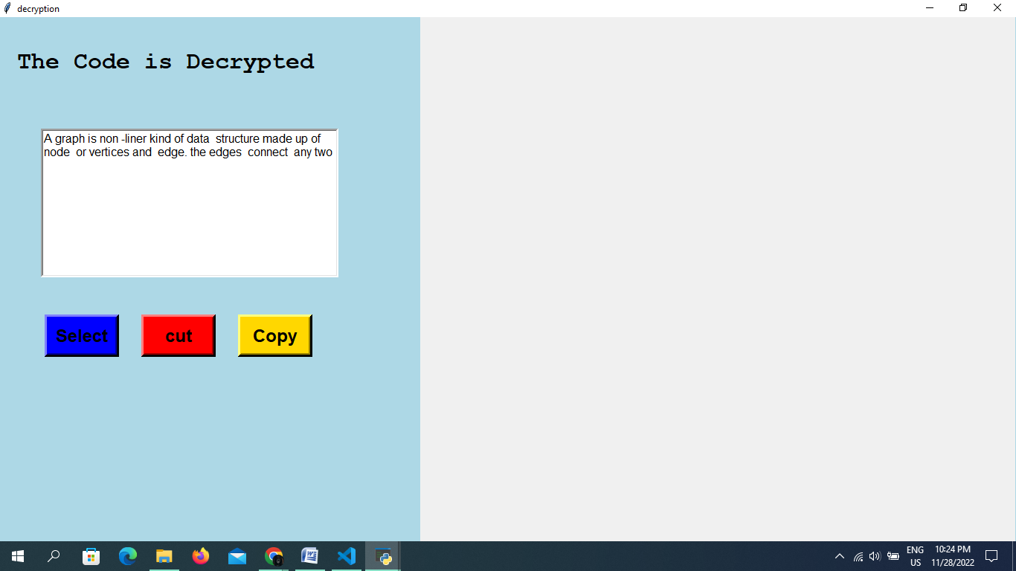

Slide 14
Testing
Software testing is a process of identifying the correctness of software by considering its all attributes (Reliability, Scalability, Portability, Re-usability, Usability) and evaluating the execution of software components to find the software bugs or errors or defects.
White box testing:-
White box testing is a testing technique, that examines the program structure and derives test data from the program logic/code.
Black box testing:-
Black box testing is a technique of software testing which examines the functionality of software without peering into its internal structure or coding.

