Slide 1
UNIVERSITY OF DHAKA · DEPARTMENT OF COMPUTER SCIENCE & ENGINEERING
AI-Powered Business Analytics System
Performance Evaluation, Insight Extraction & Strategy Optimization
①
PHARMACY VERTICAL · BANGLADESH
②
B-SMART FRAMEWORK
Design science · Leakage-controlled ML · Constraint-aware · Owner-in-the-loop
SUBMITTED BY
Md. Rakib Hossain
Roll 88 · Reg. 2020315665
Shah Jamal Islam
Roll 81 · Reg. 2020915641
SUPERVISED BY
Dr. Saifuddin Md. Tareeq
Professor, Dept. of CSE
University of Dhaka
COURSE & DATE
CSE 4114 · Project Work
4th Year, 1st Semester 2025
September 2026

Slide 2
Contents
One argument, five steps — each step answers the step before it.
01
The Problem
Introduction · Motivation · Challenges
02
What Is Known
Background Study · Literature Review & Drawbacks
03
Stated Formally
Problem Formulation
04
Our Answer
Contributions · What We Built · Proposed Methodology
05
The Evidence
Progress & Results · Timeline
B-SMART
02 / 33

Slide 3
01 · INTRODUCTION
The Decision Chain
Four linked steps connect a business event to a business outcome — each step can fail on its own.
01
02
03
04
✓
Observed Event
Analytical Estimate
Eligible Action
Later Outcome
Sale · receipt · return
KPI · forecast · risk score
Order or contact priority
Stock · response · value
THE CENTRAL PROBLEM
A trustworthy, usable connection between recording pharmacy operations, extracting predictive insight, and selecting a feasible action is missing.
B-SMART
03 / 33

Slide 4
01 · INTRODUCTION
Four Gaps We Must Close
The problem isn't a missing model — it's four linked gaps that all block a trustworthy recommendation.
01
02
03
04
!
Data Foundation
Prediction Validity
Decision
Accountability
One schema, full provenance
Leakage-safe, honest baselines
Must meet real constraints
A traceable, contestable reason
RESEARCH QUESTION
How can a Bangladesh-aware framework turn auditable retail records into leakage-controlled forecasts — then rank actions that respect a shop's real constraints?
B-SMART
04 / 33

Slide 5
02 · MOTIVATION
Why Bangladeshi Retail Pharmacies, Why Now
High-stakes inventory decisions, fragmented records, and adoption evidence all point to the same vertical.
01
02
03
Perishable Stock
Scattered Records
Fit Beats Accuracy
Too little = stock-out. Too much = cash locked in expiry.
Sales, stock and payments sit in separate ledgers.
Cost and workflow fit decide whether a tool is used.
B-SMART
05 / 33

Slide 6
02 · MOTIVATION
Who Needs What From the System
Every role touches the data differently — who creates it, who validates it, who acts on it, who is accountable.
OWNER / MANAGER
Reorder, allocate cash, accept or reject a recommendation
Needs a short feasible action + evidence — keeps final authority
SALES / INVENTORY
Record sales, returns, receipts, adjustments
Needs low-friction entry; corrections preserved, not overwritten
ACCOUNTS
Reconcile payments, expenses, margin inputs
Needs cash, revenue and estimated profit kept visibly separate
SUPPLIER / LOGISTICS
Confirm lead time, pack size, minimum order
Needs its constraints treated as real, not fixed assumptions
B-SMART
06 / 33

Slide 7
03 · CHALLENGES
Risks We Expect, and How We Control Them
Every material risk to the evidence is named in advance, with a specific prevention step.
Selection bias
→
Describe recruitment; limit claims to sample
Data leakage
→
Cutoff snapshots, grouped / temporal split
Stock-out censoring
→
Retain stock state; stratify censored periods
Small / short series
→
Eligibility rule, baselines, rolling-origin tests
Concept drift
→
Time-based tests and post-deployment monitoring
Human risk: time pressure and over-trust in confident-looking output are design constraints too.
B-SMART
07 / 33

Slide 8
04 · BACKGROUND STUDY
Three Levels of Analytics
Descriptive → Predictive → Prescriptive: an action is only as credible as the prediction and data behind it.
Descriptive
What happened, where
Predictive
What may happen next
Prescriptive
Which response to take
Five Dimensions of Data Quality
1
2
3
4
5
Syntactic validity
Entity integrity
Temporal integrity
Reconciliation
Decision adequacy
B-SMART
08 / 33

Slide 9
04 · BACKGROUND STUDY
How We Check Data Quality
Two structural checks the pipeline runs before any feature is built.
STOCK RECONCILIATION RESIDUAL — PRODUCT p, PERIOD t
r_{p,t} = I^{open}_{p,t} − I^{close}_{p,t} − Σ_{m} ΔI_{p,t,m}
A nonzero residual is logged as a data-quality event, never silently forced to zero.
Temporal Integrity Checks
Event-before-transaction
Receipt-before-order
Implausible lead time
Post-cutoff features
!
Recorded before its source transaction.
Receipt appears before its purchase order.
Negative or unrealistic supplier lead time.
Feature built after its own cutoff.
B-SMART
09 / 33

Slide 10
04 · BACKGROUND STUDY
What Makes Pharmacy Demand Different
Established customer/demand methods, and where the pharmacy vertical changes what applies.
01
02
03
04
Expiry & Shelf Life
Pack Conversion
Cold Chain
Intermittent Demand
Batch and shelf life gate the order
Box → strip → piece changes quantity
Storage limits, not just price
Many zero-sale days per SKU
K-MEANS CLUSTERING OBJECTIVE (RFM SEGMENTATION)
argmin Σ_{k=1..K} Σ_{xᵢ∈Cₖ} ‖x_{i} − μ_{k}‖²
Silhouette score decides K, not a persuasive label.
B-SMART
10 / 33

Slide 11
05 · LITERATURE REVIEW & DRAWBACKS
Five Research Areas Behind This Work
No single stream supplies the complete argument on its own — the thesis integrates all five.
01
02
03
04
05
Bangladesh Context
Data Foundations
Forecast Models
Prescriptive Analytics
Explanation & Design
Workflow fit
Traceability
Valid estimates
Feasible actions
Evaluated use
CROSS-CUTTING INTEGRITY
temporal validity · baselines · calibration · uncertainty · provenance · claim boundaries
B-SMART
11 / 33

Slide 12
05 · LITERATURE REVIEW & DRAWBACKS
Gaps in Existing Research
Six connected gaps emerge from prior work; the central gap is integration, not a missing classifier.
✓ LITERATURE DOES WELL
✗ REMAINS UNRESOLVED
Names Bangladesh SME adoption determinants (cost, workflow fit, support)
No single study links auditable records to leakage-controlled analytics
Supplies strong forecasting & customer-analytics baselines to compare against
No comparison of baseline / pooled / shop-adapted models on one workflow
Provides leakage, calibration & explanation safeguards as separate checks
No test of whether owners actually understand and correctly act on it
THE CENTRAL GAP IS INTEGRATION
Not a missing classifier — no framework yet joins traceable records, leakage-controlled models and owner-understandable actions in one pharmacy workflow.
B-SMART
12 / 33

Slide 13
06 · PROBLEM FORMULATION
What Data Are We Allowed to Use?
We call this evidence set D_t — every reported number must trace back to it, with a definition and time window.
EVIDENCE SET AT TIME t — PHARMACY b, BRANCH l, PRODUCT p, BATCH r, CUSTOMER c
D_{t} = { Sales, Stock, Batches, Expiry, Purchases, Expenses, Customers, Constraints, Context }_{≤t}
Every downstream KPI, forecast and risk score may only read from D_t — never from future data.
B-SMART
13 / 33

Slide 14
06 · PROBLEM FORMULATION
How We Calculate Sales and Margin
Two precise definitions (Net Sales and Gross Margin Rate) that make revenue auditable, not just displayed.
NET SALES OVER REPORTING WINDOW W
GROSS MARGIN RATE — REPORTED ONLY WITH COST COVERAGE
NetSales_{W} = Σ_{i∈W} q_{i}p_{i} − Σ_{i∈W}d_{i} − Σ_{r∈W}v_{r}
GrossMarginRate_{W} = (NetSales_{W} − COGS_{W}) / NetSales_{W}
Gross line value, minus recognized discount, minus valid returns assigned to the window.
If unit cost is missing for a material share of units, the system reports coverage — never a fabricated margin.
B-SMART
14 / 33

Slide 15
06 · PROBLEM FORMULATION
Predicting Demand and Customer Drop-off
Two predictions, each stated as a precise, testable function of evidence available by cutoff t.
DEMAND PREDICTION AT HORIZON h
FUTURE CUSTOMER INACTIVITY
ŷ_{b,l,p,t+h} = f( history, price,
promotion, calendar, market )
q_{c,t} = P( no purchase
in (t, t+H] | X_{c,t} )
X_{c,t} only uses records available by cutoff t; horizon H is fixed before the final test.
Quantile / calibrated-residual intervals represent uncertainty.
B-SMART
15 / 33

Slide 16
06 · PROBLEM FORMULATION
How We Score and Rank Actions
The utility score U(a), and the cost model behind a reorder recommendation.
ACTION UTILITY — SUBJECT TO CONSTRAINTS
REPLENISHMENT COST FOR CANDIDATE ORDER Q
U(a | D_{t}) = E[ΔProfit(a)]
− ActionCost(a) − λ·Risk(a)
J_{p}(Q) = c_{o}𝟙(Q>0)
+ c_{h}E[(IP+Q−D_{L})⁺]
+ c_{s}E[(D_{L}−IP−Q)⁺]
Subject to: budget · stock · MOQ · lead time · pack · shelf life · expiry · cold-chain · consent.
IP = on-hand + on-order − backorder. Costs are sensitivity-tested, never assumed exact.
B-SMART
16 / 33

Slide 17
07 · OUR CONTRIBUTIONS
What This Thesis Contributes
Five research contributions, plus a working engineering artifact.
01
Traceable Data Design
04
Prediction → Action
Auditable schema, end to end
Utility model for feasible actions
02
Leakage-Free Protocols
05
Owner-Interpretability
Rules that stop target leakage
Tested on real owner decisions
03
Honest Baselines
06
Working Implementation
Disciplined model comparison
A running app, not just a proposal
B-SMART
17 / 33

Slide 18
07 · OUR CONTRIBUTIONS
WORK ALREADY DONE
What We Have Already Built
Built ahead of the report's requirement — the prototype already runs.
BACKEND
FRONTEND
ML PIPELINES
FastAPI · 56 endpoints
React · 19 screens
16 staged scripts
21-table multi-tenant SQL schema
Owner mode in Bangla, research mode for evaluators
Leak-free retrain + a running recommendation engine
~15,200
37
2
3
lines of code
trained models
real public datasets
DB migrations
B-SMART
18 / 33

Slide 19
07 · OUR CONTRIBUTIONS
From Today's Prototype to B-SMART
Each thing we built has a limit the methodology removes.
BUILT TODAY
PROPOSED UPGRADE
Data
One shop's own records
→
Pooled multi-pharmacy evidence layer
Models
Trained on synthetic data
→
Trained on consenting pharmacy data
Validation
Single untouched holdout
→
Held-out-pharmacy transfer test
Output
Ranked list of suggestions
→
Constraint-checked, feasible actions
Trust
Model vs baseline badge
→
Reason, uncertainty and cutoff attached
B-SMART
19 / 33

Slide 20
08 · PROPOSED METHODOLOGY
System Architecture
How shared learning across pharmacies becomes one shop's specific, feasible recommendation.
DATA
Public / Reference Data
Consenting Pharmacies
Governed Evidence Layer
Validation · isolation
ANALYTICS
Analytics Outputs
Demand · risk · segments · KPI
Model Selection
Baseline · pooled · shop-adapted
DECISION
Constraint-Aware Strategy
Feasibility · benefit · cost
Owner Decision
Accept · reject · defer · modify
Outcome & Monitoring
Shop Constraints
Budget · stock · lead time
- - - dashed = monitored feedback loop, not automatic retraining
B-SMART
20 / 33

Slide 21
08 · PROPOSED METHODOLOGY
Our Database Design
The canonical data model — every KPI, forecast and risk score traces back to this schema.
Organization + Branch
Product + Supplier + Constraint
Customer + Consent
Purchase Order + Receiving
Sale + Line Items + Payment
Return + Refund + Receivable
Expense + Ledger
Stock Movements + Batch & Expiry
Import Batch + Audit Log
Validated for uniqueness, chronology, pack consistency and stock balance.
B-SMART
21 / 33

Slide 22
08 · PROPOSED METHODOLOGY
Choosing the Right Model for Each Pharmacy
The model-promotion ladder: the deployed choice is the highest level that passes every gate — it may stay the baseline.
1
LEVEL 1 — TRANSPARENT BASELINE
Always required and reproducible
Cross-shop evidence approved, gain stable?
2
LEVEL 2 — POOLED PHARMACY MODEL
Held-out-shop transfer tested
Local history enough, gain material?
3
LEVEL 3 — SHOP-ADAPTED MODEL
Same-origin comparison required
If a gate fails, the previous level is kept, with the reason.
B-SMART
22 / 33

Slide 23
08 · PROPOSED METHODOLOGY
How We Prevent Data Leakage
A versioned snapshot means future outcomes can never alter the record that produced an earlier result.
Versioned Event Ledger
Event & receipt time
Snapshot Builder
Rules fitted before cutoff
Immutable Snapshot
Features available at t
Released Output
Model, action & evidence
Decision cutoff t
Future window stays sealed
Outcome window (t, t+H]
Labels & realized events
Frozen Evaluation Sequence
Development
Freeze Protocol
Untouched Test
Decision Evaluation
Bounded Claim
B-SMART
23 / 33

Slide 24
08 · PROPOSED METHODOLOGY
The B-SMART Recommendation Algorithm
Algorithm 1 in the thesis report — exactly how one ranked recommendation gets built from raw data.
INPUT
Data at cutoff (D_{t}) · Horizon (H) · Shop constraints (C_{t}) · Candidate models (M) · Candidate actions (A)
1 · VALIDATE & SNAPSHOT
Verify source, schema & timestamps; build the immutable snapshot Xₜ
2 · PREDICT
Compare baseline / pooled / shop-adapted models; estimate demand & drop-off risk
3 · SCORE EACH ACTION
Check feasibility (budget, stock, expiry, lead time, consent); score U(a) = benefit − cost − risk
4 · RANK & RETURN
Drop infeasible actions; rank by U(a); attach reason, confidence & cutoff
OUTPUT
Rₜ — top-K ranked feasible recommendations, each with its reason, confidence and cutoff. The owner's response and the later outcome are logged for the next revalidation.
B-SMART
24 / 33

Slide 25
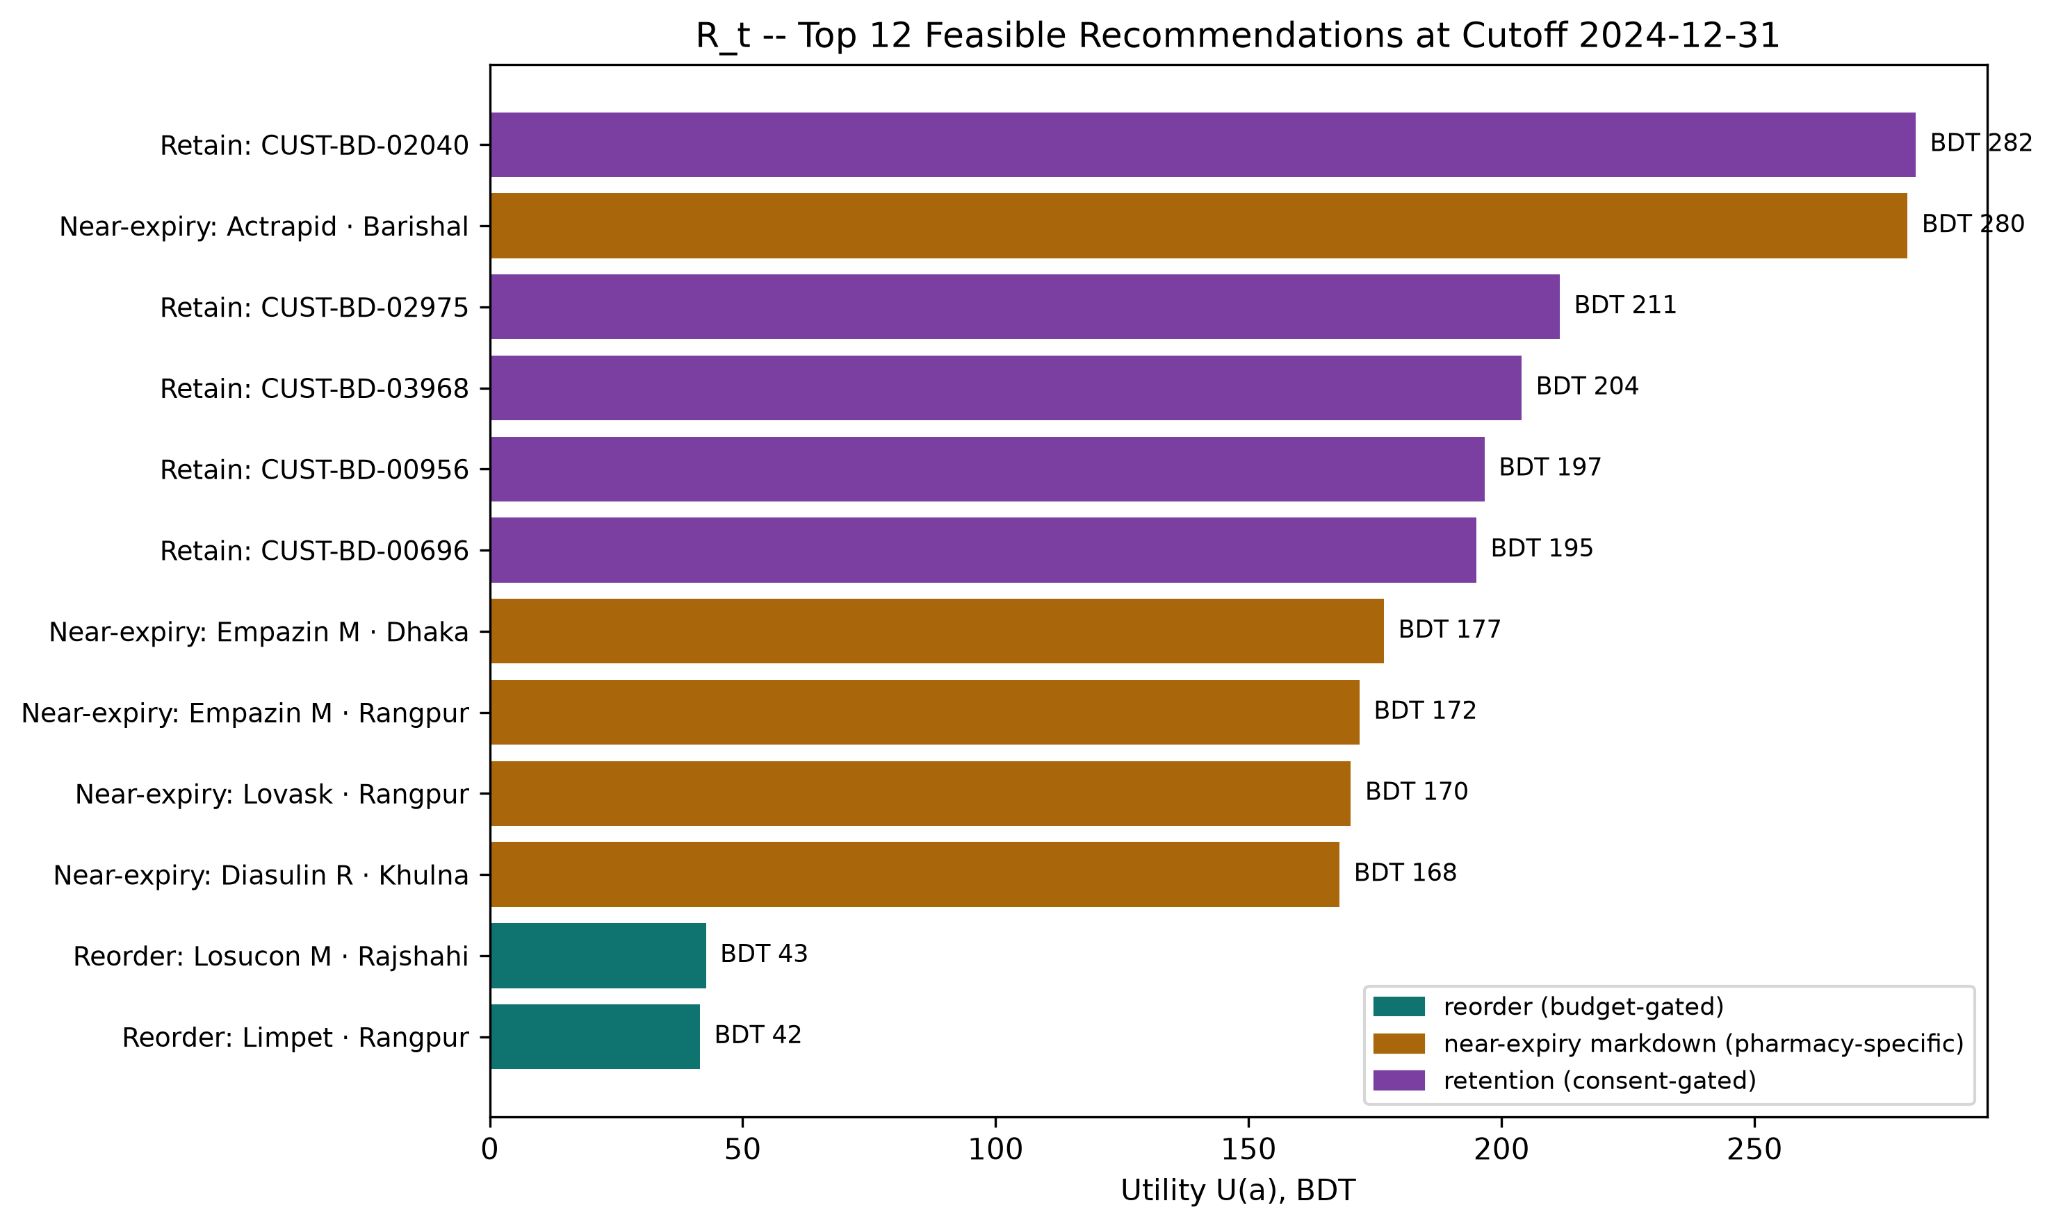
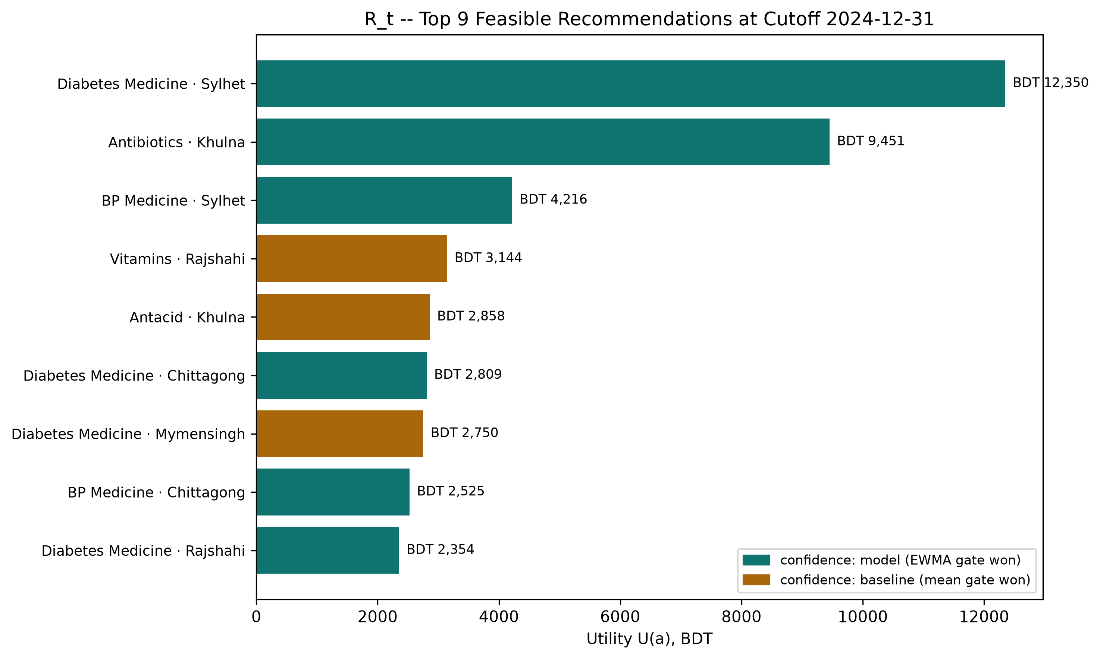
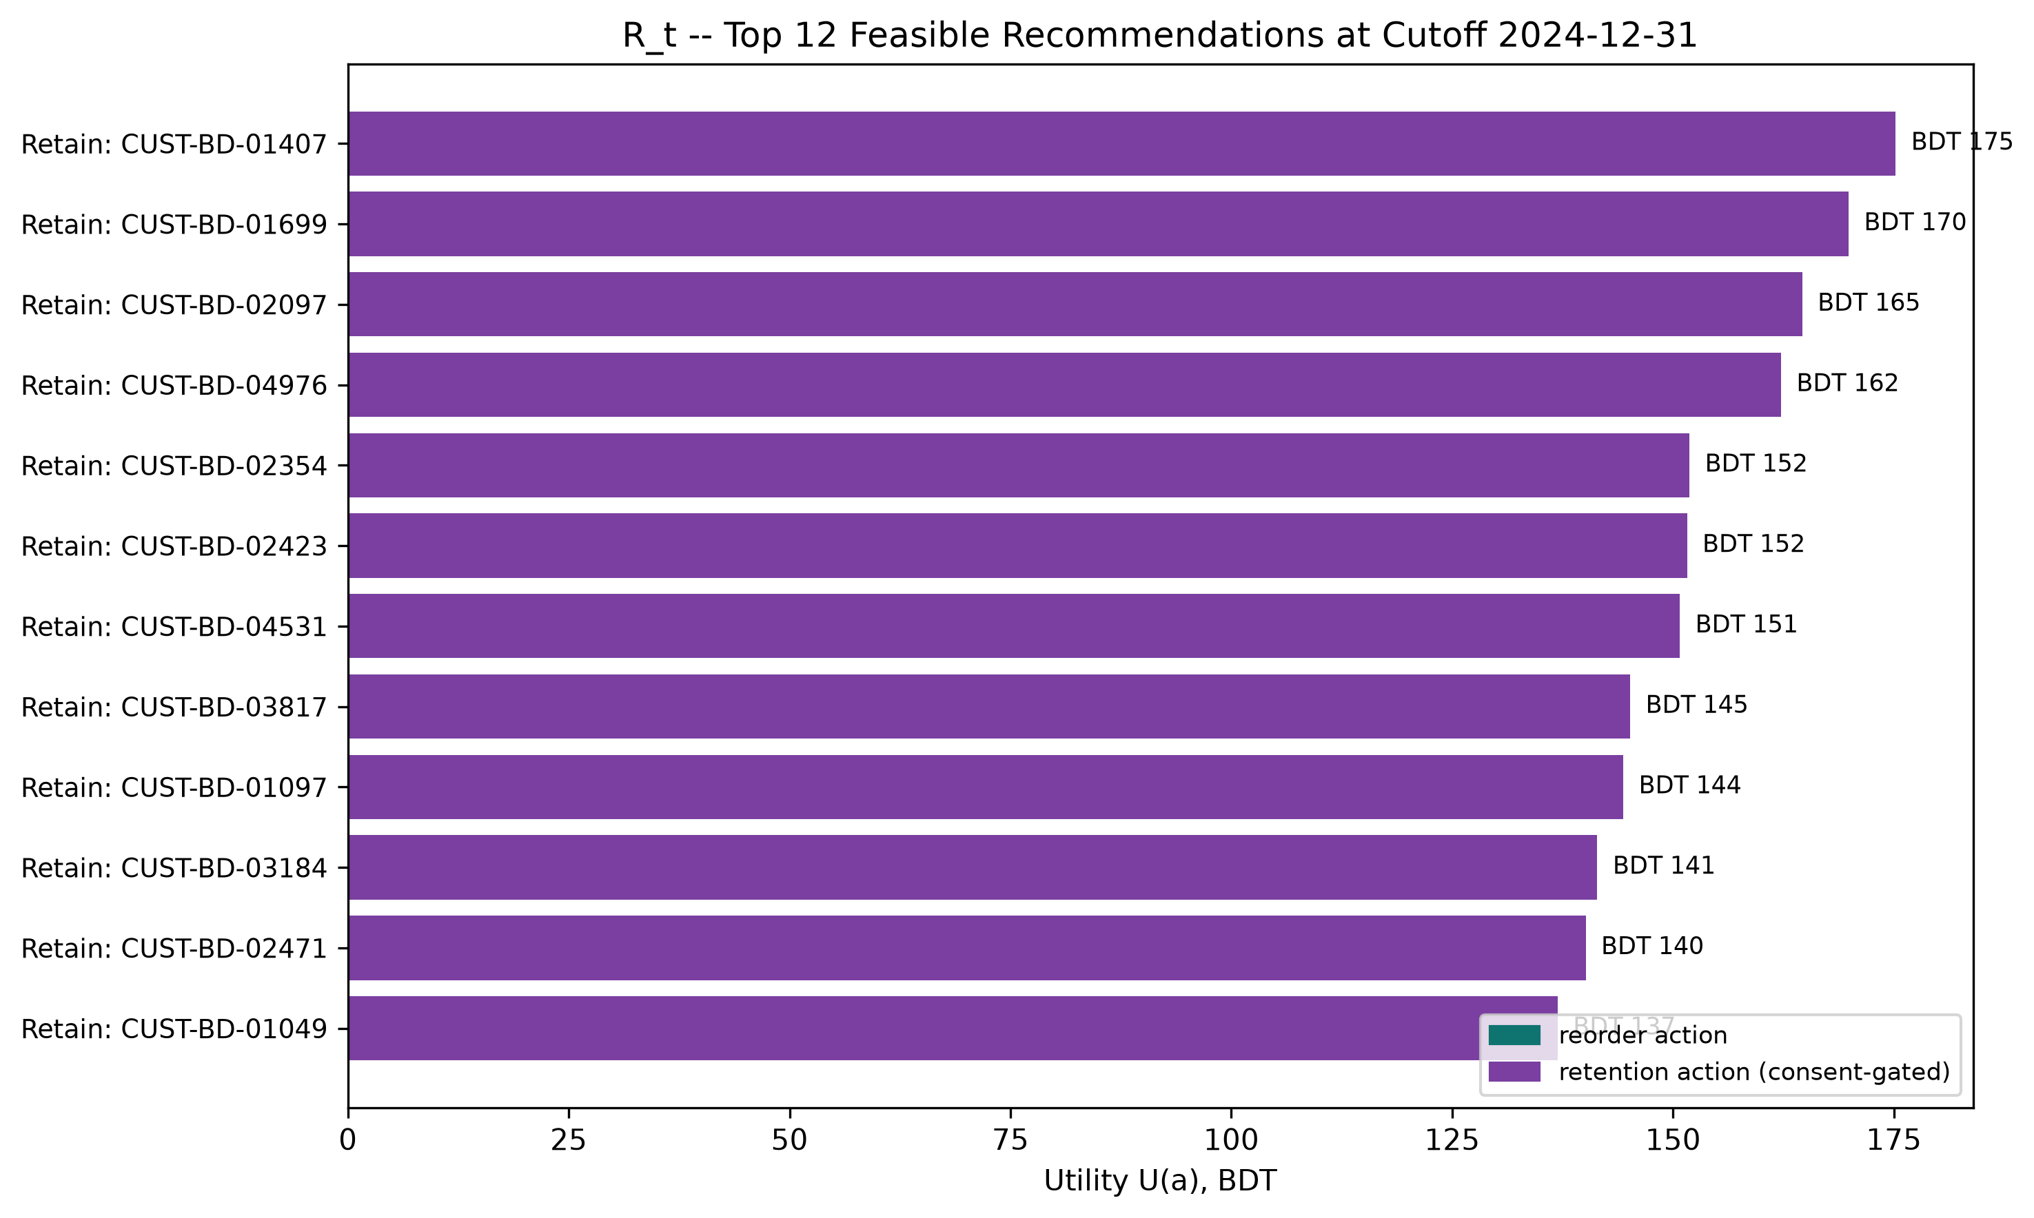
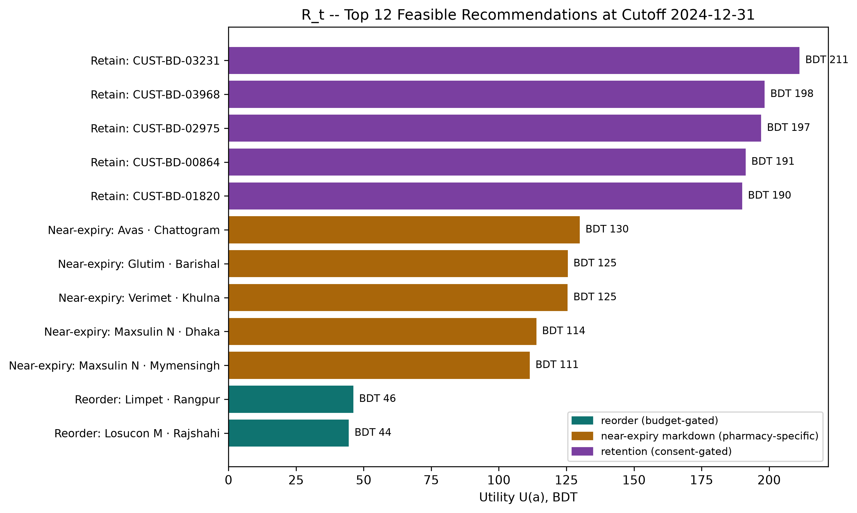
09 · PROGRESS & RESULTS
SYNTHETIC DEV DATA
We Ran the Algorithm — Here Is R_t
Algorithm 1 end to end: 13 constraints applied, then a balanced slate — 5 reorder, 5 near-expiry, 5 retention.
B-SMART
25 / 33

Slide 26
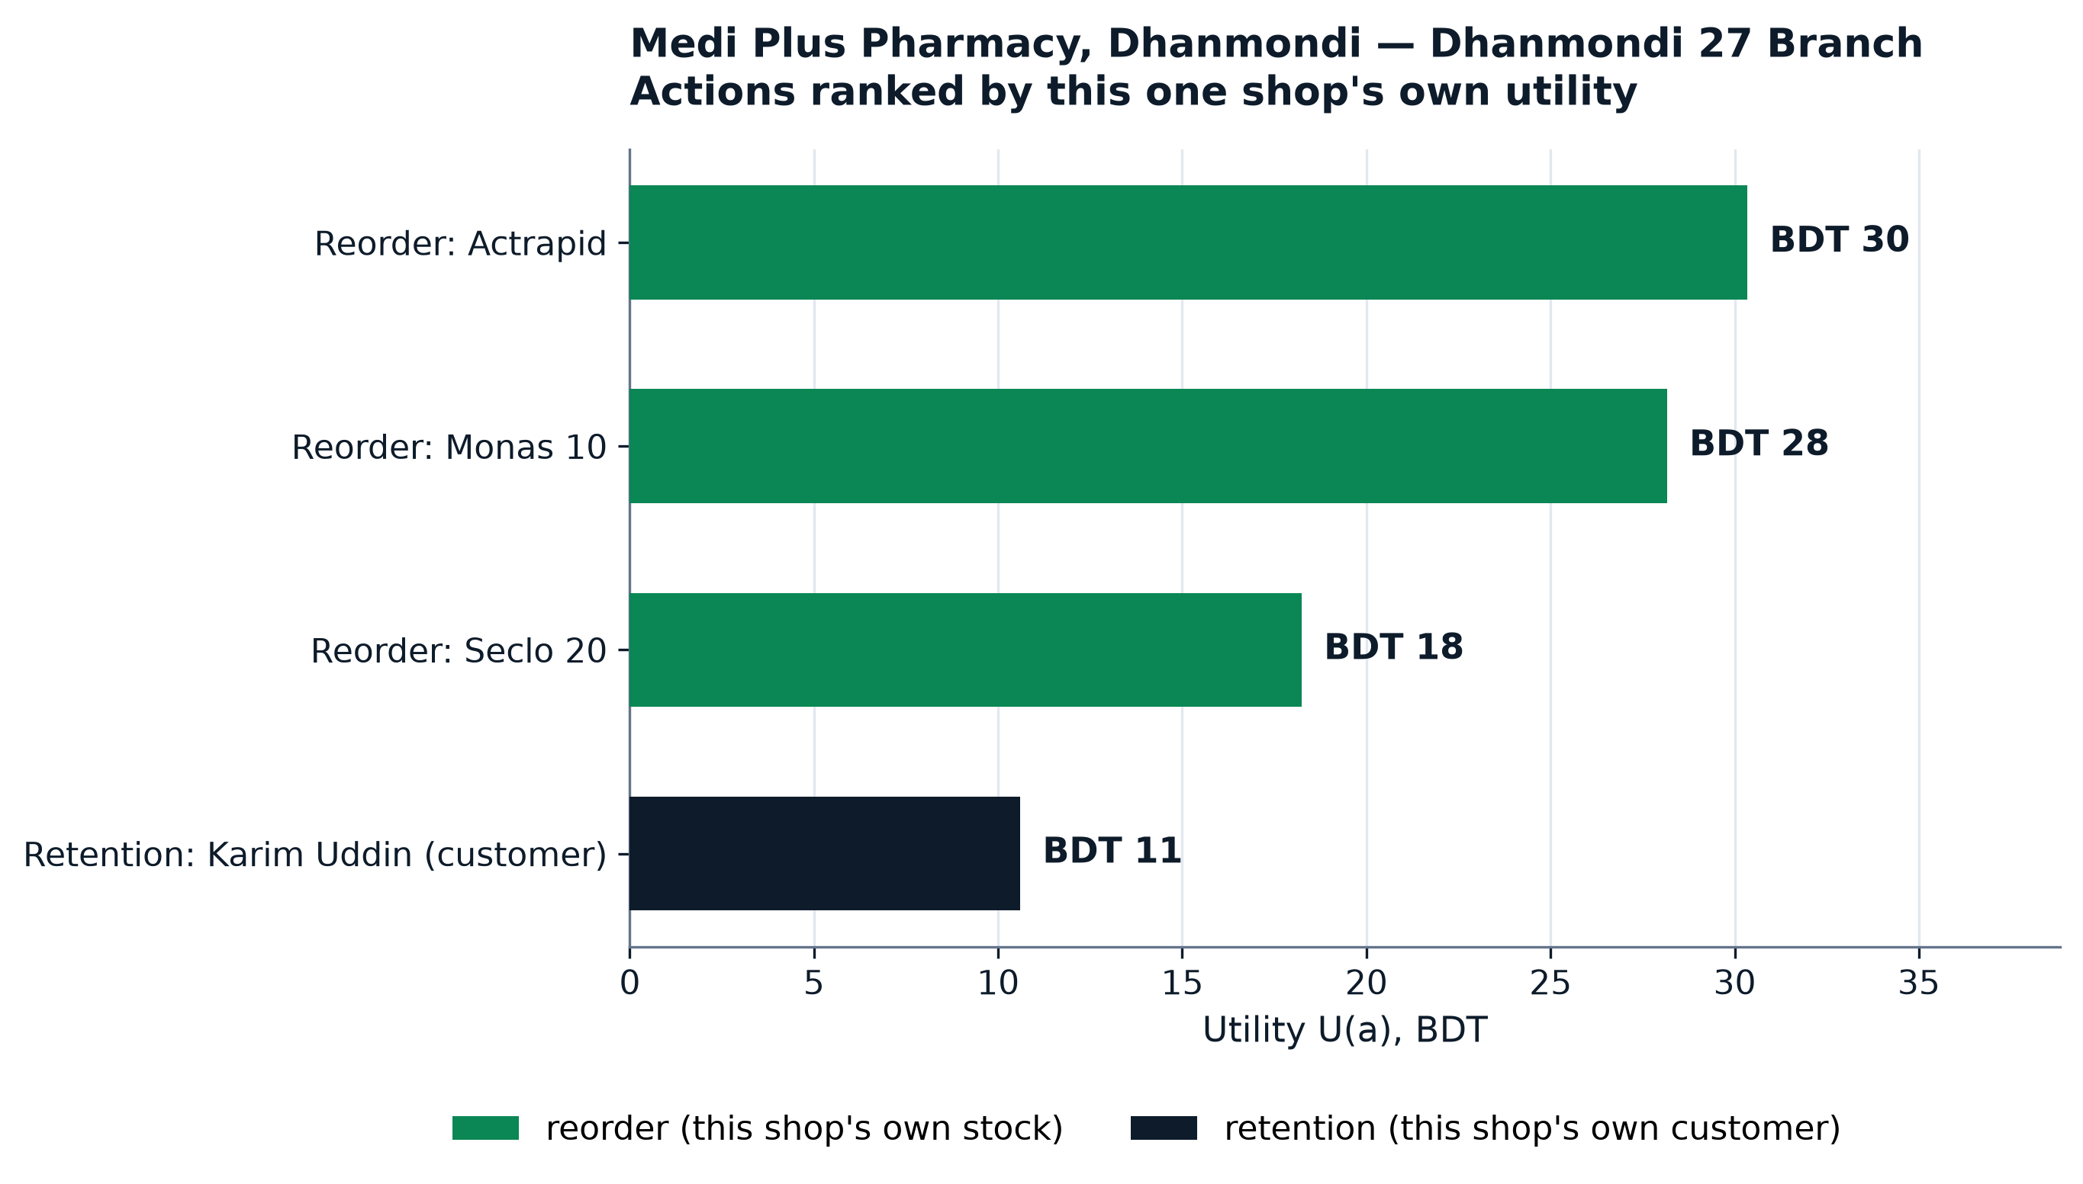
09 · PROGRESS & RESULTS
LIVE SHOP DATA
One Real Shop's Own Recommendations
Not a division average: live GET /api/app/recommendations output for one seeded pharmacy — its own branch, stock and customer.
B-SMART
26 / 33

Slide 27
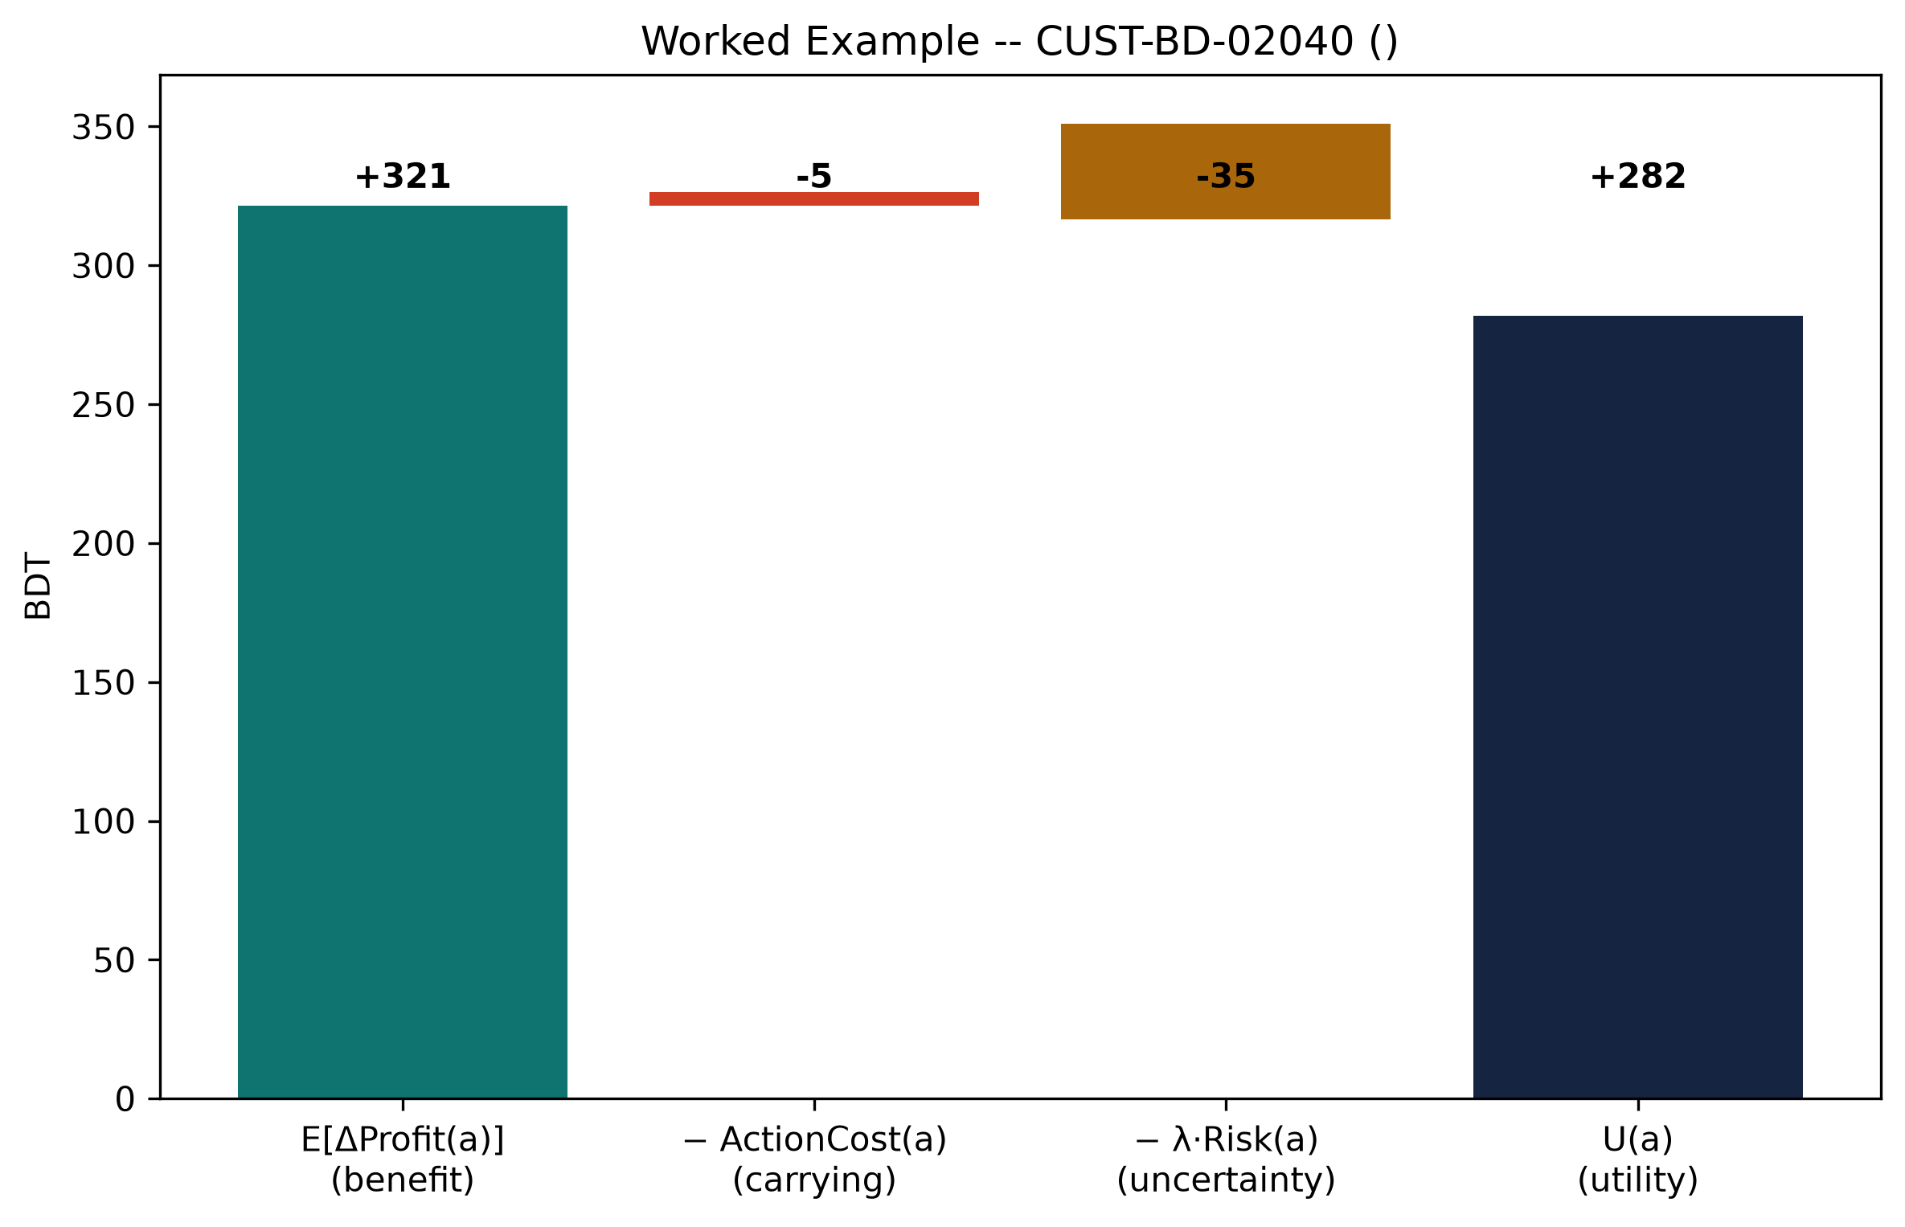
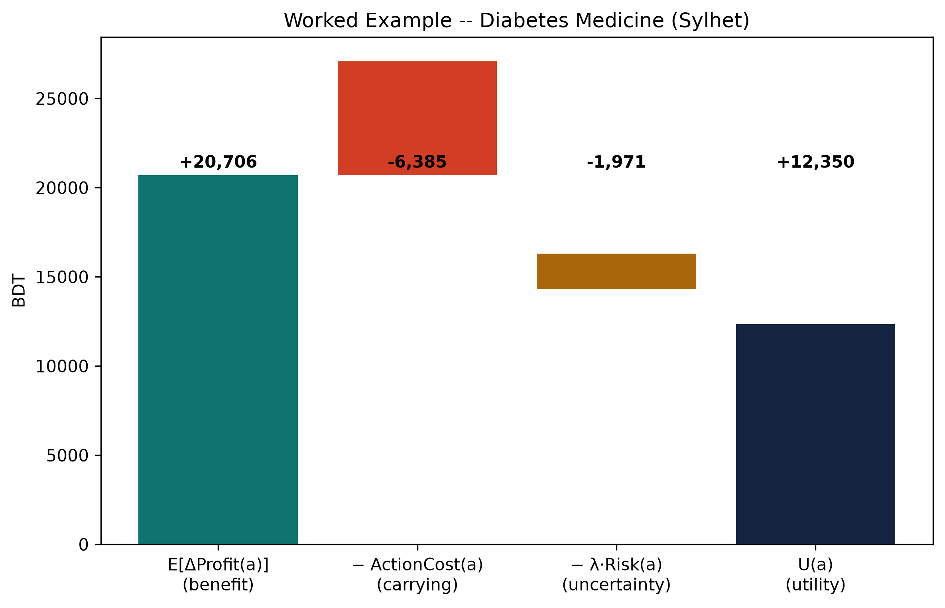
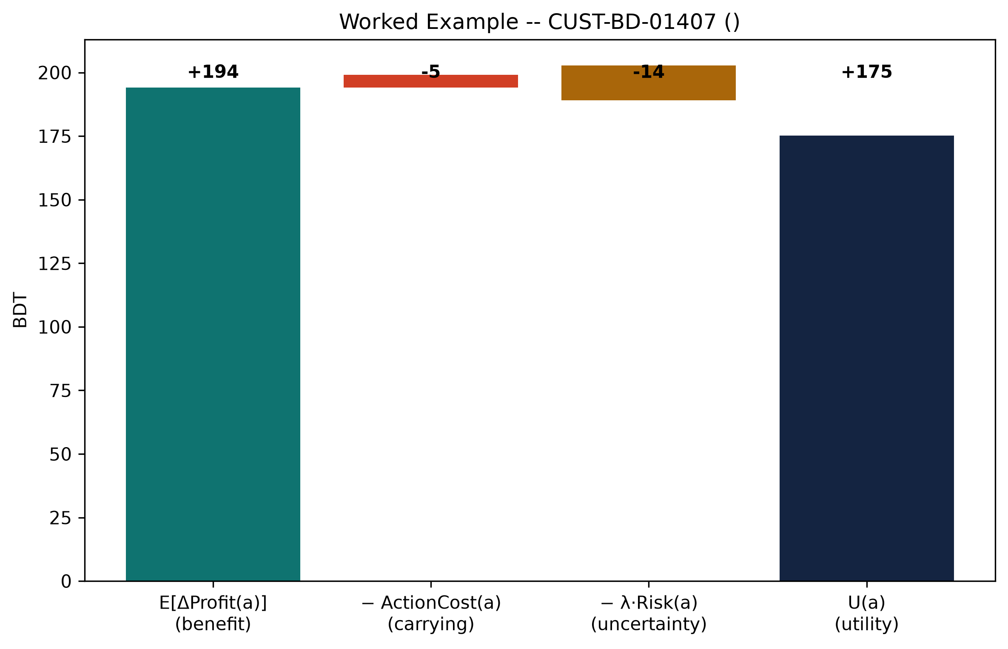
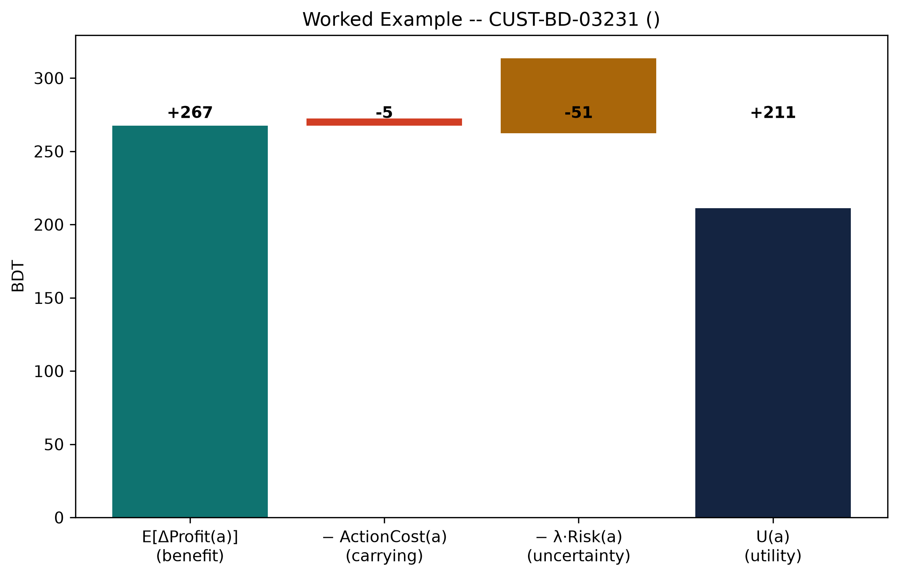
09 · PROGRESS & RESULTS
SYNTHETIC DEV DATA
One Recommendation, Fully Explained
The top action in R_t, broken into the three terms of U(a) = E[ΔProfit] − Cost − λ·Risk.
B-SMART
27 / 33

Slide 28
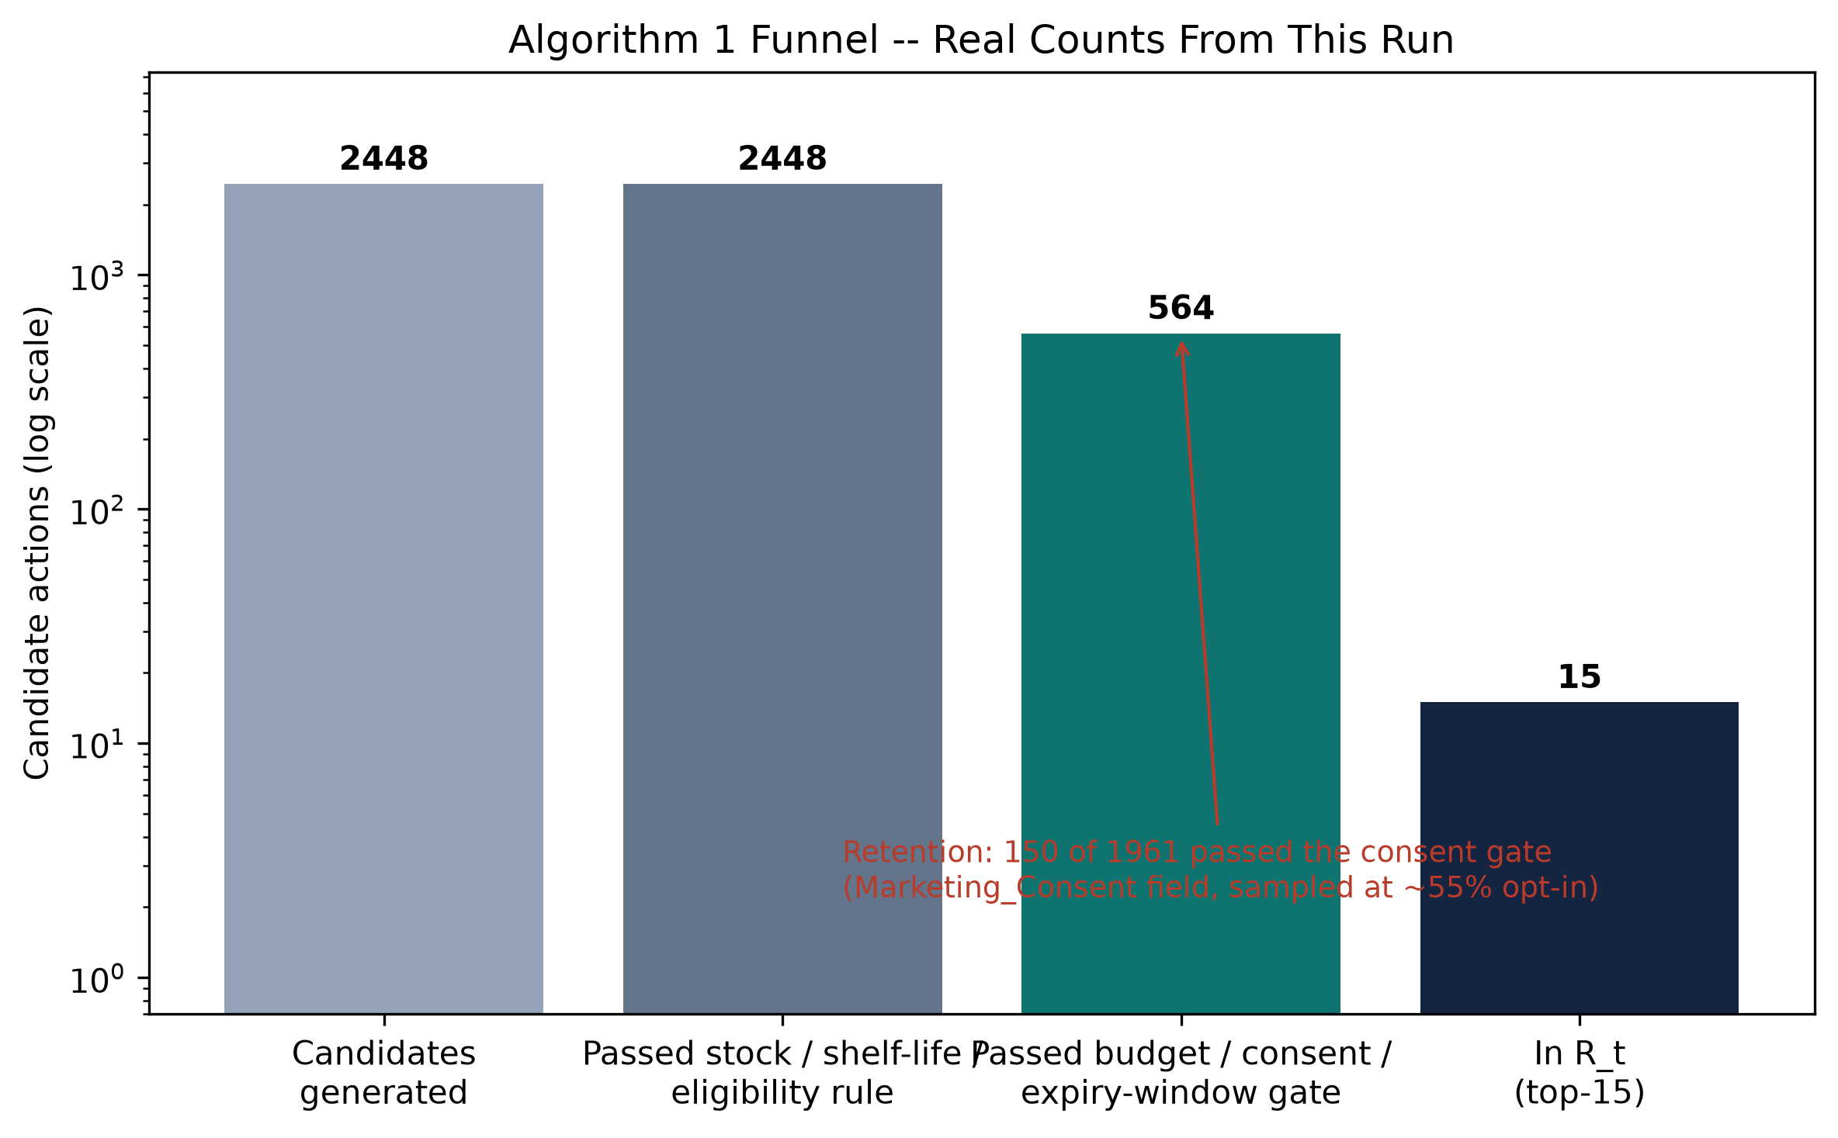
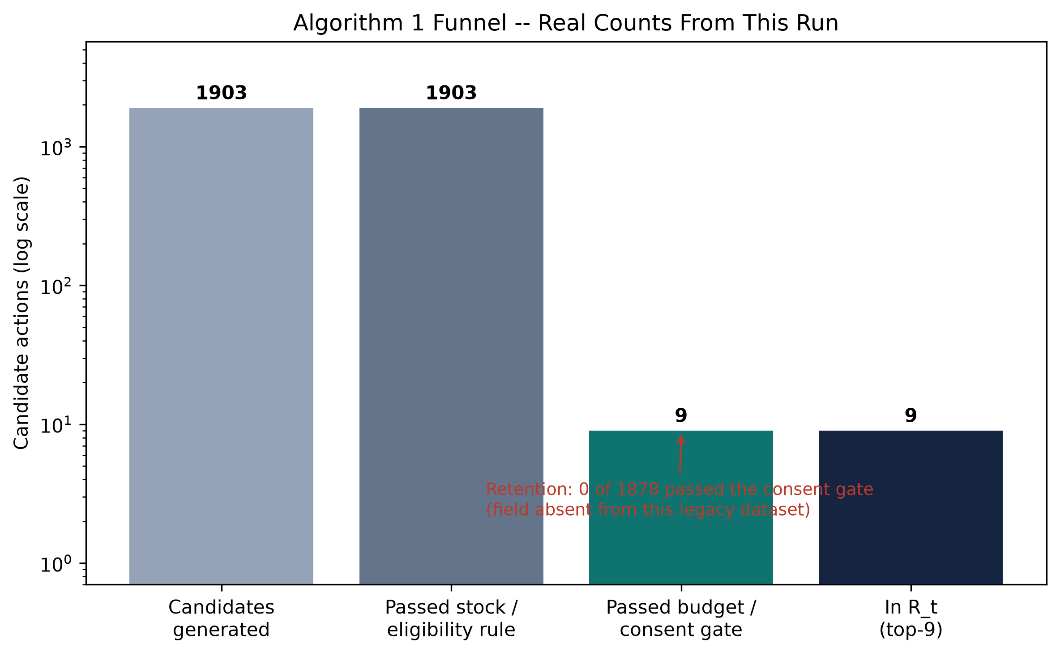
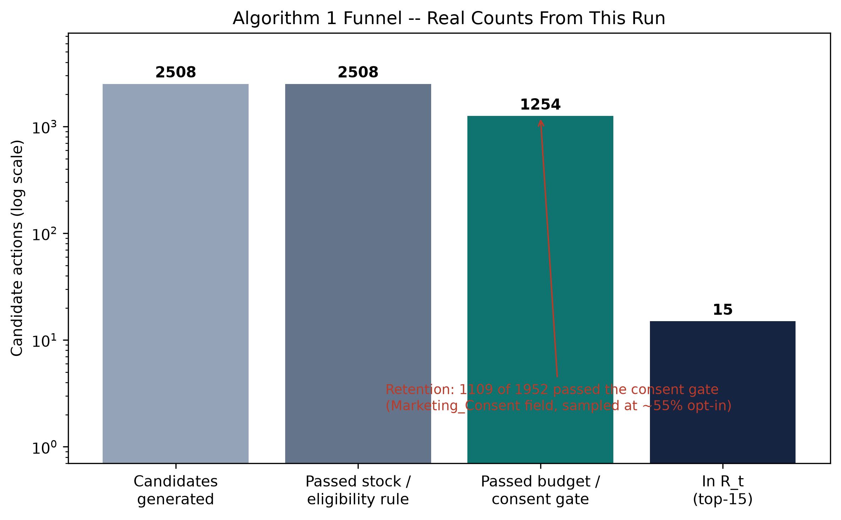
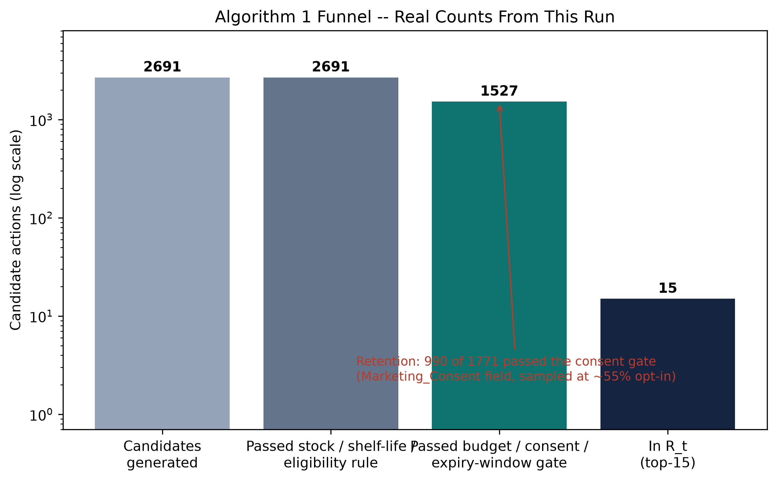
09 · PROGRESS & RESULTS
SYNTHETIC DEV DATA
2,448 Candidates In, 15 Recommendations Out
13 constraints remove 3 of every 4 candidates — budget, MOQ, storage, cold chain, shelf life, consent, capacity.
B-SMART
28 / 33

Slide 29
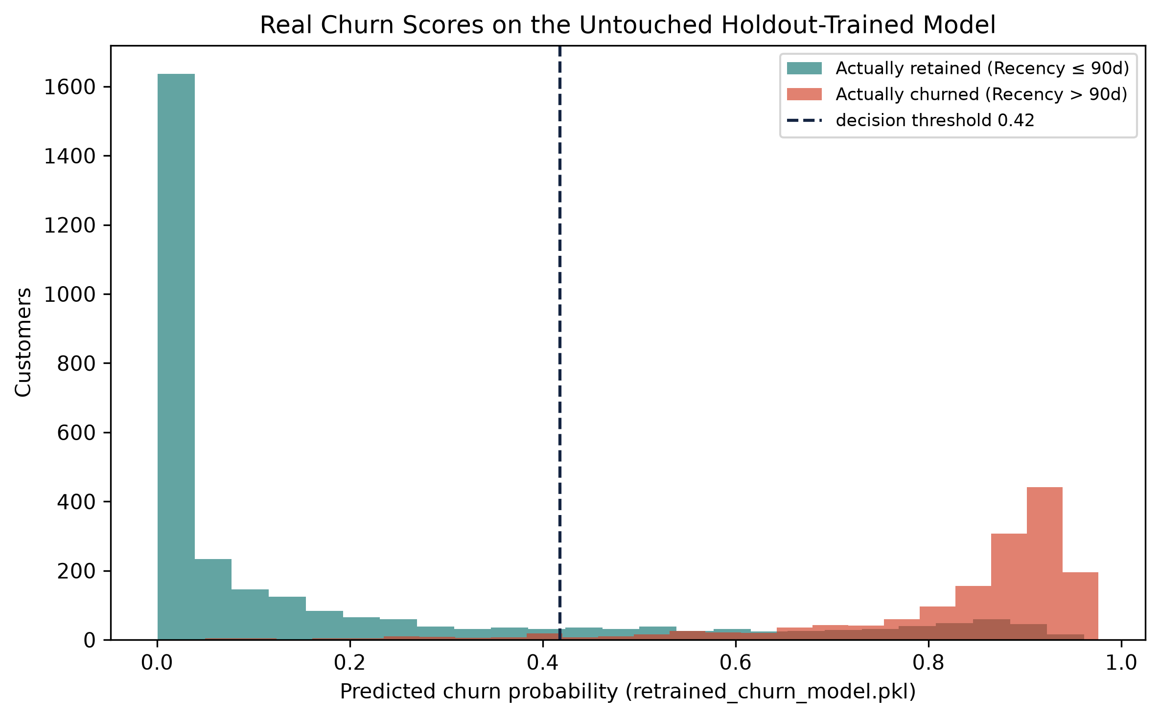
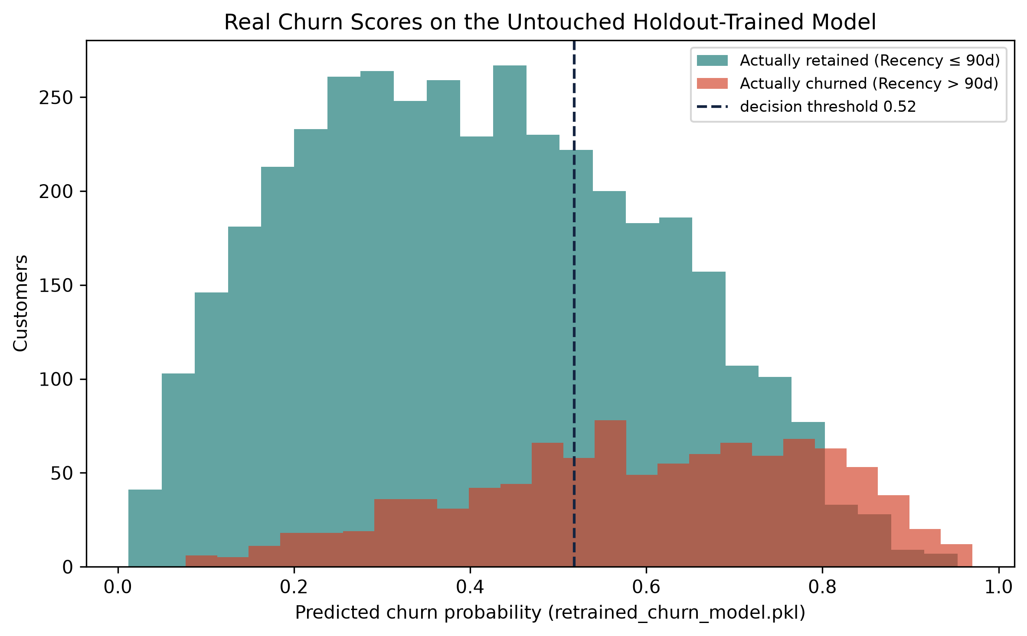
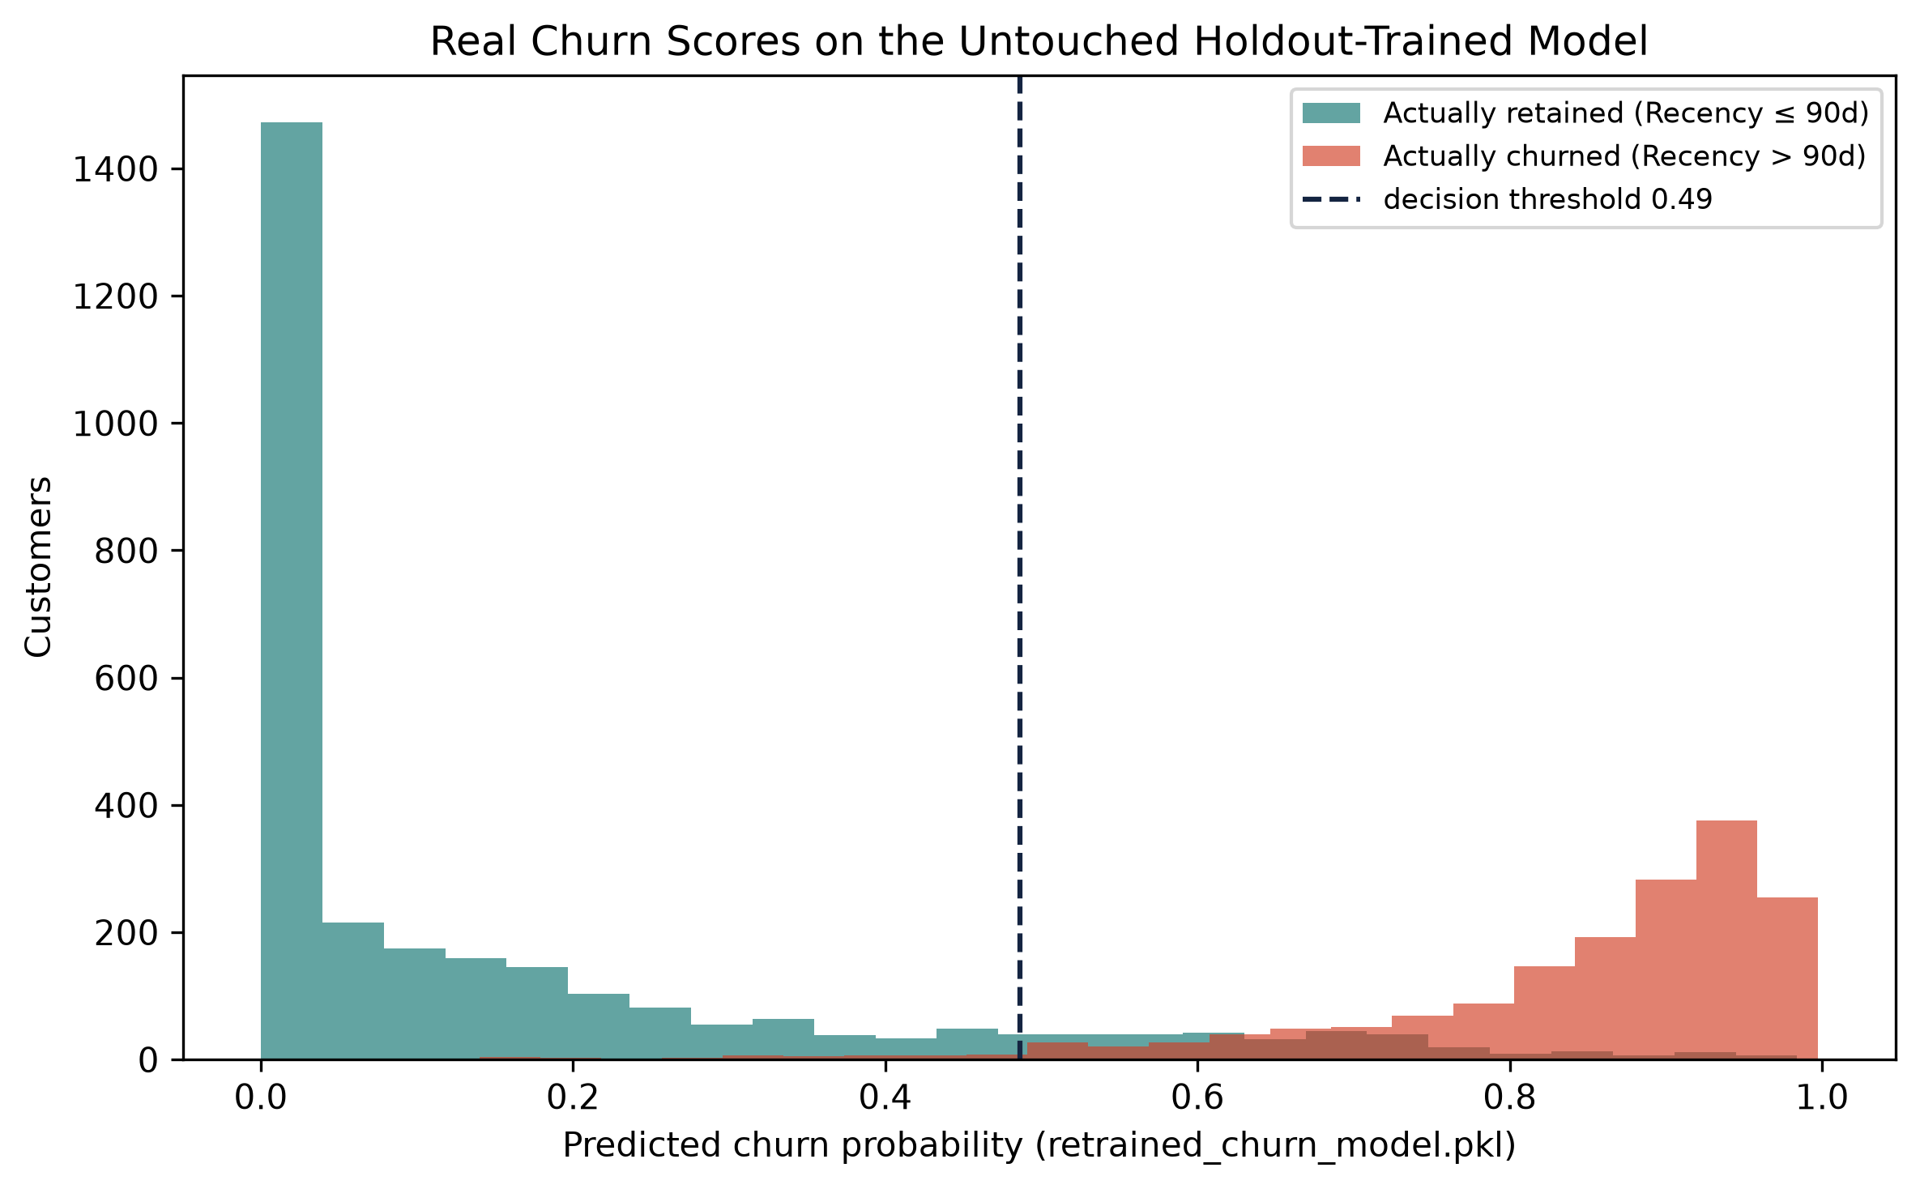
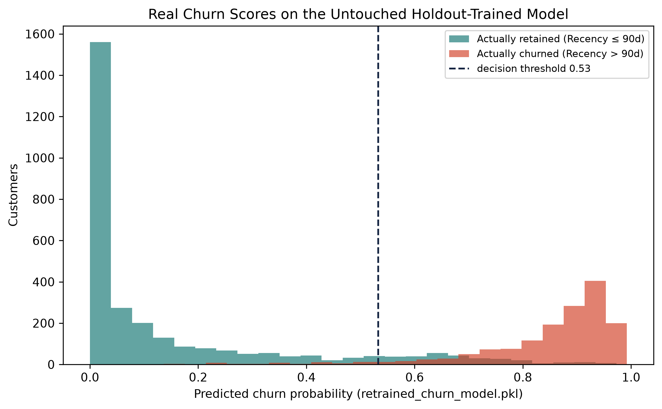
09 · PROGRESS & RESULTS
SYNTHETIC DEV DATA
The Model Behind Step 4 Actually Separates Customers
Real predicted churn probabilities from the retrained model this engine calls.
0.936
ROC-AUC · this model, applied live
PR-AUC 0.820 vs 0.343 random · Lift@10% 2.47×
1,961 of 4,510 customers cross the model's own threshold — consent then campaign capacity reduce that to 150 actionable contacts.
B-SMART
29 / 33

Slide 30
09 · PROGRESS & RESULTS
Our Data: What's Real, What's Not Yet
Three evidence tiers, never blended into one reported number.
Tier 1 — Primary
Consenting Bangladeshi pharmacies
Tier 2 — Public Real Data
WFP prices · UCI Retail II · BD demand
Tier 3 — Synthetic
30k-row pharmacy dataset · 111 real BD medicine SKUs
NOT YET COLLECTED
VALIDATED
DEV / TEST ONLY
B-SMART engineering: the previous 4 slides are Algorithm 1 actually executed on Tier 2/3 evidence — pending pharmacy partner data to close Tier 1.
B-SMART
30 / 33

Slide 31
10 · TIMELINE FOR NEXT SEMESTER
28 Weeks: 14 Done, 14 Left
Report methodology is complete. What is left is real data, then results.
WEEKS 1–14 · COMPLETE
WEEKS 15–28 · REMAINING
✓ DONE — 14 WEEKS
→ REMAINING — 14 WEEKS
W1–4
Scope fixed on pharmacies; 4 research questions set
W15–18
Onboard consenting pharmacies; import real sales history
W5–8
Literature review, research gap G1–G6, evidence tiers
W19–22
Chapter 4 — Implementation: pooled vs shop-adapted models
W9–12
Report Ch. 1–3 written: problem, background, methodology
W23–25
Chapter 5 — Results: held-out pharmacy, reorder, owner study
W13–14
App built, retrained leak-free; B-SMART engine now runs
W26–28
Final write-up, submission and defence
B-SMART
31 / 33

Slide 32
Thank You
Questions & Discussion
B-SMART turns pharmacy evidence and shop constraints into feasible, explainable, owner-accountable recommendations.
Md. Rakib Hossain · Shah Jamal Islam
Supervised by Dr. Saifuddin Md. Tareeq, Professor, Dept. of CSE, University of Dhaka
CSE 4114 · Project Work · September 2026

Slide 33
REFERENCES — BACKUP
Key References
APPENDIX · KEPT FOR Q&A
Full bibliography: 25 verified records in the thesis report.
1. Chen, Chiang & Storey (2012). Business Intelligence and Analytics. MIS Quarterly.
2. Hevner, March, Park & Ram (2004). Design Science in IS Research. MIS Quarterly.
3. Hoque, Saif, AlBar & Bao (2016). ICT Adoption for Development: Bangladesh SMEs.
4. Fader, Hardie & Lee (2005). RFM and CLV: Iso-Value Curves. J. Marketing Research.
5. Breiman (2001). Random Forests. Machine Learning.
6. Chen & Guestrin (2016). XGBoost: A Scalable Tree Boosting System. ACM SIGKDD.
7. Makridakis, Spiliotis & Assimakopoulos (2022). The M5 Competition. Int. J. Forecasting.
8. Kaufman, Rosset, Perlich & Stitelman (2012). Leakage in Data Mining. ACM TKDD.
9. Lundberg & Lee (2017). Interpreting Model Predictions (SHAP). NeurIPS 30.
10. Bertsimas & Kallus (2020). From Predictive to Prescriptive Analytics. Mgmt. Science.
B-SMART
33 / 33

