Slide 1
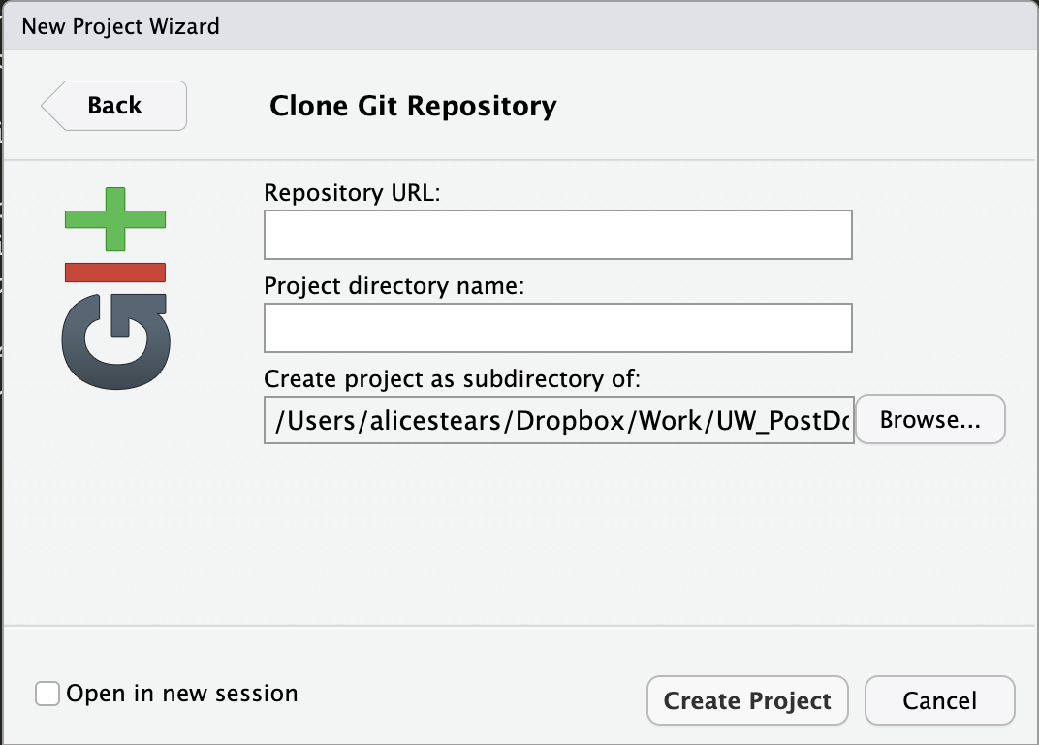
Paste the GitHub repo URL here
Add a name for the local repo (it helps to use the same name as the remote repo)
Navigate to the folder where you want the local repo to live (the new repo will be a folder inside of the directory you select here)
Click “Create Project” when you’re finished with the setup

