Slide 1

React
Sit Shlomo

Slide 2
20/06/2022
music 😊
names
nodejs refresher
how to create react project
project structure
bootstrap
components
string interpolation
jsx
State
Form
condition

Slide 3
Why react?
Easy to use and learn
Components
Strong community
Open source
Great performance
Scalability
lib

Slide 4
create-react-app
npx create-react-app first-project
create new project with all the files
create development environment
dev server
do not use special characters when naming the folder

Slide 5
jsx
JavaScript
html
together
class (css) will be from now on className
We can execute only one command

Slide 6
functional component
functional component is a component that we build with functions and not with classes
if we do not use states in then component (like we did in ContactUsPage)
then it called stateless functional component

Slide 7
run the project
make sure we in the project folder
in the terminal run the follow command
npm start

Slide 8
Bootstrap
to install bootstrap (the latest stable version) use
npm install bootstrap
in src/index.js
add this 2 lines to add bootstrap to our react project
/* import bootstrap to react project */
import "../node_modules/bootstrap/dist/css/bootstrap.css";
import "../node_modules/bootstrap/dist/js/bootstrap.bundle.js";

Slide 9
Component
we will create components in components folder
the component jsx files will start with CAPITAL letter
the component will be function
the component will always return html tag
if we need to return more then one tag (Testcomponent) we will use Fragment (don’t forget to import)
don’t forget to add
export default ComponentName

Slide 10
Component
components should be reusable
build everything with components so the webapp will be more scalable

Slide 11
String interpoulation
create variable
in the html section of the code we will write {varibaleName}

Slide 12
Page
Its component but should not be reusable

Slide 13
VDOM
https://reactjs.org/docs/faq-internals.html

Slide 14
useState
useState is hook
useState is function that accepts initial value and will return array with 2 items
Item1 is the value of the state
Item2 is function to update the value of the state
useState must be declared at the top of the function
Example:
const [email, setEmail] = useState("");

Slide 15
JS falsy
0
False
Null
Undefined
“”

Slide 16
TK
In the login form create msg under password that will say
Please provide password with at least 6 characters
When the user will create password with at least 6 characters the msg will disapear

Slide 17
Form
To prevent refresh when using form we will use onSubmit and then we will pass function
In the function we will accept one argument ev
And we will do this:
ev.preventDefault()

Slide 18
22/06/2022
Shemot
Hw
Map
Filter
Father child communication
Fontawsome
lodash
useEffect

Slide 19
Map
We will use map like we did with *ngFor in angular
Map will create brand new array with the html tags and data from array

Slide 20
TK
Create new page that will display list of users from array

Slide 21
Map
We will use map like we did with *ngFor in angular
Map will create brand new array with the html tags and data from array

Slide 22
Father child com
We will use map like we did with *ngFor in angular
Map will create brand new array with the html tags and data from array

Slide 23
Fontawsome
To add fa to our project please follow the instructions in the link:
https://fontawesome.com/docs/web/use-with/react/
To add icon from fa you will need to use the next method:
Copy the component icon from there website - <FontAwesomeIcon icon="fa-solid fa-trash-can" />
Convert the icon from “fa-solid fa-trash-can” to “faTrashCan” in the import like so - import { faTrashCan } from "@fortawesome/free-solid-svg-icons";
Make sure that you import from the right module

Slide 24
Lodash - cloneDeep
Install lodash using this command: npm i lodash
We will use lodash - cloneDeep to clone the data from the server and then we will change the array

Slide 25
TK
Create component for reach user
When clicking on user it should be deleted

Slide 26
22/06/2022
Shemot
Hw
refs
useEffect
axios

Slide 27
Refs
Refs is hook that allows us to controls elements like we did in js
1) import useRef from rect
2) const itemsDiv = useRef();
3) in the element that we want to control add
<div className="items-wrapper-imgs" ref={itemsDiv}>

Slide 28
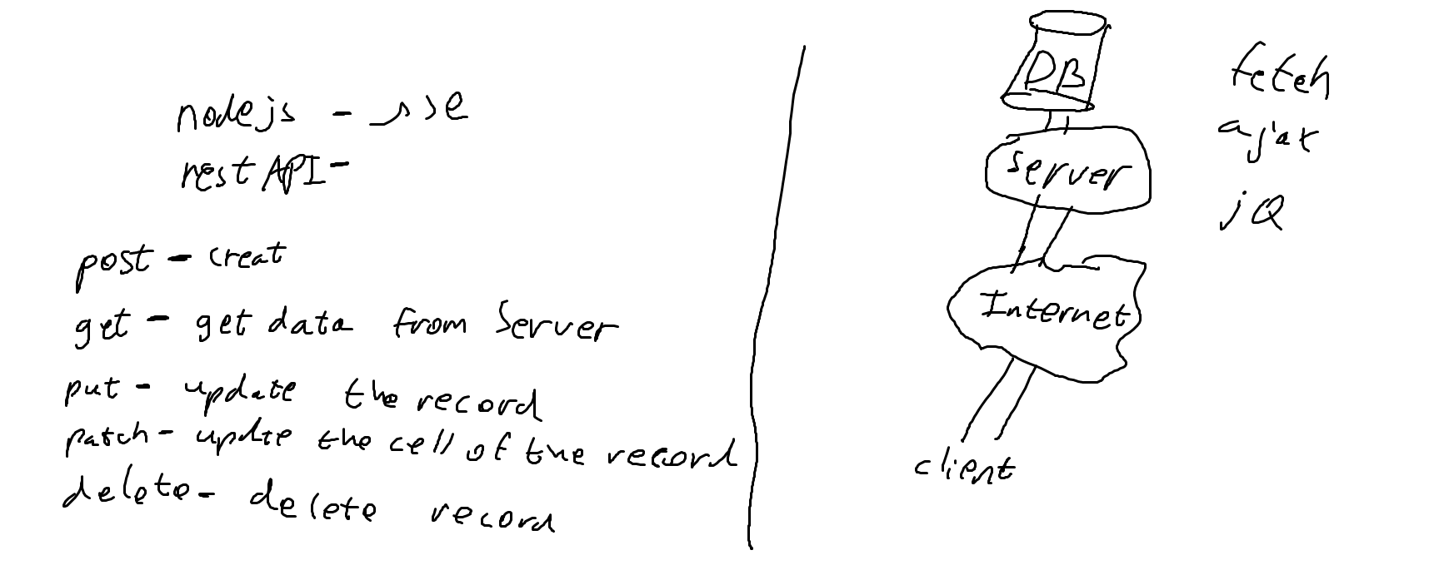
Client ⬄ Server

Slide 29
Axios – why?
Make XMLHttpRequests from the browser
Make http requests from node.js
Supports the Promise API
Intercept request and response
Transform request and response data
Cancel requests
Automatic transforms for JSON data
Client side support for protecting against XSRF

Slide 30
Axios – React
First we need to install axios
npm i axios
then we need to import axios to our component
import axios from "axios";

Slide 31
Axios – get
send get request
axios
.get("https://jsonplaceholder.typicode.com/posts")
.then((data) => {
console.log("data from axios", data.data);
})
.catch((err) => console.log("errr", err));

Slide 32
HW
create login with axios

Slide 33
29/06/2022
hw
axios
joi - messages

Slide 34
LocalStorage
localStorage is building in mini database in the browser
can save only string!
to store new record use this command
localStorage.setItem(“key", “value”);

Slide 35
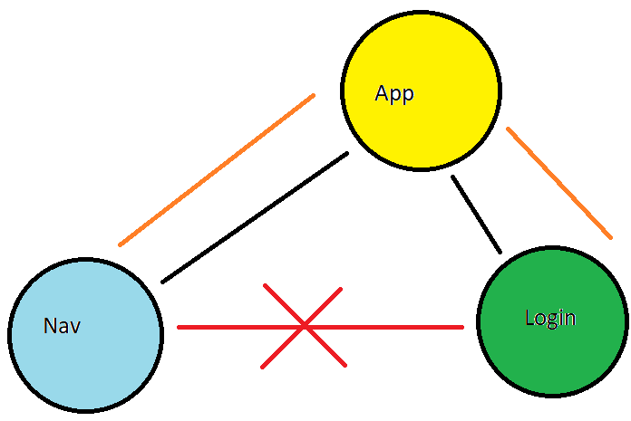
LocalStorage

Slide 36
axios - baseUrl
axios gives us the option to add base url
in index.js file
import axios from "axios";
//add this url before every axios request
//if the url is relative - then axios will ignore this url
axios.defaults.baseURL = "http://localhost:3001/api";

Slide 37
axios - interceptors
axios gives us the option to add information to the request
in index.js file
import axios from "axios";
then

Slide 38
axios - interceptors
axios.interceptors.request.use((config) => {
const token = localStorage.getItem("token");
if (token) {
//if token saved in localStorage then
//I want to add the token to the header of the request
config.headers["x-auth-token"] = token;
}
return config;
});

Slide 39
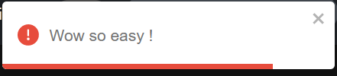
toast
better alerts

Slide 40
toast - setup
install i react-toastify
index.js
/* toastify */
import "react-toastify/dist/ReactToastify.css";
app.js
import { ToastContainer } from "react-toastify";
<ToastContainer />

Slide 41
HW
create page to display cards

Slide 42
04/07/2022
hw
useEffect
cards panel
get
edit
delete
redux

Slide 43
useEffect
useEffect it a hook that wait for changes in dependency array.
useEffect(()=>{}, [variable])
when variable will change then useEffect will call the inner function
!note if the dependency array is empty then it will run only once

Slide 44
TK
create input and btn
when input has more then 3 chars then the btn will be displayed
use USEEFFECT

Slide 45
HW
create edit card popup

Slide 46
06/07/2022
cards panel
get
edit
delete
redux
router

Slide 47
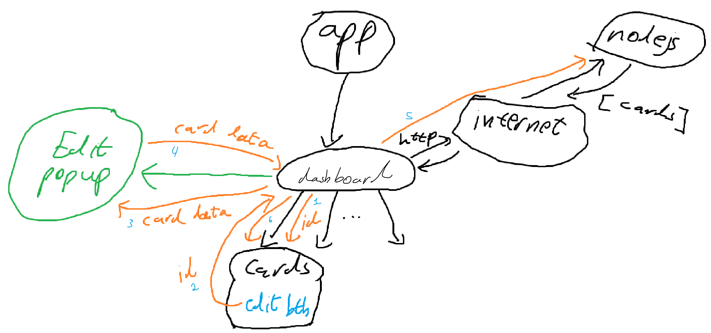
Edit card
react create array of cards
when user select card to edit – react send the id to the dashboard (parent)
dashboard (parent) send the selected card date to the edit popup (component)

Slide 48
Edit card
user edit the data and the popup send the edited data to the dashboard page (parent)
dashboard (parent) send the data to the server and wait for the response
after dashboard got ok response react will recreate the cards

Slide 49
bubbling - problem
because we use onclick of the div (parent)
when we click on elms inside this div
js activates the onclick of the div (parent)
as well, this cause a bug because each time
we will press on anything inside the form
it will hide the popup.
to stop this we must use onclick of the from
and use ev.stopPropagation(); command to tell
js don't use onclick of the div (parent)

Slide 50
redux
come to solve a big problem with passing data between components/pages
by creating global state accessible from all the components/pages
to install redux use this commands
npm i redux react-redux @reduxjs/toolkit

Slide 51
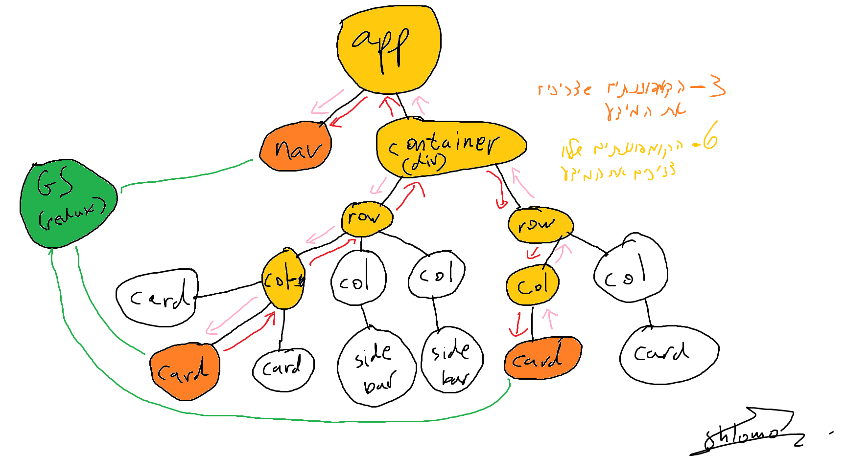
redux

Slide 52
HW
create edit card popup

Slide 53
11/07/2022
redux
router

Slide 54
TK
create redux slice that will store date

Slide 55
redux - useSelector
useSelector is a hook that allows us to get state from redux and use it in our components
import { useSelector } from "react-redux";
const loggedIn = useSelector((state) => state.auth.loggedIn);
loggedIn ? "bg-success" : "bg-danger"

Slide 56
jwt-decode
jwt-decode its an npm package that allows us to get data stored in jwt token
to install the package we will use
npm i jwt-decode
to use it:
import jwt_decode from "jwt-decode";
let decoded = jwt_decode(token);
console.log(decoded);

Slide 57
TK
create counter page and display counter page
1) counter page:
input
btn
when user input a number and press on the btn it will add the number to redux state
2) display counter page:
it will display in h1 the counter value from redux

Slide 58
React router dom
rrd is package that allows us to separate our project to pages
in our course we will use v5
install: npm i react-router-dom@5
index.js:
import { BrowserRouter } from "react-router-dom";
….

Slide 59
React router dom
in index.js setup the browser router to allow rrd to split the project in to pages
<Provider store={store}>
<BrowserRouter>
<App />
</BrowserRouter>
</Provider>

Slide 60
React router dom
Route component that comes with rrd allow as to create routes
<div className="container">
<Switch>
<Route path="/">
<HomePage />
</Route>
<Route path="/login">
<LoginPage />
</Route>
<Route path="/register">
<RegisterPage />
</Route>
</Switch>
</div>

Slide 61
React router dom - Link
link component will replace a tag
when we use a tag to navigate in our website it will refresh the page which will cause to clear everything we store in JavaScript and redux
link will navigate in our website without refresh
<Link to=“/home” >home </Link>

Slide 62
React router dom - NavLink
same as Link but when react detect that the URL is the same as defined in NavLink it will add active class
<Link to=“/home” >home </Link>

Slide 63
HW
create new project with dashboard, login page, use redux and react router dom

Slide 64
React router dom - navigate
To navigate between react pages we will use useHistory hook
import { useHistory } from "react-router-dom";
const history = useHistory();
history.push("/dashboard"); //navigate to another page

Slide 65
TK
when user done register navigate to login page

Slide 66
Deploy react to nodejs
when we ready to deploy our website to the server
in our case is nodejs project
run npm run build (in react) to create the complied ver.
copy the build directory to nodejs
in nodejs in app.js:
const path = require("path");
/* react */
app.use(express.static(path.join(__dirname, "build")));
app.get("*", (req, res) => {
res.sendFile(path.join(__dirname, "build", "index.html"));
});

Slide 67
20/07/2022
asama
hazarot
react ts

Slide 68
TK - fcc
create father component with list of animals.
display each animal in a card as a child component.
when the user click on a btn inside the card,
it will delete the card

Slide 69
Sass
to make react work with sass you need to install sass
npm i sass
then just import your sass files

Slide 70
TK - axios
create login form and show msg if the user is logged in or not
if login success then navigate to dashboard
create register page

