Slide 1

GSM BASED FIRE ALERT SYSTEM CALL AND SMS NOTIFICATION

Slide 2
Team Members
P. Vamsi – 190051601049
C. R. M. S. Raman - 190051601051
Sk. Shahabaz - 190051601067

Slide 3
Introduction
Fire alarm system provide a means to provide a means to identify a developing fire through automatic methods.
A fire alarm system warns people when smoke, fire, carbon monoxide or other fire-related emergencies are detected.
These alarms may be activated automatically from smoke detectors, and heat detectors or may also be activated via manual fire alarm activation devices such as manual call points or pull stations.

Slide 4
Alarms can be either motorized bells or wall mountable sounders or horns. They can also be speaker strobes which sound an alarm, followed by a voice evacuation message which warns people inside the building not to use the elevators.
Fire alarm sounders can be set to certain frequencies and different tones including low, medium and high, depending on the country and manufacturer of the device.
Most fire alarm systems in Europe sound like a siren with alternating frequencies.
Fire alarm warning devices can also be set to different volume levels.

Slide 5
Components
Arduino UNO
Solderless Breadboard Full Size
DF Robot SIM8000 GSM/GPRS/GPS Arduino IOT Board
Analog Flame Sensor For Arduino
Resistor 100 ohm
5 mm LED: Red
5 mm LED: Green
Jumper Wires
Tayda Electronics DC POWER JACK 2.1MM BARREL-TYPE PCB MOUNT
Test Accessory, AC Power Adaptor

Slide 6
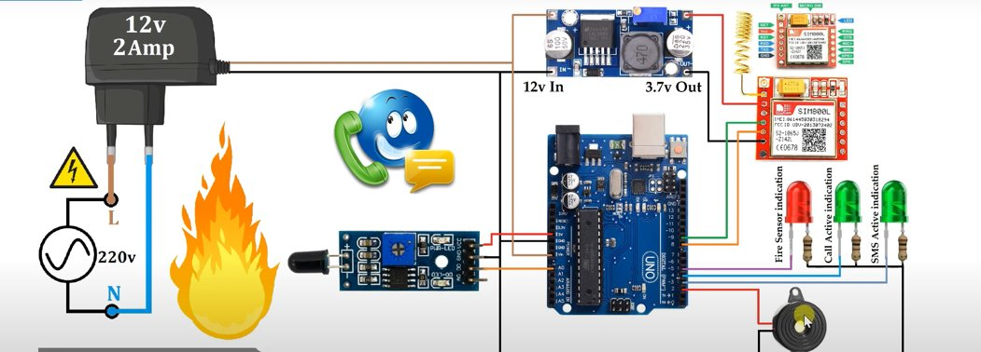
Circuit Diagram

Slide 7
GSM TECHNOLOGY
Digital cellular technology like GSM (Global System for Mobile Communication) is used to transmit mobile data as well as voice services. This concept was implemented at Bell Laboratories using a mobile radio system in 1970. As the name suggests, it is the standardization group name that was established in the year1982 to make a general European mobile telephone standard. This technology owns above 70% of the market share of the digital cellular subscriber around the world. This technology was developed by using digital technology. At present, GSM technology supports above 1 billion mobile subscribers around the world in the above 210 countries. This technology provides voice and data services from fundamental to complex.

Slide 8
Working
we are going to build a Fire Alarm System using Arduino, LM35 Temperature Sensor and GSM Module. The objectives of this fire detector using arduino is to sense the surroundings for occurrence of fire with help of LM35 temperature sensor, and send 3 SMS alerts to two mobile numbers stored inside the arduino program if fire is detected (using GSM Module).
The below done projects helps in detection of fire and send a signal from heat sensor to the sim800l module which in return gives an alert from the registered mobile number present in the module in our case the number is +91 9491888728.
The required voltage is regulated to 3.7v using a dc buck converter and sent in series to all the circuit components.

Slide 9
Since we are using a very little voltage of around 3.7v of maximum to the circuit board the lights are dimmed out but when the call is alerted in the mobile the will be definitely activated.
We have seen many typical Fire Alarm projects which will alert with a siren or that activates an automatic shutdown mechanism. This fire alarm project make use of modern communication technologies to deal with emergencies.

Slide 10
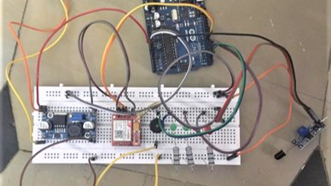
Hardware Circuit

Slide 11
Applications
SMS based Fire Alarm system are very useful in remote locations where human interaction is limited. Such systems are useful in mines, industrial areas, factories etc.
Quick Actions to shut down Fire – 90% of fire damages occur due to lack of early fire detection. A fire attack is usually silent and people will know about fire only when it has spread across a large area.
SMS based Fire Alert system gives warning immediately to multiple mobile numbers and hence remedy actions can be taken quickly. This helps to prevent major damages and losses created by a fire accident.

Slide 12

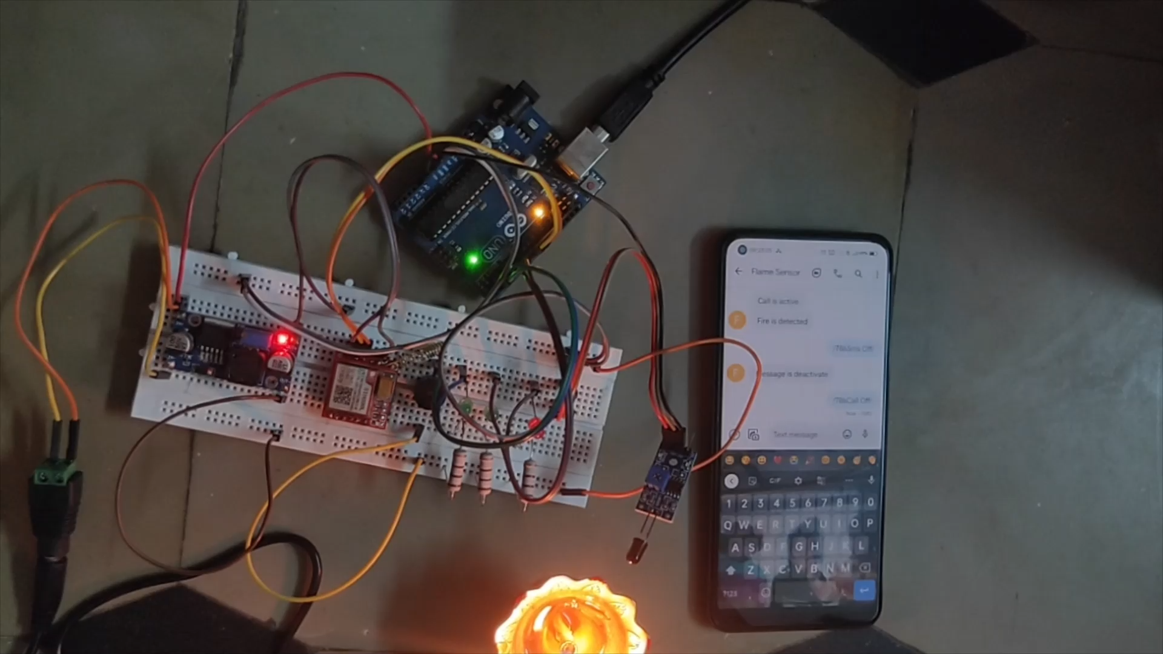
Working Video
dc project final - YouTube

Slide 13

Result
The project using the gsm technology and other basic models were successfully done with the help of the
GSM based Fire Alert System Call and SMS Notification - Arduino Project Hub
GitHub - embeddedlab786/Flame_Sensor_GSM_Call_SMS: Flame_Sensor_GSM_Call_SMS

Slide 14

Thank You

