Slide 1

Course: Machine Learning Student Name: Rayyan Al Naqbi
ID: 32483
Classical ML for Object Recognition
Exploring CIFAR-10 with PCA and SVM
Track 1 - Machine Learning Models

Slide 2
Overview & Purpose
Goal: Classify images using traditional ML methods.
Technique: PCA for dimensionality reduction, followed by SVM.
Relevance: Serves as a comparison to deep learning stratedies.

Slide 3
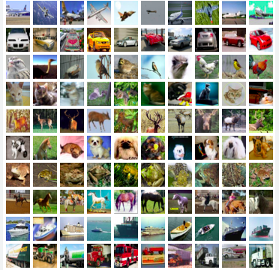
About the Dataset
Images: 60,000 (32x32 color)
Dataset: CIFAR-10
Classes: 10 categories (e.g., cat, truck, airplane)
Split:
50K train / 10K test
3

Slide 4
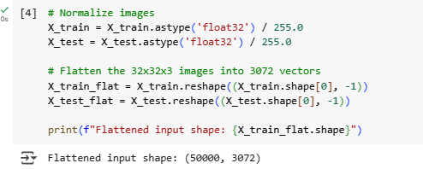
Preprocessing Steps
Flatten images to 1D arrays (3072 values)
Apply PCA to retain key features (100 components)
Create 80/20 training-validation split
Normalize pixel values to [0, 1]

Slide 5
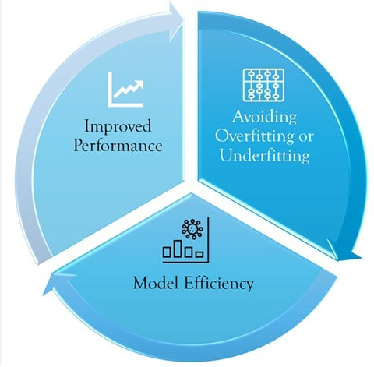
Importance of Validation
Helps avoid overfitting
Why Validate?
Optimizes hyperparameters
Assesses generalization before final testing

Slide 6
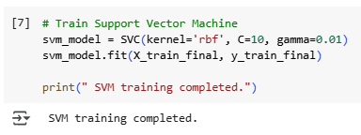
Model Configuration
Approach: PCA + SVM (RBF kernel)
Hyperparameters:
C = 10
Gamma = 0.01
Used for classification without deep learning frameworks

Slide 7
SVM Model Insights
PCA: Preserves ~95% of data variance
SVM: Captures non-linear patterns
Note: No epochs or batches—applies only to DL models

Slide 8
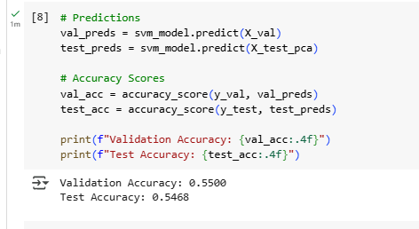
Evaluation Results
Validation Accuracy: ~55.8%
Test Accuracy: ~54.7%
Model performed moderately well on unseen data

Slide 9
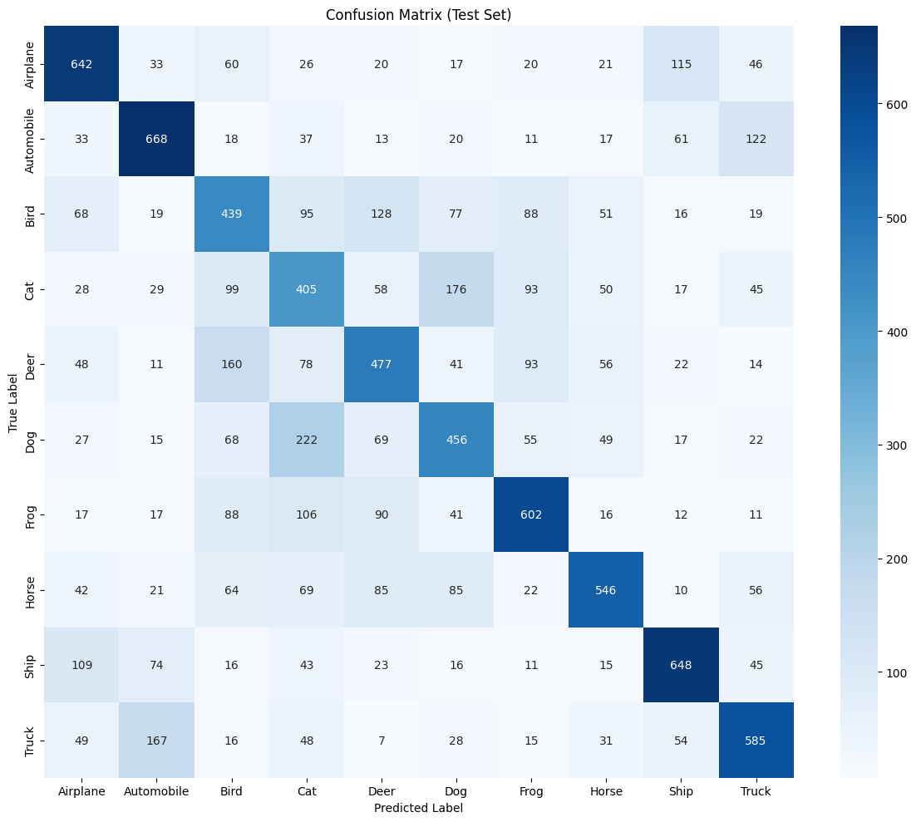
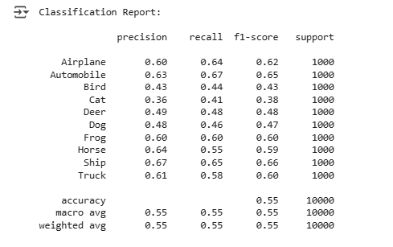
Error Distribution
Confusion matrix shows category-wise accuracy
Highlights classes frequently misclassified

Slide 10

Performance Summary
Top accuracy: Truck, Ship, Automobile
Lowest: Cat, Dog, Bird
Cause: Visual similarity and low-detail inputs

Slide 11
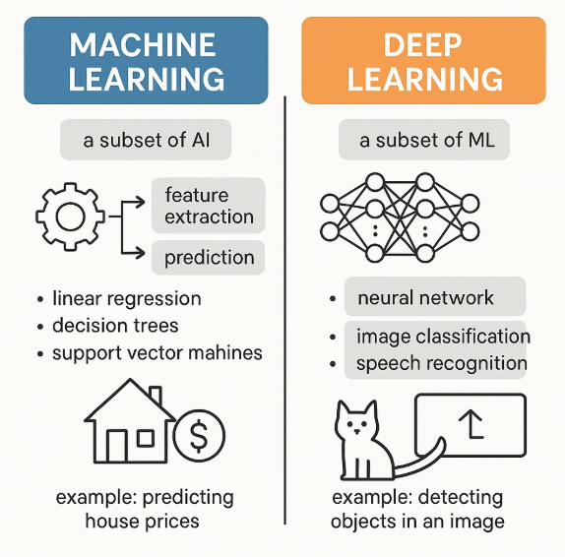
ML
vs.
Deep Learning
Classical ML: Quick, low-cost, understandable
But struggles with complex visual tasks
CNNs handle abstraction far better

Slide 12
Reflections
Key Takeaways:
PCA is crucial for efficiency
SVM is effective but limited
Accuracy/speed trade-offs are key considerations

Slide 13
Practical Applications
Classical ML suits low power devices (embedded systems, edge computing).
Useful for quick testing and prototyping.
Helps evaluate if deep learning is needed.
Deep learning is better for high accuracy production systems.

Slide 14
Final Thoughts
Traditional ML provides a solid baseline
Useful in resource-constrained environments
Still, deep learning dominates in visual domains

Slide 15
Thank You

Slide 16
References
Krizhevsky, A. (2009) Learning Multiple Layers of Features from Tiny Images. CIFAR-10 dataset creators. Available at: https://www.cs.toronto.edu/~kriz/learning-features-2009-TR.pdf (Accessed: July 14, 2025).
Momotov, A. (2025) Image Classification with SVM and PCA on CIFAR‑10. GitHub. Available at: https://github.com/Alex-Momotov/image_classification (Accessed: July 14, 2025). Wikipedia+1GitHub+1GitHub
Miczek, D. (2025) Implementing PCA and Dual PCA on CIFAR‑10. Available at: https://dmicz.github.io/machine-learning/cifar10-pca/ (Accessed: July 14, 2025). Dennis Miczek
LemuelKL (2025) CIFAR10‑HOG‑PCA‑SVM: Grayscaling, HOG, PCA, RBF SVM classifier achieving ~62%. GitHub. Available at: https://github.com/LemuelKL/CIFAR10-HOG-PCA-SVM (Accessed: July 14, 2025). GitHub
Fournier, Q. and Aloise, D. (2021) ‘Empirical comparison between autoencoders and traditional dimensionality reduction methods’, arXiv preprint arXiv:2103.04874. Available at: https://arxiv.org/abs/2103.04874 (Accessed: July 14, 2025). arXiv
Tang, Y. (2013) ‘Deep Learning using Linear Support Vector Machines’, arXiv preprint arXiv:1306.0239. Available at: https://arxiv.org/abs/1306.0239 (Accessed: July 14, 2025). arXiv
Wikipedia contributors (2025) Support vector machine. Available at: https://en.wikipedia.org/wiki/Support_vector_machine (Accessed: July 14, 2025).

